Slide 1
Data Preparation Process
Goodreads’ Books and Reviews
Diogo Almeida (up201806630)
Pedro Queirós (up201806329)

Slide 2
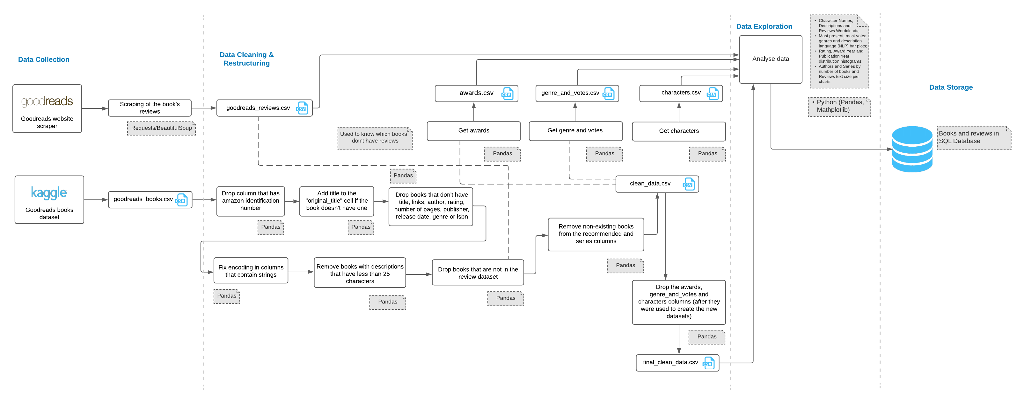
Data Extraction and Preparation

Slide 3
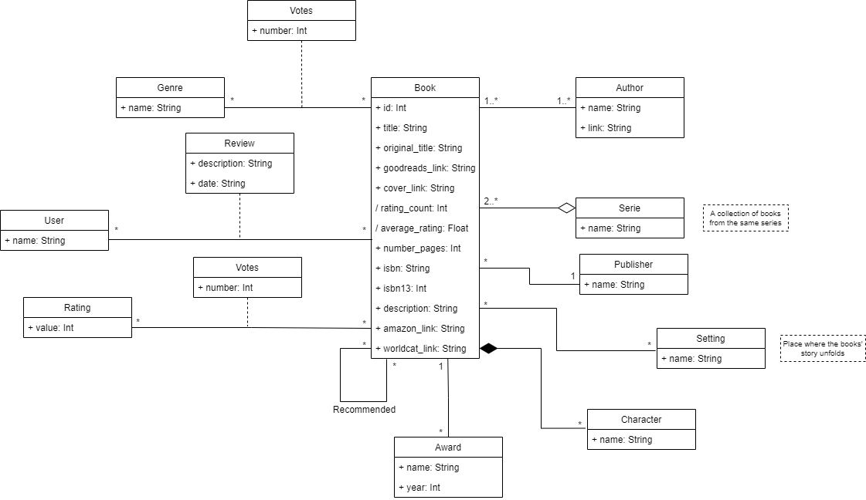
Domain Conceptual Model

Slide 4
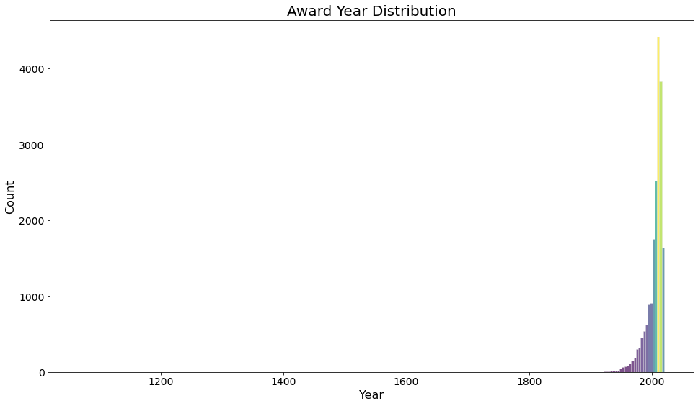
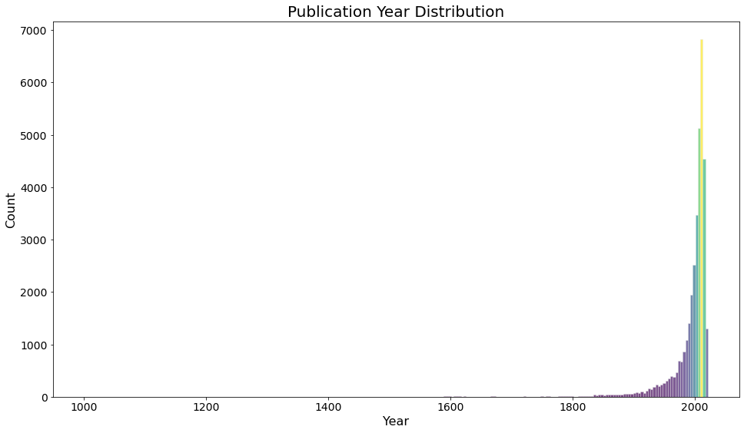
Data Characterization

Slide 5
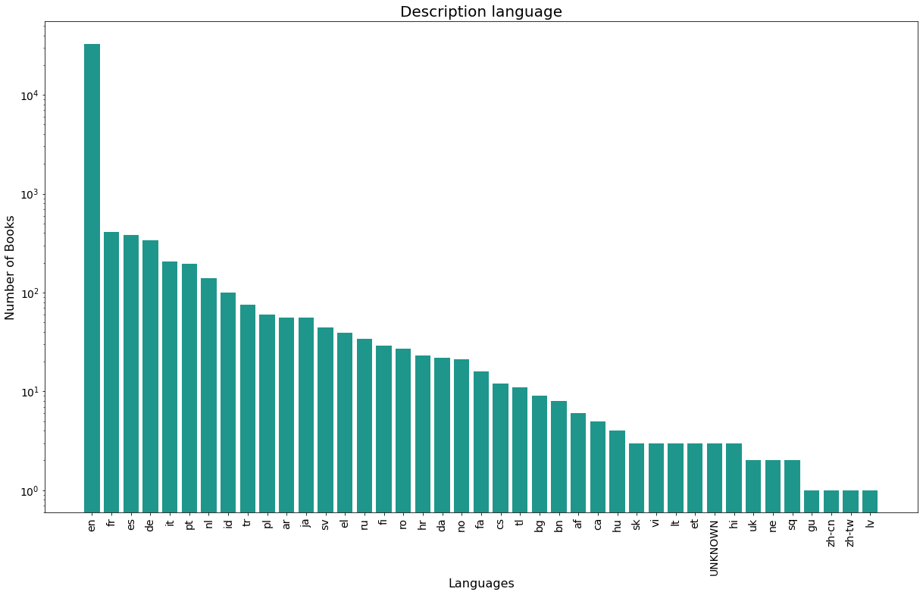
Data Characterization

Slide 6
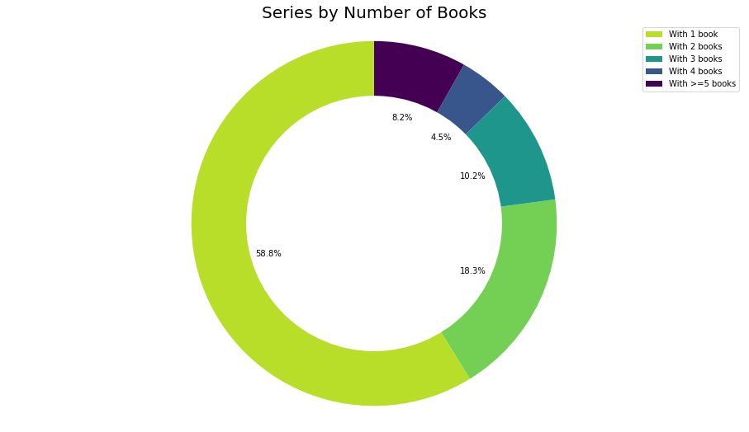
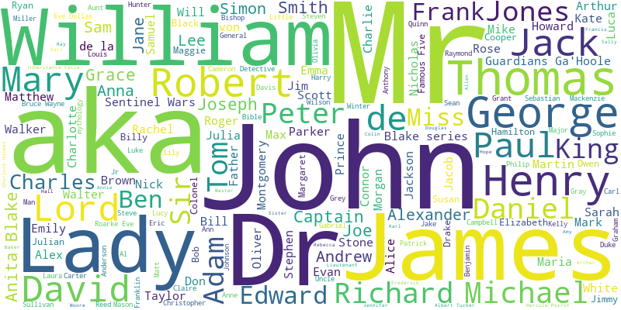
Data Characterization

Slide 7
Conclusions and Future Work
For the extraction and preparation of the information the following steps were made:
Gathering data and enrich it with data from diferentes sources
Data cleaning
Analyse the final data
Regarding future work, some of the implemented search tasks will be:
Search books by author
Search books based on their language
Search books by genre, awards or even by their reviews or rating

Slide 8
References
“Goodreads Books – 31 features” dataset:
https://www.kaggle.com/austinreese/goodreads-books
Goodreads website:
https://www.goodreads.com
Python libraries: pandas, requests, beautifulsoup and spacy:
https://pandas.pydata.org/
https://docs.python-requests.org/en/latest
https://beautiful-soup-4.readthedocs.io/en/latest
https://spacy.io/universe/project/spacy-langdetect

