Slide 1
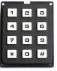
Vending Machine
Credit: 1.20
Displays status and amount inserted
Buttons to select products (showing price and name)
Slot for inserting coins
Cancel button
Slot to pick change
Slot to pick product
Keypad to enter key to open machine (not visible on the front)

