Slide 1
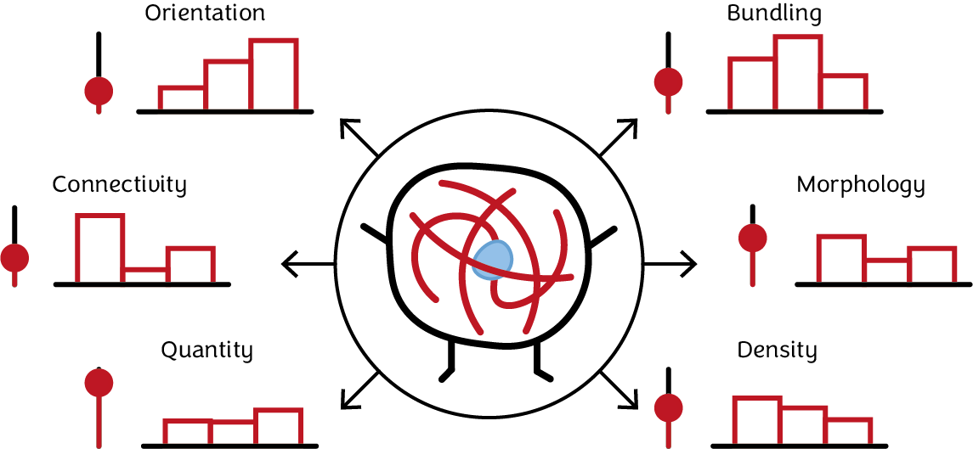

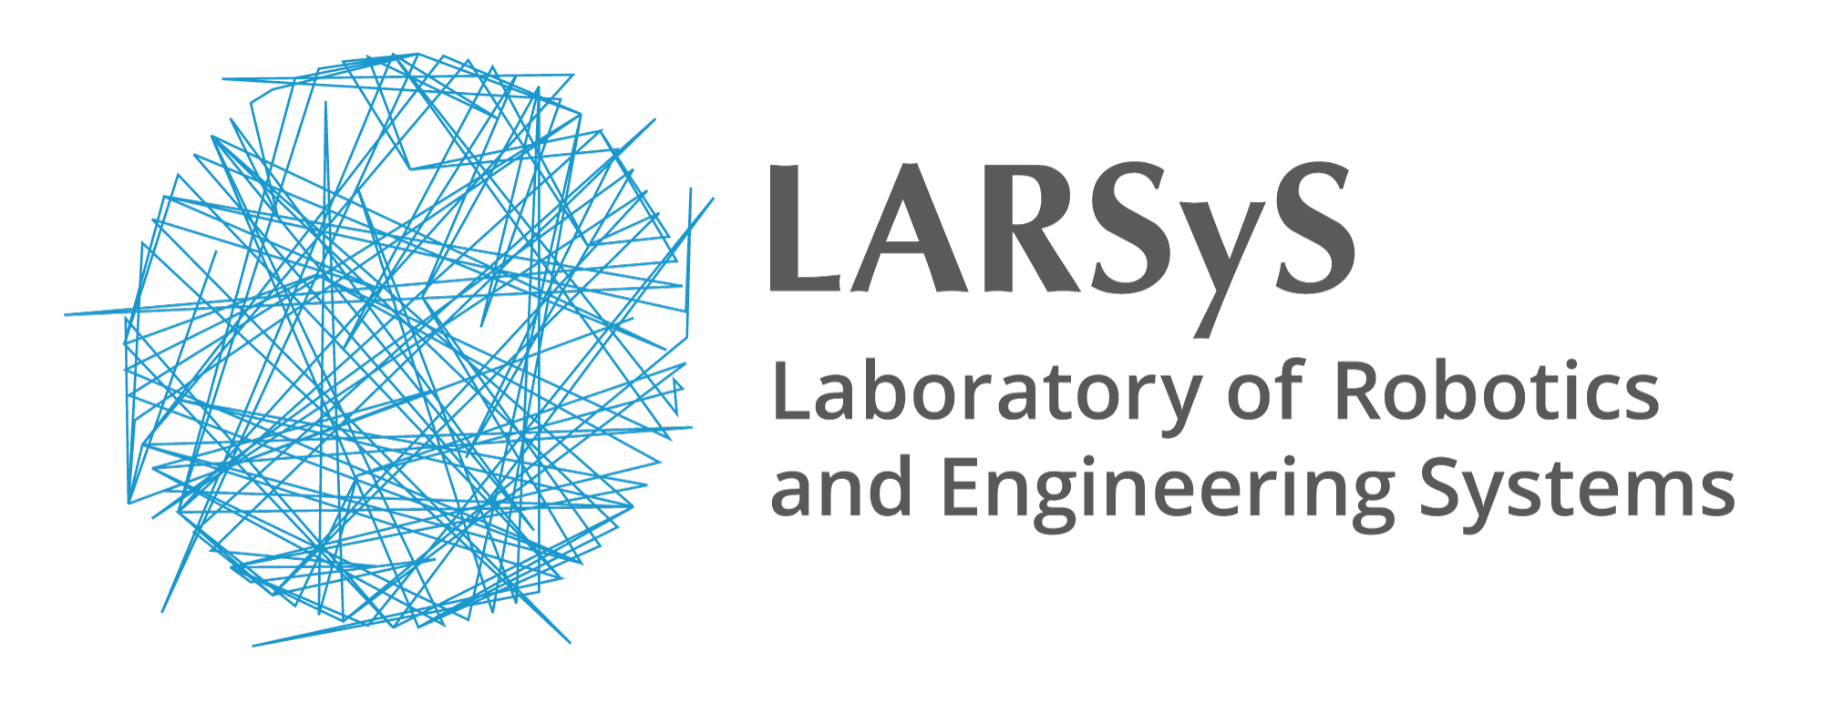



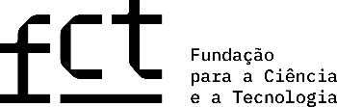
Untangling the cytoskeleton:
a model to describe cytoskeletal architecture
Diogo Fróis Vieira
#43
Supervisors
João Sanches (ISR, DBE)
PhD in Biomedical Engineering
Joana Figueiredo (i3S, FMUP)

Slide 2
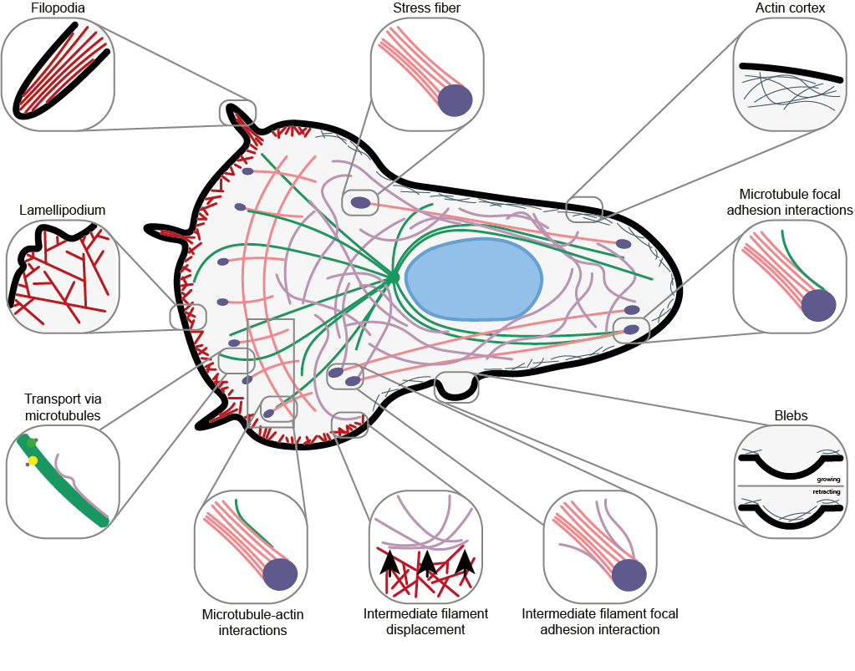
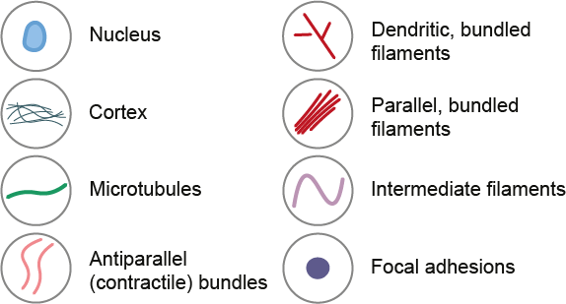
Motivation, Goals and Challenges
Motivation
Filamentous structures are ubiquitous in nature. Cytoskeleton architecture is the blueprint of celular behavior
Goal
Create a full descriptive model of cytoskeletal architecture from 2D confocal microscopy images

Slide 3
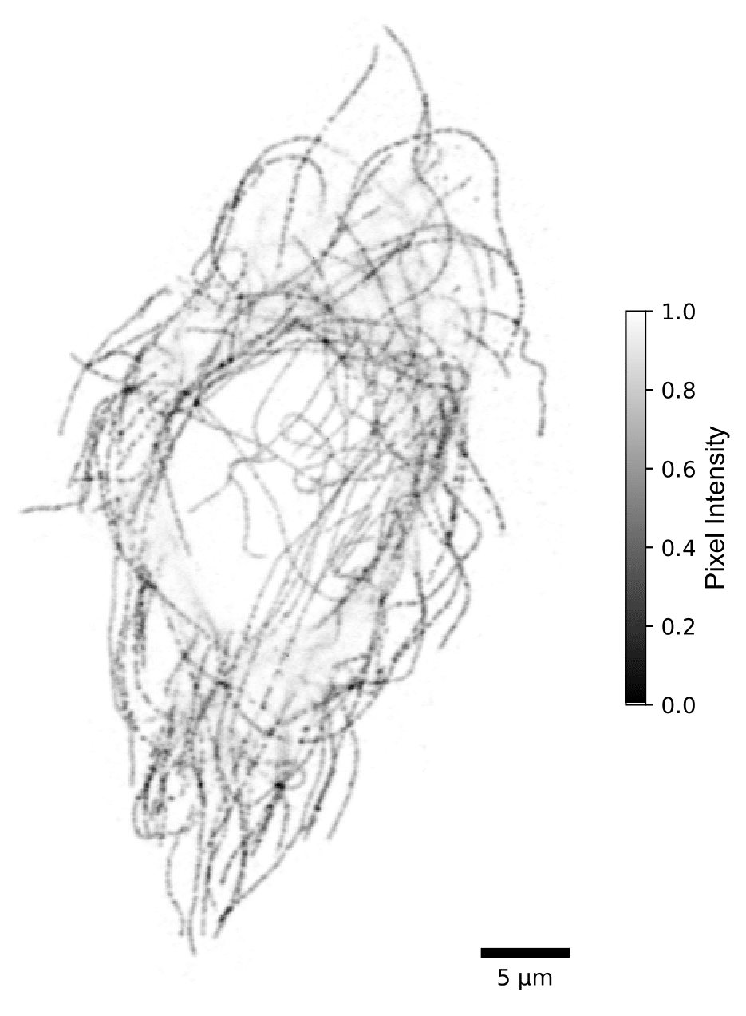
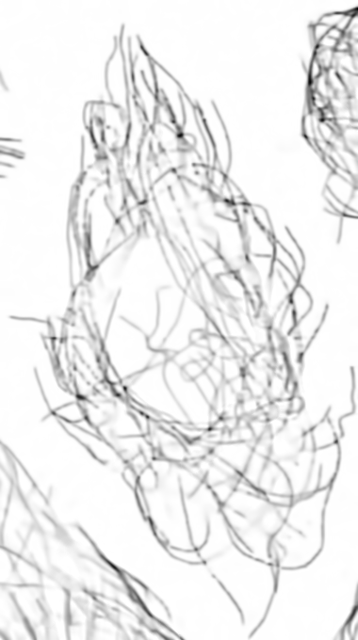
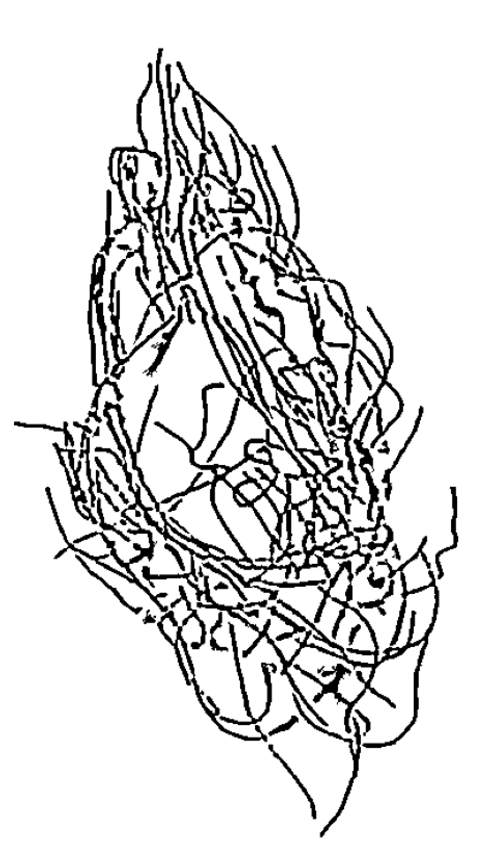
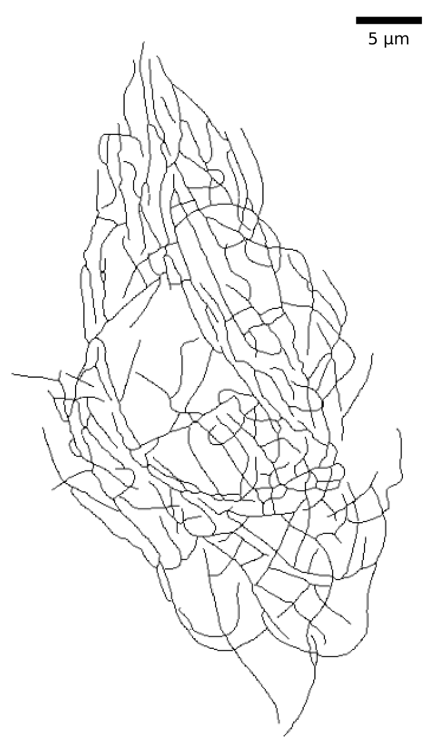
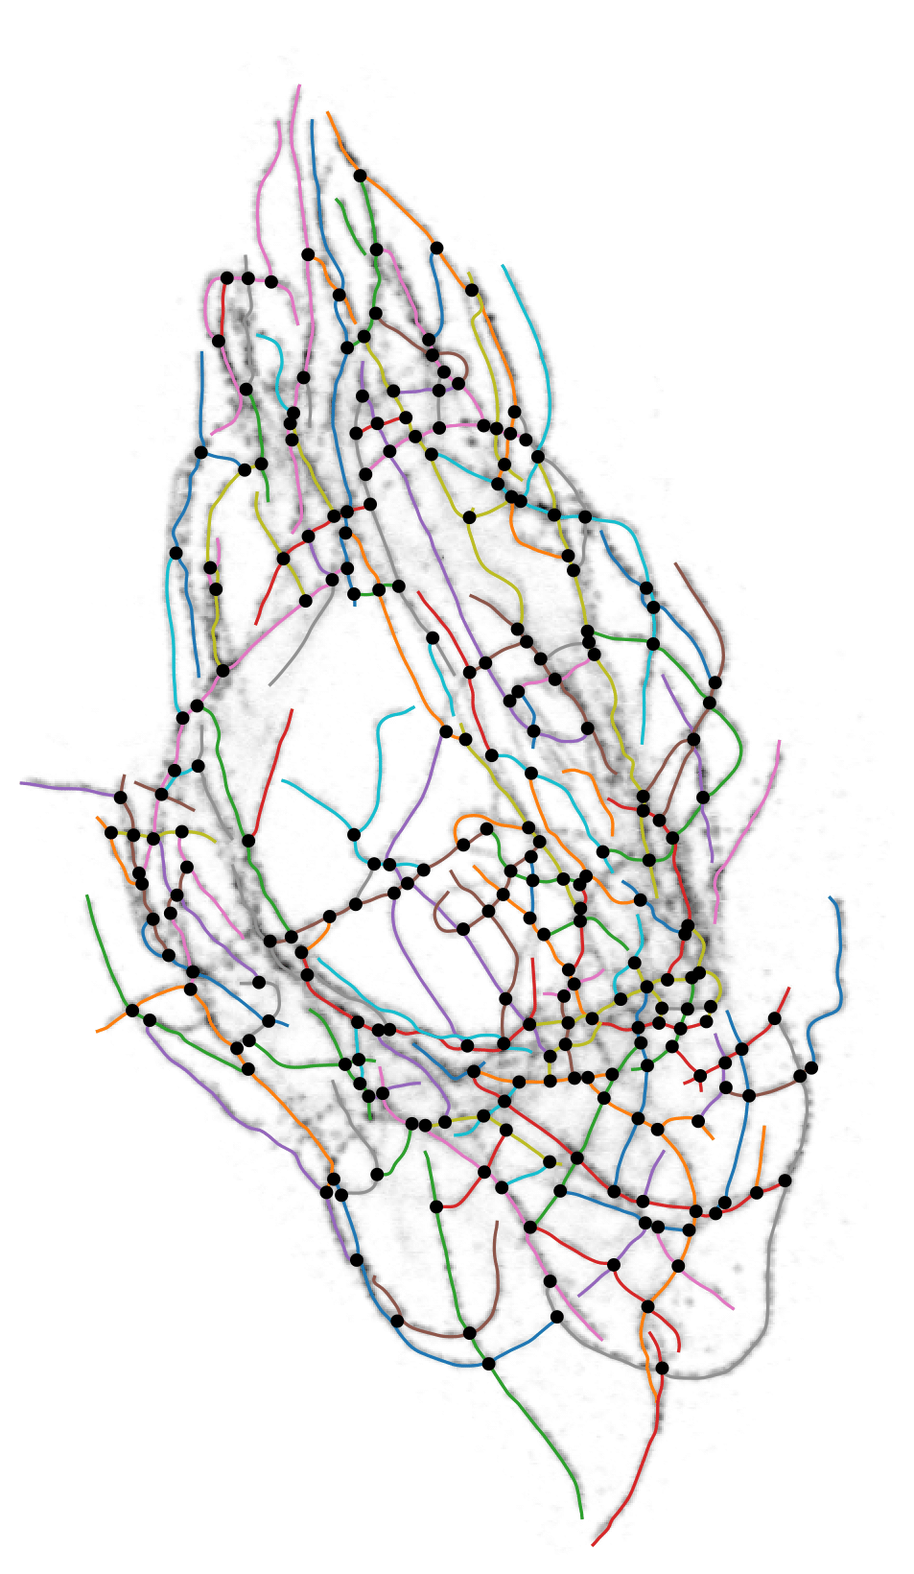
Cytoskeleton preprocessing
Raw image
Denoised
Binary Mask
Skeleton
Segmentation
Microtubules of a cell from the Human Protein Atlas dataset, imaged with confocal microscopy

Slide 4
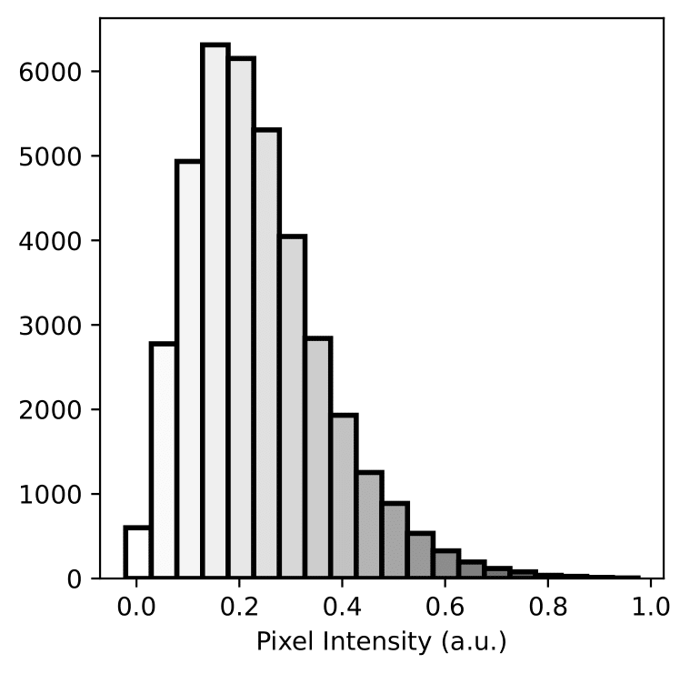
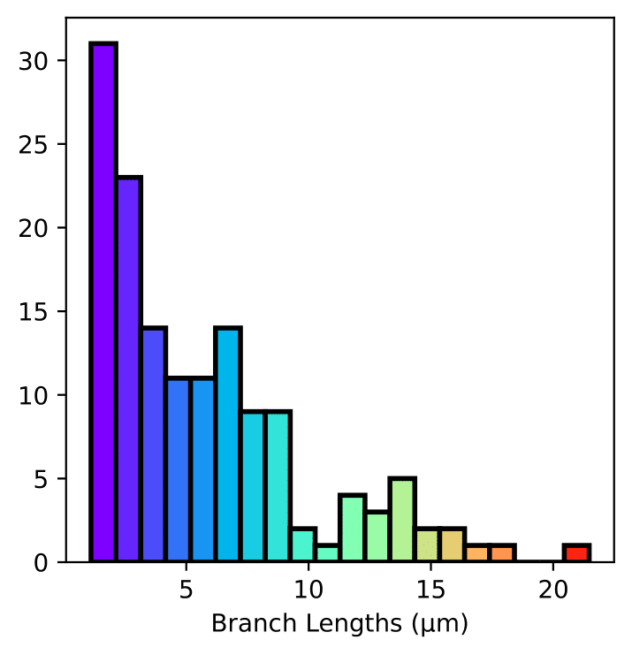
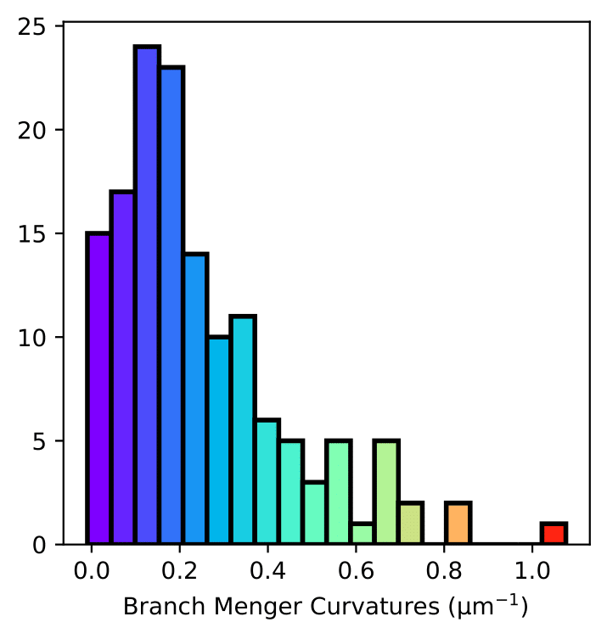
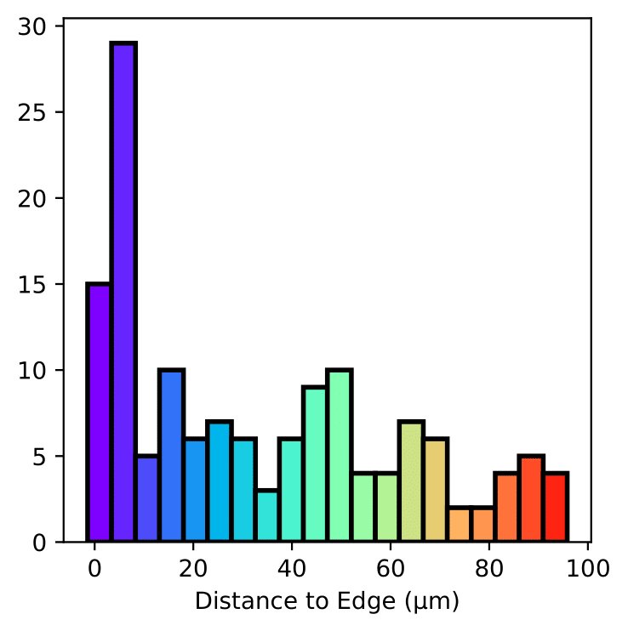
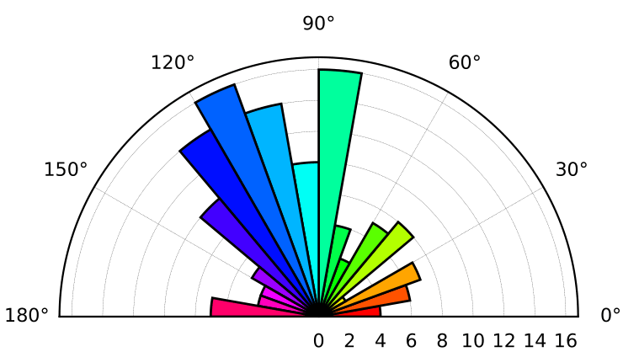
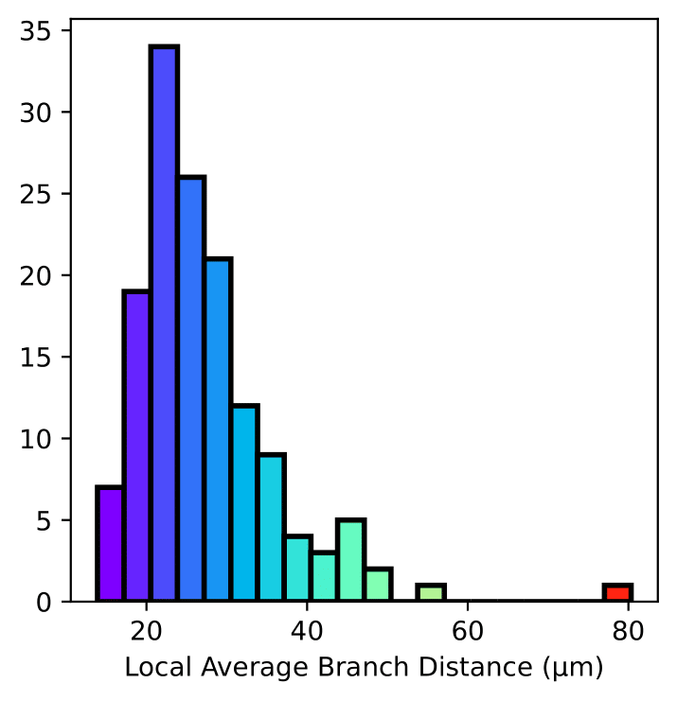
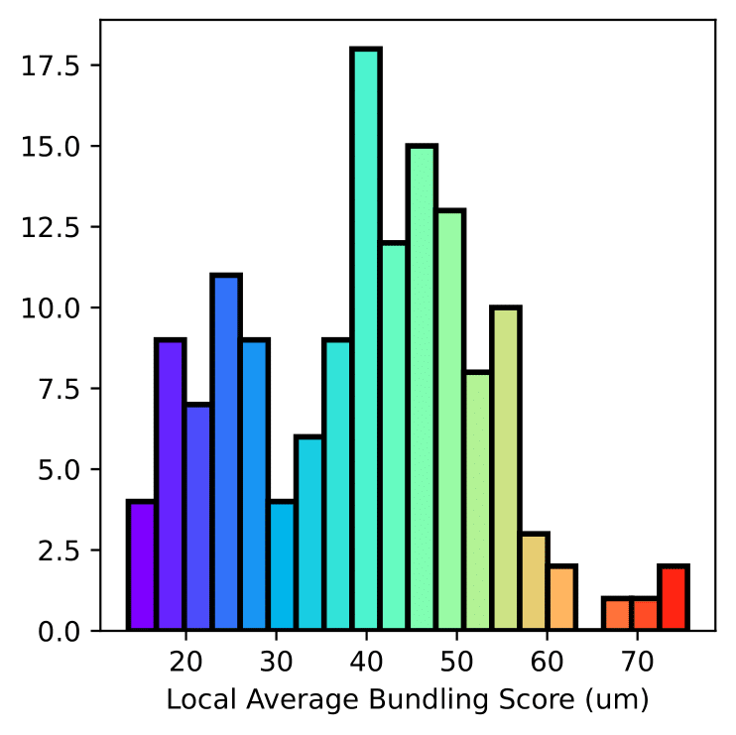
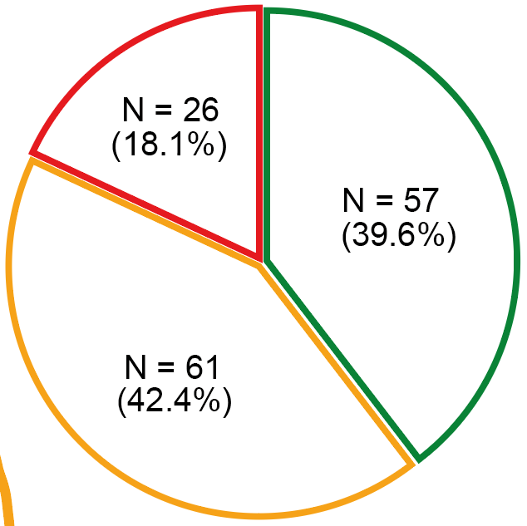
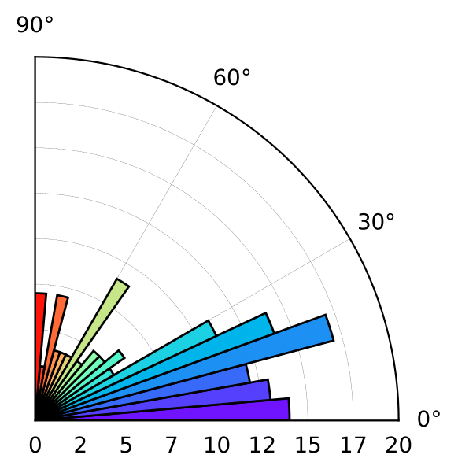
Cytoskeleton architecture
Intensity distribution
Morphology
Raw image of microtubules
I = 0.26 ± 0.13
Orientation
Density
Bundling
Connectivity

Slide 5
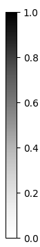
Cytoskeleton architecture
Intensity distribution
Morphology
I = 0.26 ± 0.13
Pixel Intensity
Orientation
Density
Bundling
Connectivity

Slide 6
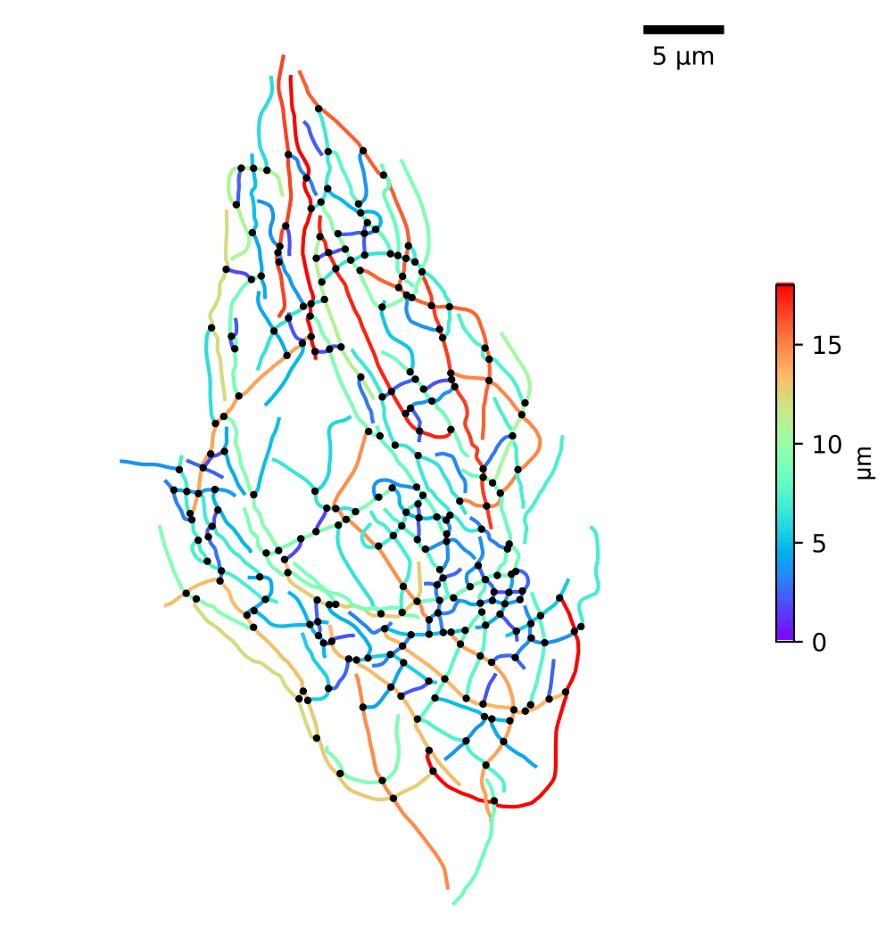
Cytoskeleton architecture
Intensity distribution
Morphology
I = 0.26 ± 0.13
Orientation
Density
Bundling
Connectivity

Slide 7
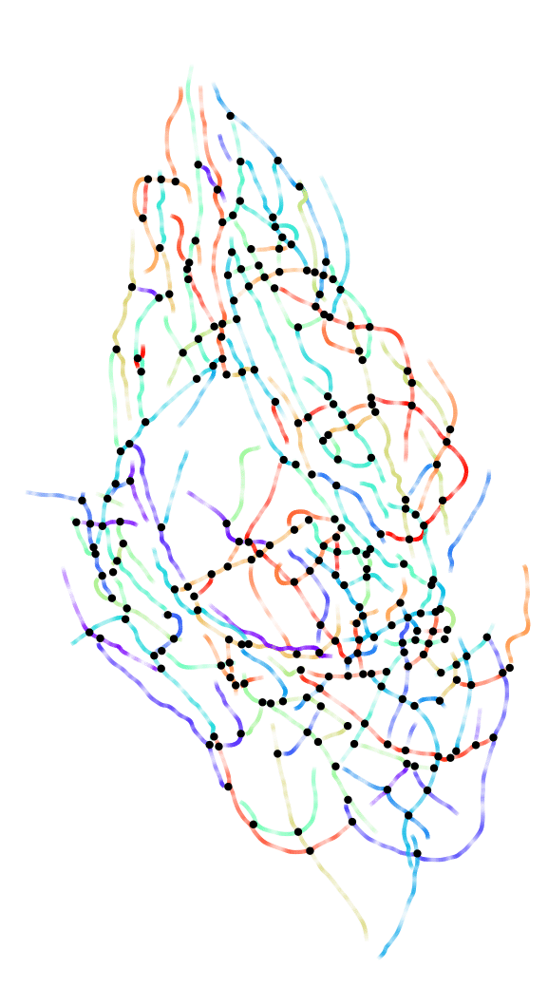
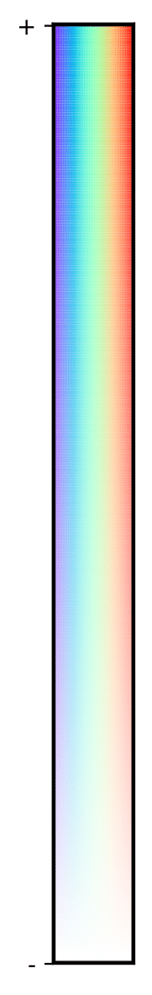
Cytoskeleton architecture
Intensity distribution
Morphology
I = 0.26 ± 0.13
curvature (μm⁻¹)
Orientation
Density
Bundling
Connectivity

Slide 8
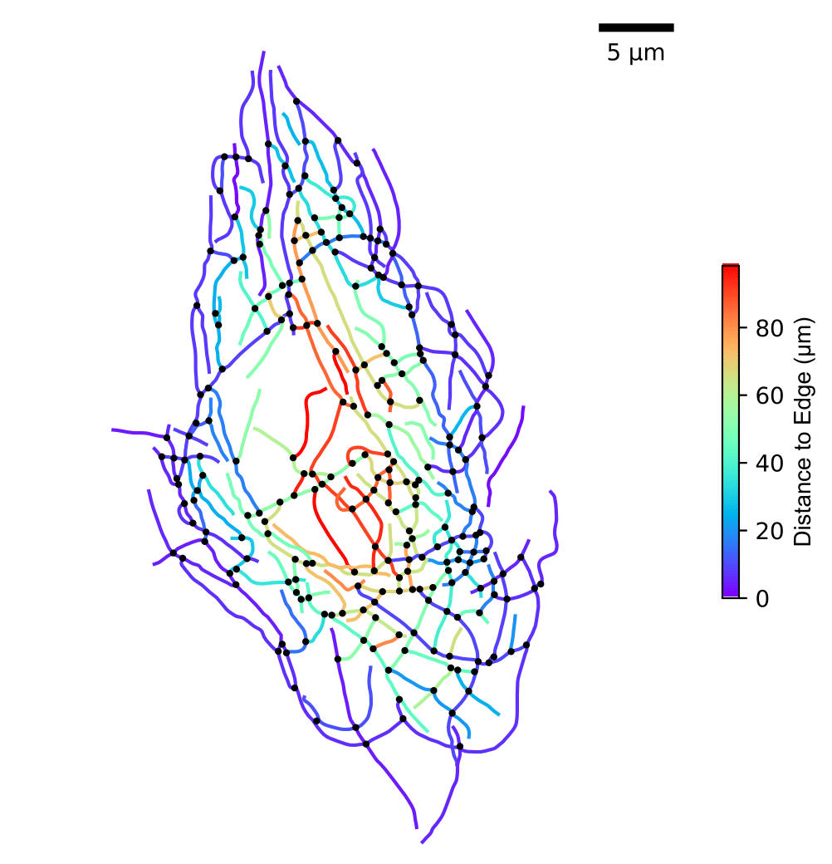
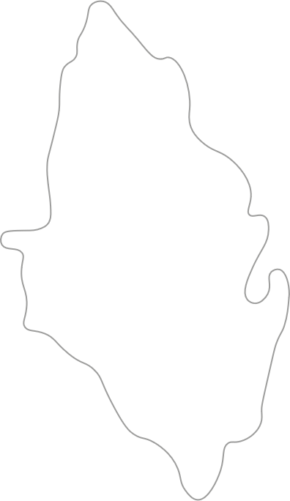
Cytoskeleton architecture
Intensity distribution
Morphology
I = 0.26 ± 0.13
Orientation
Density
Bundling
Connectivity

Slide 9
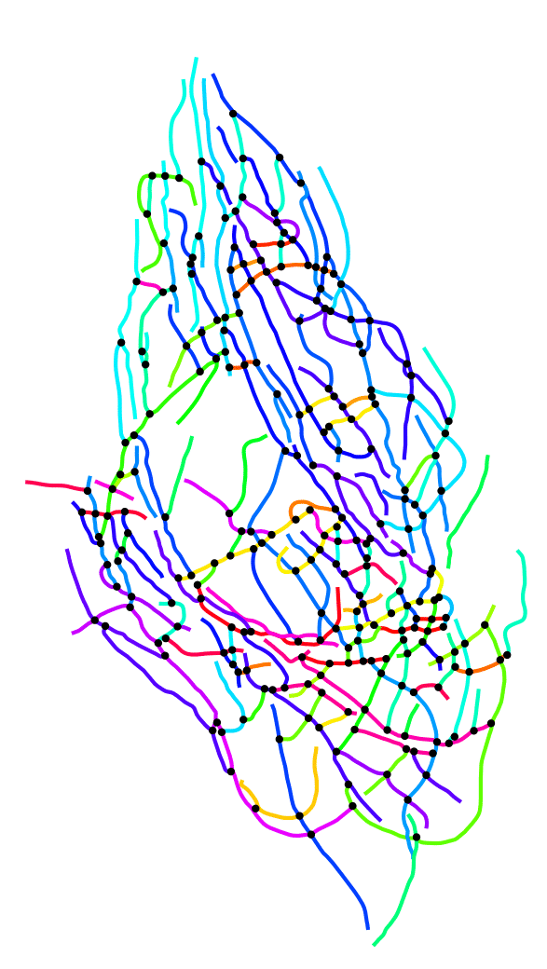
Cytoskeleton architecture
Intensity distribution
Morphology
I = 0.26 ± 0.13
Orientation
Density
Bundling
Connectivity

Slide 10
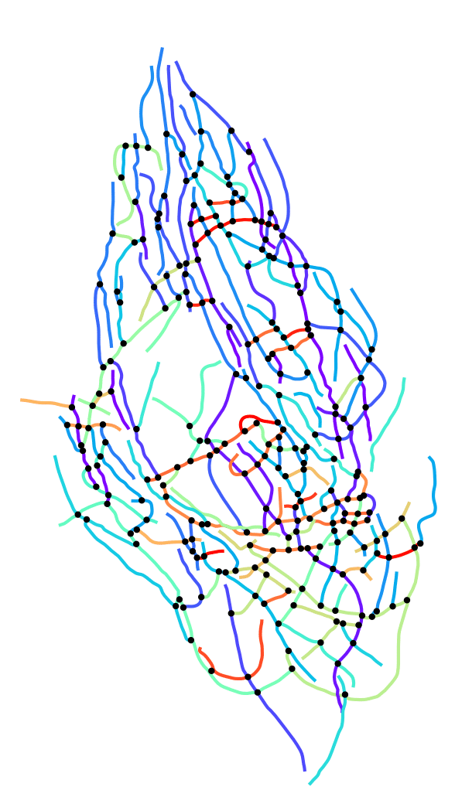
Intensity distribution
Morphology
I = 0.26 ± 0.13
Orientation
Density
Bundling
Connectivity
cell’s major axis

Slide 11
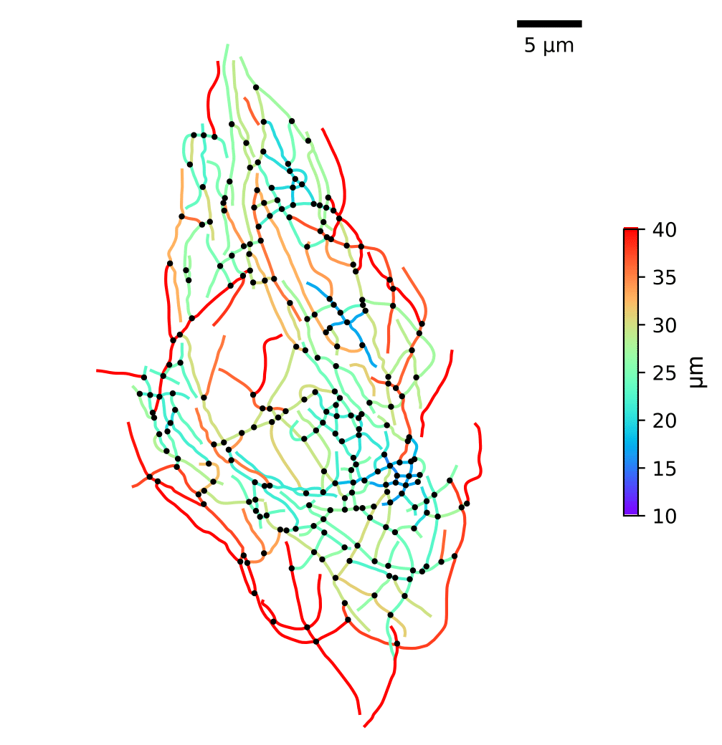
Cytoskeleton architecture
Intensity distribution
Morphology
Neighborhood: N = 5 closest
I = 0.26 ± 0.13
Orientation
Density
Bundling
Connectivity

Slide 12
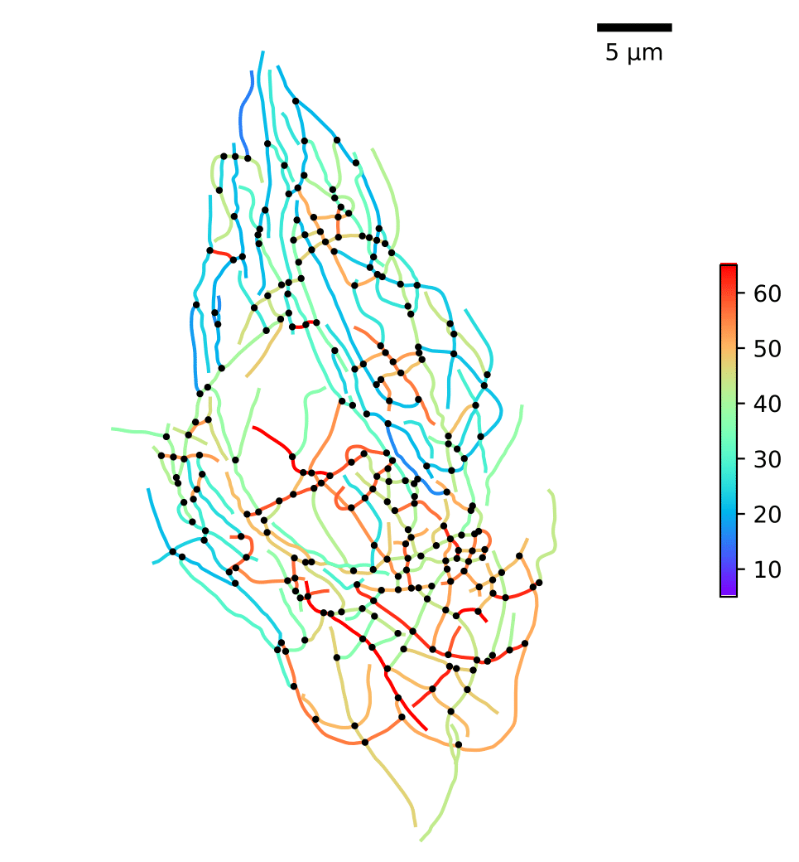
Cytoskeleton architecture
Intensity distribution
Morphology
Neighborhood: N = 5 closest
I = 0.26 ± 0.13
avg. angle difference (º)
Orientation
Density
Bundling
Connectivity

Slide 13
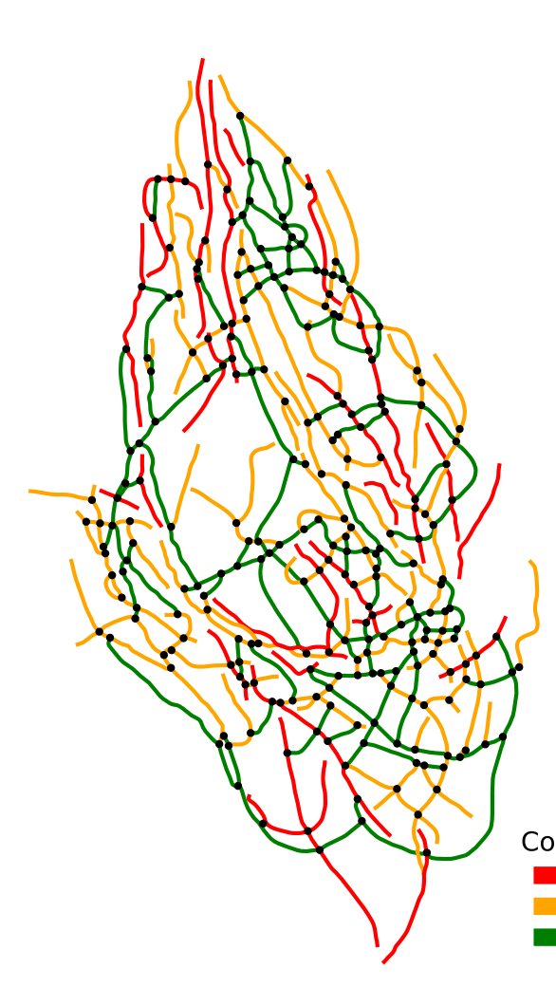
Cytoskeleton architecture
Intensity distribution
Morphology
Internal filament
1-loose end filament
Isolated filament
I = 0.26 ± 0.13
Orientation
Density
Bundling
Connectivity

Slide 14
Cytoskeleton architecture
Intensity distribution
Morphology
Raw image of microtubules
I = 0.26 ± 0.13
Orientation
Density
Bundling
Connectivity

Slide 15
Untangling the cytoskeleton:
a model to describe cytoskeletal architecture
Diogo Fróis Vieira
#43
Supervisors
João Sanches (ISR, DBE)
PhD in Biomedical Engineering
Joana Figueiredo (i3S, FMUP)

