Slide 1

To Loan or not to Loan: That is the question
Predict bank loan success
Group 29

Slide 2
Problem Contextualization
We’re working with a bank that wants to improve their services regarding loans.
Bank managers only have a vague idea of who is a good or bad client.
Can we predict the success of a loan?
Yes, but…

Slide 3
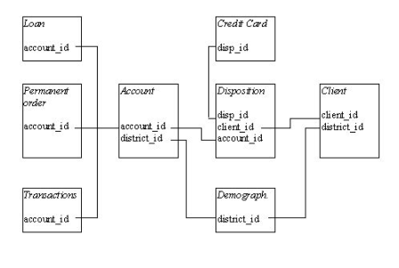
Domain Description
A Bank stores information regarding:
Accounts (4500 objects)
Clients (5369 objects)
Disposition (5369 objects)
Permanent Order (6471 objects)
Transactions (1.056.320 objects)
Loans (682 objects)
Credit Cards (892 objects)
Demographic Data (77 objects)
Goal:
Predict if a loan request should be accepted or not

Slide 4



Exploratory Data Analysis
Best and most important findings

Slide 5
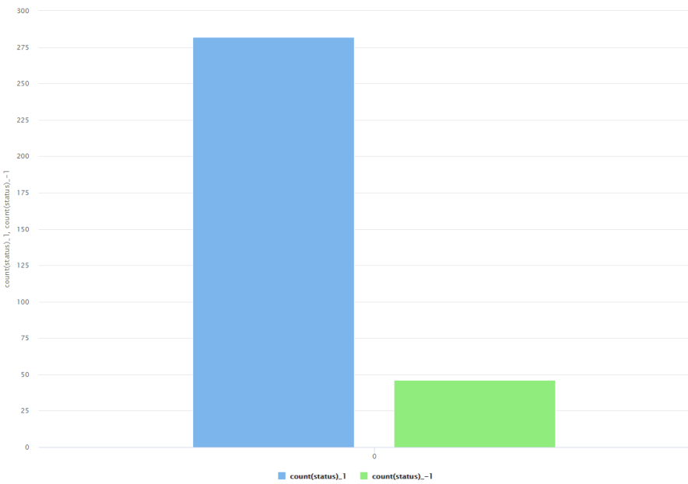
Unbalanced Data
Loans
Out of all 682 loans we only had 328 examples to train and test our model.
Out of these 328 only 46 were unsuccessful loans which is about 14%.

Slide 6

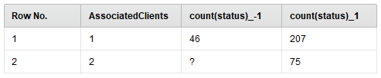
Cards and Clients
Credit Card
Number of Clients
Out of all the loans only 11 were associated to clients who have a credit card
All 11 loans ended up being paid
Out of all the loans 75 of them were associated to accounts that had 2 clients
All of these 75 loans ended up being paid

Slide 7
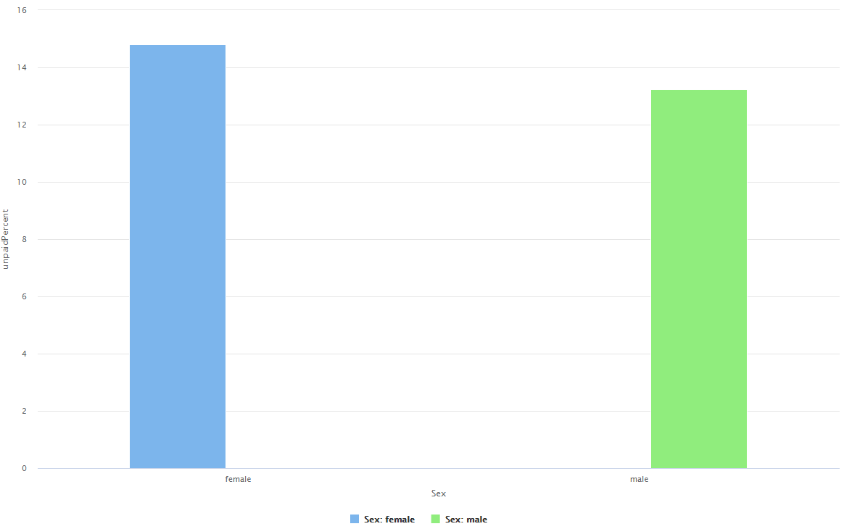
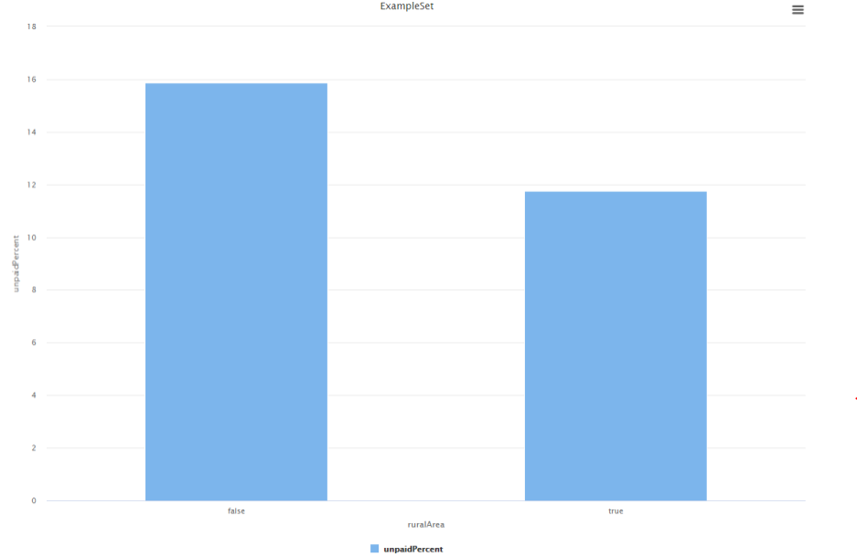
More Data Analysis
Gender
Urban vs Countryside
To the same number of loans it was possible to detect a 2% difference in the “unpaid percentage”.
Due to the lack of more information and since the difference is so small, we don’t think it is relevant.
To the same number of loans it was possible to detect a 4% difference in the “unpaid percentage”.
Due to the lack of more information and since the difference is so small, we don’t think it is relevant.

Slide 8
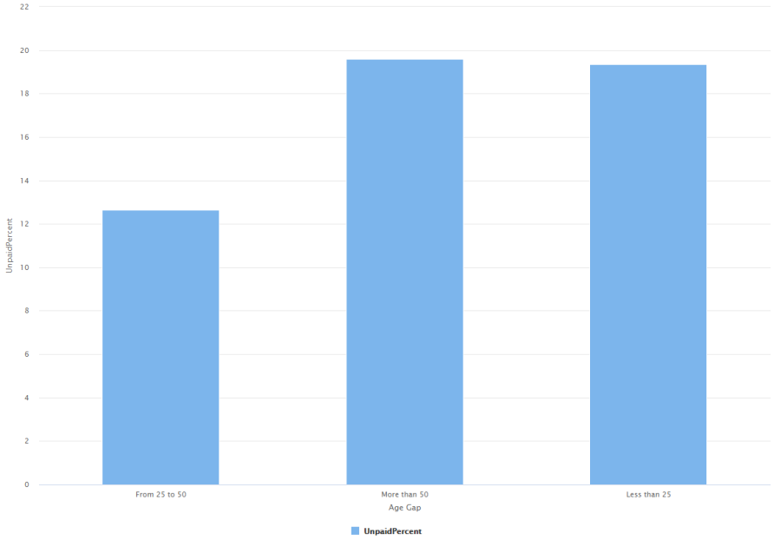
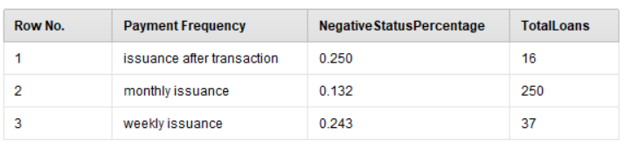
More Data Analysis
Frequency of the Payments
Age Gap
There is a lot more people with monthly payments.
Even though the percentage of loans not payed is higher, it is still not possible to retrieve any conclusion due the low number of cases.
There is a big difference between the age gap of 25 to 50 years, but we can’t relate it to a pattern due to the number of loans being substantially different.

Slide 9


Problem Definition
Should a loan be granted or not?

Slide 10

Data Preparation
Rename attributes
This is made to avoid having attributes with the same name when joining the tables and also to have a better view of all the data when testing
Fix missing values
Mainly the unemployment rate and number of committed crimes in the year of 1995 for one district
Create new tables
To save the results obtained when calculating, for example, the average income of a client from the transaction table
Join tables
To join all the information from all the tables into a single table
Remove attributes
Such as id’s and names that have no relation to the problem

Slide 11

Feature Engineering
Division of the attribute birthNumber into birthDate and gender of a client
Calculating client’s age at the time the loan was requested
Adding the number of clients associated to an account
Calculating the average income, expenses and other credits associated to a client
Adding information regarding a client: “Does this client have a card associated to him?”
Calculating criminal and unemployment growth

Slide 12
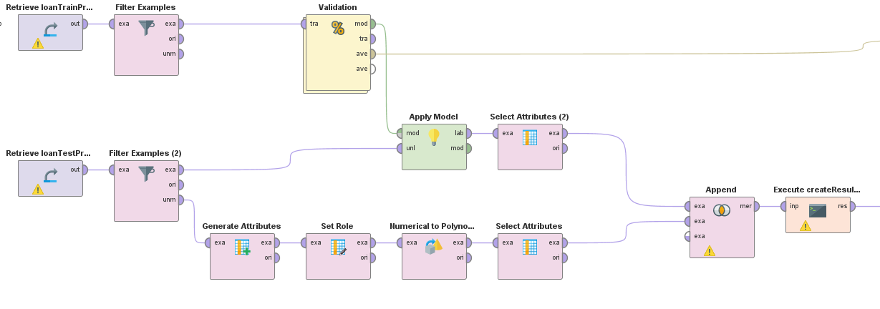
Pipelines
Our pipeline with best performance was the one where we filter the cases we knew clients would pay to reduce the number of cases of the positive class.

Slide 13
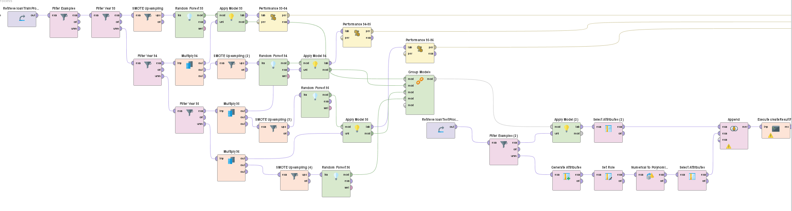
Pipelines
Another pipeline we tried but with worse results was the one where we split the data by each year of the loans, and trained models for each one and tested on the following year.

Slide 14
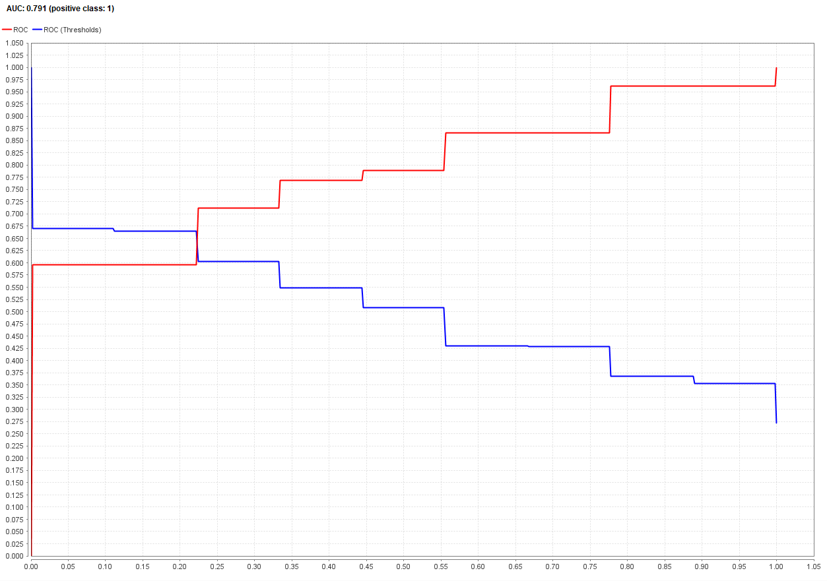
Auc Result

Slide 15

Conclusion
Can we predict the success of a loan?
Yes, but we must acknowledge there will always be an error associated to our predictions.
Although our score in the competition was one of the worst scores, we feel like we managed to learn how to solve a problem like this.
Future work:
Test more algorithms
More feature engineering

Slide 16
Code and all the files
All of the files and coding done to produce these results can be found on github:
https://github.com/pingudiogo/ECAC2020

