Slide 1

USE OF ARTIFICIAL NEURAL NETWORKS TO FAULT DETECTION AND DIAGNOSIS
Diogo Leite Rebouças, Fábio Meneghetti Ugulino de Araújo and André Laurindo Maitelli

Slide 2
USE OF ARTIFICIAL NEURAL NETWORKS TO FAULT DETECTION AND DIAGNOSIS
ABSTRACT
In a real process, all used resources, whether physical or developed in software, are subject to interruptions or operational commitments. However, in situations in which operate critical systems, any kind of problem can bring big consequences. A coupled water tank system was used as a study case model for implementing and testing the proposed methodology. The developed system should generate a set of signals to notify the process operator about the faults that are occurring, enabling changes in control strategy or control parameters. Due to the damage risks involved with sensors, actuators and amplifiers of the real plant, the data set of the faults are computationally generated and the results will be collected from numerical simulations of the process model. The system will be composed by structures with Artificial Neural Networks.
<number> / 15

Slide 3
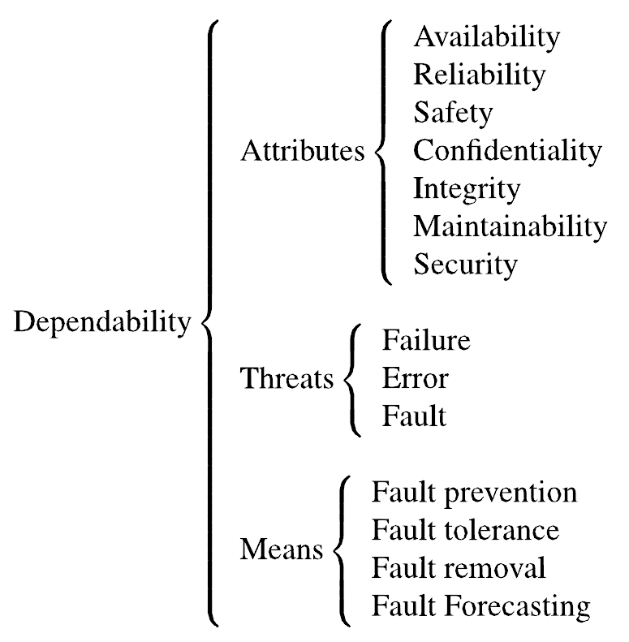
USE OF ARTIFICIAL NEURAL NETWORKS TO FAULT DETECTION AND DIAGNOSIS
INTRODUCTION
The computer systems can be characterized by five fundamental properties: functionality, usability, performance, cost and dependability. The term dependability is related to the system ability to provides a service that can be, justifiably, reliable.
The term failure must be used to indicate when occur a deviation of the system behavior, making it incapable to provide the service for which it was designed. An error, however, is related to the system state and can lead to a failure. Briefly, if there is an error, then there is a sequence of actions that can lead to a failure. Last, but not least, the term fault is the cause of an error and is related to a defect. Normally, it is said that the term fault may be defined as a defect that has the potential to generate errors.
<number> / 15

Slide 4
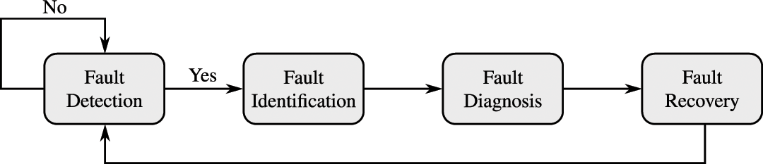
USE OF ARTIFICIAL NEURAL NETWORKS TO FAULT DETECTION AND DIAGNOSIS
FAULT DETECTION AND DIAGNOSIS
In order to ensure the success of planned operations and recognize the behavioral problems in the process, many supervision and monitoring systems are being developed. These systems can detect, diagnose and eliminate faults, ensuring that the process operations satisfies the performance specifications.
There are four states involved in the process monitoring: fault detection, fault isolation, fault diagnosis and fault recovery. Although arranged as a sequence of actions, all states are not always strictly necessary.
<number> / 15

Slide 5
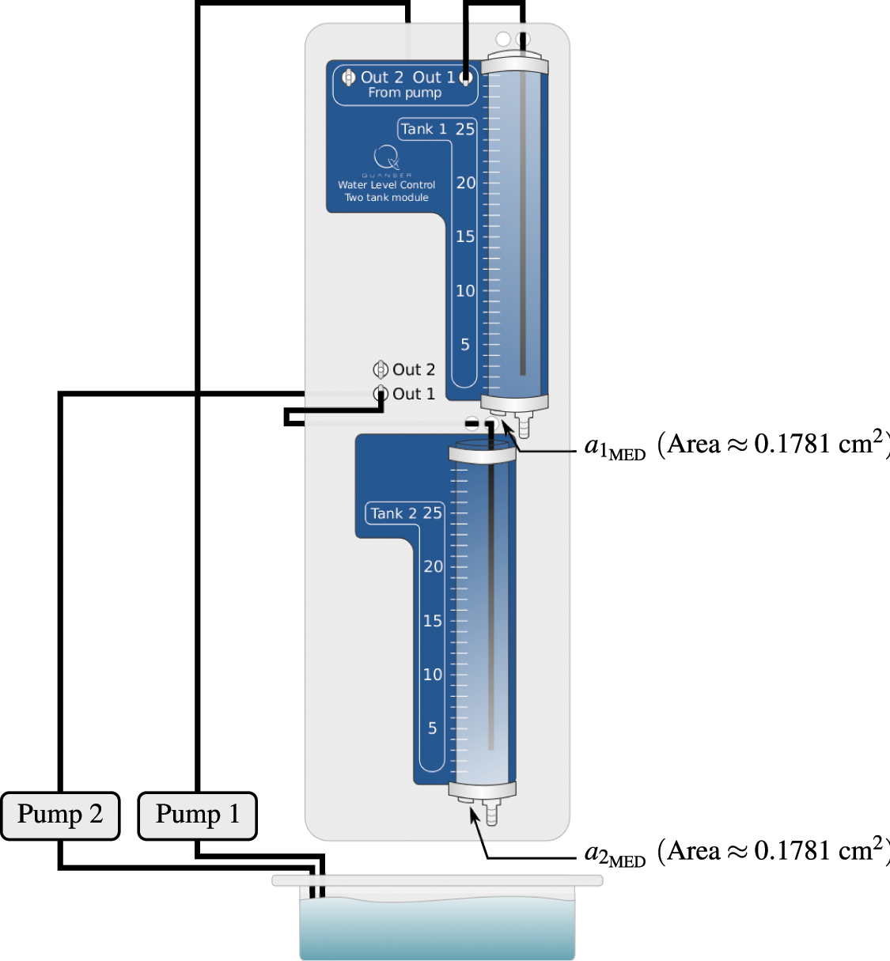
USE OF ARTIFICIAL NEURAL NETWORKS TO FAULT DETECTION AND DIAGNOSIS
STUDY CASE MODEL
The study case model used consists of a coupled water tanks system developed by Quanser®.
OBJECTIVES AND METHODOLOGY
Provide a Fault Detection and Diagnosis (FDD) System, that should be capable to generate alert signals to the process operator in such way that they can be post processed by another system.
The system will use a residual error generated by the difference between the real measured variable and the estimated value of this variable obtained from an identification structure.
<number> / 15

Slide 6
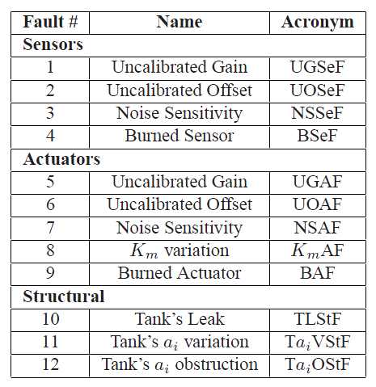
USE OF ARTIFICIAL NEURAL NETWORKS TO FAULT DETECTION AND DIAGNOSIS
SELECTED FAULTS
Despite the various faults that may exist in a coupled water tanks, only some of these were selected to be simulated.
Since in these types of simulation the system is normally exposed to adverse conditions, which could cause damage throughout the structure involved, the proposed system was computationally simulated (Runge-Kutta).
<number> / 15

Slide 7
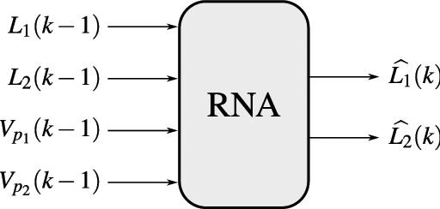
USE OF ARTIFICIAL NEURAL NETWORKS TO FAULT DETECTION AND DIAGNOSIS
NEURAL STRUCTURES
The neural structure for identification, that must represent the dynamics of the system, has a single neural network, which receives as input the past values of the levels, L₁(k−1) and L₂(k−1), and voltages applied, V_{p1}(k−1) and V_{p2}(k−1), generating, on its output, estimated levels, called L₁(k) and b L₂(k).
The best trained neural network to this purpose was obtained from a second-order model NNARX with eight neurons on hidden layer.The validation mean square error was 3.73 × 10⁻⁶.
<number> / 15

Slide 8
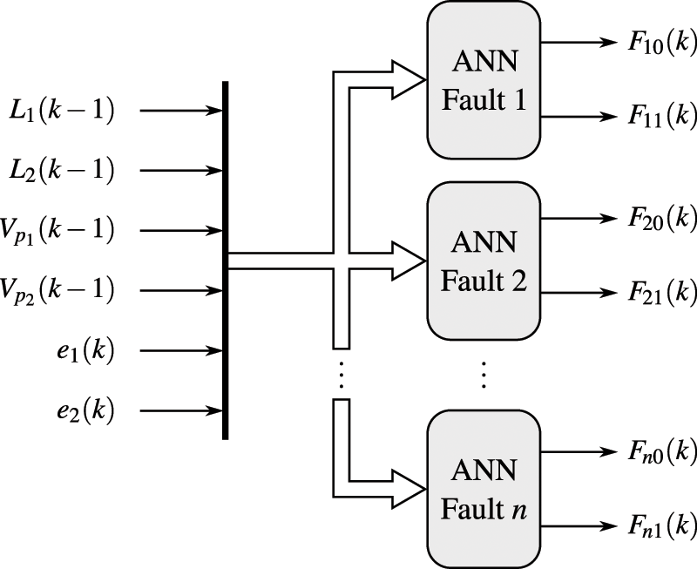
USE OF ARTIFICIAL NEURAL NETWORKS TO FAULT DETECTION AND DIAGNOSIS
NEURAL STRUCTURES
The structure of FDD, in turn, was composed by twelve neural networks, in which each of these is associated with a single fault, configuring a set of “specialists”. However, it is not a committee machine, since there is no network that performs the decision-making.
The input of each network is composed by the past values of the levels, L₁(k−1) and L₂(k−1), the voltages applied to the pumps, V_{p1}(k−1) and V_{p2} (k−1), and the residual errors produced from the difference between the real and estimated output.
The output of each network is a 2-bit binary word, which indicates whether the fault is being detected in T₁, in T₂ or in T₁ and T₂ simultaneously.
<number> / 15

Slide 9
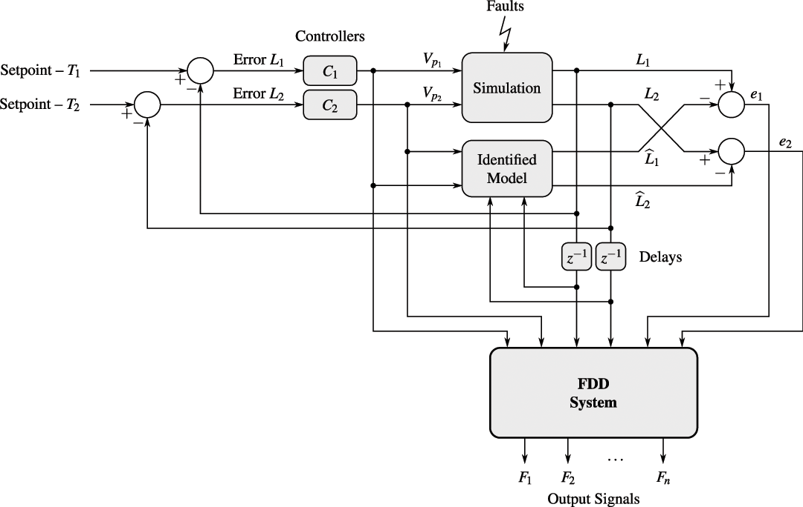
USE OF ARTIFICIAL NEURAL NETWORKS TO FAULT DETECTION AND DIAGNOSIS
PROPOSED SYSTEM
<number> / 15

Slide 10
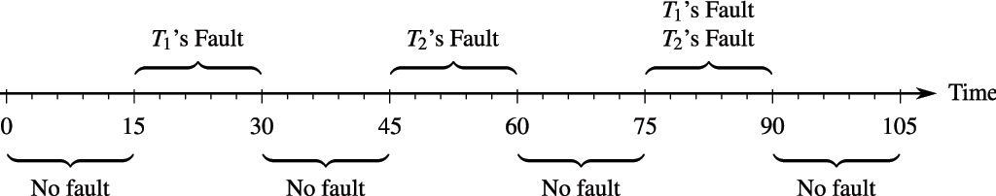
USE OF ARTIFICIAL NEURAL NETWORKS TO FAULT DETECTION AND DIAGNOSIS
RESULTS
The first step to be taken for the identification and detection processes, is to obtain the experimental samples for a supervised neural networks training. So, the data acquisition was done by a stimulation of the system through the application of pseudo random binary signals (PRBSs) in the setpoint of each tank and in the system fault parameters.
During the identification process were obtained 6,000 (six thousand) samples, which is equivalent to 10 (ten) minutes of simulation. About the fault detection process, 12,000 (twelve thousand) samples were obtained, which is equivalent to 20 (twenty) minutes of simulation. All data were collected with a sampling period of 100 ms, identical to that used in the real process.
The system was composed after a selection of the best structures and submitted to the final simulation of one minute and forty five seconds, divided into intervals of fifteen seconds.
<number> / 15

Slide 11
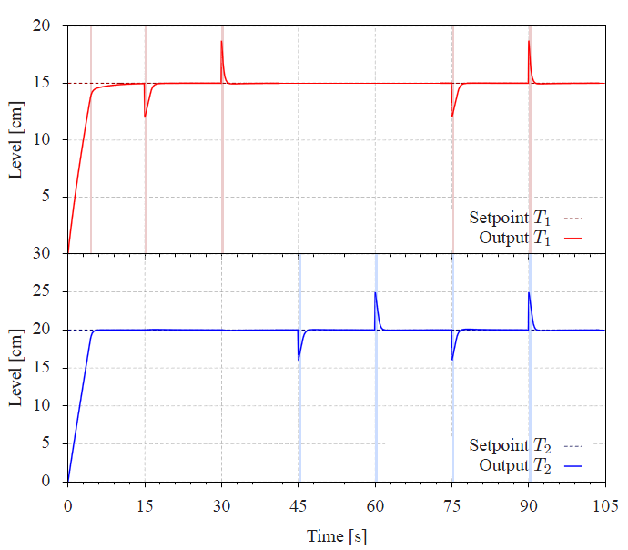
USE OF ARTIFICIAL NEURAL NETWORKS TO FAULT DETECTION AND DIAGNOSIS
RESULTS
The first fault to be simulated was UGSeF. In this simulation the value of the sensor gain was reduced to 80% of the default value.
The system identified the presence of the fault only when the parameter value was modified. After this period, the fault was “compensated” by the controllers, who sent more voltage to the pump, causing the return of the output to the setpoint.
However, that “compensation” was made in a improperly way, since the sensor’s reading had an error of 20%.
The system behaved in a similar manner to that in UOSeF and TLStF.
<number> / 15
UGSeF Simulation

Slide 12
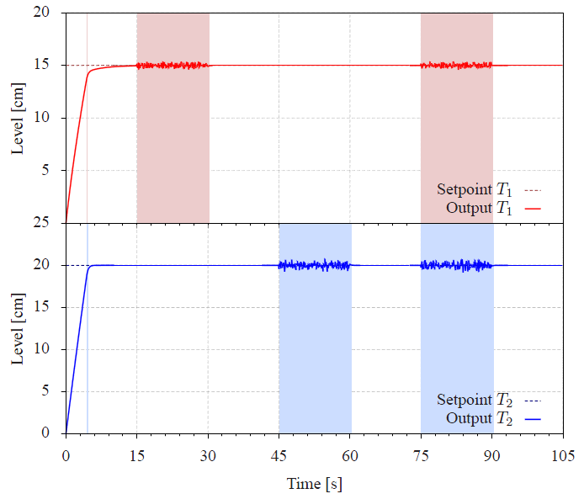
USE OF ARTIFICIAL NEURAL NETWORKS TO FAULT DETECTION AND DIAGNOSIS
RESULTS
Another simulation shows that the NSSeF was easily identified by the system. Due to the noise with uniform distribution (±2%), the system can not detect the fault at some points.
Unlike the NSSeF, the simulation performed to the NSAF was not so easily identified. The results obtained for T₁ can even be considered reasonable, while the results for T₂ are clearly unacceptable, since none of the points in which the fault should have been identified were recognized by the network.
All other remaining faults were easily identified by the system.
<number> / 15
NNSeF Simulation

Slide 13
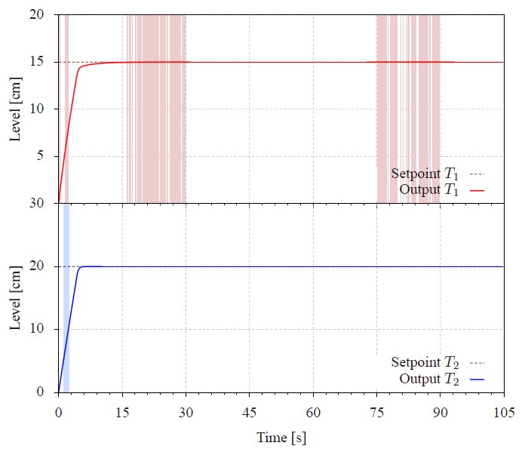
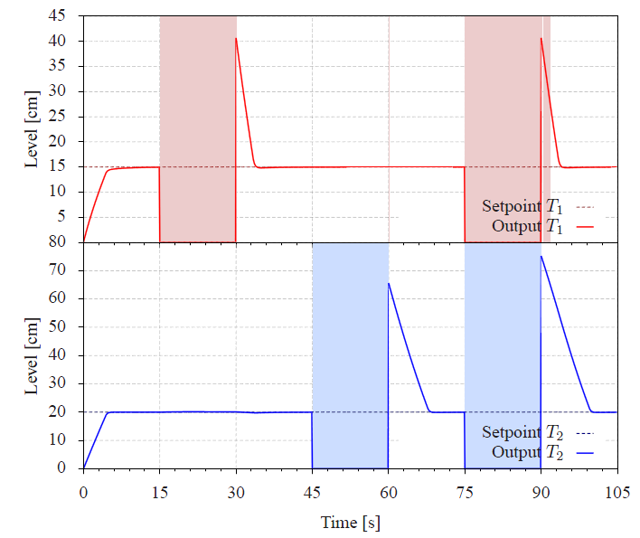
USE OF ARTIFICIAL NEURAL NETWORKS TO FAULT DETECTION AND DIAGNOSIS
RESULTS
<number> / 15
NSAF Simulation
BSeF Simulation

Slide 14
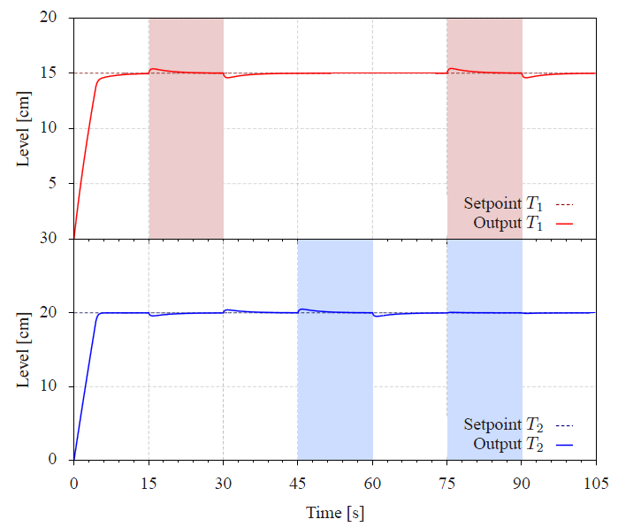
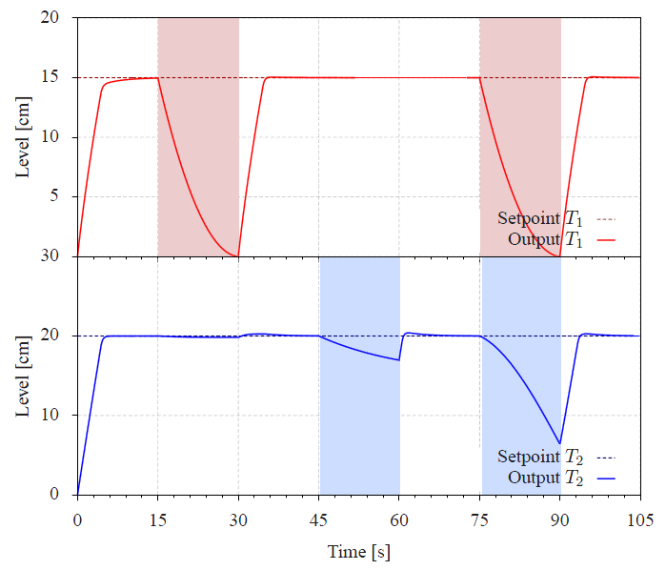
USE OF ARTIFICIAL NEURAL NETWORKS TO FAULT DETECTION AND DIAGNOSIS
RESULTS
<number> / 15
T_{ai}OStF Simulation
BAF Simulation

Slide 15
USE OF ARTIFICIAL NEURAL NETWORKS TO FAULT DETECTION AND DIAGNOSIS
CONCLUSIONS
This work was developed in order to provide a FDD system for a coupled water tanks. Thereunto, the system uses a neural structure to process the available values and inform the user about the faults that are occurring.
Since this structure is completely disjointed, another techniques can be mixed to compose a hybrid fault detection and diagnosis system. The used techniques can replace those networks whose the performance were below the expectations.
Among the twelve selected faults, eight were easily identified and three had a satisfactory performance, with a small detection problem that can be solved with binary flags.
Thus, the system had a satisfactory performance and could be capable to identify about 92% of the proposed faults, proving that MLP networks are efficient structures for identification and for the fault detection and diagnosis.
<number> / 15

