Slide 1
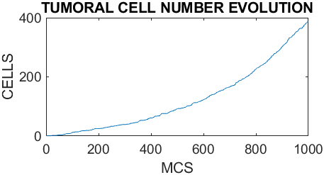
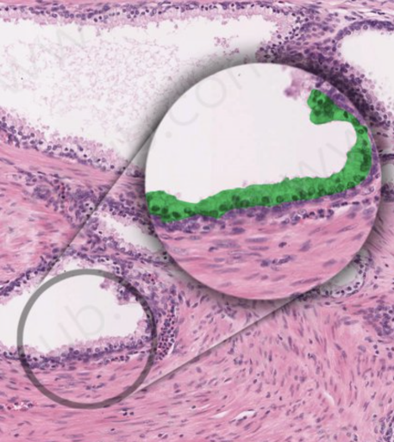
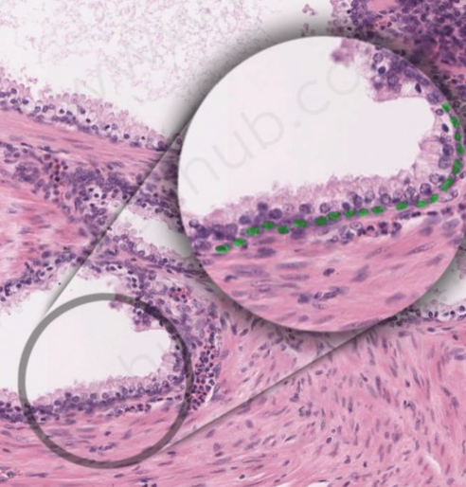
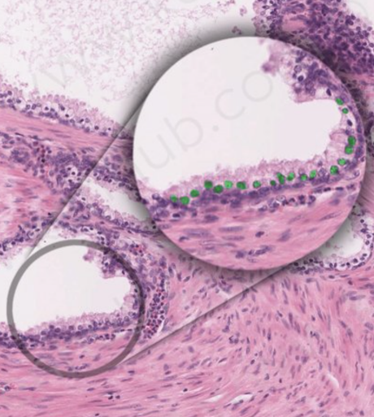
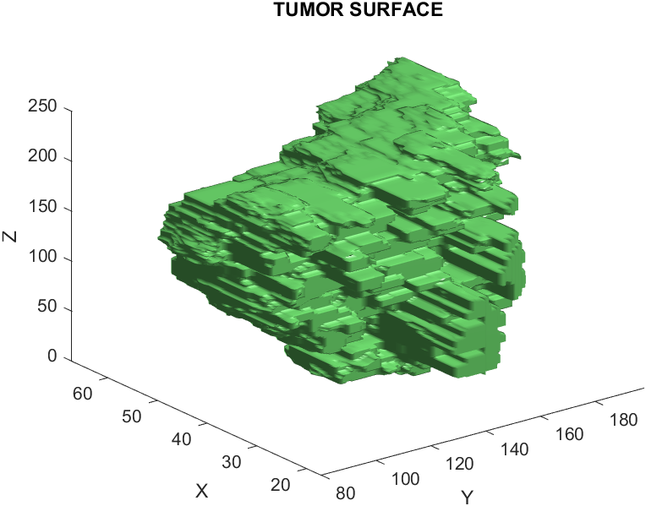



3D SIMULATON OF PROSTATE TISSUE AND CANCER DEVELOPMENT
Licenciatura Engenharia Biomédica
Diogo Monteiro Martins
Supervisors: João Carvalho, Rui Travasso
Introduction
The usage of computational power to model biological processes has been used not only to verify existing knowledge but also to gain new insights. This project focuses in applying these modelling methods to a tumor, allowing to predict different outcomes depending on several parameters and conditions that affect the development environment. From the results acquired it is possible to envision new therapies as well as new diagnose methods and the effect of medical procedures and drugs. The developed 3D model is based on the Cellular Pots Model (CPM) and describes in a realistic way the growth of a tumor in the prostatic glands. The model was based on a previous code written for the bladder cancer [1], developed in the programming language C/C++.
Objectives
Simulation Results
Create 3D computational model to simulate prostate tumor growth
Test if the tumor starting layer has a significant impact in the tumor progress
Test how changes in parameters like the cellular adhesion and inelasticity constant affects the tumor growth
Compare with experimental results (Gleason criteria)
Code implementation and test the results of different therapeutic approaches
The simulation was run for 1000 Monte Carlo Steps (MCS)
Each MCS consists in trying to copy a voxel as many times as there are voxels in the grid
The cells geometry was designed according to the histological images
The values of the parameters were adapted to a normal tumoral growth
Prostate Anatomy and Histology
The prostate gland [2] is an organ located below the bladder posterior to the rectum and surrounds the prostatic portion of the urethra
The prostate [3] is composed by 30 to 50 tubuloalveolar glands surrounded by the fibromuscular stroma
Each gland contains several prostatic acini that surround the ducts
The acini [4] have an epithelium with two layers and three cell types: luminal, basal and neuroendocrine cells (the last are not included in the current model due to simplification reasons)
Figure 2 – Simulation Result Evolution of the Number of Tumoral Cells
Figure 1 – Luminal Cells / Basal Cells / Neuroendocrine Cells [5]
Cellular Pots Model
The CPM [6] consists in a discrete grid or a lattice that contains voxels or pixels
Each voxel can either belong to a cell or to the medium and the dynamics of the model are simulated when a cell tries to “copy” it’s voxels to another cell
These “copies” can occur based on an energy parameter, the Hamiltonian (calculated using the adhesion energy and the inelasticity constant of the cell which is associated with the deviation from the target volume)
Tumoral cells have an inelasticity constant higher than normal cells allowing them to grow in an uncontrolled way invading other cells and possibly killing them due to high pressure
Figure 3 – Simulation Result of Tumor Growth
Future Work
Systematic study of the different parameters' relevance in the tumor growth
Test the tumor starting layer hypothesis
Implementation of medical approaches and comparation with the experimental results
References
[1] Joao Carvalho, Valeria Lopes, Rui Travasso, A three dimensional computer model of urothelium and bladder cancer initiation, progress and collective invasion, Informatics in Medicine Unlocked, Volume 26, 2021, 100750, ISSN 2352-9148, https://doi.org/10.1016/j.imu.2021.100750.
[2] F. H. Netter, Atlas of Human Anatomy, 6 ed., Saunders/Elsevier, 2008, p. 640.
[3] J. Carneiro e L. C. Junqueira, Histologia Básica Teto & Atlas, 13 ed., G. Koogan, Ed., 2017, p. 568.
[4] Salem, O., & Hansen, C. G. (2019). The Hippo Pathway in Prostate Cancer. Cells, 8(4), 370. https://doi.org/10.3390/cells8040370.
[5] https://www.kenhub.com/pt/study/prostata-pt. [Online] [Acedido: 4 15, 2023.]
[6] Voss-Böhme A. (2012). Multi-scale modeling in morphogenesis: a critical analysis of the cellular Potts model. PloS one, 7(9), e42852. https://doi.org/10.1371/journal.pone.0042852.

