Slide 1

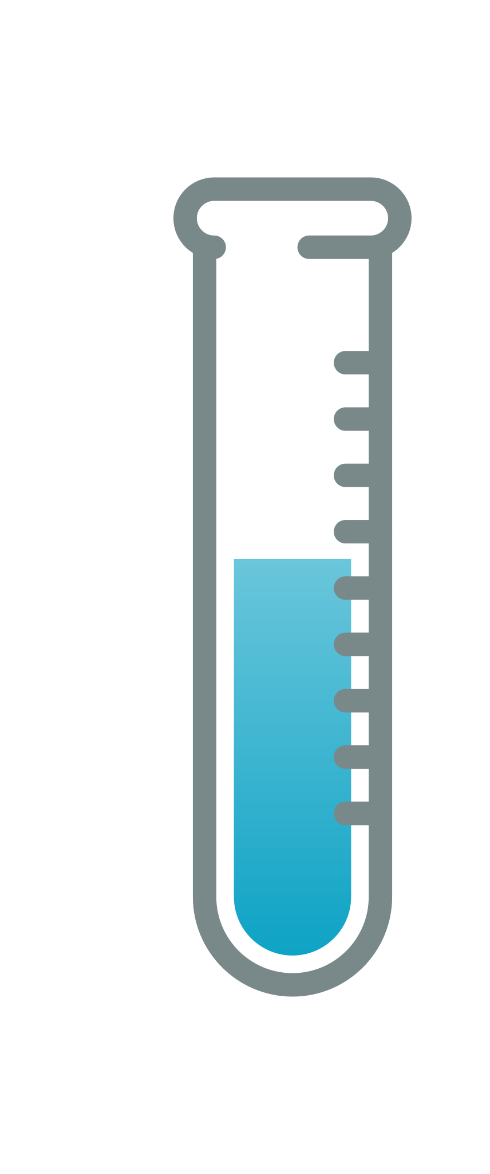
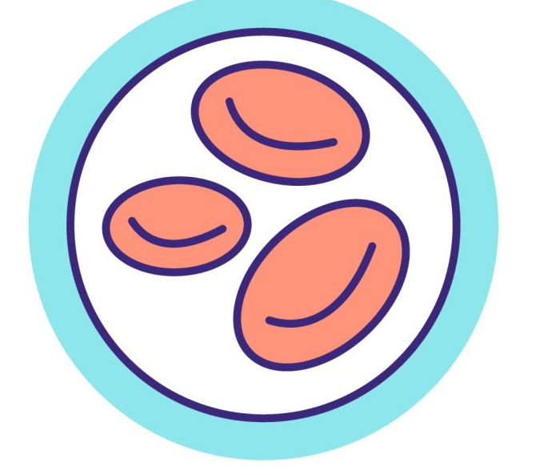

166 740 whole genomes
42 blood-related traits
Non-coding regulatory regions
Blood cell line annotations
ABC
Activity-by-contact
CRD
Cis-regulatory domains
Cell counts
Biomarkers
HIC
Promoter-capture Hi-C
UK Biobank
NC
All non-coding annot.
Regulatory regions
MAF < 1%
CADD score > 15
Variant filtering
Gene-based association testing
For gene i out of ~18 000 genes and annotation j ⇒ test rare variants for association with trait
ABC
Covariates
CRD
Relatedness
Conditional
HIC
Replication

