Slide 1
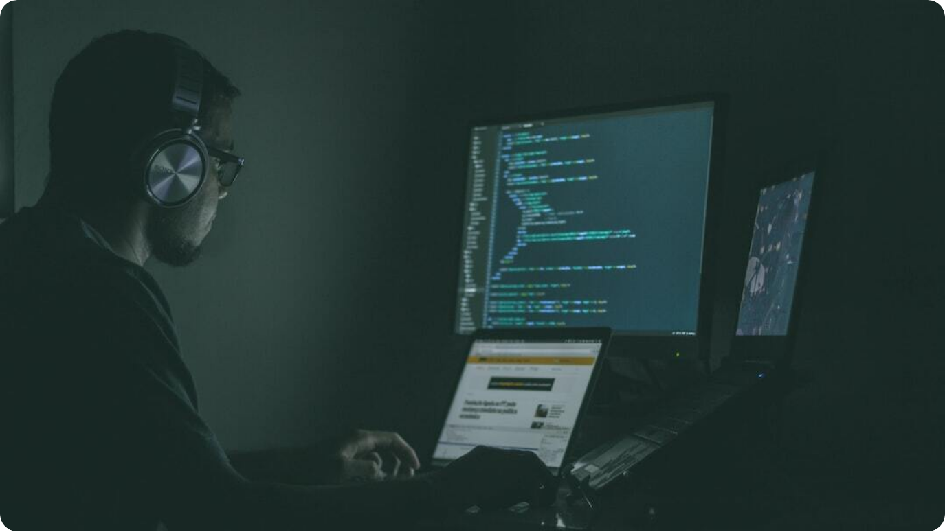
Critical Analysis of Human Factors in Cyber Security for a Local Start‑Up
Understanding Human Vulnerabilities: Analyzing the role of human behavior and cognitive factors in cybersecurity breaches at start-ups.
Focus Areas: Cognitive limitations, insider threats, and design–behavior mismatches.
Photo by Jefferson Santos on Unsplash
Notes:
This document presents a critical and comprehensive analysis of various human factors involved in the field of cybersecurity, specifically within the unique context of a local start‑up. The detailed outline will carefully examine how human vulnerabilities, including cognitive limitations and the potential for insider threats, significantly influence security outcomes in environments that operate with limited resources and capabilities. The overall aim is to thoroughly understand these crucial factors and to suggest practical and actionable measures aimed at reducing the associated risks that arise from such vulnerabilities in cybersecurity practices. (Edet et al. 2024)

Slide 2



Introduction
Vulnerability of Start-ups
Limited resources and informal security protocols expose start-ups to higher cyber risks.
Role of Human Factors
Employee behavior and decision-making are key vulnerabilities in cybersecurity.
Presentation Structure
We will examine Cognitive Limitations & Human Error, Insider Threats, and Design–Behavior Mismatches.
Notes:
Start‑ups typically function with limited resources and frequently do not possess the developed security frameworks present in larger organisations. This situation renders them particularly vulnerable to cyber risks originating from human actions. Factors such as employee conduct, cognitive biases, and decision‑making under stress can lead to significant vulnerabilities. This presentation aims to examine three related areas: cognitive limitations and human error, insider threats, and discrepancies between design and behaviour. Gaining insight into these human‑centred challenges is essential for establishing robust security frameworks within start‑up environments. (Schütz et al. 2023)

Slide 3



Cognitive Limitations & Human Error (Part 1)
Attention Span
Limited focus can lead to overlooking critical security protocols.
Memory Constraints
Difficulty remembering complex passwords or procedures creates security vulnerabilities.
Cognitive Biases
Underestimating risks or overestimating personal security capabilities.
Notes:
Cognitive limitations among individuals represent a significant and pressing risk factor in the complex and evolving realm of cybersecurity. Employees who have short attention spans may inadvertently overlook critical security alerts or crucial procedures, thereby putting the entire organisation at risk. Additionally, memory limitations—such as the inability to accurately recall complicated and frequently changing passwords—tend to compound these security threats even further. Cognitive biases, which include overconfidence in one's abilities and a prevalent tendency to underestimate potential dangers, can profoundly impair decision‑making processes and diminish overall alertness. Start‑ups, in particular, are especially vulnerable to these challenges, as their dynamic work environments often promote a culture of multitasking, leading to distractions. Acknowledging and understanding these cognitive limitations is of utmost importance for developing and implementing robust and effective security measures that protect the integrity of sensitive information and data. (Andrade et al. 2022)

Slide 4



Cognitive Limitations & Human Error (Part 2)
Misconfiguration
31% of cloud data breaches result from human misconfiguration errors.
Weak Passwords
37% of attacks leverage stolen or weak credentials.
Phishing Attacks
Phishing costs companies an average of $4.9 million per breach.
Notes:
An in‑depth analysis of the frequent errors made by humans that adversely affect cybersecurity reveals a number of key issues that cannot be overlooked. Misconfiguration is a predominant factor, accounting for an alarming 31 % of all breaches specifically related to cloud services, which often result from mistakes made during the initial set‑up processes. Furthermore, weak passwords are a major vulnerability in the landscape of cybersecurity, with a startling 37 % of breaches stemming from compromised or inadequately secure credentials. Phishing attacks pose another significant threat; these types of attacks exploit the inherent trust people tend to have in one another and are recognised as the most financially damaging, with an average loss of approximately $4.9 million for each incident. In start‑up environments, the challenges posed by multitasking, a lack of sufficient staffing, and the absence of adequate formal training only serve to exacerbate these serious risks, thereby ensuring that human error remains a persistent and pressing concern in the realm of cybersecurity practices. (Ncubukezi 2022)

Slide 5

Insider Threats
Malicious Insider: An individual who intentionally exploits their access for harm.
Unintentional Insider: An employee who inadvertently causes a breach due to negligence or error.
Drivers of Insider Threats: Trust, excessive access levels, and gaps in monitoring enable insider risks.
Photo by Hirpa D on Unsplash
Notes:
Insider threats represent a considerable and pressing type of cyber risk, particularly prevalent in start‑ups where there is frequently a pronounced degree of personal trust and a lack of formalised access controls. Malicious insiders actively and deliberately seek to inflict harm and damage, while unintentional insiders might inadvertently cause significant issues through errors or carelessness during their daily activities. Various contributing factors play a role in this situation, including excessively trusting personnel, granting overly wide access permissions without proper limitations, and the existence of inadequate oversight regarding employee actions and behaviours. Effectively managing insider threats requires a thoughtful and strategic approach that carefully balances the necessity of trust with the need for ongoing validation and oversight, even within smaller, more flexible organisations that prioritise adaptability and innovation. (Felzensztein & Bagheri 2024)

Slide 6



Design–Behavior Mismatches
Complex Security Protocols
User-unfriendly protocols often lead to non-compliance or workarounds.
Workarounds and Bypasses
Employees bypass security measures that inhibit workflow efficiency.
Limited Usability Testing
Start-ups often deploy security solutions without robust user testing, increasing mismatch risks.
Notes:
Design–behaviour mismatches frequently occur when security systems are developed without fully addressing the actual behaviours and needs of users. When complicated protocols and processes are implemented, they can lead to significant user frustration, which may ultimately result in the adoption of workarounds or even the complete deactivation of essential security protections. In the context of start‑ups, which are often characterised by rapid growth and constrained financial resources, the emphasis is frequently placed on functionality rather than thorough usability testing. As a result, even well‑intentioned security measures that are designed to be effective may be inadvertently bypassed, thereby creating unrecognised and potentially serious vulnerabilities within the system. It is absolutely essential to prioritise a human‑centred approach to security design in order to effectively address these critical issues and ensure that security systems are not only functional but also user‑friendly and aligned with actual user behaviour. (Ruohonena)

Slide 7

Discussion & Synthesis
Intersecting Factors: Cognitive limitations, insider threats, and design mismatches collectively weaken security systems.
Systemic Vulnerabilities: Human-centered vulnerabilities can compound, leading to systemic cyber weaknesses.
Need for Integration: Start-ups must adopt integrated, behavior-focused cyber security strategies.
Photo by Nicolas Picard on Unsplash
Notes:
When examining the complex interplay of cognitive limitations, insider threats, and design–behaviour misalignments collectively, a significant and multifaceted risk emerges. Each of these individual elements not only exists in isolation but also exacerbates the others, leading to a systemic vulnerability that can severely impact a start‑up’s overall security framework. The human factors involved—such as user mistakes, decision‑making errors, and trust‑related mishaps—are deeply interconnected and often behave in highly unpredictable ways. In order to effectively address these substantial challenges, start‑ups should proactively implement a comprehensive and robust security strategy that emphasises recognising and reshaping human behaviour. This thoughtful approach requires the development of systems that are not only resilient but also robust against both external threats and the internal realities associated with human actions and interactions. It is essential for organisations to understand how these dynamics function to enhance their protective measures. (Tettey et al. 2024)

Slide 8



Conclusion
Recap of Factors
Cognitive limitations, insider threats, and design mismatches critically impact cybersecurity.
Implications for Start-Ups
Resource constraints intensify human-related vulnerabilities.
Human-Centric Security Imperative
Security designs must account for human behavior to be effective in start-ups.
Notes:
In summary, this insightful presentation has thoroughly analysed the substantial and varied risks that cognitive limitations, insider threats, and design–behaviour mismatches pose to cybersecurity in start‑ups. The challenges faced are further heightened by the common resource limitations and the often casual organisational structures found in start‑up settings. A solely technical fix is insufficient and inadequate; instead, a comprehensive human‑focused strategy to cybersecurity is essential for success. Start‑ups should place a strong emphasis on usability, robust awareness training, and valuable behavioural insights within their security frameworks. By adopting these practices, they can develop resilient organisations that are well‑equipped to effectively address both technical and human‑related threats. This multifaceted approach will better protect their innovative environments and ensure sustainability in the long term.
References:
Andrade, R.O., Fuertes, W., Cazares, M., Ortiz‑Garcés, I. and Navas, G., 2022. An exploratory study of cognitive sciences applied to cybersecurity. Electronics, 11(11), p. 1692. mdpi.com
Edet, A., Silas, A., Ekaetor, E., Ebong, O., Isaac, E. and Udoetor, N., 2024. Data‑Driven Framework for Classification and Management of Start‑Up Risk For High Investment Returns. Advanced Journal of Science, Technology and Engineering, 4(2), pp. 81‑102. abjournals.org
Felzensztein, C. and Bagheri, A., 2024. Start‑ups’ scaling‑up strategies at the regional periphery. International Journal of Entrepreneurial Behavior & Research, 30(10), pp. 2411‑2442. researchgate.net
Ncubukezi, T., 2022, March. Human errors: A cybersecurity concern and the weakest link to small businesses. In Proceedings of the 17th International Conference on Information Warfare and Security (p. 395). researchgate.net
Ruohonena, J., no date. Designs, Designing, Designers, and Design Science Revisited. files.osf.io. osf.io
Schütz, F., Spierau, B., Rampold, F., Nickerson, R.C. and Trang, S., 2023. Chasing Cyber Security Unicorns: A Taxonomy‑based Analysis of Cyber Security Start‑ups' Business Models. In ECIS. researchgate.net
Tettey, F., Parupelli, S.K. and Desai, S., 2024. A review of biomedical devices: classification, regulatory guidelines, human factors, software as a medical device, and cybersecurity. Biomedical Materials & Devices. nsf.gov

