Slide 1

DSD 2025–2026 · UTAD × JILIN UNIVERSITY · MONITOR LAYER
M1 Team
Mid-Term Progress Update
Patient Mobile Application · Limb Motion Recognition & Assistant
Diogo Pinhel
Yiding Wang
Team Leader
Vice Team Leader
Enhe Zhang
Sara Costa
Programmer / Tester
Programmer / Tester
Mid-Term Progress Meeting · May 2026
Notes:
1

Slide 2
TEAM M1 — SCOPE & OBJECTIVE
What Does M1 Do?
M1 turns rehabilitation data into a clear, patient-facing mobile experience.
👤 Login & Registration
🏃 Exercise Flow
📡 Sensor Connection
Patient authentication & profile management
Start, monitor and end rehabilitation exercises
BLE connection to WitMotion WT9011 IMU sensors
📊 Real-Time Feedback
🏥 Clinical Information
🔗 Backend Sync (V2)
Live joint angle display, posture alerts, haptics
Pain tracking, schedule, AI evaluation display
Data sync via IF2 interface with V2 Backend API
Notes:
2

Slide 3
TEAM STRUCTURE
How We Organised the Work
Diogo Pinhel
Yiding Wang
Team Leader
Vice Team Leader
Team coordination & planning
SRS development
High-Level Design & DFD
Website updates & cross-team communication
Mid-Term Presentation
Task allocation & weekly reports
SRS adjustment & standardization
Cross-team documentation integration
Prototype code review & bug fixes
V2 interface testing
Enhe Zhang
Sara Costa
Programmer / Tester
Programmer / Tester
DevEco Studio project setup
Login & registration pages
Exercise flow & sensor screens
Homepage & history page
Interface Specification (initial)
Patient app mockups
UI redesign & accessibility improvements
Pain tracking & clinical features
Interface Specification (updates & corrections)
Notes:
3

Slide 4
INDIVIDUAL CONTRIBUTIONS — WEEKS 3, 4 & 5
What Each Member Has Done
Member | Week 3 | Week 4 | Week 5
Diogo Pinhel Team Leader | First SRS versions Team coordination | High-Level Design Internal DFD | HLD/DFD improvements Team coordination Website updates Mid-Term Presentation Cooperation with V2 Update some views in mobile app
Yiding Wang Vice Team Lead | SRS adjustment Task allocation standards | Weekly task list & report Cross-team SRS standardization SRS internal use cases rewritten | Weekly task list & report Prototype review & bug fixes SRS integration (all teams) V2 interface testing
Enhe Zhang Programmer | DevEco Studio setup Login & register pages Interface Spec (started) | Exercise flow pages Sensor connection screen Real-time exercise screen Homepage & history page | Sensor→real-time connection fix App prototype improvement
Sara Costa Programmer | Patient app mockups (initial) | UI redesign based on feedback Accessibility improvements Pain tracking & clinical features Interface Specification | Interface Spec updates Missing endpoints identified Confirmed corrections with S2 & V2
Notes:
4

Slide 5
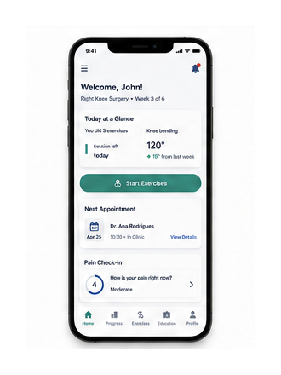
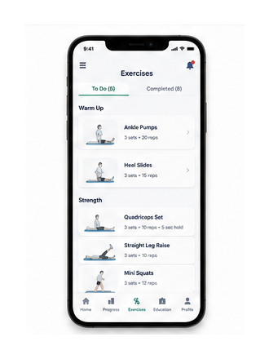
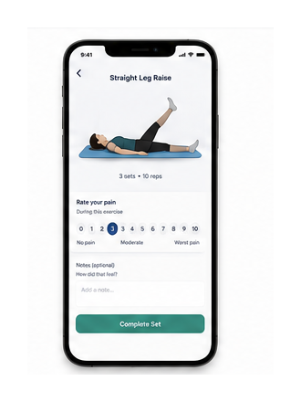
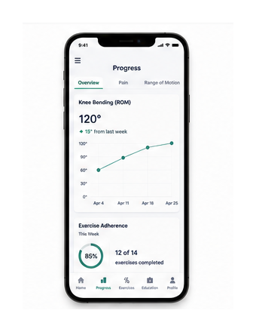
UI DESIGN
Mockups & UI Evolution
Patient-centred design · Redesign based on feedback · Accessibility improvements · Clinical pain tracking · Pain-based exercise skip
Homepage
Exercise List
Exercise Details
Progress
Notes:
5

Slide 6
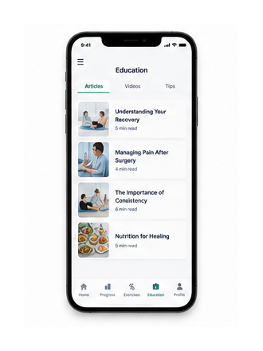
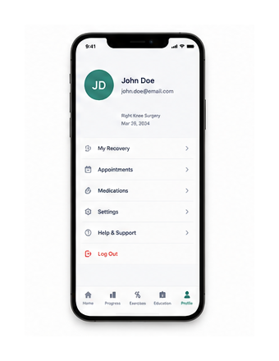
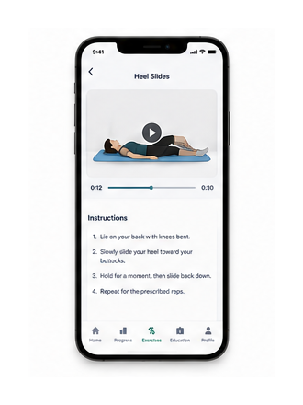
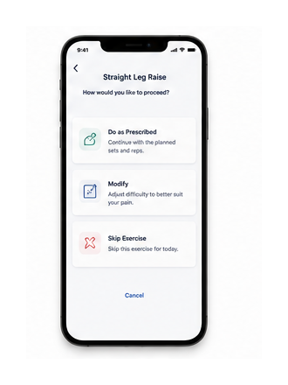
UI DESIGN
Mockups & UI Evolution
Patient-centred design · Redesign based on feedback · Accessibility improvements · Clinical pain tracking · Pain-based exercise skip
🖼️
Insert Mockup
Education
Profile
Video Player
Skip/Modify Exercise
Notes:
6

Slide 7
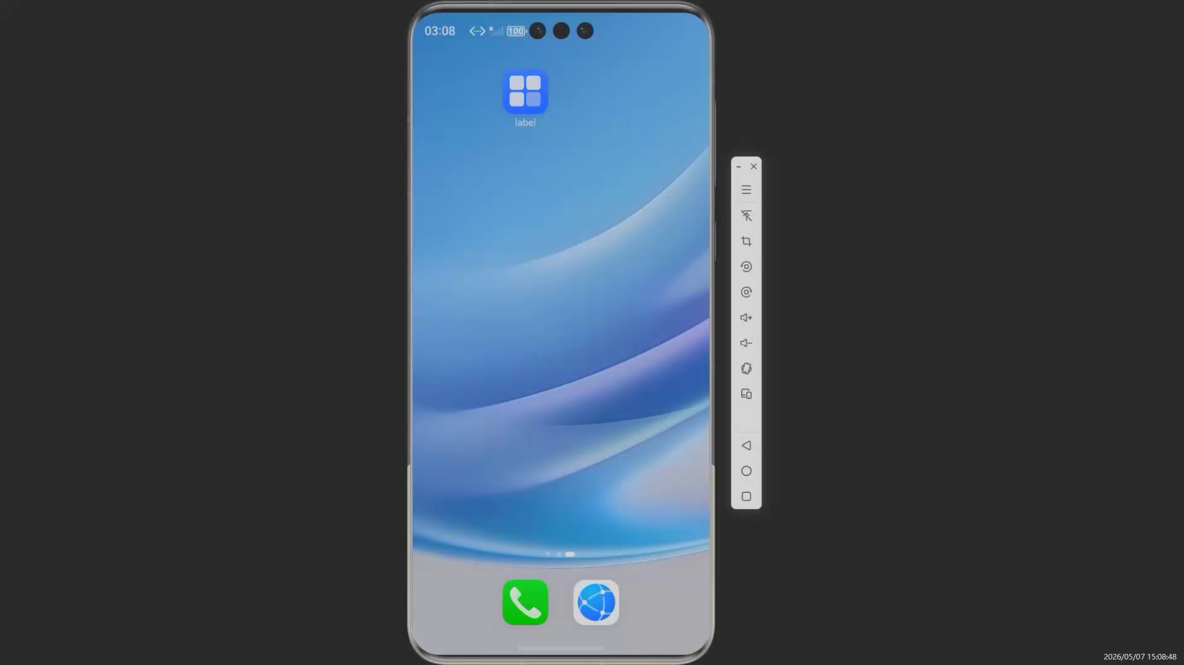
APPLICATION PROTOTYPE
Working Prototype — Current State
Login & Register
Homepage
Exercise Flow
Sensor Connection
Real-Time Exercise
History Page
▶ Insert Prototype Demo Video Here
diogopinhel.github.io/DSD2026_TeamM1/2026/04/29/M1_APP_Prototype_Introduction.html
Notes:
7

Slide 8
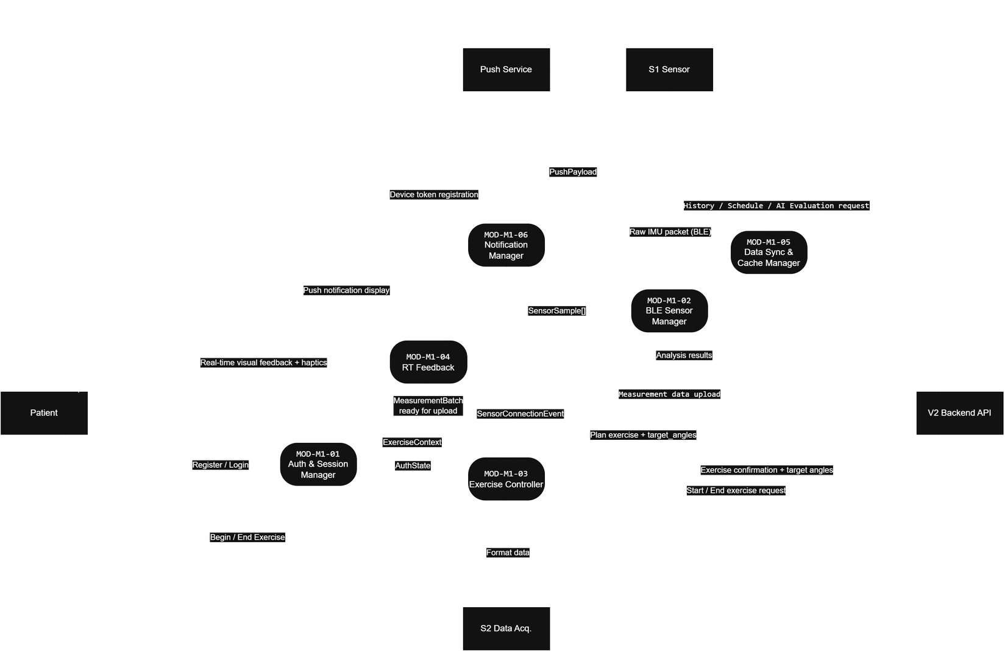
SYSTEM ARCHITECTURE
Internal Data Flow — M1 Modules
MOD-01
Auth & Session Manager
MOD-02
BLE Sensor Manager
MOD-03
Exercise Controller
MOD-04
RT Feedback
MOD-05
Data Sync & Cache
MOD-06
Notification Manager
Notes:
8

Slide 9
PROGRESS SUMMARY
Main Achievements So Far
📄 SRS Documents
🗂️ High-Level Design & DFD
🔌 Interface Specification M1–V2
Created, reviewed and integrated across all teams
Developed and improved after professor & team feedback
Created and updated with confirmed endpoints (S2 & V2)
🎨 Mockups Redesigned
📱 Functional Prototype
🧪 Backend Interface Tested
UI redesign, accessibility improvements, clinical features added
Login, exercise flow, sensor screens, history — in development
V2 interface tested by Wang (initial version)
🤝 Cross-Team Collaboration
🌐 Website / News Updates
📋 Integration SRS
Active cooperation with V2 Backend, S1 and S2 teams
Team site updated to improve communication with all teams
All teams SRS integrated into a single reference document
Notes:
9

Slide 10
ROADMAP — UPCOMING FOCUS
Next Steps
01
Finish Mobile Prototype
02
Integrate V2 Backend
03
Resolve V2 Backend Dependencies
Complete remaining screens and navigation flows
Connect the app to V2 API — auth, exercises, measurements
Identify and align with V2 on missing database parameters, new endpoints and data structures required to support the M1 exercise and patient flows
👤 Enhe
👤 Pinhel + Wang + Enhe
👤 Pinhel + Wang
04
Align with S1 & S2
05
Testing & Bug Fixing
06
Final Demo & Documentation
Discuss and confirm interface usage for sensor data flow
Test the full exercise flow, fix issues, improve UX
Prepare final demo build and complete documentation
👤 Wang
👤 Enhe
👤 All
Notes:
10

Slide 11
DOCUMENTATION & REFERENCES
Links & Resources
Project Website
News & Documents
High-Level Design
🔗 diogopinhel.github.io/DSD2026_TeamM1/
🔗diogopinhel.github.io/DSD2026_TeamM1/news.html
🔗diogopinhel.github.io/DSD2026_TeamM1/2026/05/05/M1-High-Level-Design-V1.2.html
GitHub Repository
Week 4 Tasks
Interface Specification
🔗github.com/diogopinhel/DSD2026_TeamM1
🔗diogopinhel.github.io/DSD2026_TeamM1/2026/04/29/M1_Weekly_Report_W1.html
🔗diogopinhel.github.io/DSD2026_TeamM1/2026/05/05/M1_Interface_Specification.html
Team Members
All SRS Integration
App Prototype
🔗diogopinhel.github.io/DSD2026_TeamM1/team.html
🔗diogopinhel.github.io/DSD2026_TeamM1/2026/05/06/ALL_SRS_v0.2.html
🔗diogopinhel.github.io/DSD2026_TeamM1/2026/04/29/M1_APP_Prototype_Introduction.html
Notes:
11

