Slide 1
FootballDB
Diogo Jesus (97596) Pedro Rodrigues (92338)

Slide 2
Introduction

Slide 3
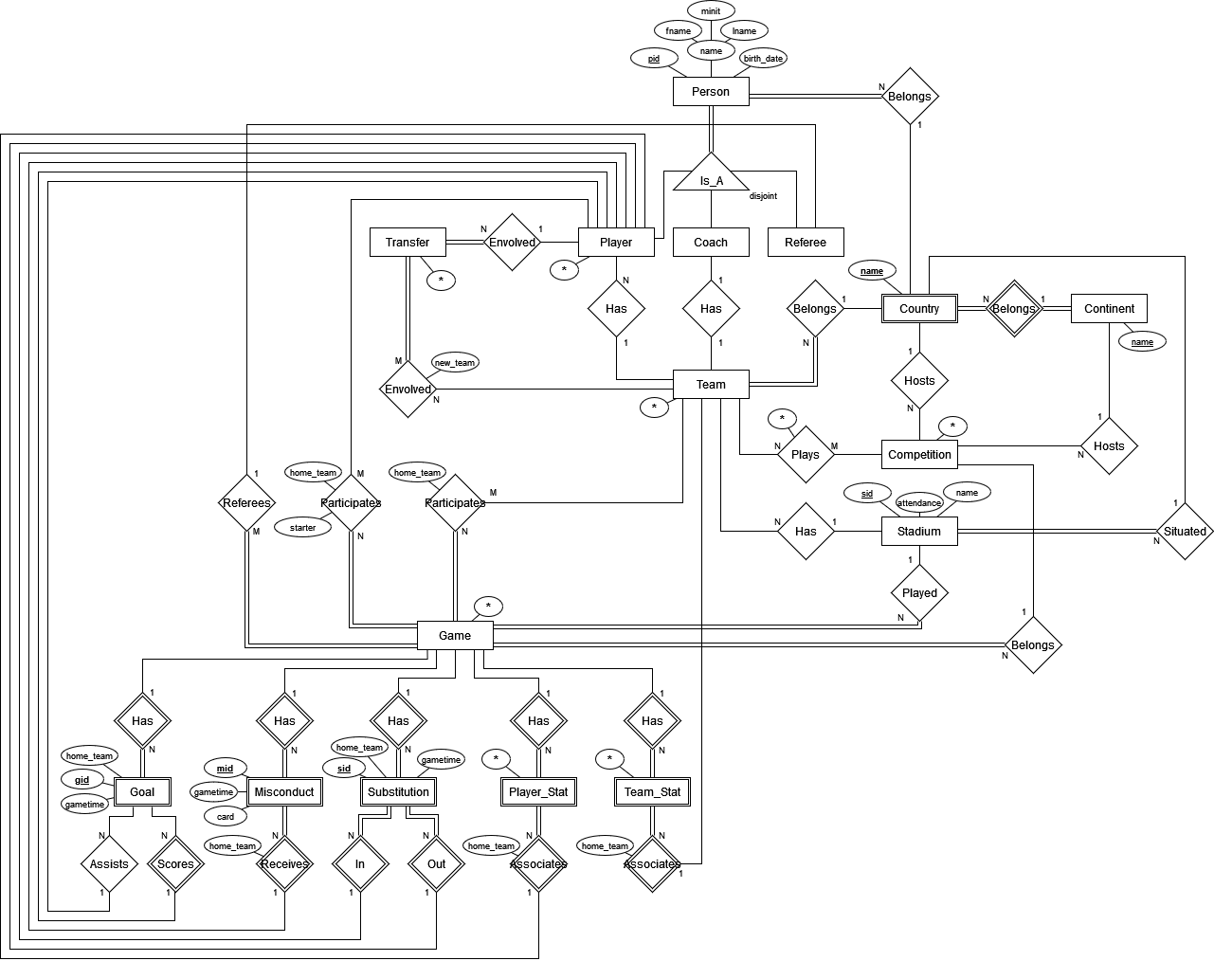
Diagrama Entidade/Relacionamento I

Slide 4
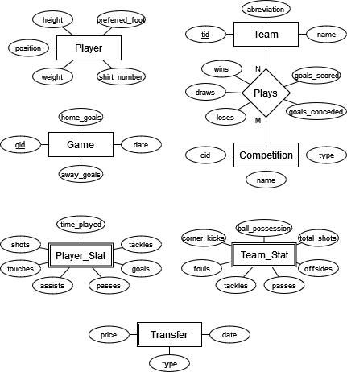
Diagrama Entidade/Relacionamento II

Slide 5
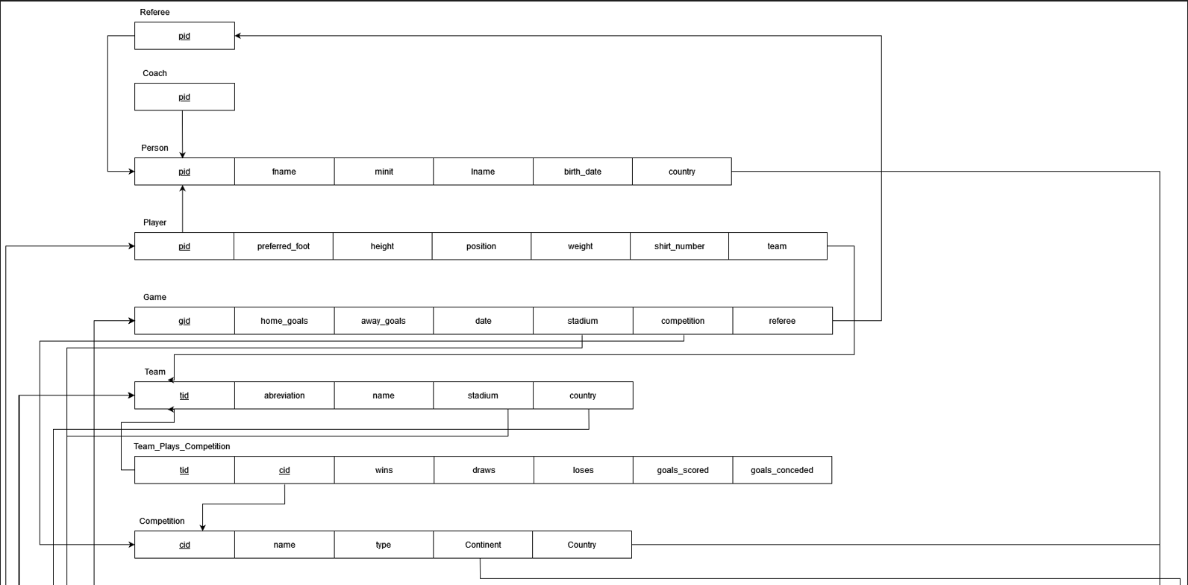
Esquema Relacional I

Slide 6
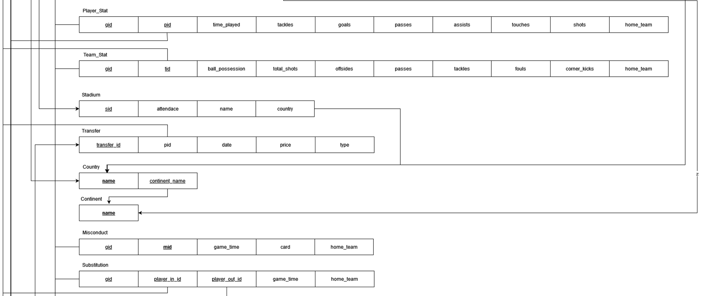
Esquema Relacional II

Slide 7
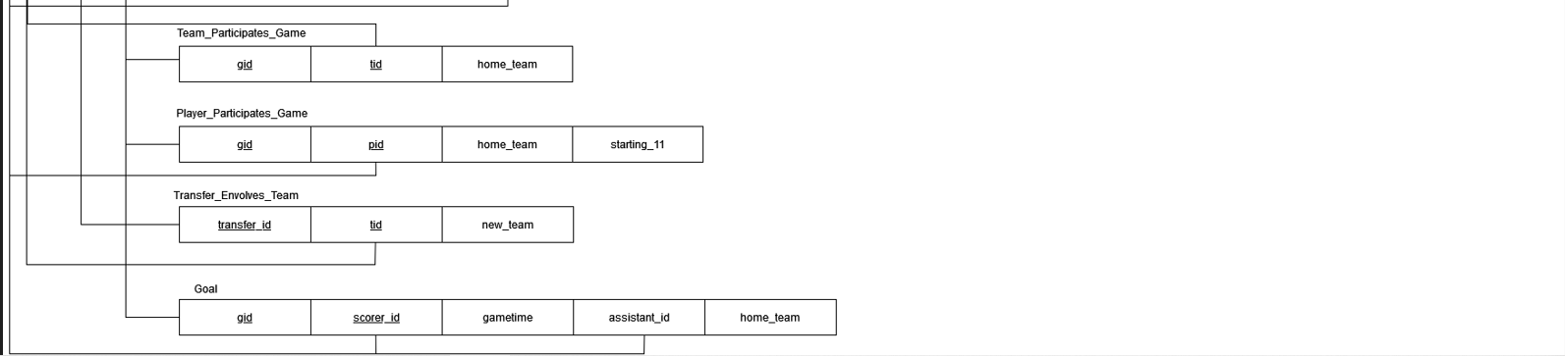
Esquema Relacional III

Slide 8
Normalização
- Após uma análise do sistema e do esquema relacional concluímos que não eram necessárias alterações ao diagrama.

Slide 9
Views
- V_MATCH
- V_TEAM
- V_PLAYER
- V_TEAM_IN_COMPETITION
- V_MISSCONDUCT

Slide 10
Triggers I
-TR_continent –
Prevents from adding new continents.
-TR_country –
Prevents from adding new countrys.
-TR_position –
Prevents from adding new positions.
-TR_foot –
Prevents from adding new preferred foot.
-TR_competition_type –
Prevents from addint new competition types.
-TR_card –
Prevents from adding new cards.

Slide 11
Triggers II
-TR_insert_new_team -
Prevents from adding a new coach that is already coaching another team. Team stadium must be in the same country as the team country.
-TR_associate_team_with_competition –
Team must be in the same country (and continent) as competition. You only can add team and competitions other values are updated according to the data from table GAME.
-TR_insert_new_competition –
Domestic competitions should have a country associated.
- TR_insert_new_player –
Players cannot have the same shirt number.
- TR_insert_new_team_stat–
Team stats are generated automatically based on the player stats.

Slide 12
Stored Procedures
- Procedures:
- Add Games, Add Players, Add Statiumds, etc...
- Get informations about games, players, competitions, etc...
- Remove Games, Remove Players, Remove Stadiums, etc...

Slide 13
User Defined Functions (UDFs)
- Search Fuctions that get arguments:
- UDF_getGameParticipants
- UDF_getPlayerStatByGameAndPlayer
- UDF_getTeamStatByGame

Slide 14
Indexes
- Index in Player(team)
- Index in Team(id)
- Index in Game(id)
- Index in Game(competition)
- Index in Substitution(game)
- Index in MissConduct(game)
- Index in Team_Stat(game)
- Index in Player_Stat(game)

Slide 15
Demonstration

Slide 16
THANKS!
Questions?
Diogo Jesus (97596)
Pedro Rodrigues (92338)

