Slide 1

scene editor with pre-loaded assets
Made by: Diogo Pereira de Jesus (nmec:97596)

Slide 2


Original Idea
Func1
Func2
Func3
Func4
Func5
Func6
Func7
Func8
Button
Button
Button
Button
Button

Slide 3
Idea Re-Evaluated
Scene editor instead of a single plain scene.
Real-time configuration by user (instead of predefined function selection).
Import of different types of assets.

Slide 4
Architecture Design
Two-thread program.
Main thread handles OpenGL context.
Second thread handles user input.
Communication through global variables (r/w only depending on the thread) and Queues.

Slide 5
Architecture Design
Main Thread
init
Secondary Thread
update
read
read
read
Config
Parameters+ Queues
Asset Database
(external)

Slide 6


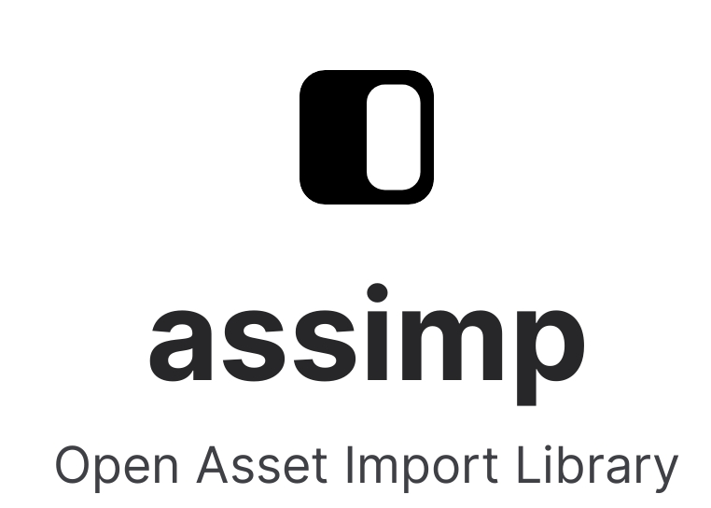



Implementation
Central idea of exploring core OpenGL programming.
Context creation:
Graphical User Interface:
Helper Libraries:

Slide 7
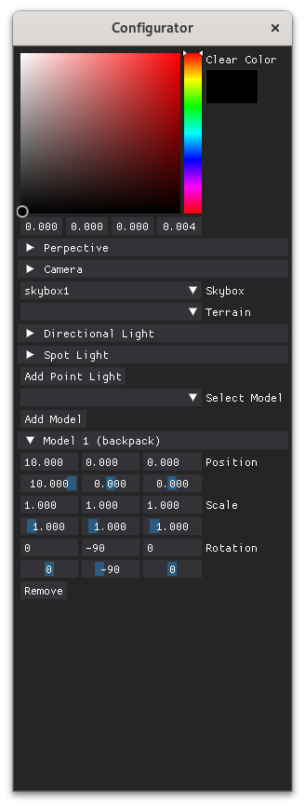
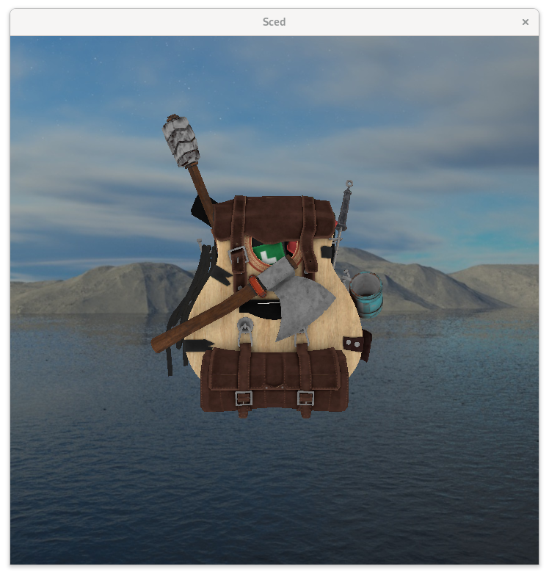
Final Design

Slide 8
Functionalities
Progress bar when loading assets:

Slide 9
Functionalities
Import pre-loaded Models into the scene:

Slide 10
Functionalities
Apply transformations to model:

Slide 11
Functionalities
Manipulate and create different light sources:

Slide 12
Functionalities
Select pre-loaded skybox:

Slide 13
Functionalities
Select terrains based on pre-loaded height maps:

Slide 14
Functionalities
Move and rotate camera along the xyz:

Slide 15
Functionalities
Manipulate perspective projection (frustum):

Slide 16
Functionalities
Export rendered scene to an image:

Slide 17
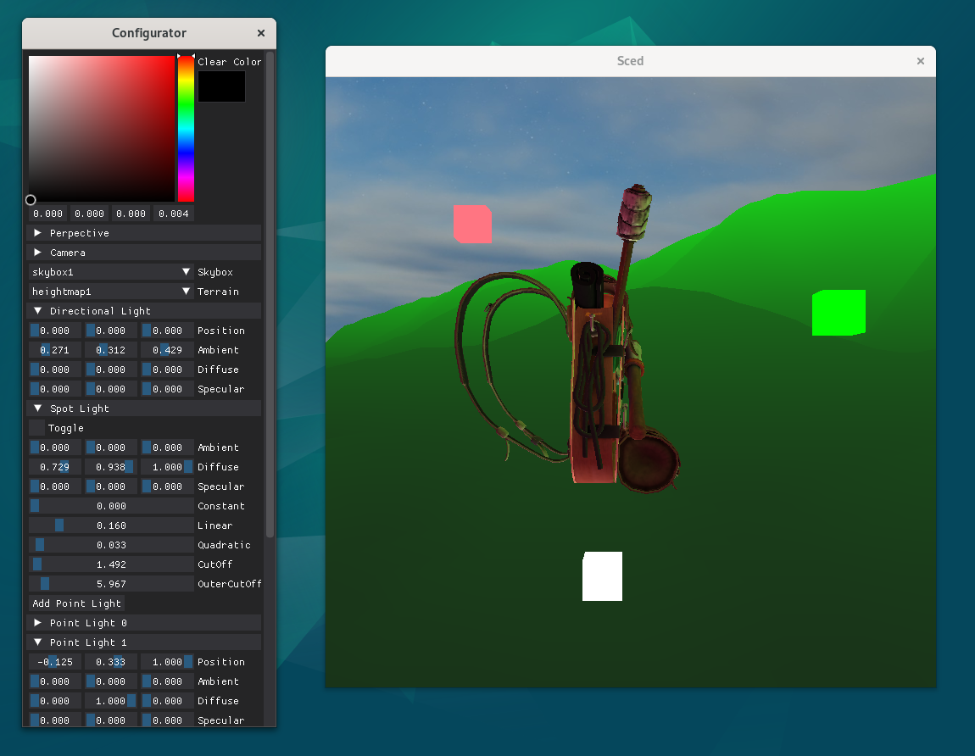
Example Results

Slide 18
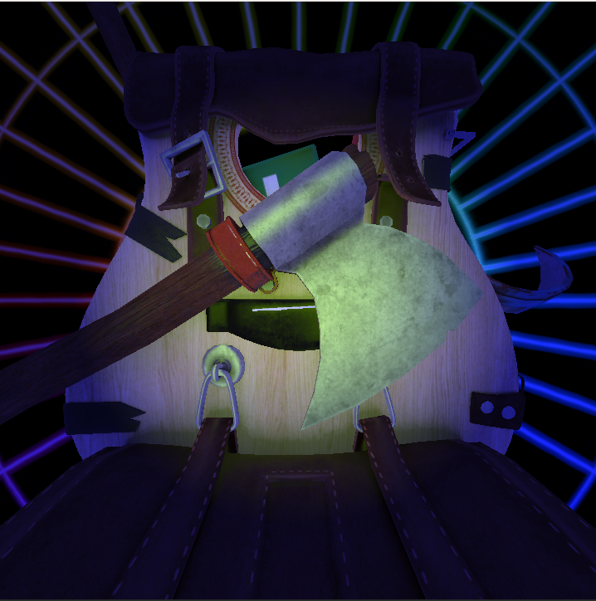
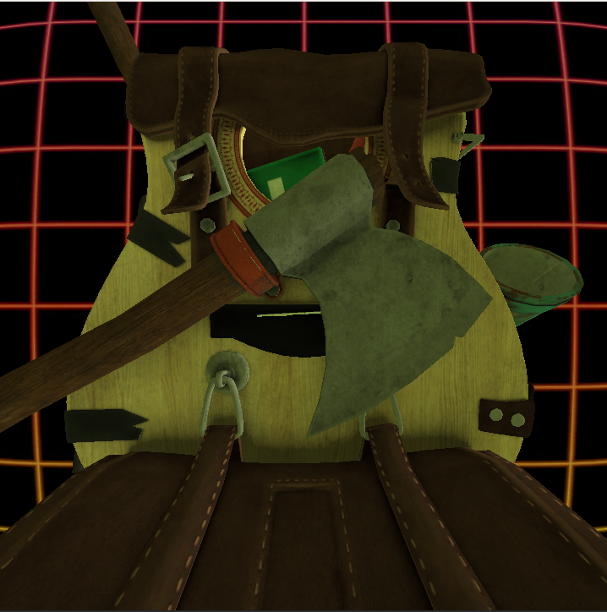
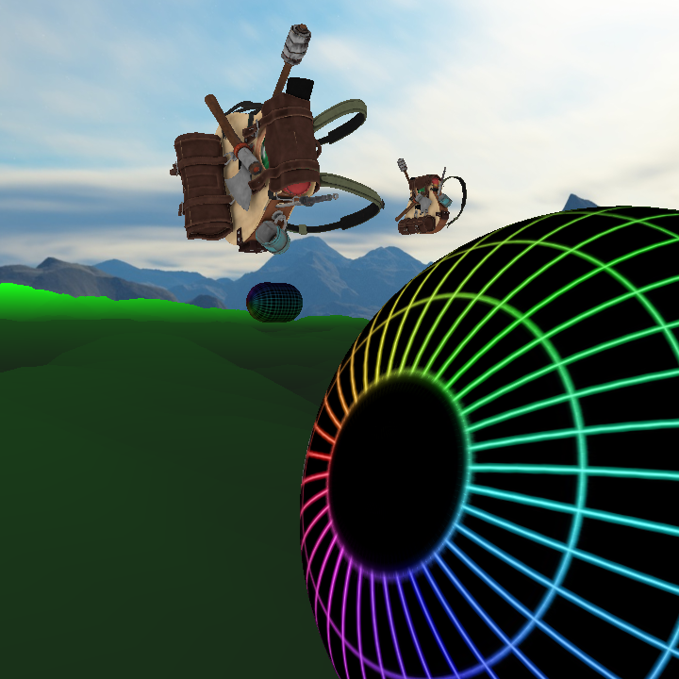
Example Results

Slide 19
Concepts learned
Model loading with OpenGL.
Cubemap creation (more specifically skyboxes)
Terrain generation based on Height-Maps (CPU-Only generation).
Lighting with multiple types of casters.

Slide 20
Limitations
Only one spot light available with position and direction of the camera.
Does not support dynamic loading of assets.
CPU-intensive task of generating terrains.
Lack of manipulation for terrains (due to being pre-loaded).
Cannot save state between executions

Slide 21
Conclusion
This project is a result of many hours of reading through documentations and executing the same tutorials multiple times in order to create something at least usable.
Accomplished some of the proposed goals, but with some clear limitations in the final result.

Slide 22
References
https://learnopengl.com/
https://docs.gl/
https://ogldev.org/
https://dearpygui.readthedocs.io/
Etc,etc,etc (more documentation)

