Slide 1
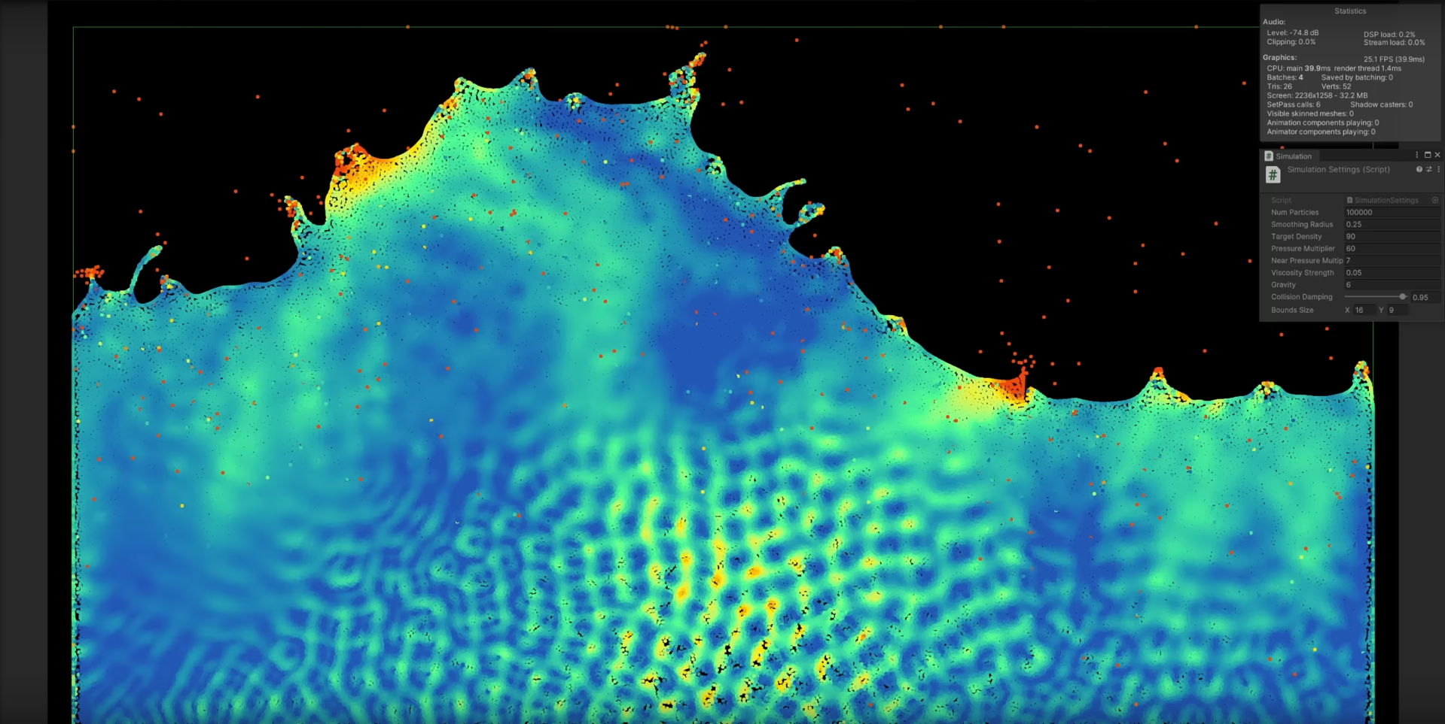
Objective
  Create a GUI application to present in real-time some functionalities of computer graphics.
Fig.1 – Main inspiration to this project. Fluid simulation created by Sebastian Lague with interactivity parameters as gravity and fluid density.

Slide 2
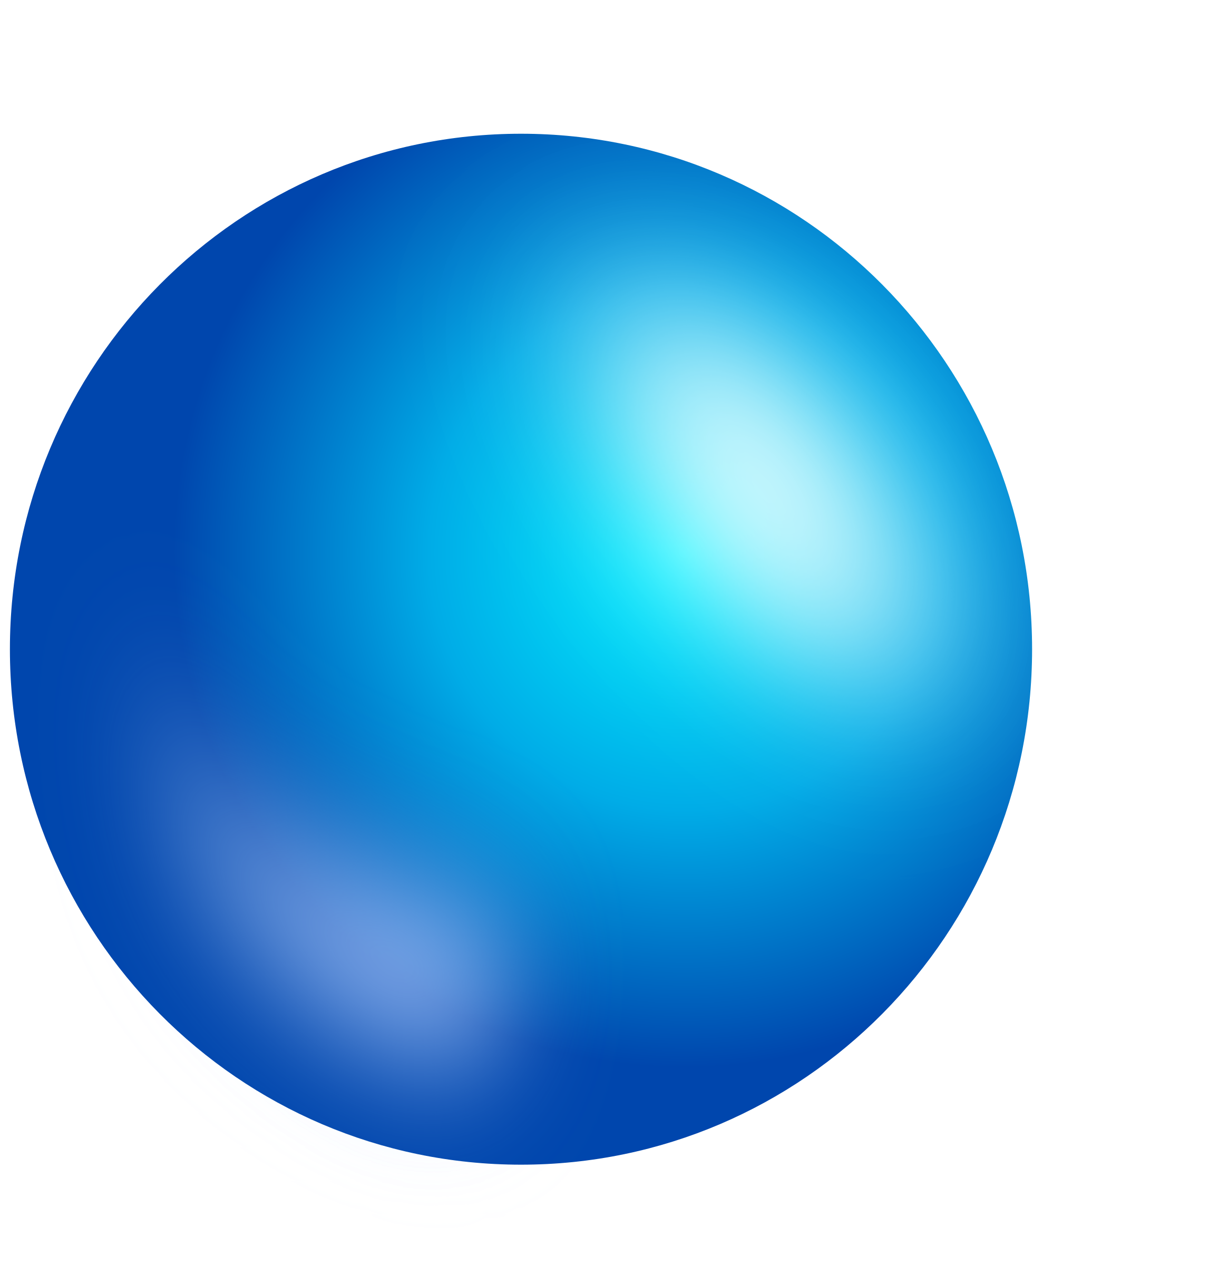
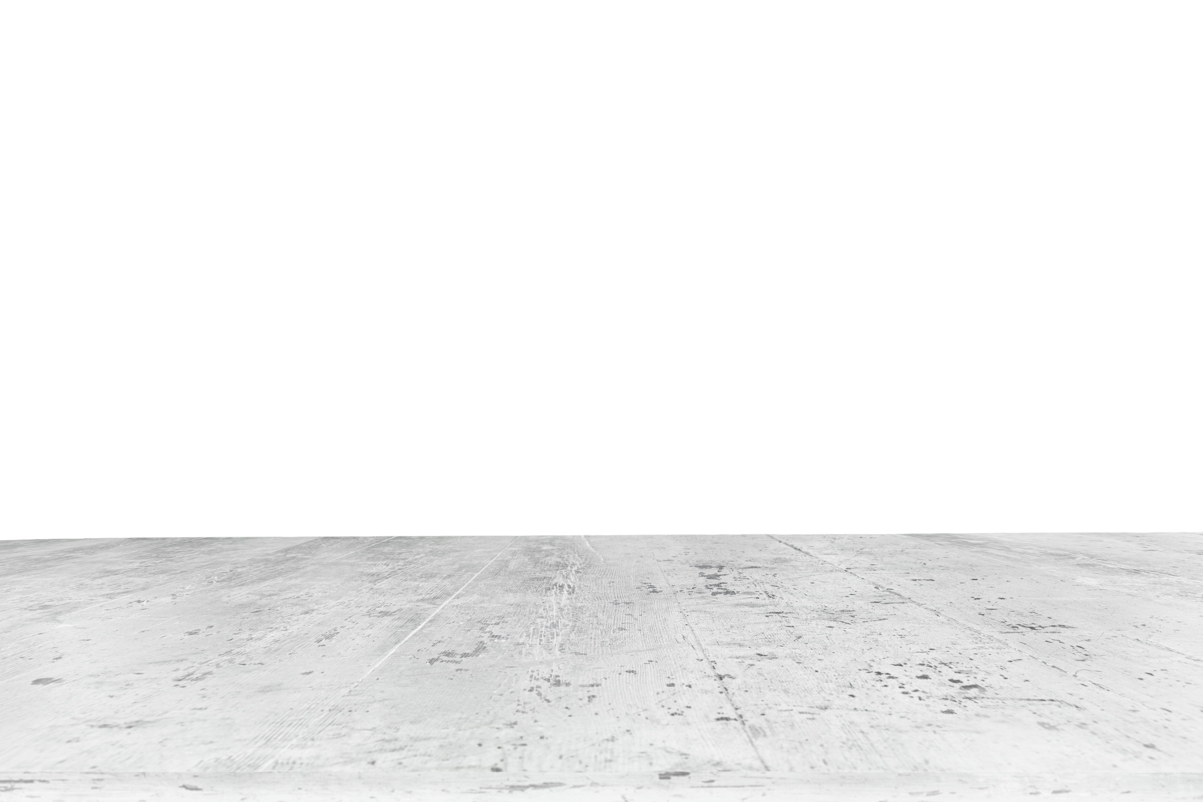
Design
One plane centered on a 3D model (sphere).
A side bar presenting multiple transformations.
Func1
Func2
Func3
Func4
Func5
Func6
Func7
Func8
Button
Button
Button
Button
Button

Slide 3
Graphical Transformations
  Move the light source around the model.
  Move the camera around the model.
  Change between projections (parallel and perspective).
  Change between types of shading (flat, goraud, phong, etc).
  Control the number of vertices on the sphere (decimation of the model).
  Control scaling of the model.
  Apply noise to the model. Checkbox to enable/disable Gaussian smoothing.
  Remove the model and apply a texture to the floor. Change between different texture filters.
  Per review: Create a secondary point-of-view to observe the frustum of the main camera.
  Per review: Create a closed box around the model and apply ray tracing.

Slide 4
Development
Interactivity and visualization will be handled through PyGame.
Computations related to graphical transformations in the pane will be developed with PyOpenGL.

