Slide 1

IRONHACK · 2025
FAKE NEWS CLASSIFIER
Presented by
Diogo Simoes, Keberth Rodriguez & Javier Garcia

Slide 2
Intro
  A Machine Learning Approach to Detecting Real vs Fake News
  Your Name · Ironhack · 2025
  Fake news influences elections and public opinion.
  Goal: Build a model that classifies news headlines as real or fake.
  Achieved high accuracy using classical ML techniques.
Notes:
we are presenting a machine learning mini project on fake news detection.
Fake news spreads extremely fast online and can influence politics, finance, and public behavior.
our goal here was to build a model that can automatically classify a news headline as real or fake based
only on text.
The project includes understanding the dataset, preprocessing the text, selecting and comparing
models, tuning hyperparameters, and finally generating predictions for a separate test file.
By the end, we reach a very strong 94.7% accuracy using a clean and efficient ML pipeline.

Slide 3
Problem Definition
Distinguish between real and fake news using short headlines.
Headlines are emotional, political, and ambiguous.
Output: predictions for testing.csv in the correct format.
Notes:
The challenge lies in the nature of the data: headlines are short, often emotional, and sometimes
intentionally ambiguous.
Fake news writers purposely copy the writing style of real news to appear credible, so the model must
learn very subtle differences in language patterns.
The main task was to train a classifier using the provided training data and then predict unknown labels
in the test dataset.
A key requirement from the brief is maintaining the exact CSV structure when submitting predictions.

Slide 4
Dataset Overview
  34,152 labeled headlines (0=fake, 1=real).
  9,984 test headlines (label 2 = unknown).
  Balanced classes and short, political text.
Notes:
The training dataset contains over 34k headlines, split evenly between real and fake. This balance is
important because models trained on imbalanced data can become biased.
The test dataset contains nearly 10k headlines, but all labels are marked as ‘2’, which actually means
‘unknown’. Our job is to replace these with 0 or 1 using the trained model.
Most headlines are short, usually under 12 words, which means we need features that work well for
compact text. We also see that political language dominates — Trump, government, decisions,
scandals — which helps the model learn domain-specific patterns

Slide 5
Preprocessing Pipeline
  Lowercasing and tokenization.
  Removing punctuation and English stopwords.
  TF-IDF vectorization with 1–2 grams.
  Lemmatization was tested but optional.

Slide 6
Feature Engineering
  TF-IDF chosen as main representation.
  ngram_range = (1, 2), max_df = 0.90, min_df = 5.
  Captures important words and short expressions.
  20,000 max features

Slide 7
Models Tested
  Logistic Regression
  Linear SVC
  Multinomial Naive Bayes
  Random Forest
  RandomizedSearchCV for tuning.

Slide 8
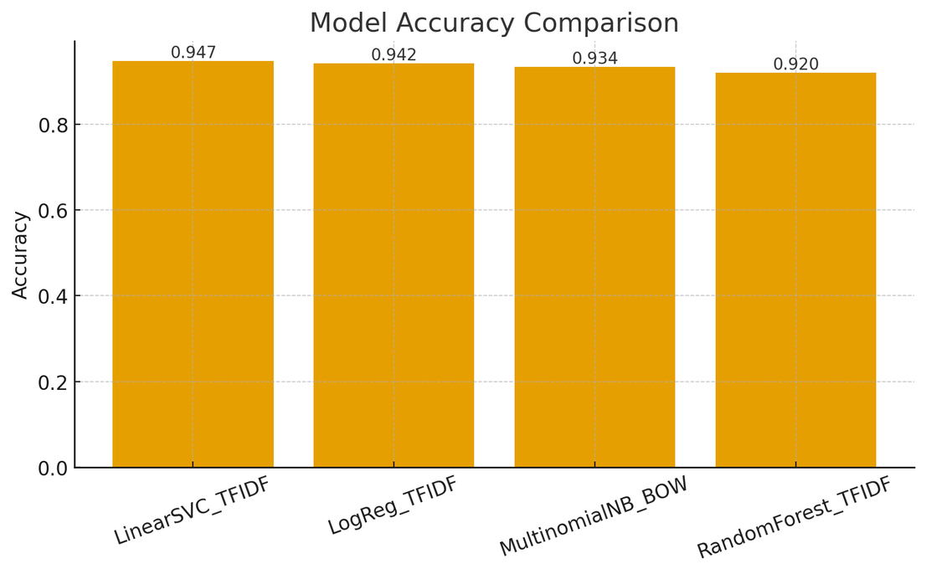
Model Comparison
  Linear SVC: 94.69%.
  Naive Bayes and Random Forest lower.

Slide 9
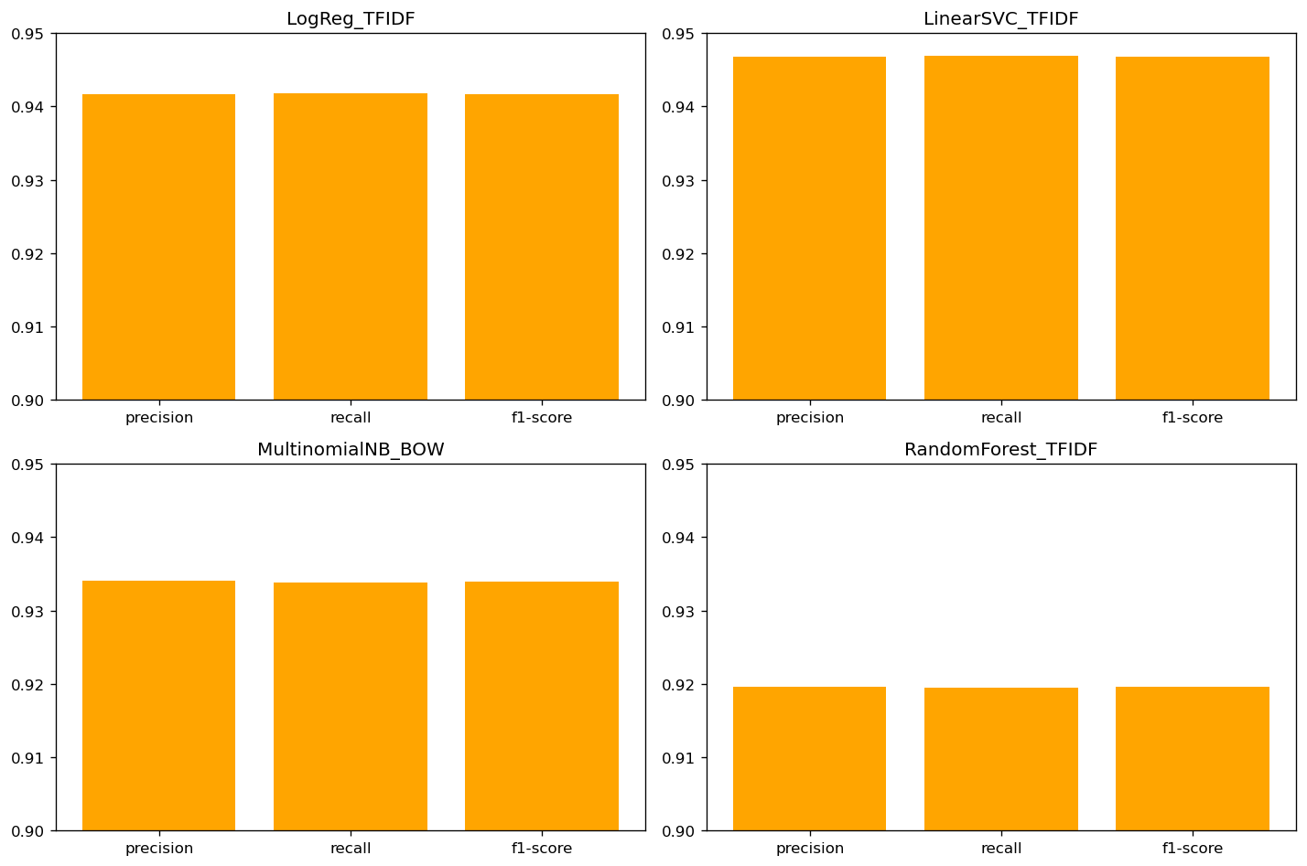

Slide 10

Thank You!

