Slide 1


NetShop
Best car shop ever!

Slide 2

WHY NETSHOP?
It is excelent way to practise in developing something from rhe bebinning;
NetShop is using three tier architecture;
We by urselves can select what to sell and how to sell it;

Slide 3

HOW WAS IT?
Planning stage
Installing software stage
Database stage
Implementation stage
Refactoring stage
Interface stage
Testing stage

Slide 4
PLANNING STAGE
We have developed our own work plan
We decided what we will do step by step

Slide 5
INSTALLING SOFTWARE
Jetty or Tomcat
Eclipse or NetBeans
MySQL or Oracle

Slide 6
DATABASE STAGE
Creating structure of database
Creating tables and fields
Filling in database

Slide 7
IMPLEMENTATION STAGE
Creating classes for database
Creating methods for classes
Trying to check our method workability

Slide 8
REFACTORING STAGE
Rewriting code adding spring
and hybernate support

Slide 9
INTERFACE STAGE
What pages will be made and how will they look like
Writing front-end
Checking is everything looks like it was conceived
Checking that front-end is compatible with back-end

Slide 10
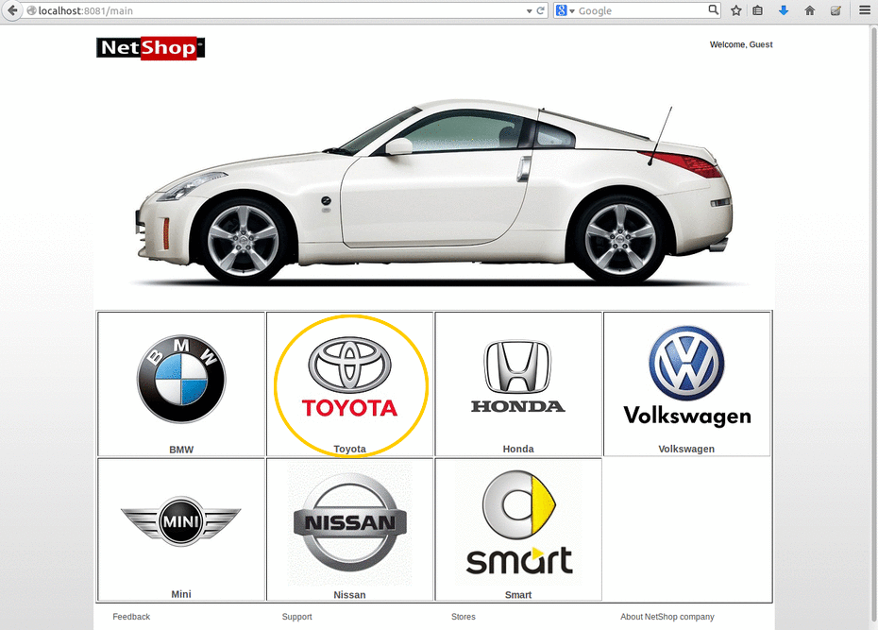
MAIN PAGE
Writing Selenium tests
Writing Mockito tests
Running tests
Running tests after changing source code

Slide 11
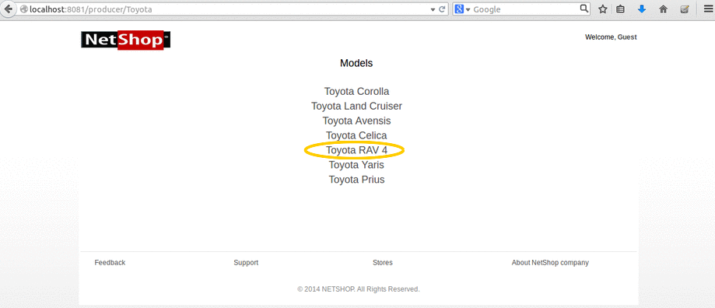
SELECT
MODEL
Writing Selenium tests
Writing Mockito tests
Running tests
Running tests after changing source code

Slide 12
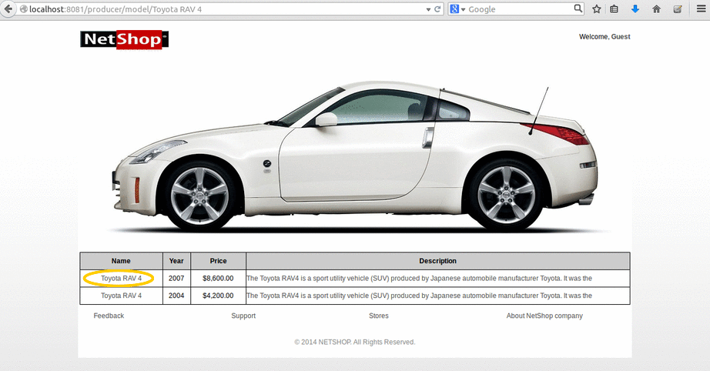
SELECT
Writing Selenium tests
Writing Mockito tests
Running tests
Running tests after changing source code

Slide 13
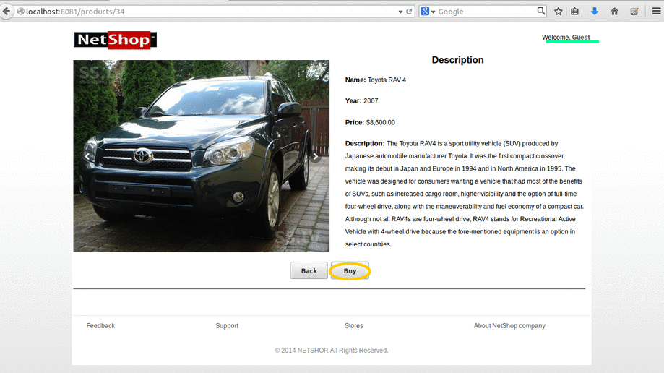
REVIEW CAR
Writing Selenium tests
Writing Mockito tests
Running tests
Running tests after changing source code

Slide 14
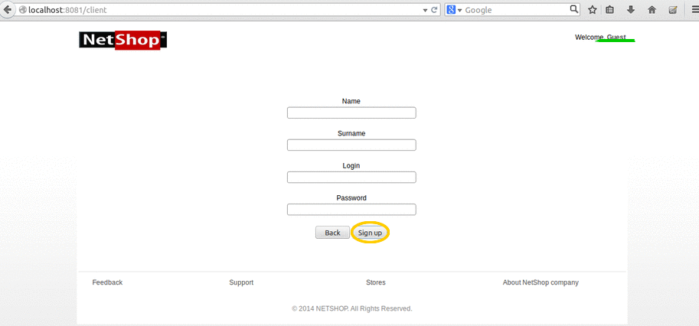
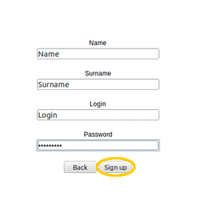
FILL IN AND REGISTER
Writing Selenium tests
Writing Mockito tests
Running tests
Running tests after changing source code

Slide 15
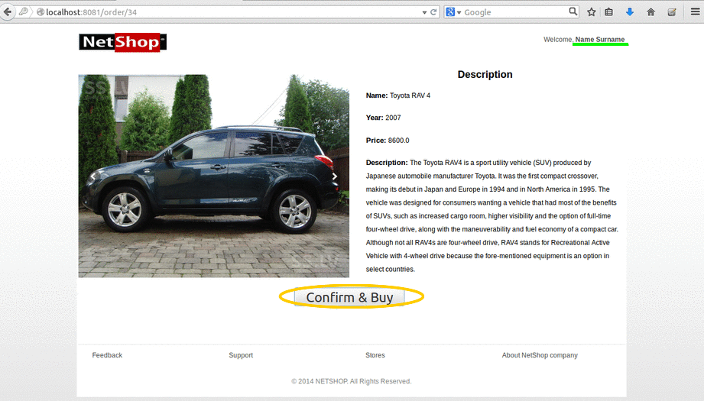
CONFIRM YOUR CAR
Writing Selenium tests
Writing Mockito tests
Running tests
Running tests after changing source code

Slide 16
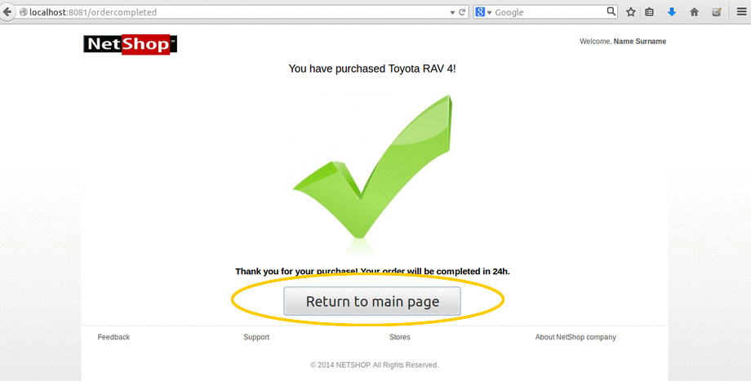
ORDER COMPLETED
Writing Selenium tests
Writing Mockito tests
Running tests
Running tests after changing source code

Slide 17
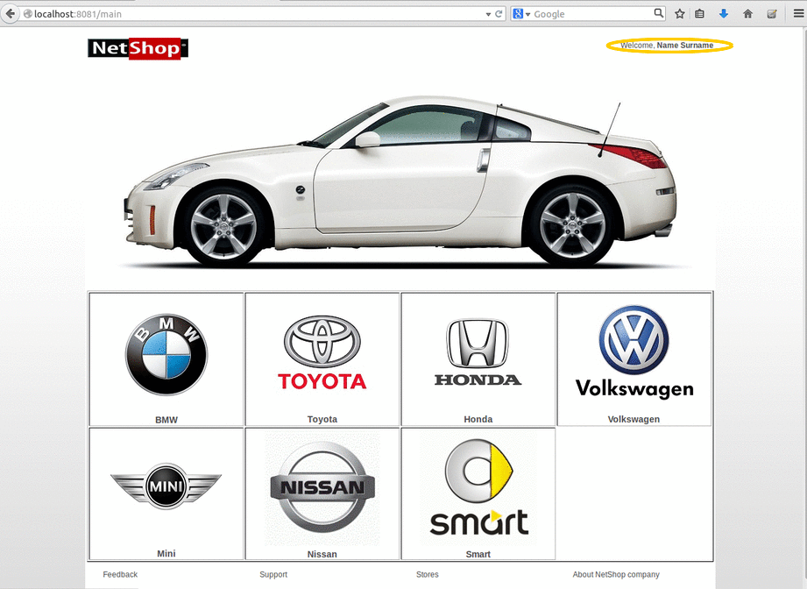
CONTINUE SHOPPING
Writing Selenium tests
Writing Mockito tests
Running tests
Running tests after changing source code

Slide 18
TESTING STAGE STAGE
Writing Selenium tests
Writing Mockito tests
Running tests
Running tests after changing source code

Slide 19
SOME WORDS ABOUT PROJECT
Short term performance
Huge amount of new information
Lots of errors and error fixes

Slide 20
In conclusion
Things thar are learned: ….
If we had more time, we would ….

Slide 21

Thank you for your attention!

