Slide 1
Uncertainty Lecture 1: Non probabilistic decision theory and the rise of classical probability
Diomides Mavroyiannis, 2022

Slide 2
Plan
Probability is the building block of statistics
Non probabilistic decision making.
Principle of indifference
Combinations and permutations

Slide 3
Calculating without probabilities
Max/ Min
The biggest/smaller
Order
Pick the second one
Maxmin
Pick the action that has the highest minimum
Lexicographic Maxmin
Like maxmin but if two are equal the check the next smallest in those two
Regret Minimization
Do a minmax but construct a regret table first

Slide 4
Regret table
Return | Interest Rates rise | Static rates | Interest rates fall | Worst return
Stocks | -4 | 4 | 12 | -4
Bonds | -2 | 3 | 8 | -2
Money Market | 3 | 2 | 1 | 1
Best Return | 3 | 4 | 12
Subtract the best return from each column to construct the regret table
Regret | Interest rates rise | Static rates | Interest rates fall | Worst regret
Stock | 7 | 0 | 0 | 7
Bonds | 5 | 1 | 4 | 5
Money Market | 0 | 2 | 11 | 11

Slide 5
What is a probability?
It is a measure, such as length or weight
It is a number ranging from 0 to 1
Two kinds
Discreet
Can be listed
Easier to map to real world
Continuous
Infinite possibilities
Better for proving theorems

Slide 6
Laplace
We ought then to regard the present state of the universe as the effect of its anterior state and as the cause of the one which is to follow. Given for one instant an intelligence which could comprehend all the forces by which nature is animated and the respective situation of the beings who compose it – an intelligence sufficiently vast to submit these data to analysis – it would embrace in the same formula the movements of the greatest bodies of the universe and those of the lightest atom; for it, nothing would be uncertain and the future, as the past would be present to its eyes.
-- (1814:4) Laplace
Extrapolating from this success, it was natural to suppose that a sufficiently vast intelligence could calculate the entire future course of the universe. Laplace himself relates his vast intelligence to human successes in astronomy. As he says: The human mind offers, in the perfection which it has been able to give to astronomy, a feeble idea of this intelligence. Its discoveries in mechanics and geometry, added to that of universal gravity, have enabled it to comprehend in the same analytical expressions the past and future states of the system of the world.
-- (1814:4) Laplace

Slide 7
Origin 2
The curve described by a simple molecule of air or vapor is regulated in a manner just as certain as the planetary orbits; ...
-- (1814:6) Laplace
would embrace in the same formula the movements of the greatest bodies of the universe and those of the lightest atom
-- (1814:4) Laplace

Slide 8
The principle of indifference
The curve described by a simple molecule of air or vapor is regulated in a manner just as certain as the planetary orbits; the only difference between them is that which comes from our ignorance.
Probability is relative, in part to this ignorance, in part to our knowledge.
We know that of three or a greater number of events a single one ought to occur; but nothing induces us to believe that one of them will occur rather than the others. In this state of indecision, it is impossible for us to announce their occurrence with certainty.
-- (1814:6) Laplace

Slide 9
The principle of indifference 2
In a completely deterministic system, probabilities cannot be inherent in objective nature but must be relative to human ignorance. Suppose in a particular situation there seem to be three possible outcomes, A, B or C. Because of universal determinism, one of these (A say) must occur, and Laplace’s demon would be able to foresee the occurrence of A. However, if we humans do not know enough about either the laws of nature or the initial conditions, or both, we may not be able to predict which of A, B or C will occur. In this situation we have to have recourse to the calculus of probabilities.

Slide 10
Von Mises Counter-example
Classical theory can’t deal with a biased die
Even though Laplace does deal with biased die in his mathematical theory, his philosophical theory fails to take it into account
But how are we to deal with the problem of a biased die by means of a theory which knows only probability based on a number of equally likely results?; ...
-- (1928:69) Von Mises

Slide 11
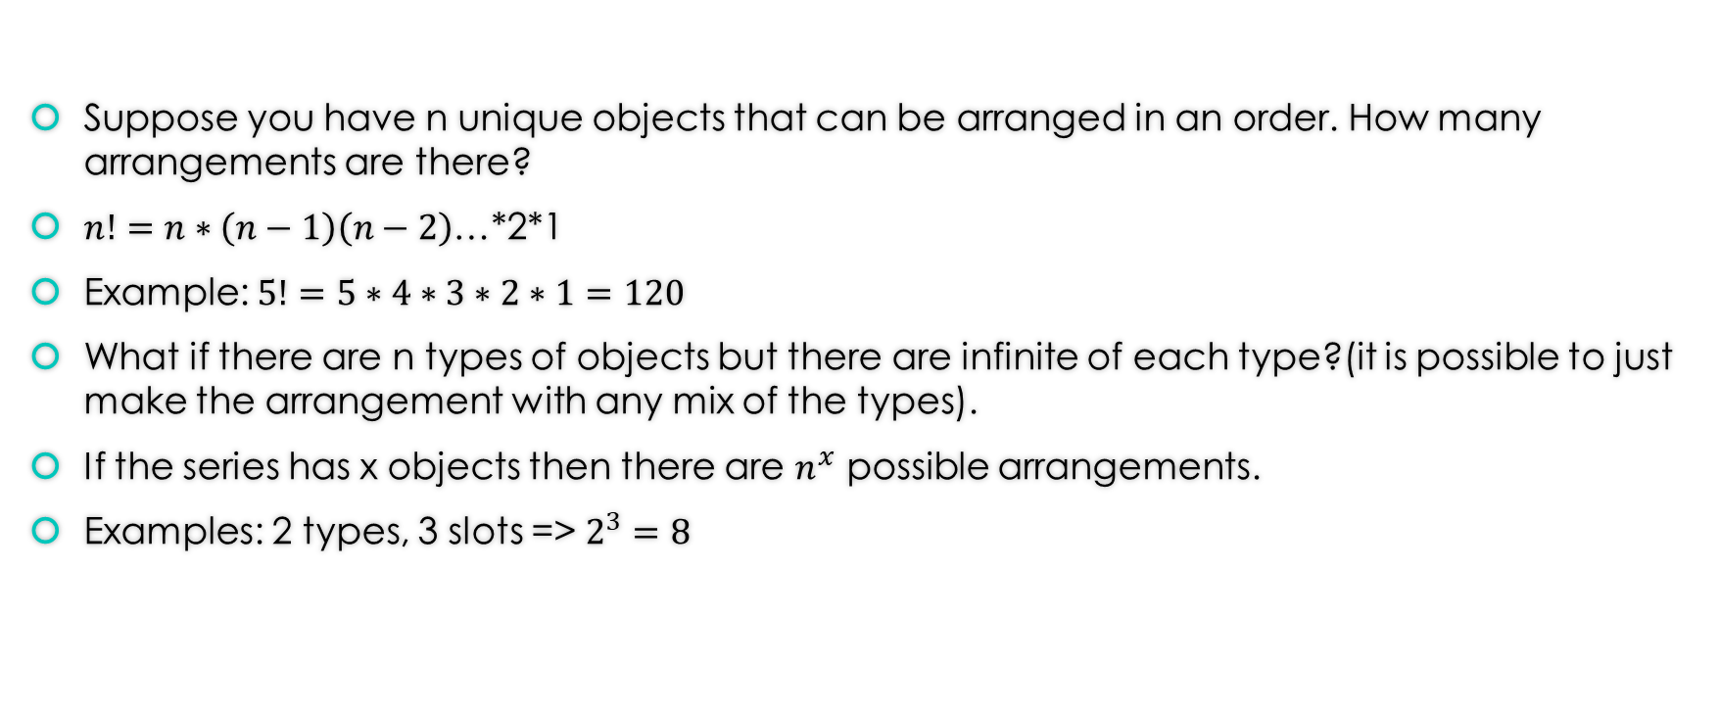
Permutation
Suppose you have n unique objects that can be arranged in an order. How many arrangements are there?
$n!=n∗\left(n−1\right)\left(n−2\right)$…*2*1
Example: $5!=5∗4∗3∗2∗1=120$
What if there are n types of objects but there are infinite of each type?(it is possible to just make the arrangement with any mix of the types).
If the series has x objects then there are $n^{x}$ possible arrangements.
Examples: 2 types, 3 slots => $2^{3}=8$

Slide 12
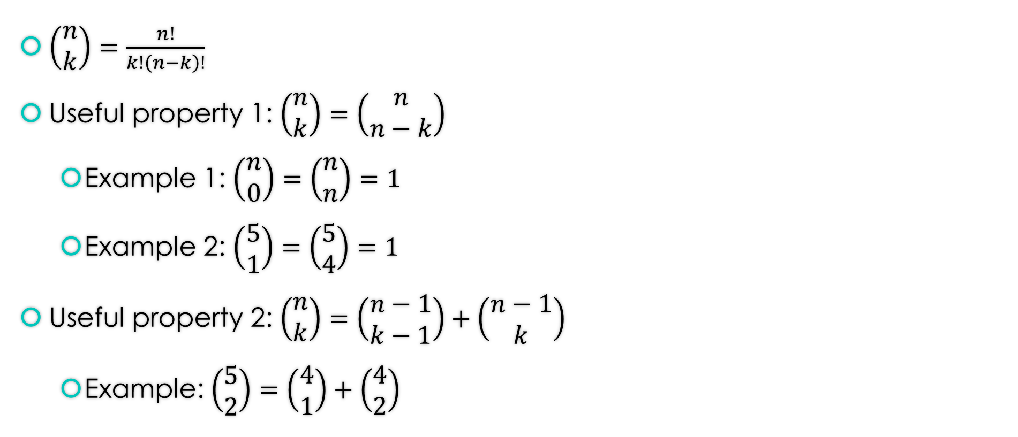
Combination without repetition
$\left(\begin{matrix}n \\ k\end{matrix}\right)=\frac{n!}{k!\left(n−k\right)!}$
Useful property 1: $\left(\begin{matrix}n \\ k\end{matrix}\right)=\left(\begin{matrix}n \\ n−k\end{matrix}\right)$
Example 1: $\left(\begin{matrix}n \\ 0\end{matrix}\right)=\left(\begin{matrix}n \\ n\end{matrix}\right)=1$
Example 2: $\left(\begin{matrix}5 \\ 1\end{matrix}\right)=\left(\begin{matrix}5 \\ 4\end{matrix}\right)=1$
Useful property 2: $\left(\begin{matrix}n \\ k\end{matrix}\right)=\left(\begin{matrix}n−1 \\ k−1\end{matrix}\right)+\left(\begin{matrix}n−1 \\ k\end{matrix}\right)$
Example: $\left(\begin{matrix}5 \\ 2\end{matrix}\right)=\left(\begin{matrix}4 \\ 1\end{matrix}\right)+\left(\begin{matrix}4 \\ 2\end{matrix}\right)$

Slide 13
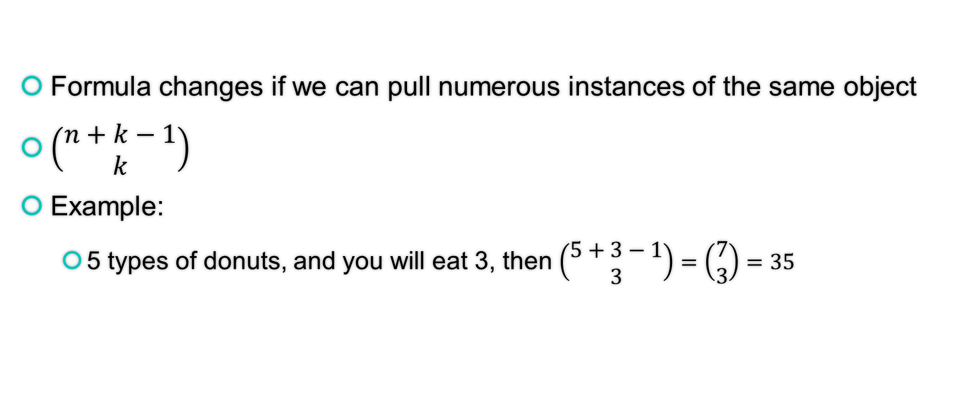
Combination with repetition
Formula changes if we can pull numerous instances of the same object
$\left(\begin{matrix}n+k−1 \\ k\end{matrix}\right)$
Example:
5 types of donuts, and you will eat 3, then $\left(\begin{matrix}5+3−1 \\ 3\end{matrix}\right)=\left(\begin{matrix}7 \\ 3\end{matrix}\right)=35$

Slide 14
Play around with the following link
https://www.hackmath.net/en/calculator/combinations-and-permutations?n=7&k=3&order=0&repeat=0

