Slide 1
Uncertainty
Diomides Mavroyiannis, 2022

Slide 2
Risk and uncertainty plan
Risk and uncertainty: Classical probability
Random variables
Utility
Conditional probability: Bayes
Ambiguity
Rational Risk seeking behavior
Probability as frequency
A brief survey of approaches to statistics

Slide 3
Teaching approach: Popperian
Start with a problem or paradox
Ask students why this might be an important problem.
Give standard answers why the problem is important
Explain that a solution is often not just a question of calculation but about using the appropriate categories.

Slide 4
Who is this for?
Philosophy: Those who want to have a more rigorous understanding of epistemology
Economics; Building blocks for modelling agents
Mathematics: The basics of probabilistic modelling
Neuroscience and Cognitive Sciences: How do we model agents making decisions?
Computer science: How can computers make decisions using the same framework?
Humanities: General understanding of how we model decision making

Slide 5
Example: Risk vs Uncertainty
Allais and Ellsberg
If we assume people are acting with a probability in mind we have an incoherence about how people assign value.
If the probability is incomplete, the paradox is resolved.

Slide 6
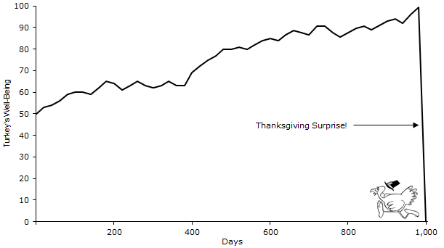
Example: The Turkey problem
Data is often insufficient
The question: is there convergence?

Slide 7
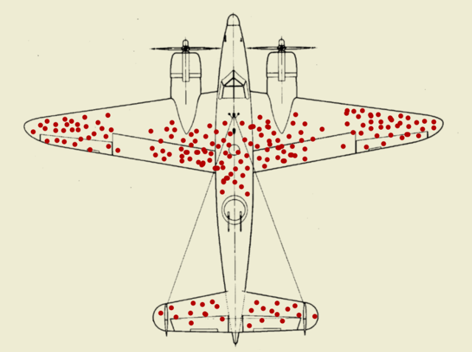
Causal: What can we infer from this picture?

Slide 8
Assessment Types and Weighting
Group Weekly assignments (30%): a few simple questions about the current class material, 8 question sets in total
Individual Quiz(30%): a few quiz questions where students can apply their knowledge
Exam (30%): A written exam the week after the last class of the term from the material of the term.
Overall performance (10%): active presence at classes and quality of assignments are rewarded.

