Slide 1
Econometrics Lecture 2: Functions of two random variables
Diomides Mavroyiannis, 2022

Slide 2
Association
In popular culture the term correlation is used to denote relationship
Association is the word use by statisticians to signify ANY relationship
The main measures of association are:
Covariance
Pearson Correlation
Spearman Rank Correlation
Co-integration and other Non-Linear measures

Slide 3
Joint Probability of two die
X\Y | 1 | 2 | 3 | 4 | 5 | 6
1 | 1/36 | 1/36 | 1/36 | 1/36 | 1/36 | 1/36
2 | 1/36 | 1/36 | 1/36 | 1/36 | 1/36 | 1/36
3 | 1/36 | 1/36 | 1/36 | 1/36 | 1/36 | 1/36
4 | 1/36 | 1/36 | 1/36 | 1/36 | 1/36 | 1/36
5 | 1/36 | 1/36 | 1/36 | 1/36 | 1/36 | 1/36
6 | 1/36 | 1/36 | 1/36 | 1/36 | 1/36 | 1/36

Slide 4
Marginal PDF
X\T | 2 | 3 | 4 | 5 | 6 | 7 | 8 | 9 | 10 | 11 | 12
1 | 1/36 | 1/36 | 1/36 | 1/36 | 1/36 | 1/36 | 0 | 0 | 0 | 0 | 0
2 | 0 | 1/36 | 1/36 | 1/36 | 1/36 | 1/36 | 1/36 | 0 | 0 | 0 | 0
3 | 0 | 0 | 1/36 | 1/36 | 1/36 | 1/36 | 1/36 | 1/36 | 0 | 0 | 0
4 | 0 | 0 | 0 | 1/36 | 1/36 | 1/36 | 1/36 | 1/36 | 1/36 | 0 | 0
5 | 0 | 0 | 0 | 0 | 1/36 | 1/36 | 1/36 | 1/36 | 1/36 | 1/36
6 | 0 | 0 | 0 | 0 | 0 | 1/36 | 1/36 | 1/36 | 1/36 | 1/36 | 1/36

Slide 5
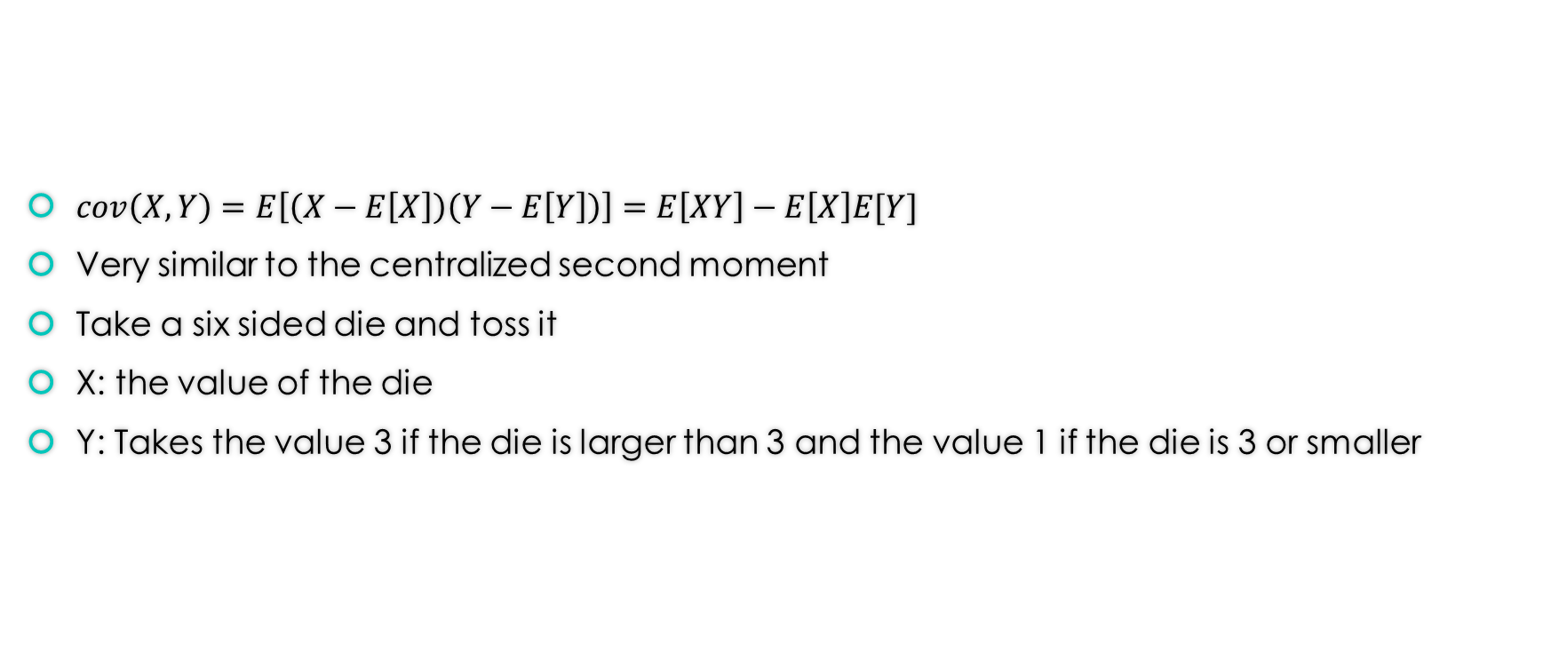
Covariance
$cov\left(X,Y\right)=E\left[\left(X−E\left[X\right]\right)\left(Y−E\left[Y\right]\right)\right]=E\left[XY\right]−E\left[X\right]E[Y]$
Very similar to the centralized second moment
Take a six sided die and toss it
X: the value of the die
Y: Takes the value 3 if the die is larger than 3 and the value 1 if the die is 3 or smaller

Slide 6

Covariance Example
Expected value of X = 3.5, expected value of Y = 2
$\frac{1}{6}\left(1∗1\right)+\frac{1}{6}\left(2∗1\right)+\frac{1}{6}\left(3∗1\right)+\frac{1}{6}\left(4∗3\right)+\frac{1}{6}\left(5∗3\right)+\frac{1}{6}\left(6∗3\right)−3.5∗2$

Slide 7
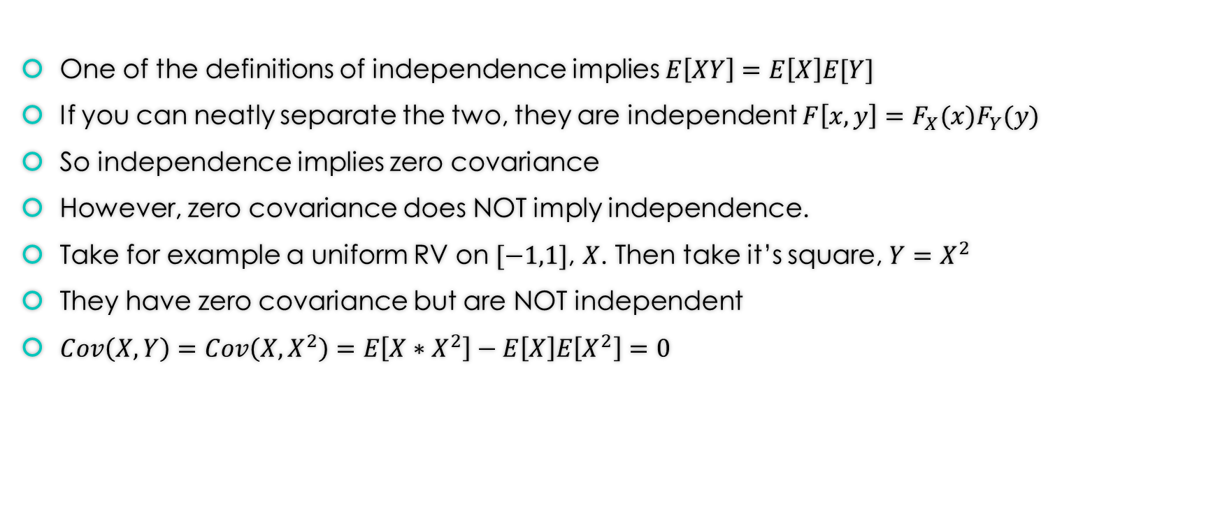
Covariance and independence
One of the definitions of independence implies $E\left[XY\right]=E\left[X\right]E[Y]$
If you can neatly separate the two, they are independent $F\left[x,y\right]=F_{X}(x)F_{Y}(y)$
So independence implies zero covariance
However, zero covariance does NOT imply independence.
Take for example a uniform RV on $[−1,1]$, $X$. Then take it’s square, $Y=X^{2}$
They have zero covariance but are NOT independent
$Cov\left(X,Y\right)=Cov\left(X,X^{2}\right)=E\left[X∗X^{2}\right]−E\left[X\right]E\left[X^{2}\right]=0$

Slide 8

Properties of Covariance!
$Cov\left(aX+b,cY+d\right)=acCov\left(X,Y\right)$
Absolutes don’t matter
$Cov\left(X_{1}+X_{2}, Y\right)=Cov\left(X_{1},Y\right)+Cov(X_{2},Y)$
Sums have additive covariances
$Cov\left(X,X\right)=Var(X)$
Self explanatory
$Cov\left(X, Y\right)=E\left(XY\right)−μ_{X}μ_{Y}$

Slide 9
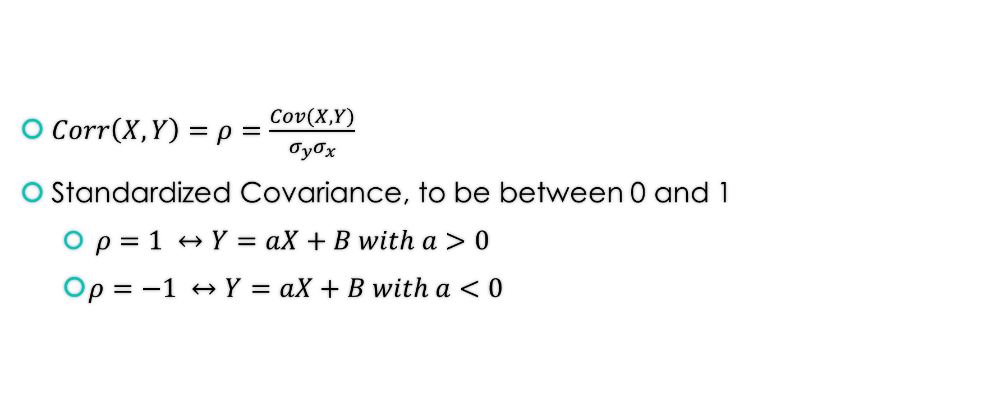
Correlation
$Corr\left(X,Y\right)=ρ=\frac{Cov(X,Y)}{σ_{y}σ_{x}}$
Standardized Covariance, to be between 0 and 1
$ρ=1 ↔Y=aX+B with a>0$
$ρ=−1 ↔Y=aX+B with a<0$

Slide 10
Simple lesson: Correlation is not causation
https://www.tylervigen.com/spurious-correlations
However, association is a necessary condition for causality.

