Slide 1
Econometrics Lecture 3: Hypothesis testing
Diomides Mavroyiannis, 2022

Slide 2
What is hypothesis testing
The idea of hypothesis testing: Could my data just be noise?
We must construct tests so that we can rule out noise
H0: Null hypothesis
If we incorrectly reject the null, it is TYPE 1 error
H1: Alternative hypothesis
If we incorrectly reject the alternative hypothesis it is type 2

Slide 3
One vs two tails
Idea: Is our hypothesis an equality or an inequality? Our degrees of freedom will be n-1
If our null is for example that the mean is 0, then this is a two tailed test.
If our null is that the mean is greater than 0, then this is a one tailed test

Slide 4
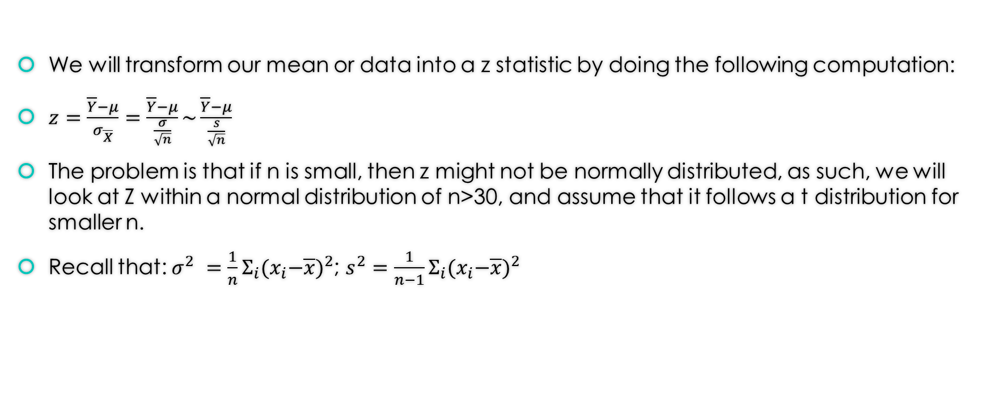
General approach
We will transform our mean or data into a z statistic by doing the following computation:
$z=\frac{\overline{Y}−μ}{σ_{\overline{X}}}=\frac{\overline{Y}−μ}{\frac{σ}{\sqrt{n}}}\sim \frac{\overline{Y}−μ}{\frac{s}{\sqrt{n}}}$
The problem is that if n is small, then z might not be normally distributed, as such, we will look at Z within a normal distribution of n>30, and assume that it follows a t distribution for smaller n.
Recall that: $σ^{2} =\frac{1}{n}Σ_{i}{{(x}_{i}−\overline{x})}^{2}$; $s^{2}={\frac{1}{n−1}Σ}_{i}{{(x}_{i}−\overline{x})}^{2}$

Slide 5
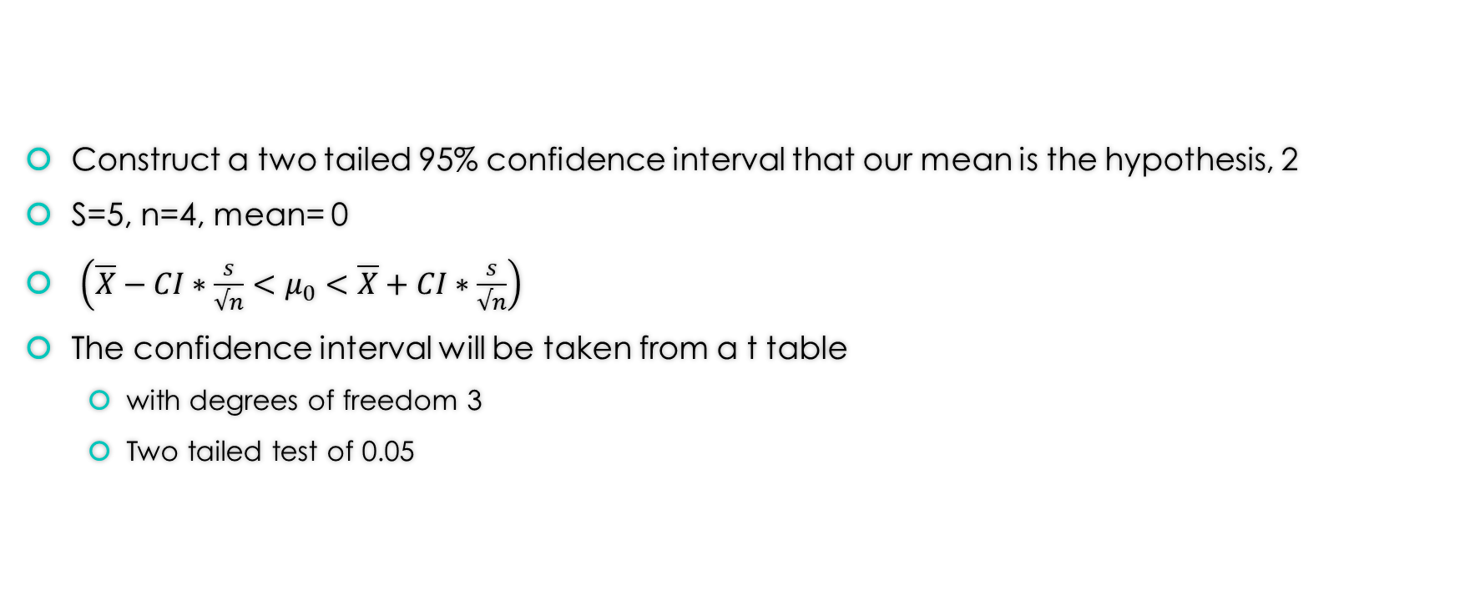
Confidence interval example
Construct a two tailed 95% confidence interval that our mean is the hypothesis, 2
S=5, n=4, mean= 0
$\left(\overline{X}−CI∗\frac{s}{√n}<μ_{0}<\overline{X}+CI∗\frac{s}{√n}\right)$
The confidence interval will be taken from a t table
with degrees of freedom 3
Two tailed test of 0.05

Slide 6
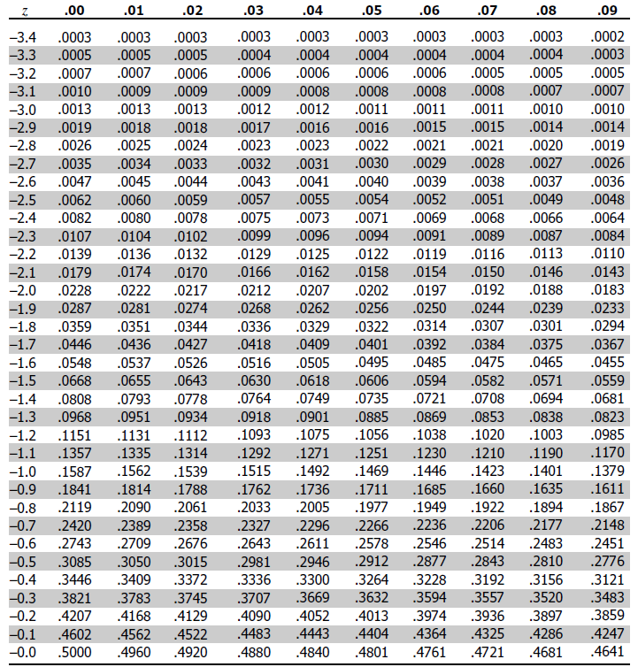
Z table

