Slide 1
Econometrics Lecture 4: Regression
Diomides Mavroyiannis, 2022

Slide 2
What is a regression line?
The regression line is a measure of the relationship between two variables
It is built on correlation, but also takes into account absolute numbers
If there are more than two variables, then we are measuring conditional correlation.

Slide 3
$$X_{1}$$
𝑋_1
$$Y$$
𝑌

Slide 4
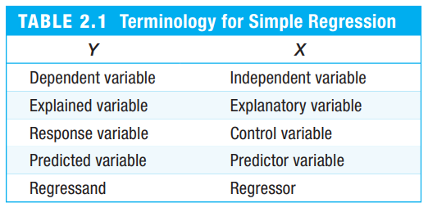

The linear regression equation
$y_{i}=β_{0}+β_{1}x_{i}+u_{i}$
$y_{i}$ is the dependent variable
$x_{i}$ is the independent variable
$u_{i}$ is the error term
$β_{1}$ is the slope coefficient
$β_{0}$ is the magnitude difference

Slide 5

The slope and intercept coefficient
$\hat{β_{1}}=\frac{Σ_{i}^{n}\left(x_{i}−\overline{x}\right)(y_{i}−\overline{y})}{Σ_{i}^{n}{\left(x_{i}−\overline{x}\right)}^{2}}=\frac{Cov(x,y)}{Var(x)}$
$\hat{β_{0}}=\overline{y}−\hat{β_{1}}\overline{x}$

Slide 6
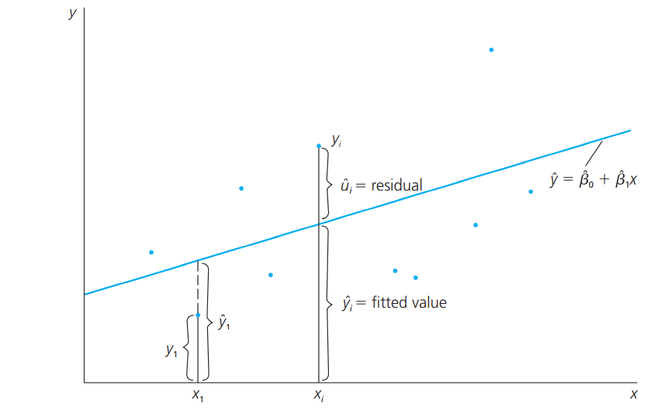
Properties of OLS

Slide 7
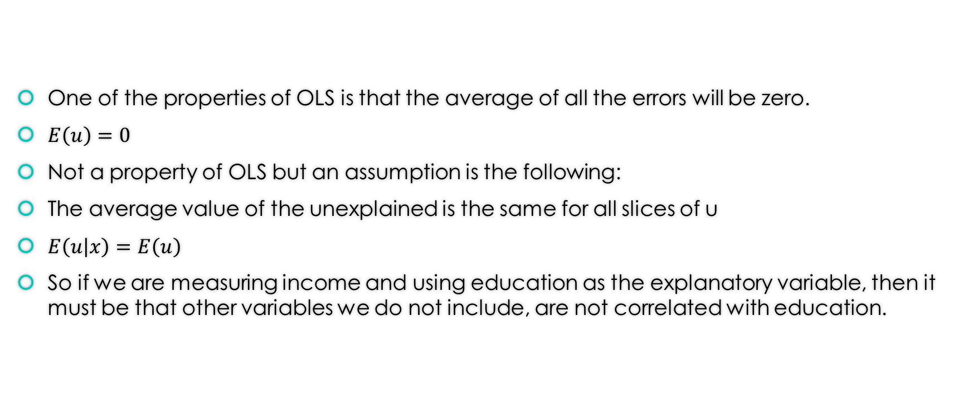
Errors properties and assumption
One of the properties of OLS is that the average of all the errors will be zero.
$E\left(u\right)=0$
Not a property of OLS but an assumption is the following:
The average value of the unexplained is the same for all slices of u
$E\left(u | x\right)=E\left(u\right)$
So if we are measuring income and using education as the explanatory variable, then it must be that other variables we do not include, are not correlated with education.

Slide 8
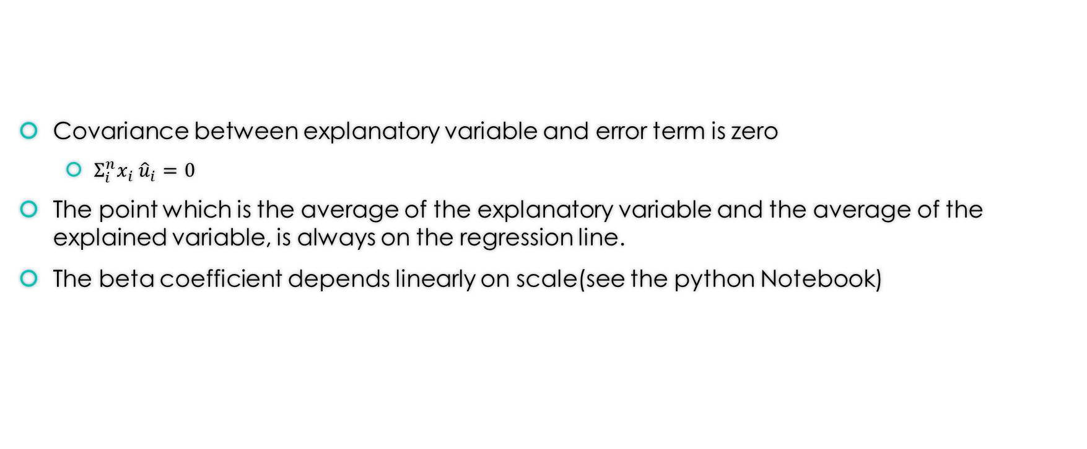
Further properties:
Covariance between explanatory variable and error term is zero
$Σ_{i}^{n}x_{i} {\hat{u}}_{i}=0$
The point which is the average of the explanatory variable and the average of the explained variable, is always on the regression line.
The beta coefficient depends linearly on scale(see the python Notebook)

Slide 9
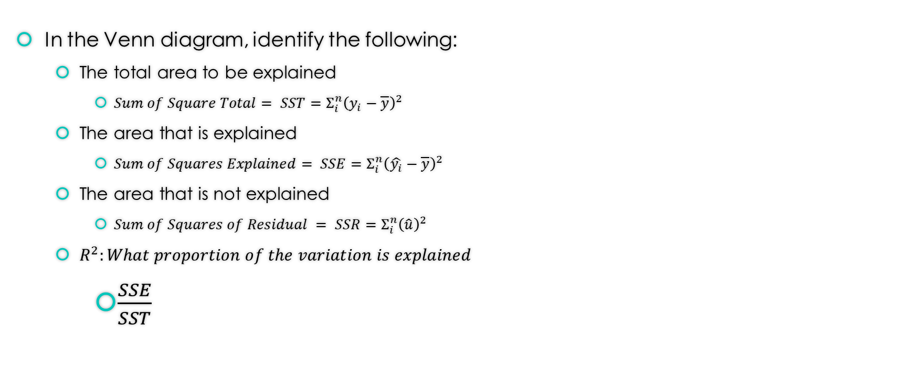
Question
In the Venn diagram, identify the following:
The total area to be explained
$Sum of Square Total= SST=Σ_{i}^{n}{\left(y_{i}−\overline{y}\right)}^{2}$
The area that is explained
$Sum of Squares Explained= SSE=Σ_{i}^{n}{\left(\hat{y_{i}}−\overline{y}\right)}^{2}$
The area that is not explained
$Sum of Squares of Residual = SSR=Σ_{i}^{n}{\left(\hat{u}\right)}^{2}$
$R^{2}:What proportion of the variation is explained$
$\frac{SSE}{SST}$

