Slide 1
Econometrics Lecture 5: Multiple Regression
Diomides Mavroyiannis, 2022

Slide 2
What is a regression line?
Two ways to get the regression coefficient in multiple regression
One is by matrix algebra
The other is the theorem we will look at

Slide 3
Venn
$$X_{1}$$
𝑋_1
$$X_{2}$$
𝑋_2
$$Y$$
𝑌

Slide 4
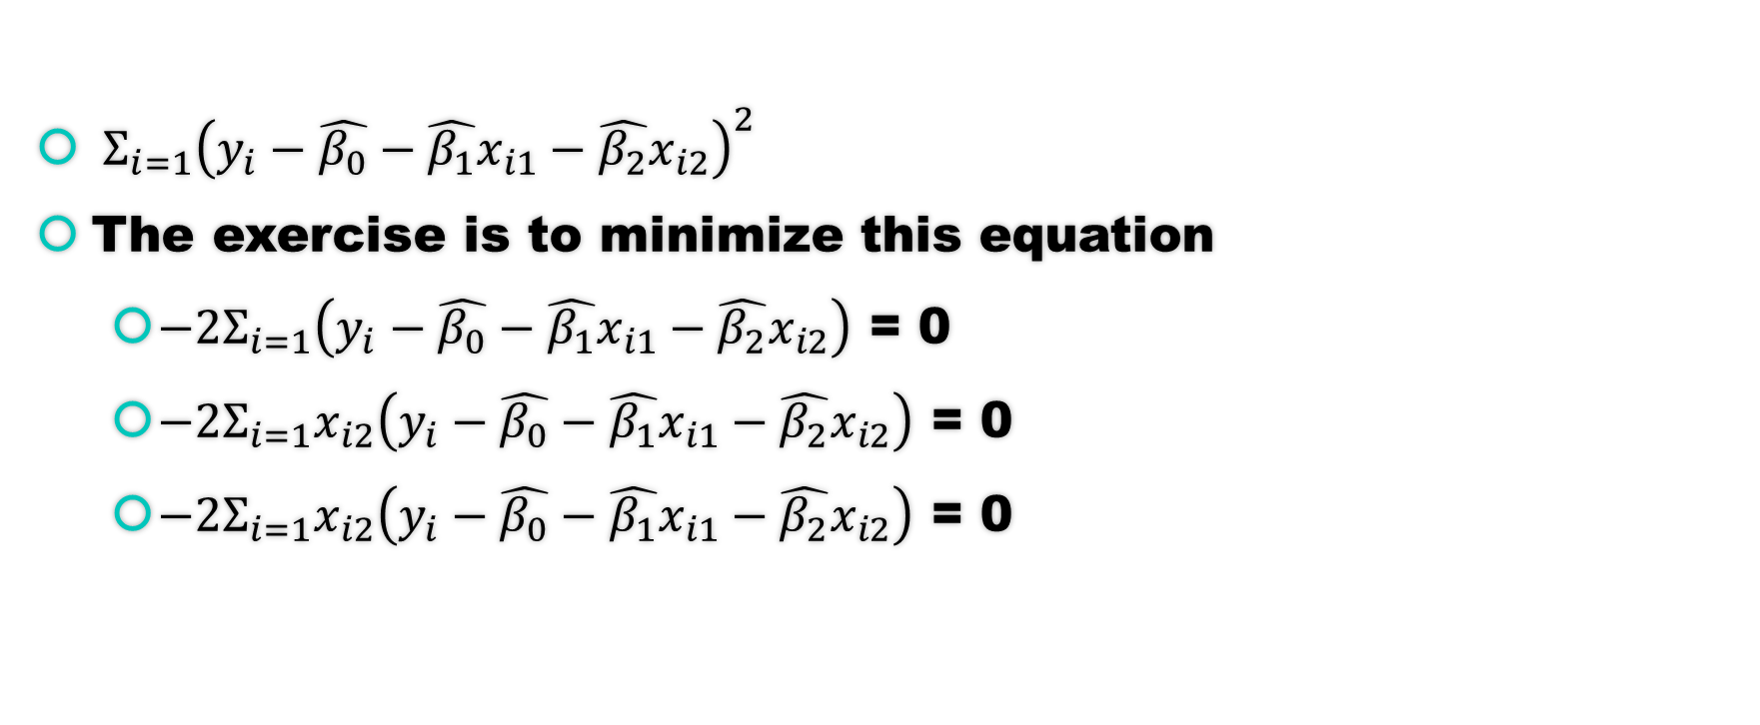
Minimizing
$Σ_{i=1}{\left(y_{i}−\hat{β_{0}}−\hat{β_{1}}x_{i1}−\hat{β_{2}}x_{i2}\right)}^{2}$
The exercise is to minimize this equation
${−2Σ}_{i=1}\left(y_{i}−\hat{β_{0}}−\hat{β_{1}}x_{i1}−\hat{β_{2}}x_{i2}\right)$ = 0
${−2Σ}_{i=1}x_{i2}\left(y_{i}−\hat{β_{0}}−\hat{β_{1}}x_{i1}−\hat{β_{2}}x_{i2}\right)$ = 0
${−2Σ}_{i=1}x_{i2}\left(y_{i}−\hat{β_{0}}−\hat{β_{1}}x_{i1}−\hat{β_{2}}x_{i2}\right)$ = 0

Slide 5
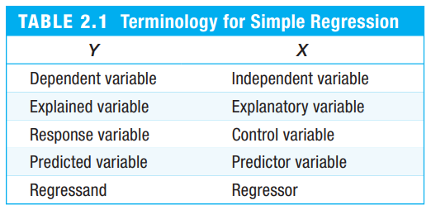

The linear regression equation
$y_{i}=β_{0}+β_{1}x_{i}+β_{2}x_{i}+u_{i}$
$y_{i}$ is the dependent variable
$x_{i}$ is the independent variable
$u_{i}$ is the error term
$β_{1}$ is the slope coefficient
$β_{0}$ is the magnitude difference

Slide 6
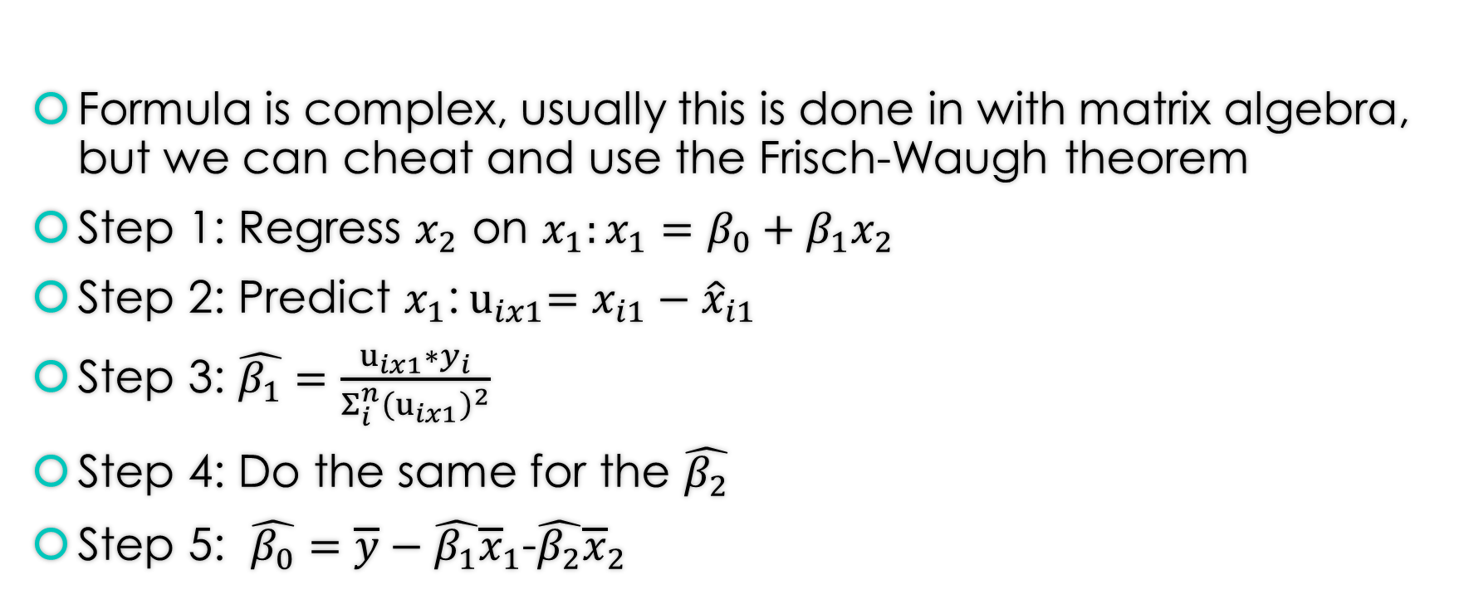
The slope and intercept coefficient
Formula is complex, usually this is done in with matrix algebra, but we can cheat and use the Frisch-Waugh theorem
Step 1: Regress $x_{2}$ on $x_{1}:x_{1}=β_{0}+β_{1}x_{2}$
Step 2: Predict $x_{1}$:${ u}_{ix1}=x_{i1}−{\hat{x}}_{i1}$
Step 3: $\hat{β_{1}}=\frac{u_{ix1}∗y_{i}}{Σ_{i}^{n}{\left(u_{ix1}\right)}^{2}}$
Step 4: Do the same for the $\hat{β_{2}}$
Step 5: $\hat{β_{0}}=\overline{y}−\hat{β_{1}}{\overline{x}}_{1}$-$\hat{β_{2}}{\overline{x}}_{2}$

Slide 7
Collinearity
The overlap or correlation of the independent variables is called Collinearity
If two variables are perfectly collinear, there is no single coefficient as there are no exact linear relationships
Solution: Drop one of the variables
If the co-linearity is not perfect but simply high, then a higher sample is required when doing testing

Slide 8
Venn with irrelevant variable
$$X_{1}$$
𝑋_1
$$X_{2}$$
𝑋_2
$$Y$$
𝑌
$$X_{3}$$
𝑋_3

Slide 9
Further properties:
Irrelevant variables have a beta of 0 and can be excluded
Variables which are correlated but are entirely explained by another, will also have a beta of zero

Slide 10
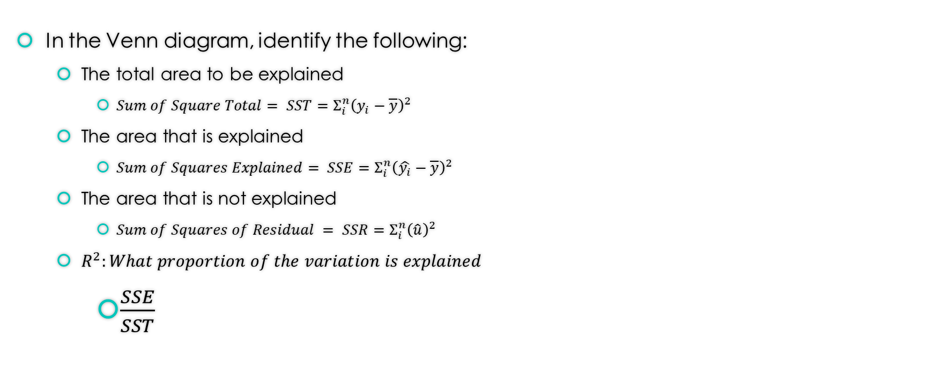
Everything else remains the same
In the Venn diagram, identify the following:
The total area to be explained
$Sum of Square Total= SST=Σ_{i}^{n}{\left(y_{i}−\overline{y}\right)}^{2}$
The area that is explained
$Sum of Squares Explained= SSE=Σ_{i}^{n}{\left(\hat{y_{i}}−\overline{y}\right)}^{2}$
The area that is not explained
$Sum of Squares of Residual = SSR=Σ_{i}^{n}{\left(\hat{u}\right)}^{2}$
$R^{2}:What proportion of the variation is explained$
$\frac{SSE}{SST}$

