Slide 1
Econometrics Lecture 6: Variable transformations
Diomides Mavroyiannis, 2022

Slide 2
Types of transformations
Non-linear effects
Combined effects
Log-Log
Dummy

Slide 3
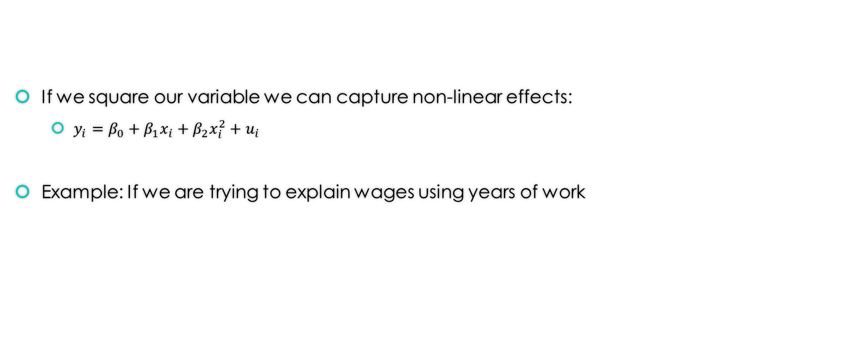
Non-Linear Effects
If we square our variable we can capture non-linear effects:
$y_{i}=β_{0}+β_{1}x_{i}+β_{2}x_{i}^{2}+u_{i}$
Example: If we are trying to explain wages using years of work

Slide 4

Combined/Interaction effects
We can create an interaction effect by multiplying variables:
$y_{i}=β_{0}+β_{1}x_{i}+β_{2}y_{i}+β_{3}y_{i}x_{i}+u_{i}$
Example: Marriage may have a unique effect on women

Slide 5
Logs
Taking the log Y
X is in units and Y is in percent
Increasing X by 1 unit, will increase Y by 2%
Taking the log of X
X is in percent and Y is in units
Increasing X by 1% will increase Y by 2 units
Log of Y and X
X is in percent and Y is in percent
Increasing X by 1% will increase Y by 2%

Slide 6
Dummy variables
Dummy variables are superior to category type variables
Example: Imagine we want to measure the effect of neighborhood on income and that there are 4 neighborhoods. Making one variable that takes on 4 values would average out the effects of each one
Solution: Dummy for each neighborhood

