Slide 1
Econometrics Lecture 7: Causality
Diomides Mavroyiannis, 2022

Slide 2
Causality Plan
What is a DAG?
What is a collider?
RCT
Backdoor
Front door
Instrumental variables

Slide 3
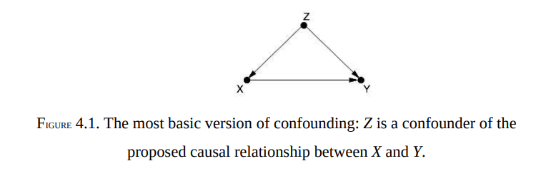
Directed Acyclic Graphs

Slide 4
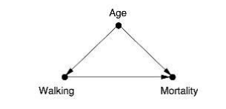
DAG Example

Slide 5
The collider
There is one kind of edge configuration which causes complications for controlling, the collider. Which of the four following configurations creates independence between X and Y if we control for Z?
X →Z→Y
X ←Z→Y
X ←Z ← Y
X → Z ← Y

Slide 6
An Randomized control trial
Separate our sample into a control and treatment group
Whether any particular patient is in one group or the other must be RANDOM
Compare the averages of the two groups to see the effect of the randomization
Example 1: We treat Cancer patients with chemo, some of them receive some other chemo treatment, whilst others receive a newer one(why does a placebo not work?)
Example 2: We randomly give some of the employed a basic income but don’t give some others.
Note: Why might COVID RCT’s not work well?

Slide 7
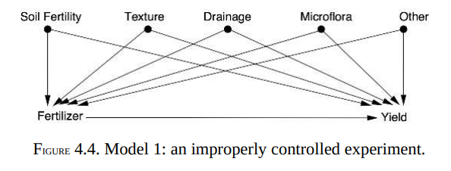
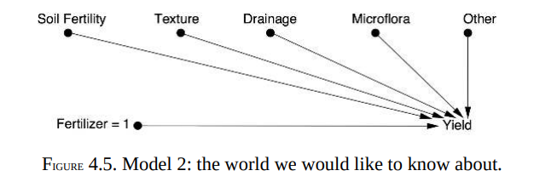
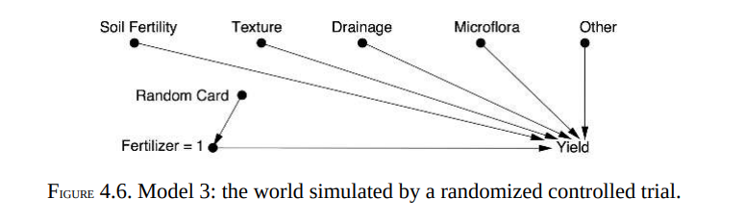
RCT’s in DAG

Slide 8
Backdoor criterion in a nutshell
The function of backdoor criterion is to know what we must control.
There are backdoor paths from X to Y
All the backdoors must be blocked
Step 1: Identify all the backdoor paths
Step 2: Identify which paths are already blocked by colliders
Step 3: Identify which control vectors would close all paths

Slide 9
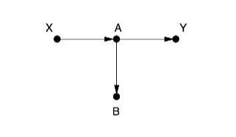
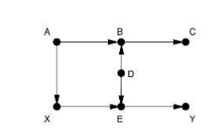
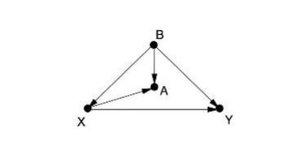
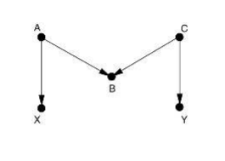
Backdoor criterion: Practice
Notes:
Top left, no control required
Top right, no control required
Bottom left: B
Bottom right: A,C, AC, no control, AB, AB, ACB, BC

Slide 10
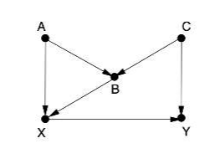
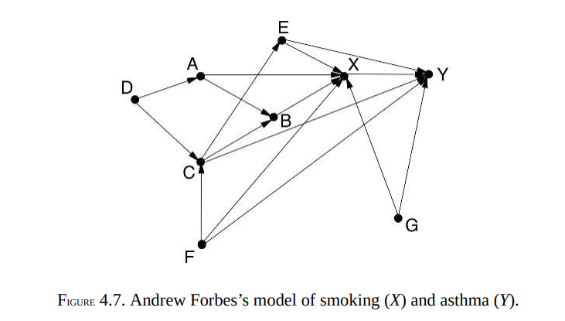
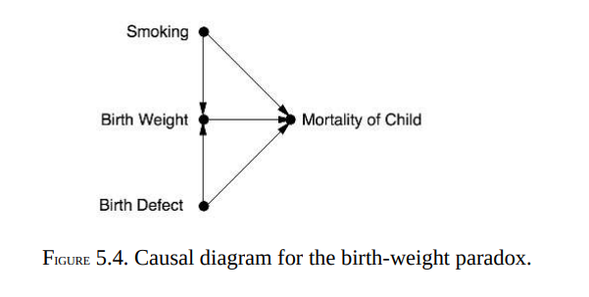
Try this alone

Slide 11
Front door criterion in a nutshell
Instead of measuring the effect of X on Y. We find a Z caused by X that is not related to any of the causes of X AND such that the Z has a causal effect on Y.
We then measure the effect of X on Z.
Then measure the effect of Z on Y.
Use these to compute the effects of X on Y

Slide 12
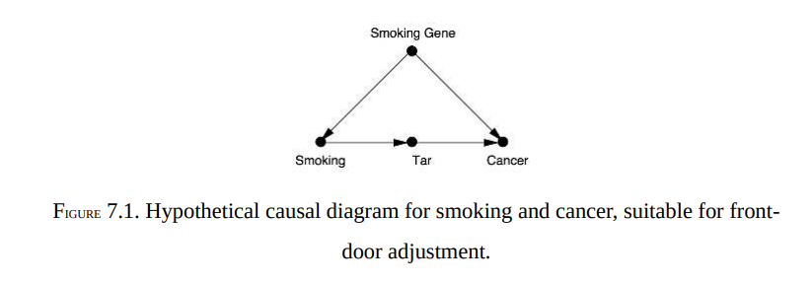
Front Door Criterion

Slide 13
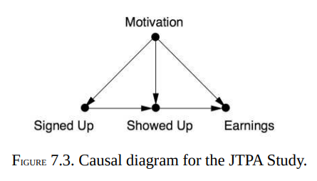
Is there a solution?

Slide 14
Instrumental variables
An instrumental variable is one which is correlated with X but not Y
We predict the instrumental variable, Z, by using X, and then use the predicted Z as the regressor instead of X.
Stronger correlations make for better instruments

Slide 15
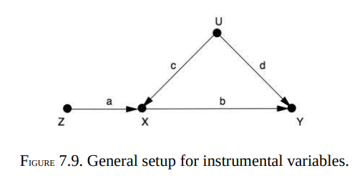
Instrumental Variables

