Slide 1
Econometrics Lecture 8: Wrap up
Diomides Mavroyiannis, 2022

Slide 2
Plan
Bias, consistency and efficiency
Measurement error in Y
Measurement error in X
Heteroskedasticity

Slide 3
Bias vs consistency vs efficiency
Bias: The sample mean is on average equal to the true mean
Cause 1: model error
Cause 2: Omitted variable
Cause 3: Independent variable measurement error
Consistency: As sample size increases, the distribution around the true value becomes a point
Efficiency: How small are the errors per observation? A more efficient estimator can have for example lower error on beta than a less efficient one.
Most common is heteroskedasticity

Slide 4
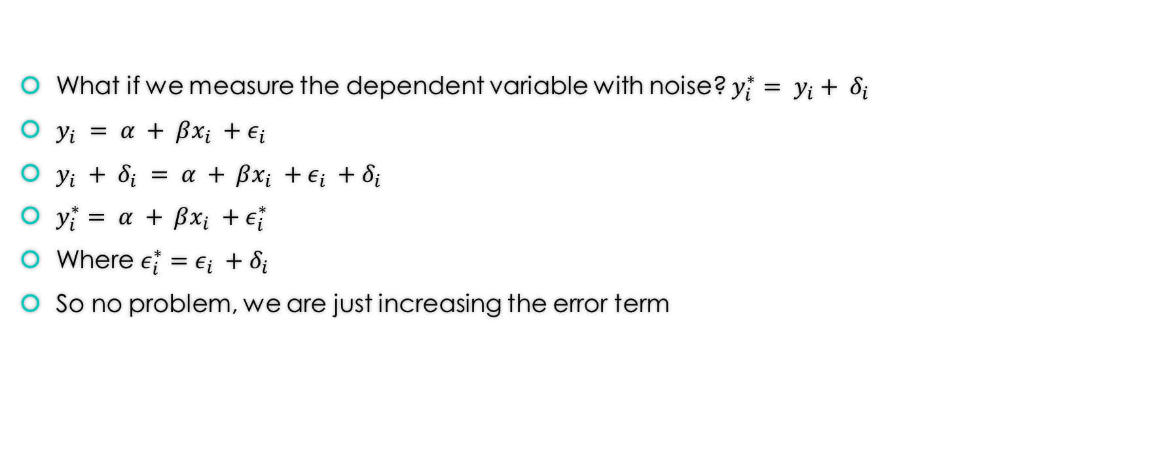
Dependent variable error
What if we measure the dependent variable with noise? $y_{i}^{∗}= y_{i}+ δ_{i}$
$y_{i} = α + βx_{i} +ε_{i}$
$y_{i} + δ_{i} = α + βx_{i} +ε_{i} +δ_{i}$
$y_{i}^{∗}= α + βx_{i} +ε_{i}^{∗}$
Where $ε_{i}^{∗}=ε_{i} +δ_{i}$
So no problem, we are just increasing the error term

Slide 5
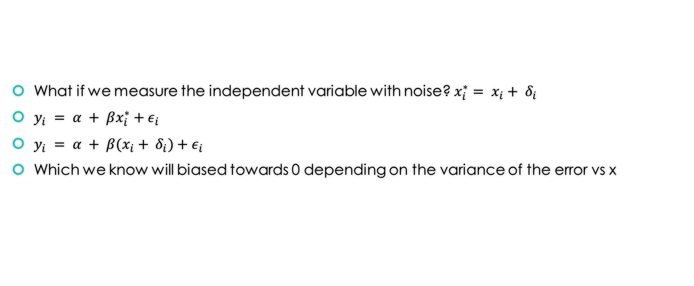
Independent variable error
What if we measure the independent variable with noise? $x_{i}^{∗}= x_{i}+ δ_{i}$
$y_{i} = α + βx_{i}^{∗}+ε_{i}$
$y_{i} = α + β(x_{i}+ δ_{i})+ε_{i}$
Which we know will biased towards 0 depending on the variance of the error vs x

Slide 6
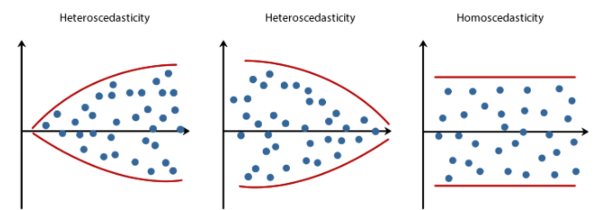
Different kinds of errors

