Slide 1
Econometrics Lecture 1: Functions of one random variable
Diomides Mavroyiannis, 2022

Slide 2
Why probability for statistics?
Probability is the building block of statistics
To contrast:
Probability
Logical
Few rules
Unique answer
Statistics
Different approaches
Empirical
Good arguments on all sides

Slide 3
What is a probability?
It is a measure, such as length or weight
It is a number ranging from 0 to 1
Two kinds
Discreet
Can be listed
Easier to map to real world
Continuous
Infinite possibilities
Better for proving theorems

Slide 4
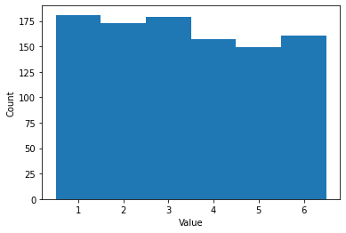
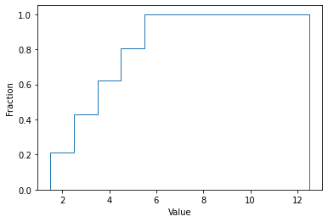
PDFs and CDFs of a fair sided die
Outcome | 1 | 2 | 3 | 4 | 5 | 6
PDF | 1/6 | 1/6 | 1/6 | 1/6 | 1/6 | 1/6
CDF | 1/6 | 2/6 | 3/6 | 4/6 | 5/6 | 1
PDF(probability density function)
CDF(Cumulative density function)

Slide 5
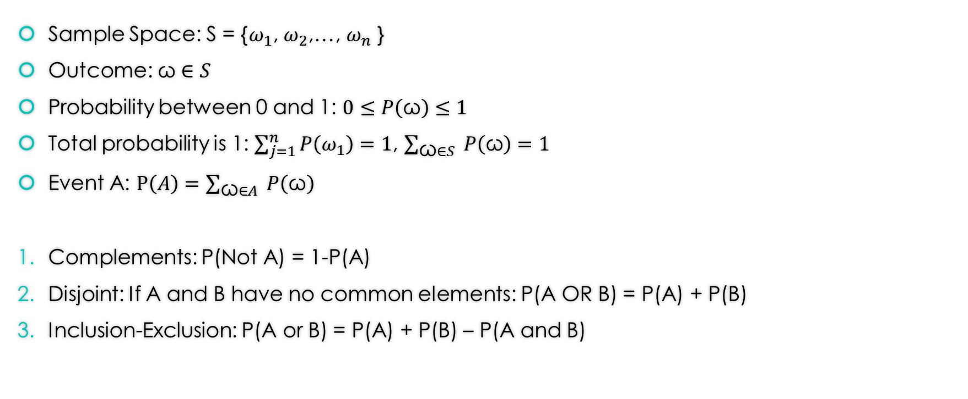
Rules of probability
Sample Space: S = {$ω_{1}$, $ω_{2}$,…, $ω_{n}$ }
Outcome:$\text{ω}∈S$
Probability between 0 and 1: $0≤P\left(\text{ω}\right)≤1$
Total probability is 1: $\sum_{j=1}^{n}{P\left(ω_{1}\right)=1}$, $\sum_{\text{ω}∈S }{P\left(\text{ω}\right)=1}$
Event A: $P\left(A\right)=\sum_{\text{ω}∈A }{P\left(\text{ω}\right)}$
Complements: P(Not A) = 1-P(A)
Disjoint: If A and B have no common elements: P(A OR B) = P(A) + P(B)
Inclusion-Exclusion: P(A or B) = P(A) + P(B) – P(A and B)

Slide 6
Sample space with numerous realizations
1 coin toss = {H, T}
2 coin tosses = {HH, HT, TH, TT}
3 coin tosses = {HHH, HHT, HTH, THH, HTT, THT, TTH, TTT}
Event example:
Exactly two heads, {HHT, HTH, THH}
At least two heads, {HHH, HHT, HTH, THH}
At most one head, {HTT, THT, TTH, TTT}

Slide 7
What are moments?
Random variables can differ quite a bit, to better understand their differences, we create measures
The moments are the truth of the variable. Statistics is the art of creating measures to approach moments.

Slide 8
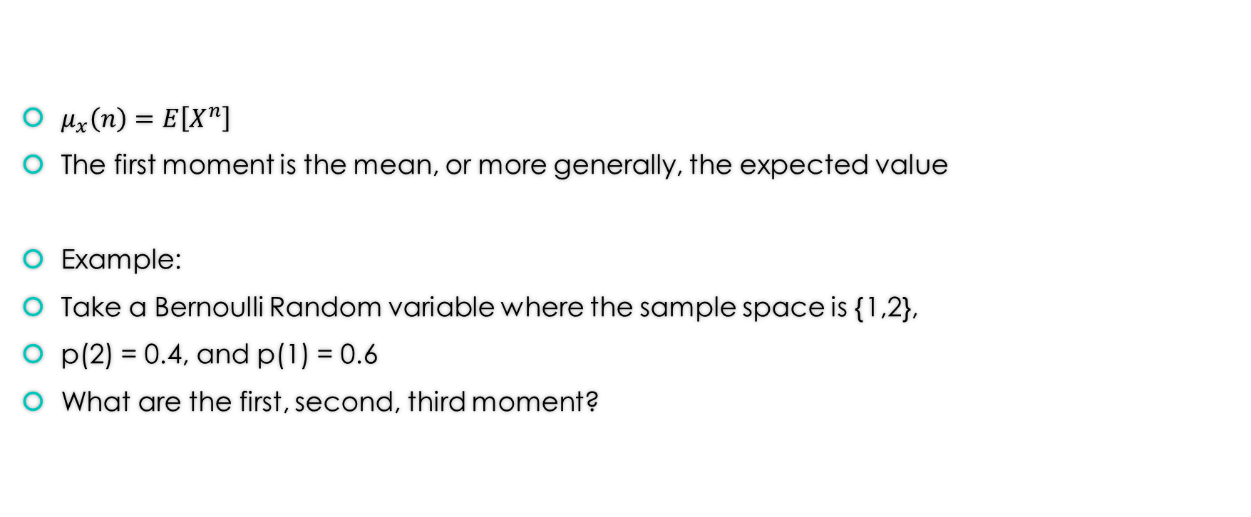
Moments of a random variable
$μ_{x}\left(n\right)=E\left[X^{n}\right]$
The first moment is the mean, or more generally, the expected value
Example:
Take a Bernoulli Random variable where the sample space is {1,2},
p(2) = 0.4, and p(1) = 0.6
What are the first, second, third moment?

Slide 9

Moments of a random variable: Answer
$E\left[X^{1}\right]$ = 0.6*1 + 0.4*2 = 1.4 = 7/5
$E\left[X^{2}\right]=0.6∗1^{2}+0.4∗2^{2}=2.2=11/5$
$E\left[X^{3}\right]=0.6∗1^{3}+0.4∗2^{3}=3.8=19/5$

Slide 10
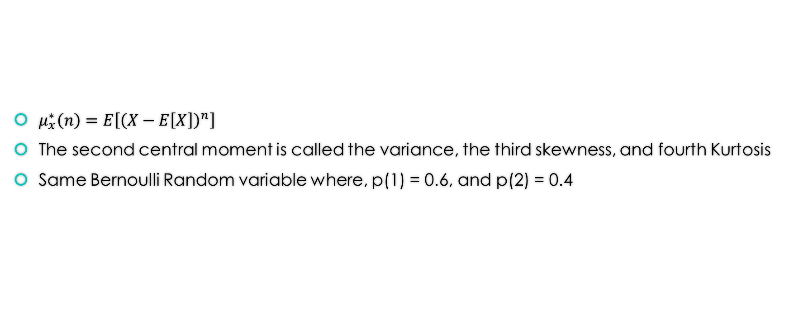
Central moment
$μ_{x}^{∗}\left(n\right)=E\left[{\left(X−E\left[X\right]\right)}^{n}\right]$
The second central moment is called the variance, the third skewness, and fourth Kurtosis
Same Bernoulli Random variable where, p(1) = 0.6, and p(2) = 0.4

Slide 11

Central moment: Answers
$E\left[{\left(X−E\left[X\right]\right)}^{1}\right]=0.6(1−\text{1.4}\text{) +0.4(2−}\text{1.4}\text{)}$ = 0
$E\left[{\left(X−E\left[X\right]\right)}^{2}\right]=\text{V}\text{arianc}\text{e}=0.6{\left(1−1.4\right)}^{2}\text{+}0.4{\left(2−1.4\right)}^{2}$ = 0.36
$E\left[{\left(X−E\left[X\right]\right)}^{3}\right]=0.6{\left(1−1.4\right)}^{3}\text{+}0.4{\left(2−1.4\right)}^{3}=−0.0432$

Slide 12
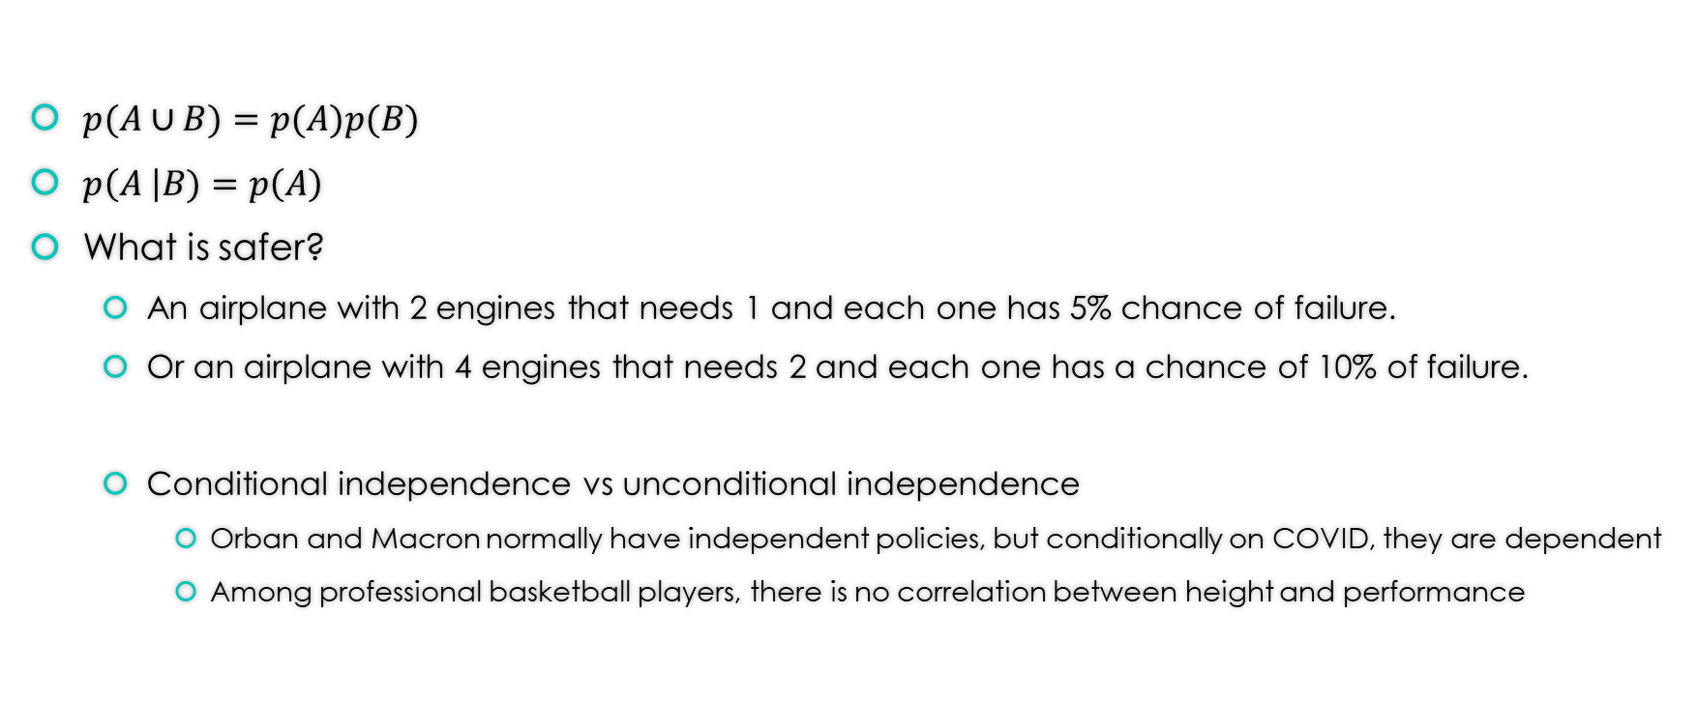
What is independence?
$p(A∪B)=p(A)p(B)$
$p\left(A \right|B)=p\left(A\right)$
What is safer?
An airplane with 2 engines that needs 1 and each one has 5% chance of failure.
Or an airplane with 4 engines that needs 2 and each one has a chance of 10% of failure.
Conditional independence vs unconditional independence
Orban and Macron normally have independent policies, but conditionally on COVID, they are dependent
Among professional basketball players, there is no correlation between height and performance

Slide 13
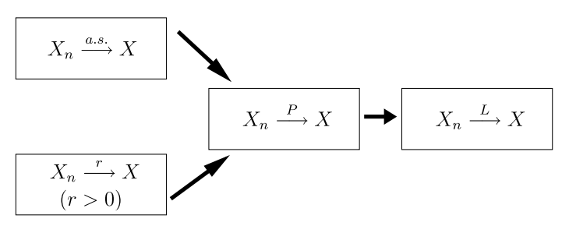

Law of large numbers
The weak law of large numbers: The average will become arbitrarily close to the expected value as the sample size approaches infinity
$\frac{S_{n}}{n}−μ→_{p}{0}$ OR $S_{n}→_{p}{E[X_{n}]}$

