Slide 1
Riding on a Turtle’s Back
Diogo Monteiro, 97606
Introduction to Computer Graphics – 2021/2022 – Project 1

Slide 2
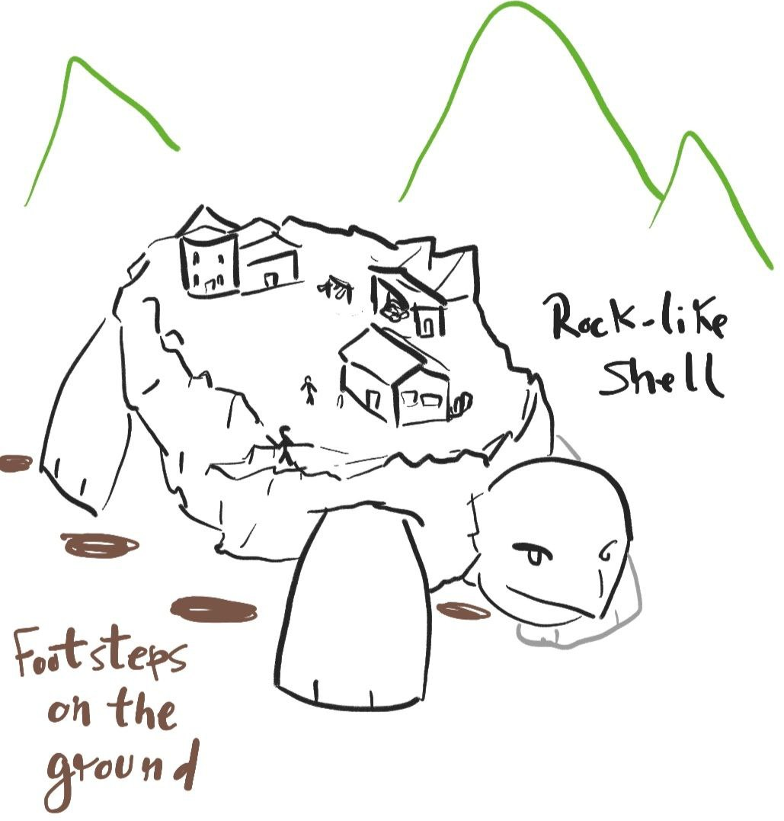
Main ideas
The goal: model and animate a giant turtle walking across a landscape, with people on its back
Uses basic three.js, OrbitControls, and dat.GUI
Available on https://diomont.github.io/ICG_projeto1/
(might be a bit laggy)

Slide 3
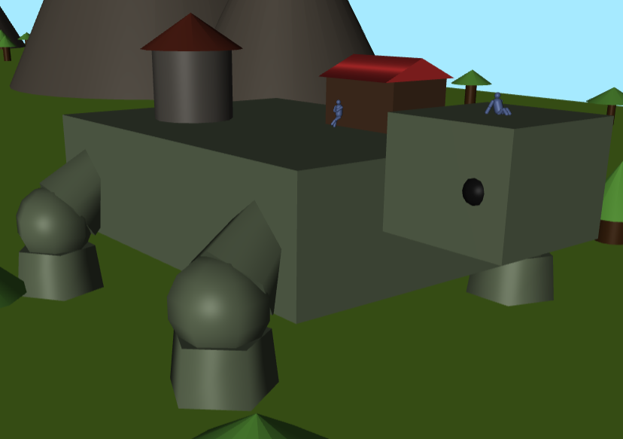
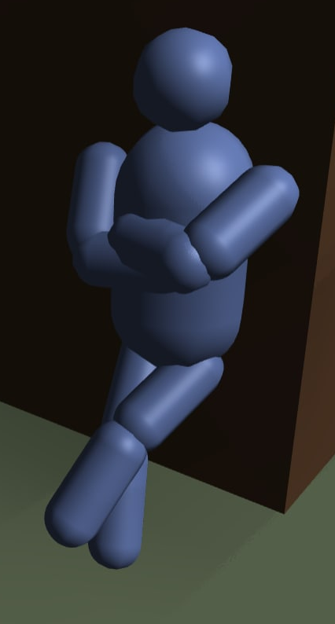
Models
Turtle
Person
House
Tower
Ground
Mountains
Trees

Slide 4
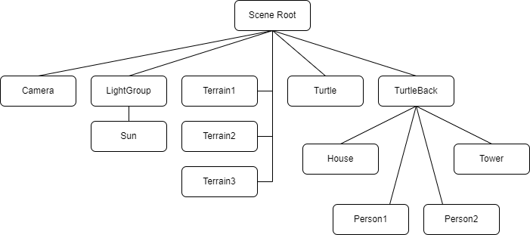
Scene Graph

Slide 5
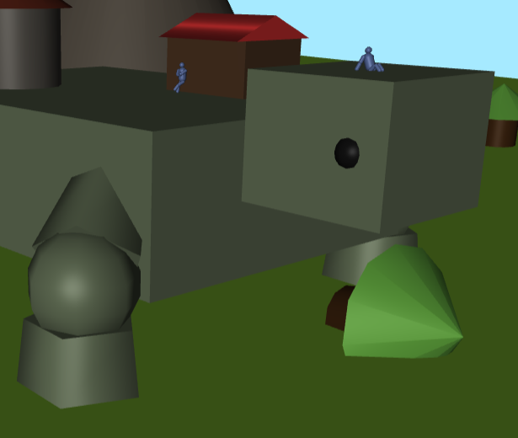
Animation
Turtle walking
Trees shaking when turtle takes a step
Trees falling over when colliding with turtle
Looping terrain
Day/Night cycle

Slide 6
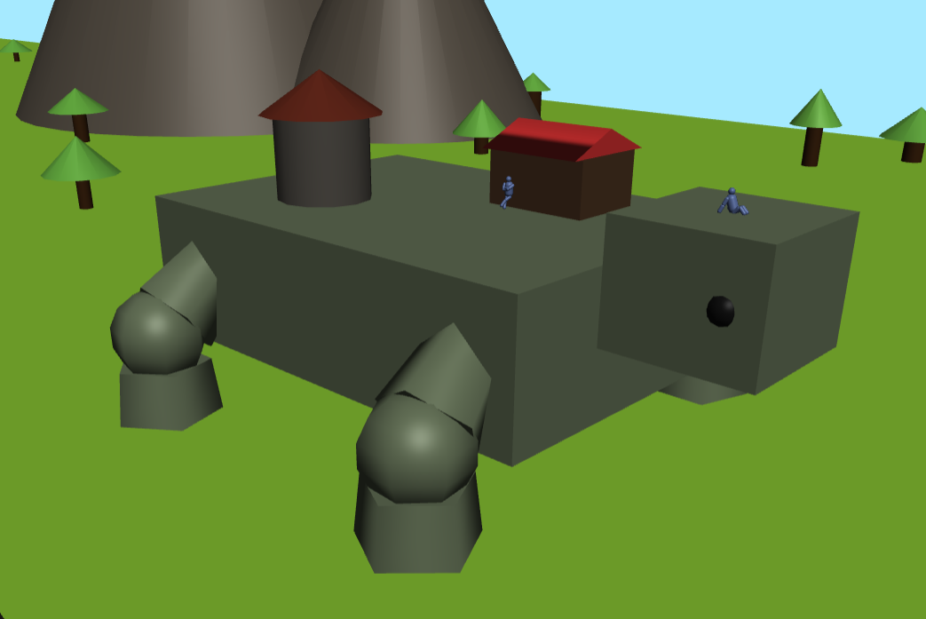
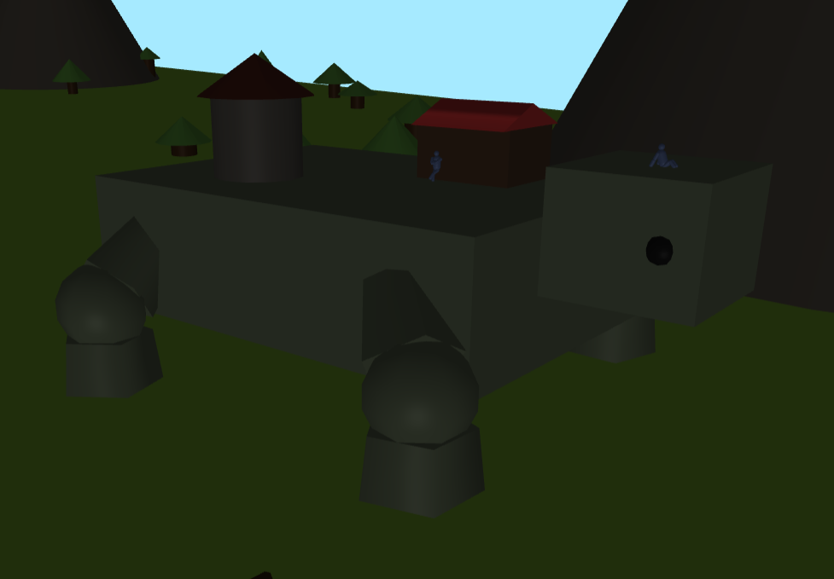
Illumination
Low intensity ambient light
Directional light simulating the sun
Day/night cycle, controllable with GUI slider

Slide 7
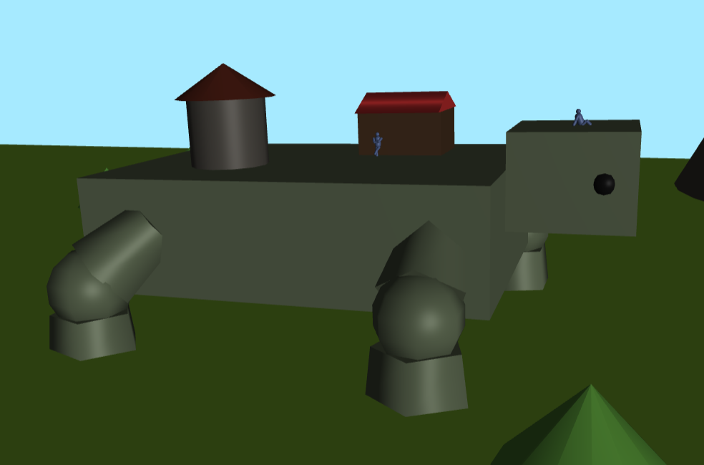
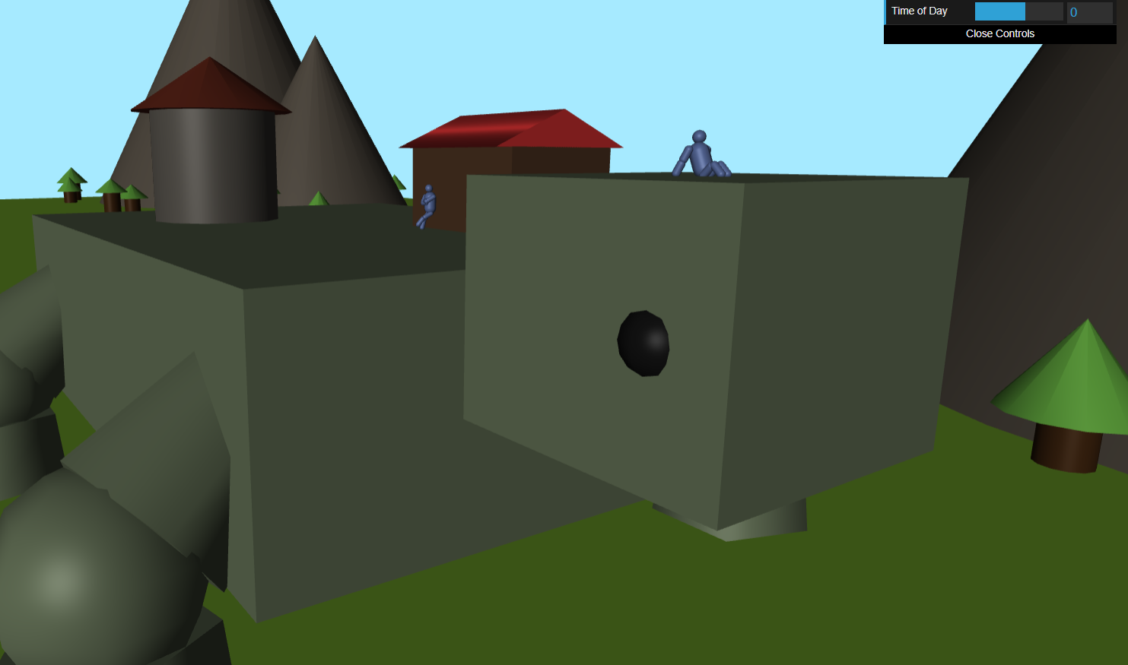
User Interaction
Free camera control using OrbitControls
Manually set time of day using GUI slider

Slide 8
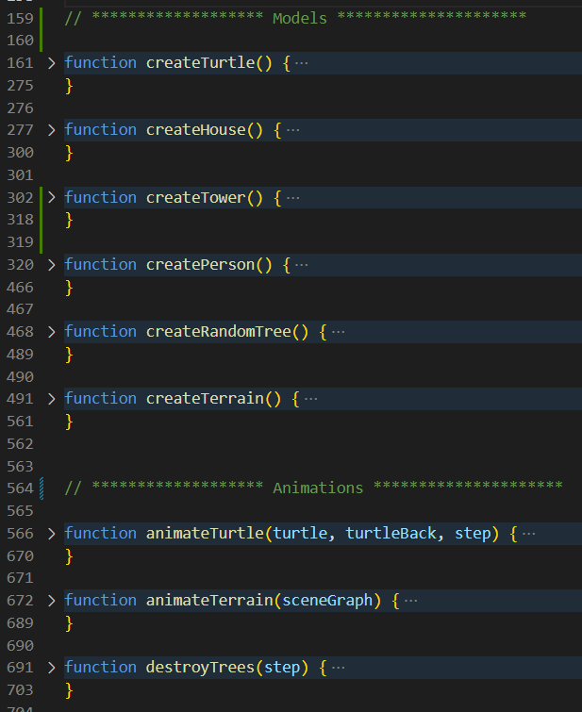
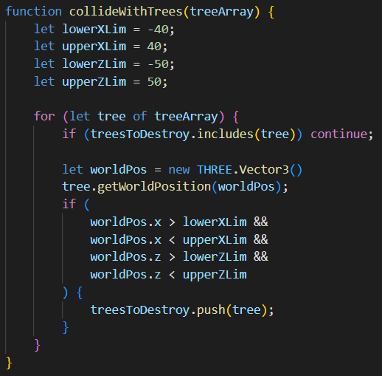
Development
Most code in one file, organized in functions to create, animate, and pose models
No real collision detection with trees, merely a trick

Slide 9
Conclusions
Animating is hard work!
Collisions are tough too
Things to improve:
Dynamic animations (move objects based on real-time interactions)
More interesting lighting
More OOP-like structure (turn models into classes, and their animations and poses to methods)
Different approach to animation (using something like keyframes, for instance?)

Slide 10
References
Three.js documentation
Past pratical guides
dat.GUI documentation

