Slide 1
Time Management App
Nabou Diouf

Slide 2
Project Overview
The Time Management App helps users log, track, and query time usage.
Features:
- Record tasks (DATE, FROM, TO, TASK, TAG)
- Query tasks by date, task, or tag
- Generate reports for time usage
- Prioritize tasks based on time spent
Technologies: Flutter, Firebase

Slide 3
Design Patterns
- Singleton: Used for Firebase service initialization
- MVC (Model-View-Controller): Applied for UI and logic separation
- Observer: Implemented for real-time database updates
- Factory Method: Used for widget creation based on conditions

Slide 4
Code Smells and Refactoring
- Code Duplication: Extracted reusable functions for date/time handling
- Long Methods: Split into smaller, well-named functions
- Tight Coupling: Introduced dependency injection for Firebase services
- Missing Comments: Added documentation for complex methods

Slide 5
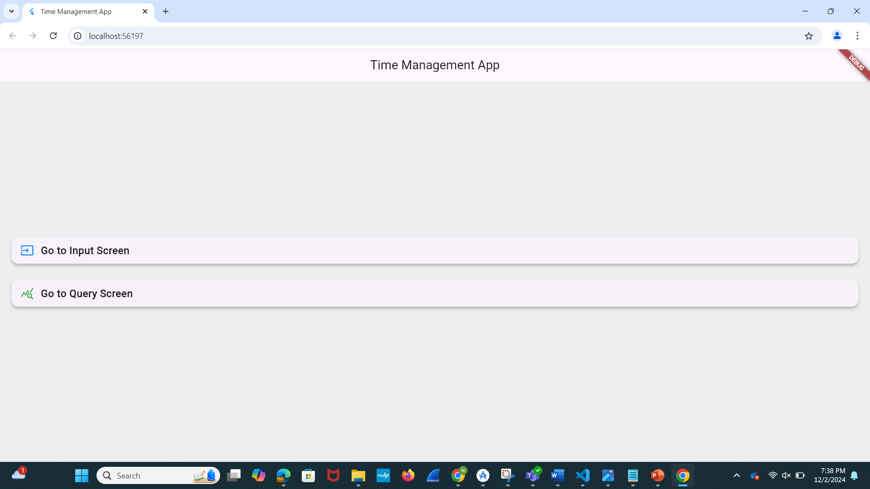
Home Screen

Slide 6
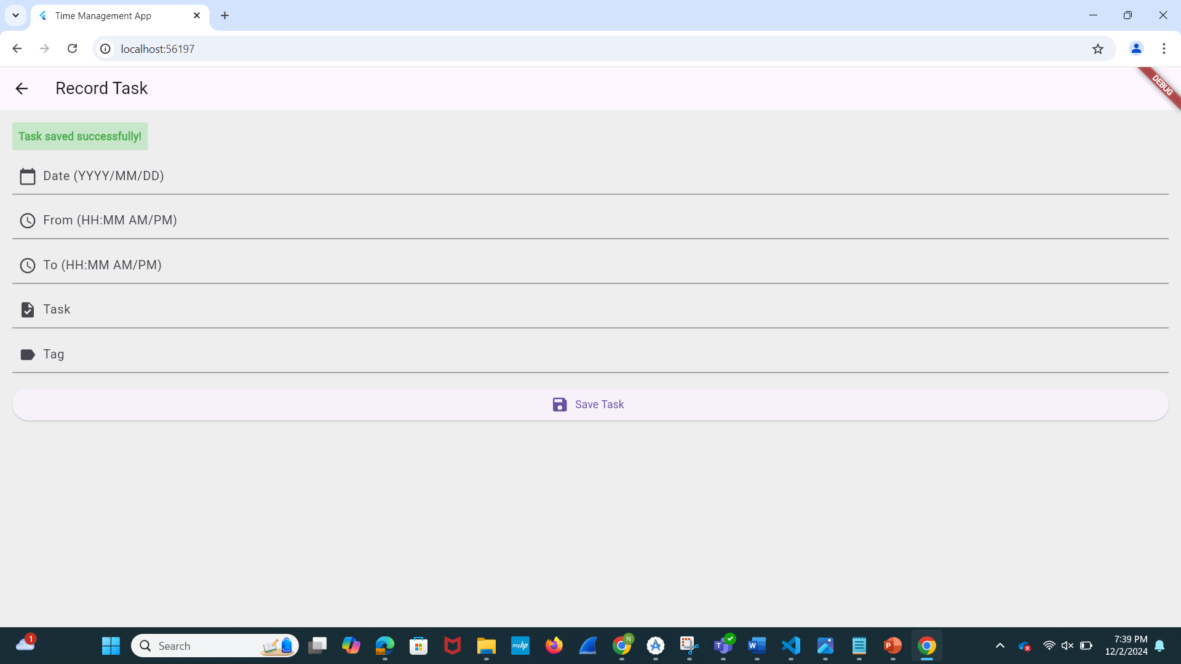
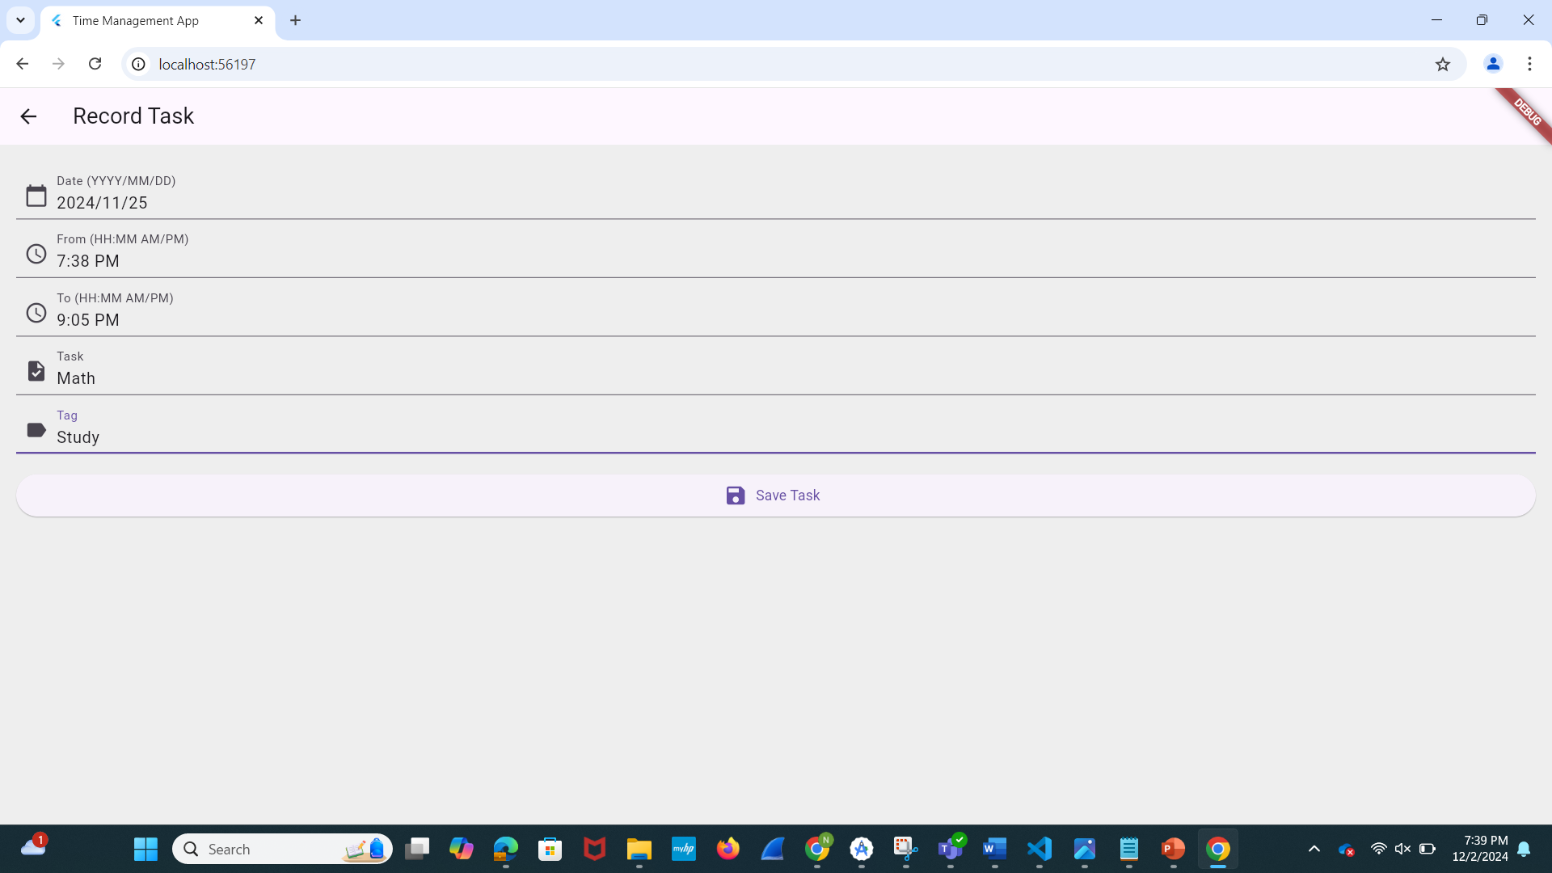
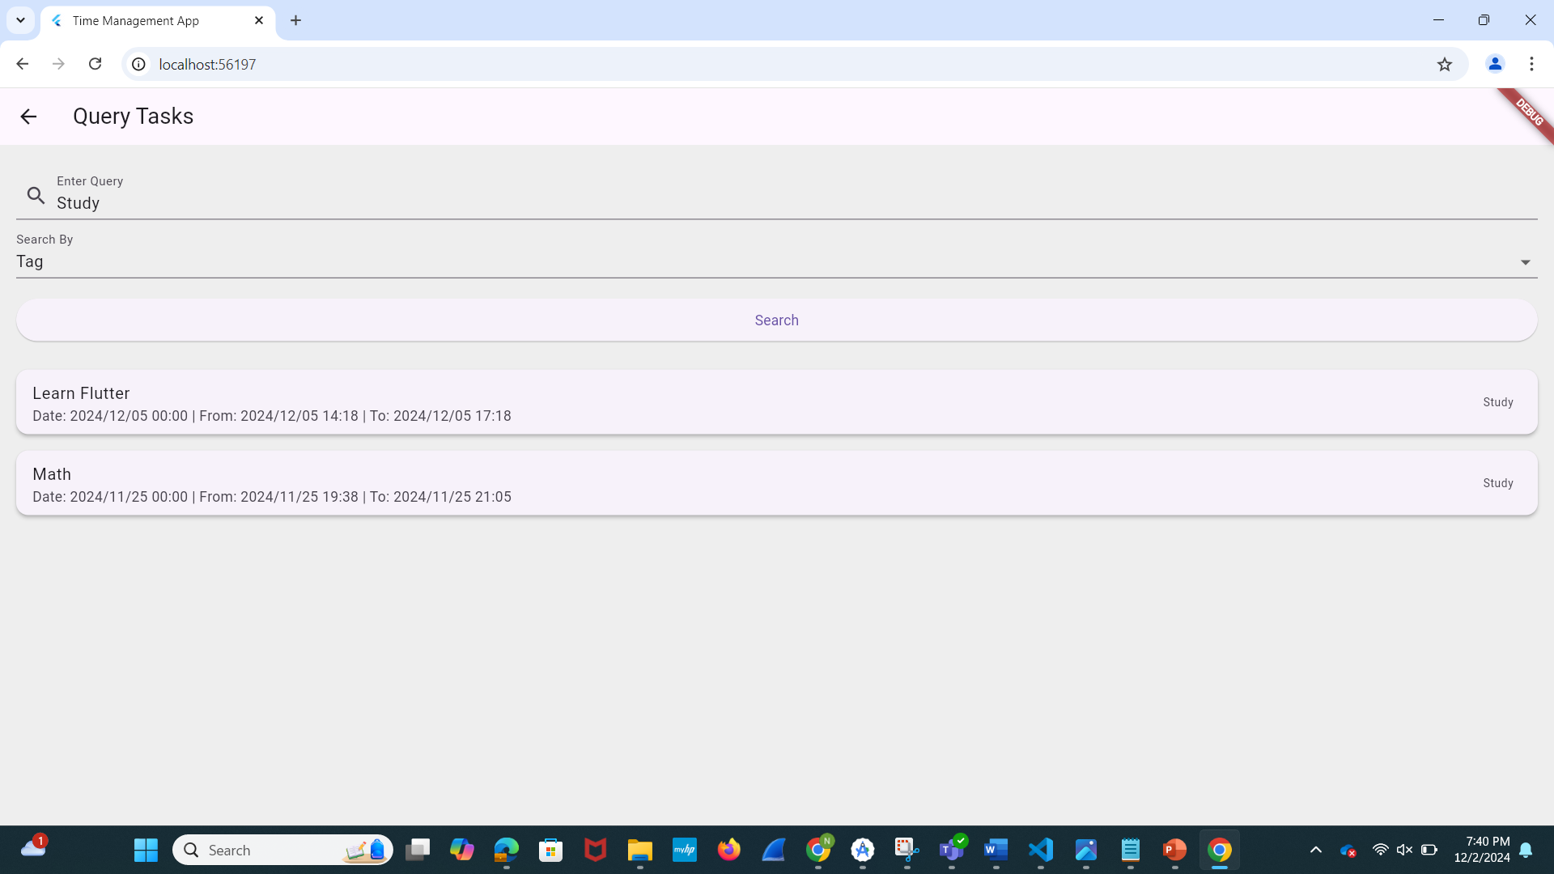
Ver1 Input and Query Screen

Slide 7
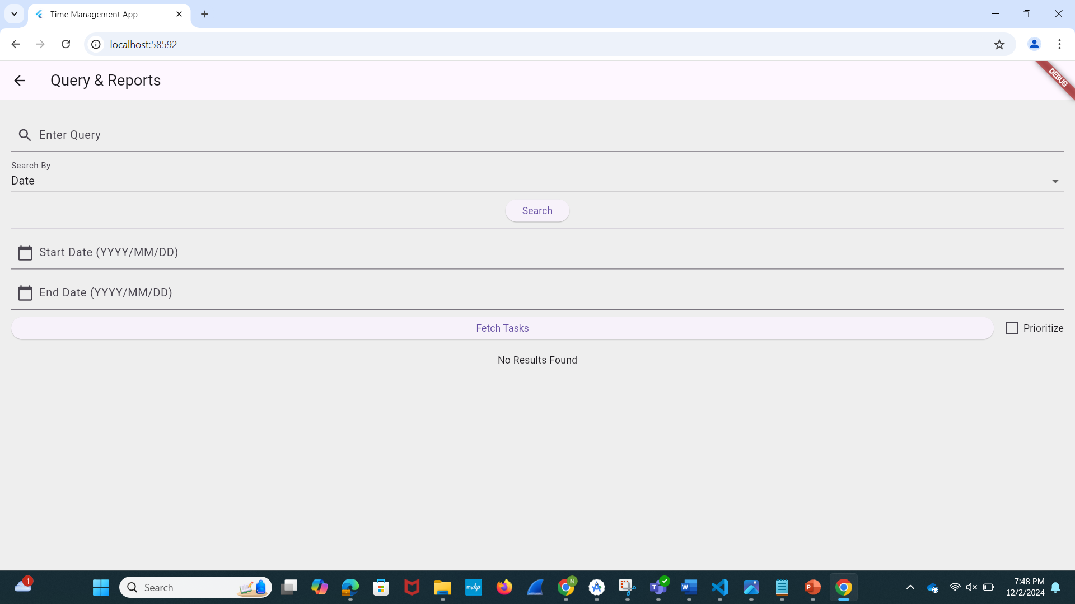
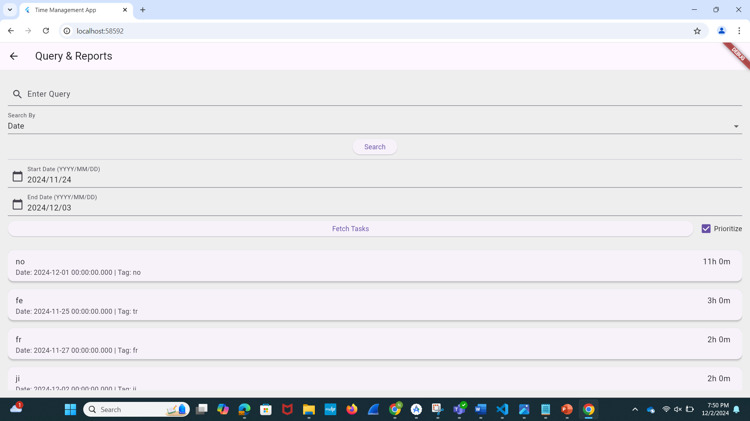

Ver2 Query Screen

Slide 8
Final Submission
- GitHub Repository: https://github.com/dionabou/ASE456-001_TimeManagementApp

Slide 9
Milestones and Deadlines
Milestone 1: Set up project (10/11/2024)
Milestone 2: Establish Firebase connection (10/17/2024)
Milestone 3: Build prototype (10/24/2024)
Milestone 4: Implement query functionality (10/31/2024)
Milestone 5: Add report generation (11/07/2024)
Milestone 6: Complete Version 1 (11/14/2024)
Milestone 7: Conduct regression testing (11/21/2024)
Milestone 8: Finalize application (11/28/2024)
Milestone 9: Submit project (12/02/2024)

Slide 10
Thank you!

