Slide 1
Final Report: Erasmus+
Knowledge Project
Dion Buckley - C00220868
30.04.2020

Slide 2
Introduction
Built a native mobile app for iOS AND Android using React Native (Facebook)
Worked as part of a larger team with students and faculty from various countries and fields (Erasmus+)
All towards education and behavioural guidance for coeliac disease sufferers

Slide 3
Methods
Qualitative
Planned to observe and question coeliac patients during a 21 day challenge. This was my chance to isolate one metric for my study; The effect of gamification on engagement
And
To achieve this a coeliac control group would have been set up to test a quiz without any gamified elements. Then there would have been a another group to test the gamified quiz.
Quantitative
Measurements were to be taken also during the test period. My app is setup to persist data over multiple instances so we could track time spent on certain screens or login frequency
Quantity
Quality

Slide 4
Results
Pandemic
Unfortunately the 21 day challenge was unable to go ahead due to the Covid-19 pandemic and another high level study could not be produced in time
However a clear path has been laid down for the mantle to be taken up again once the dust settles and I feel confident that another group can pick up the work done by the amazing Erasmus+ team

Slide 5
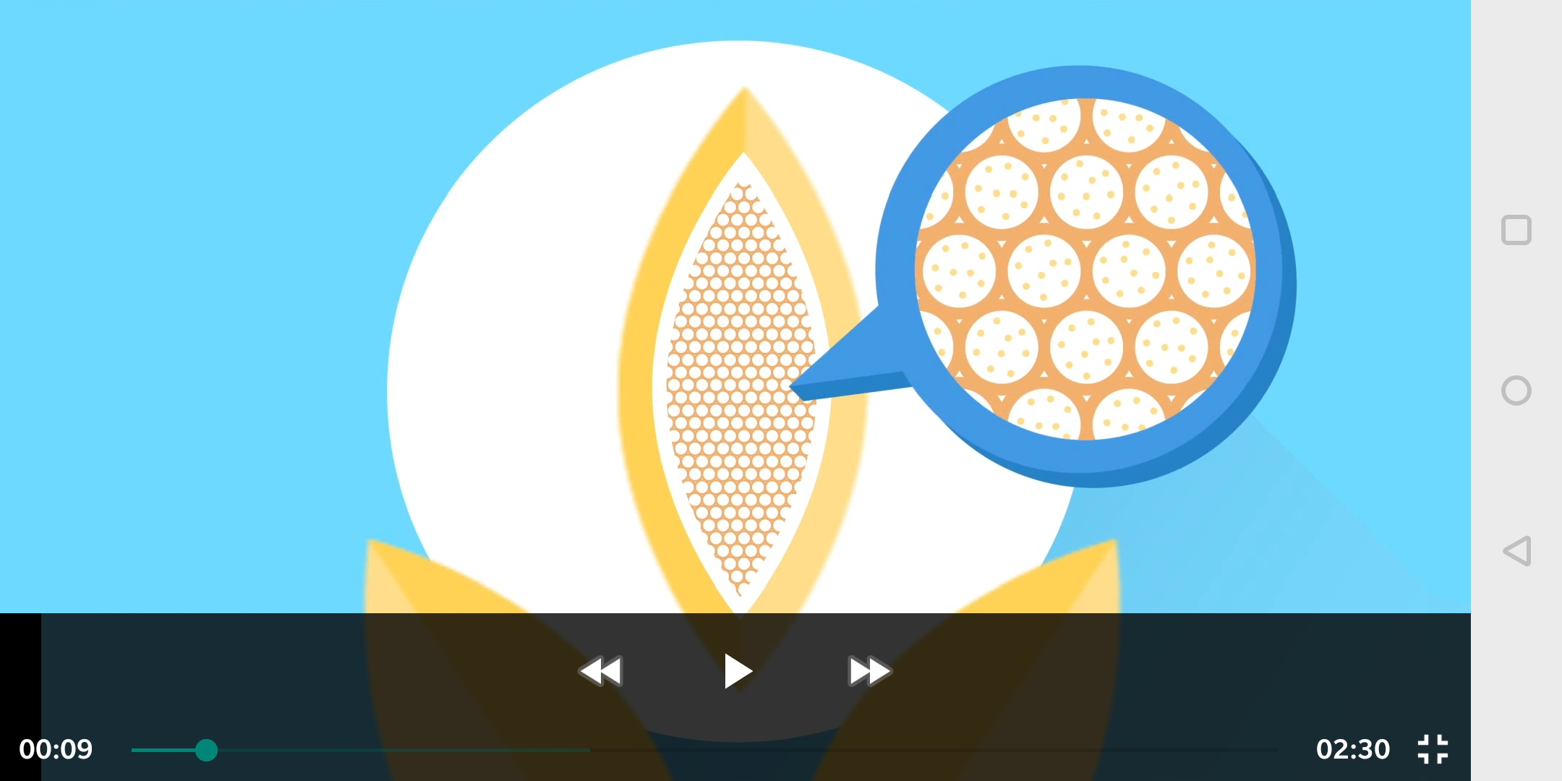
Implemented
Feature
Set
&&
Tech
Stack

Slide 6
Tech Stack and Feature Set
Python flask web server
API pulls medical data from desqol GDrive
Stores locally on MariaDB datastore
Shared Erasmus+ celiapp backend at play
Gamified Quiz using streaks, particles and more
Resource management system
Persistence upon exit
Potential real world impact
Stack navigator
+ Extra back handling and alert
Native video player and sound effects
Custom loading bar, buttons and font

Slide 7
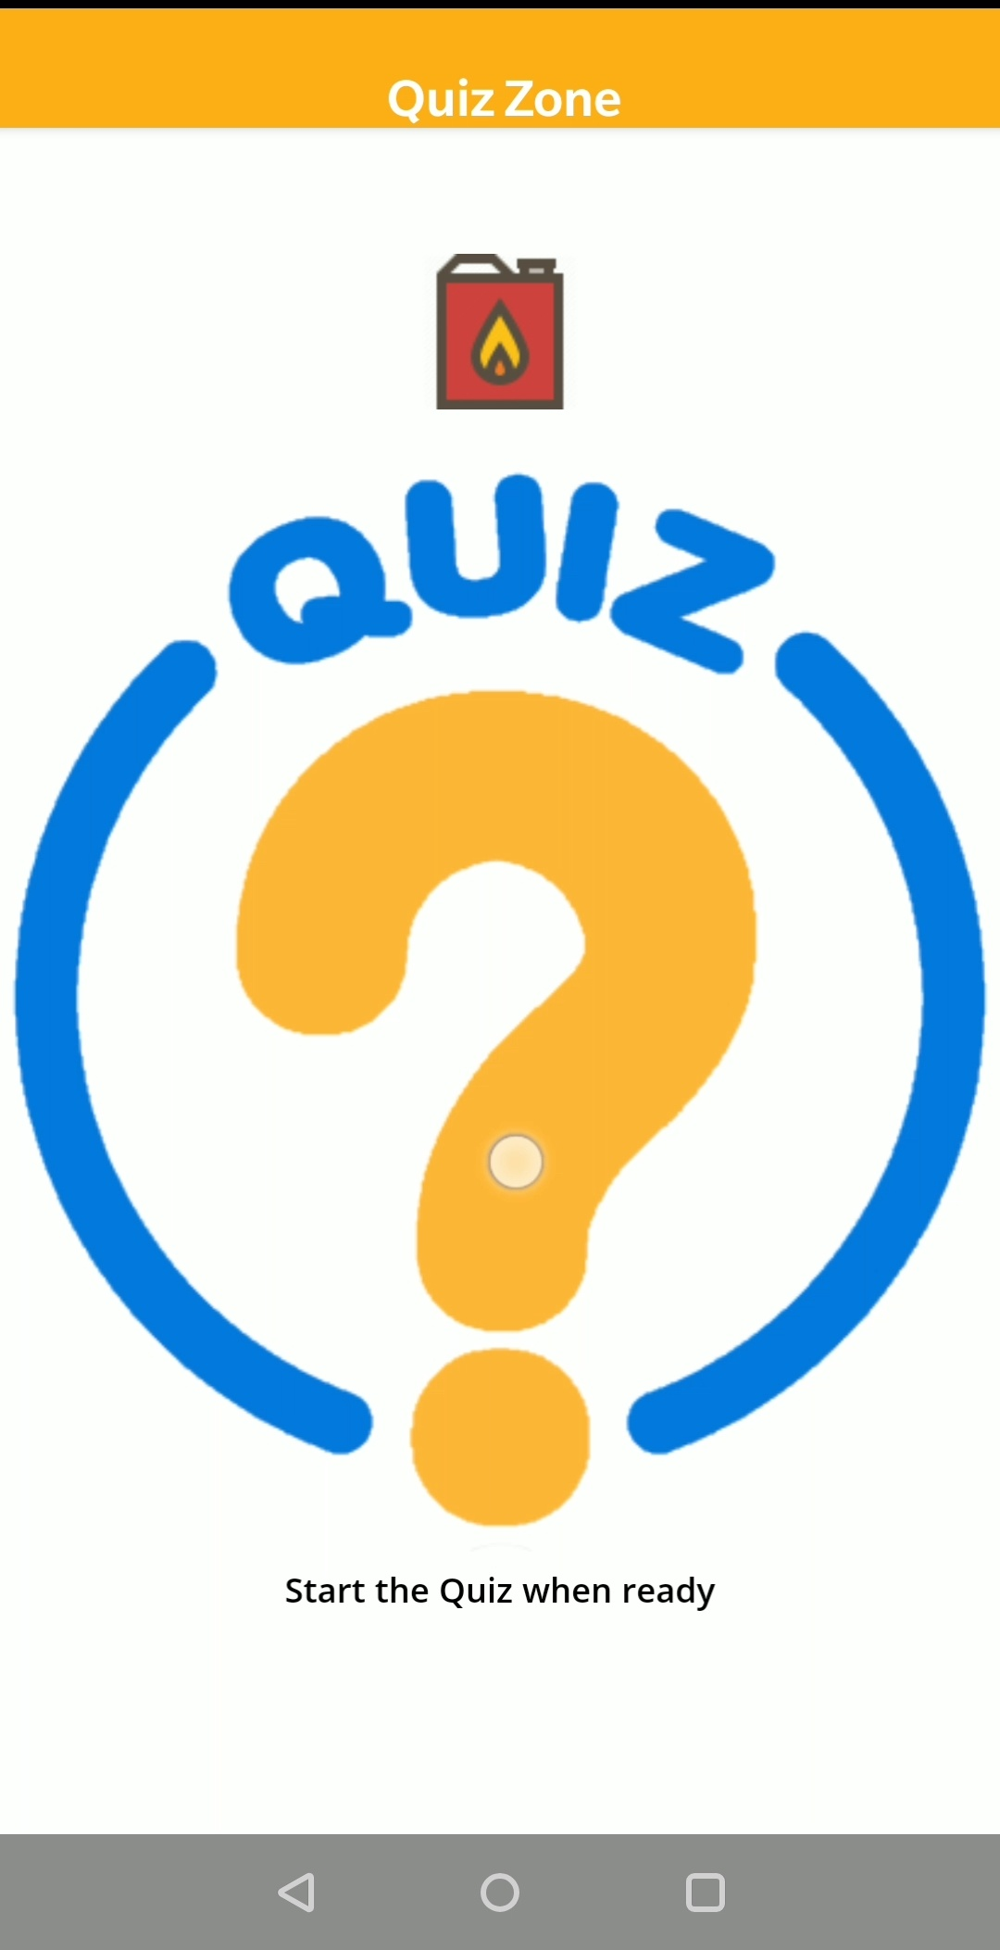
Feature Set Demo

Slide 8
Conclusions
For my own achievement I feel strongly that delving into the React Native development wormhole AND the world of research will stick with me for a time to come
As a team we have achieved a great deal towards creating a long lasting change in behaviour and therefore quality of life for the coeliac sufferers
Overall this ‘masterpiece’ project has really come together on all fronts making the final app something I am quite satisfied with
Further work on this project would be to make a more cohesive experience, e.g coins on videos with more links between video and quiz AND even more data points utilized.

Slide 9
Thank you!
Questions?
Presentation template by SlidesCarnival

