Slide 1










Slide 2
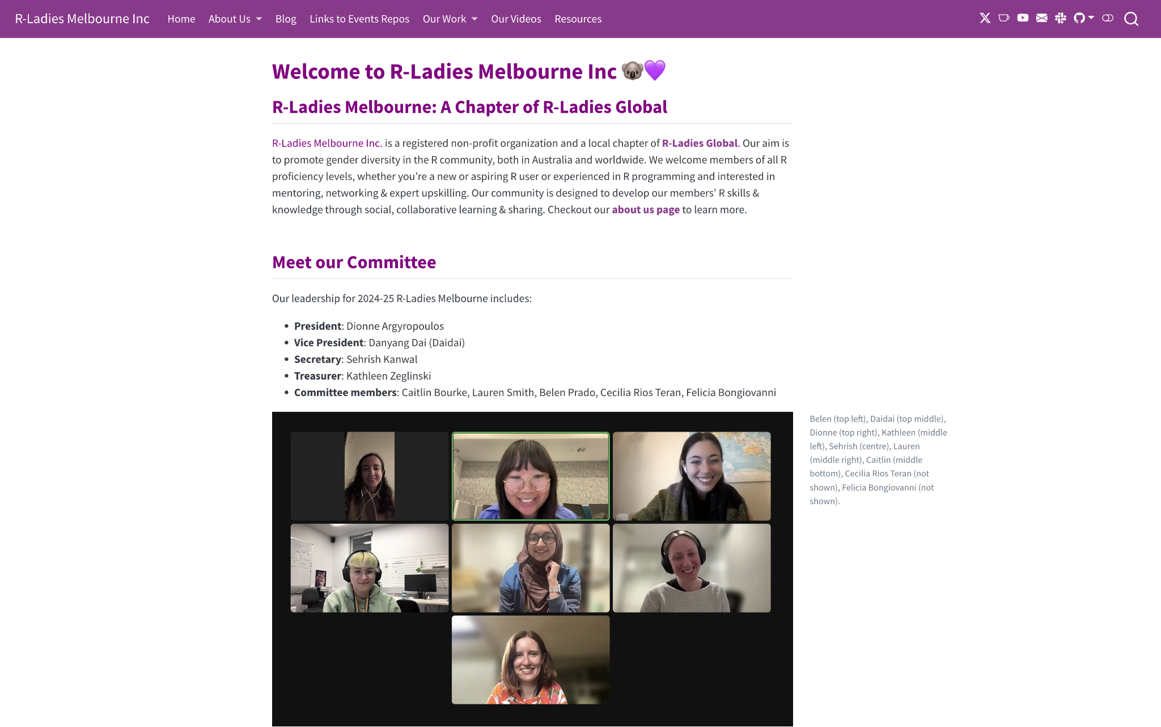
Notes:
We have a website that houses all of our main goals, as well as updates on events, our committee, and our legacy, and resources

