Slide 1
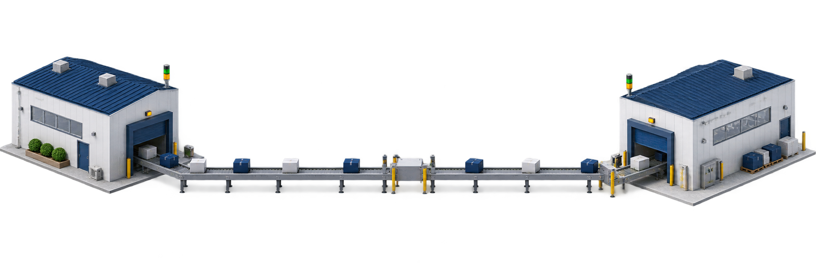
ARMATURE MONITORING SYSTEM
SLIDE 1 / 3
Material Flow & System Usage — ARMATURE LINE BOP ↔ BLOWER ASSY BOP
BLOWER ASSY BOP
FUNGSI VIEWER
PRODUCTION
1
LOGIN
2
PILIH K62/K70
3
CHECK STOCK
4
USE MATERIAL
5
REQUEST MATERIAL
✓
Melihat stock material
View, use, and request material
✓
USE dan REQUEST material
✓
Melihat ARMATURE RUNNING
ARMATURE LINE BOP
FUNGSI BOP
SUPPLY
1
LOGIN
2
DASHBOARD
3
REQUEST RECEIVED
4
PROCESS REQUEST
5
UPDATE STOCK
✓
Monitoring stock
Handle request and actual stock
✓
Menangani request
✓
Update actual stock
PENDING
ONGOING
DONE
✓
Edit ARMATURE RUNNING
IMPORTANT
DONE hanya menyelesaikan request. DONE tidak otomatis menambah stock. Stock berubah melalui USE atau UPDATE STOCK.
REQUEST MATERIAL · BLOWER ASSY BOP → ARMATURE LINE BOP
ARMATURE LINE BOP
BLOWER ASSY BOP
ARMATURE SUPPLY / STOCK UPDATED · ARMATURE LINE BOP → BLOWER ASSY BOP
Notes:
System overview. Viewer and BOP each have a separate role-based flow. DONE closes a request only; USE or UPDATE STOCK changes stock.

Slide 2
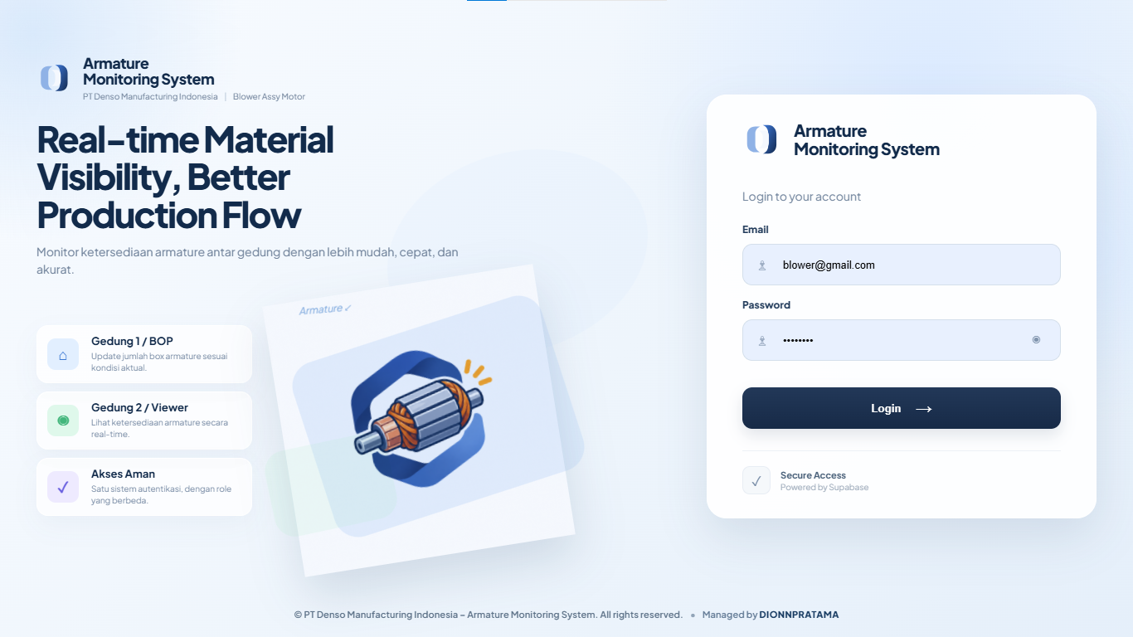
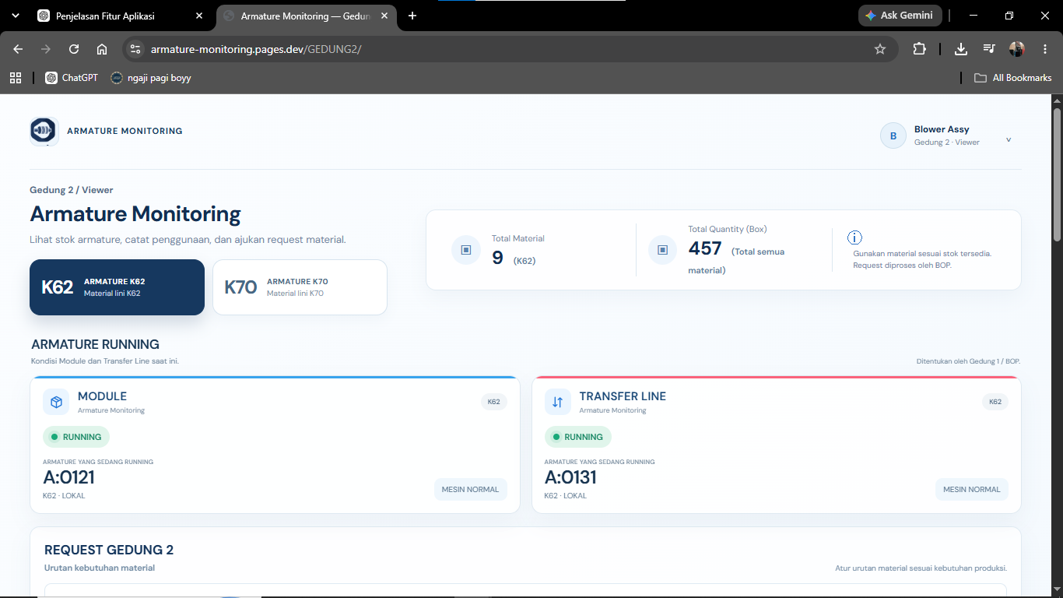
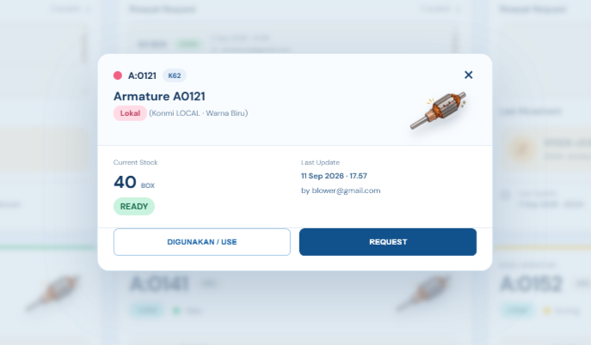
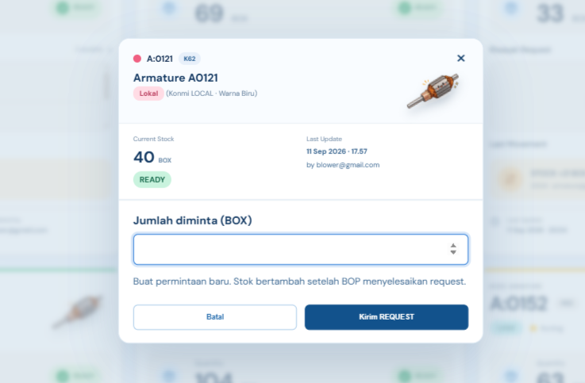
BLOWER ASSY BOP
SLIDE 2 / 3
Viewer / Production User Flow
VIEWER USER FLOW
VIEW + USE + REQUEST
01
02
03
04
VIEWER LOGIN
VIEWER DASHBOARD
USE MATERIAL POPUP
REQUEST MATERIAL POPUP
01 LOGIN
02 SELECT & CHECK
A. USE MATERIAL
B. REQUEST MATERIAL
Login menggunakan akun role Viewer / Production.
K62
K70
USE Input jumlah BOX Confirm
REQUEST Input BOX Submit
✓
Part Number
10 BOX → USE 4 BOX → 6 BOX
PENDING
SECURE ACCESS
✓
Quantity BOX
Stock otomatis berkurang sesuai jumlah material yang digunakan.
Request dikirim ke ARMATURE LINE BOP untuk diproses.
✓
Status READY / EMPTY
✓
Last Update
BLOWER ASSY BOP
Production checks available stock before using or requesting material.
FLOW NOTE
Viewer dapat melihat data dan mencatat penggunaan. Viewer tidak dapat mengubah actual stock secara langsung.
VIEW STOCK
USE
REQUEST
Notes:
Viewer flow: login, select K62 or K70, check stock, then use material or submit a request. Replace all four dashed frames with original screenshots.

Slide 3
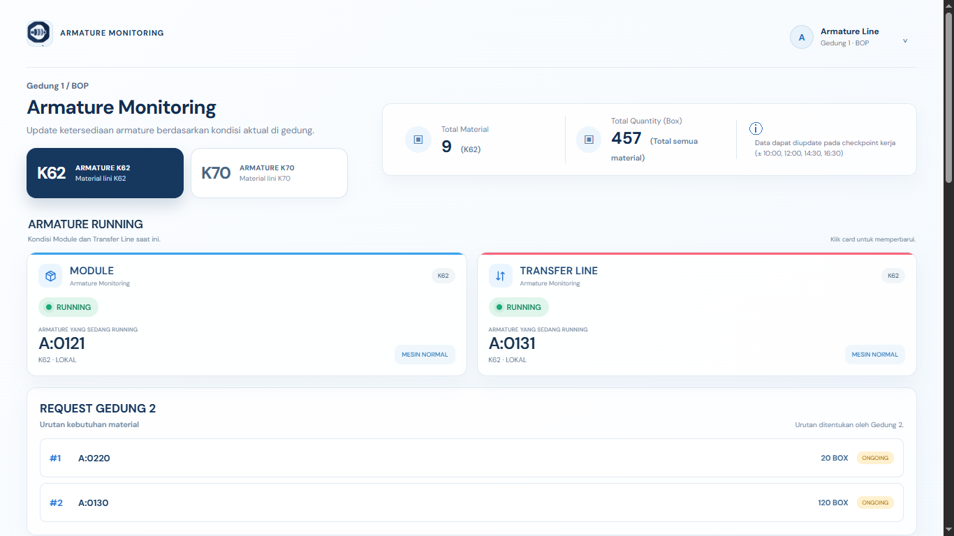
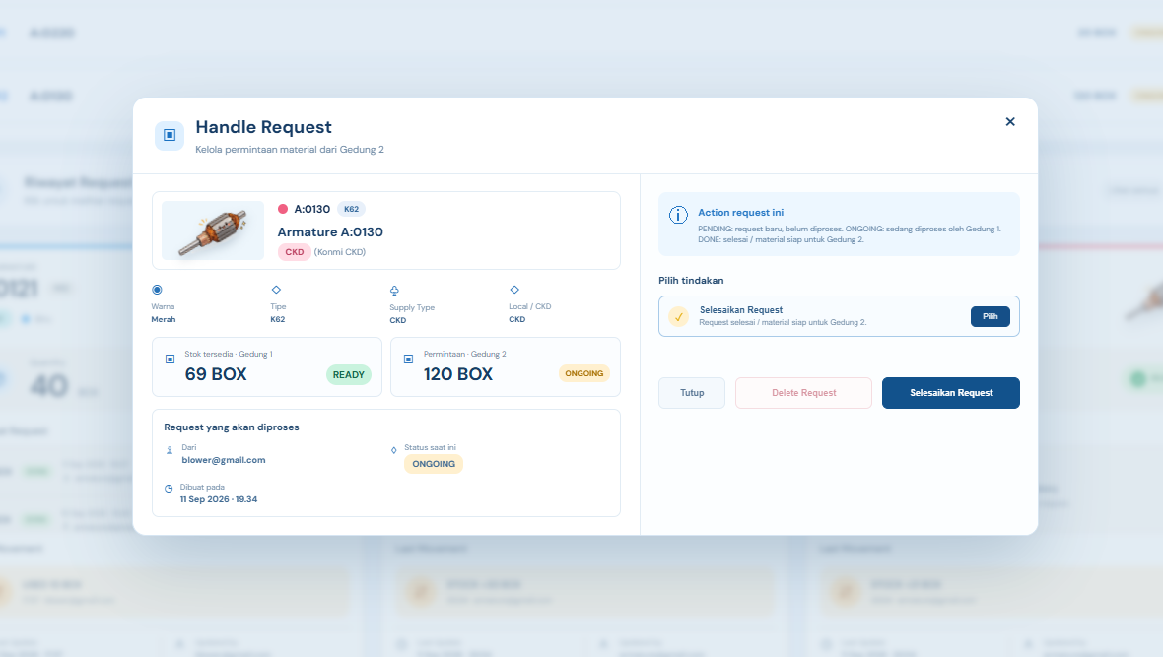
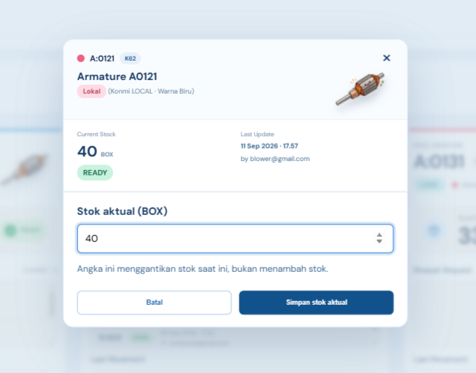
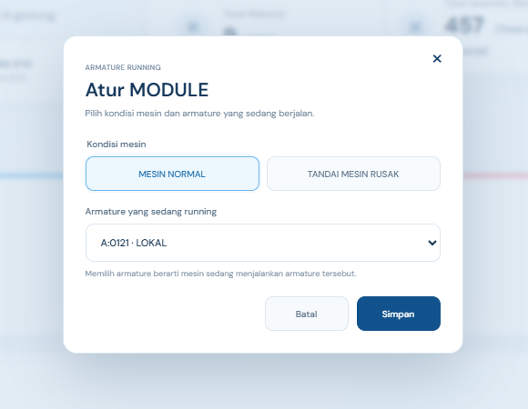
ARMATURE LINE BOP
SLIDE 3 / 3
Material Supply & Request Handling Flow
BOP USER FLOW
EDIT ACCESS
01
02
03
04
BOP DASHBOARD
REQUEST PROCESSING
UPDATE STOCK
ARMATURE RUNNING
01 LOGIN & DASHBOARD
02 HANDLE REQUEST
03 UPDATE STOCK
04 ARMATURE RUNNING
✓
Monitoring stock
REQUEST RECEIVED
Input actual stock setelah material disiapkan atau dikirim.
BOP menentukan material yang sedang running pada Module dan Transfer Line.
✓
Lihat request masuk
PENDING
ONGOING
DONE
✓
Check K62 / K70
STOCK UPDATED
MODULE
TRANSFER LINE
BOP menyiapkan dan mengirim material.
ARMATURE LINE BOP
BOP handles incoming requests, supplies material, and records actual stock.
IMPORTANT
DONE hanya menyelesaikan request. Stock berubah melalui USE atau UPDATE STOCK.
HANDLE REQUEST
UPDATE STOCK
Notes:
BOP flow: open dashboard, receive and process requests, move status from pending to ongoing to done, update actual stock, and edit Armature Running. Replace all four dashed frames with original screenshots.

