Slide 1
Capstone Project The Battle of Neighborhoods (Week 2)
A project for applied data science capstone

Slide 2
Predicting the most appropriate city, depending on needs
In general, finding the best city for specific needs worldwide, can be useful to:
Tourists
Travel agencies
Business People - Investors

Slide 3
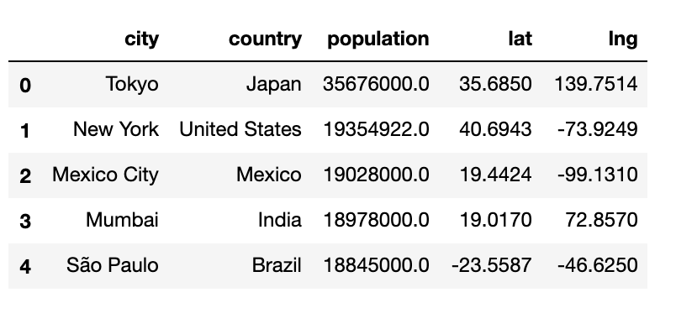
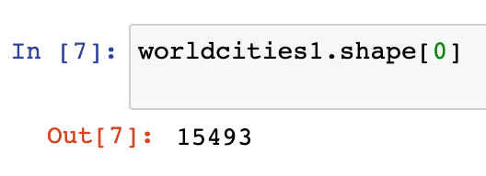
Data acquisition and cleaning
Cities worldwide from Simple Maps, data scraped from https://simplemaps.com/data/world-cities
In total, 15493 cities are included in the data

Slide 4
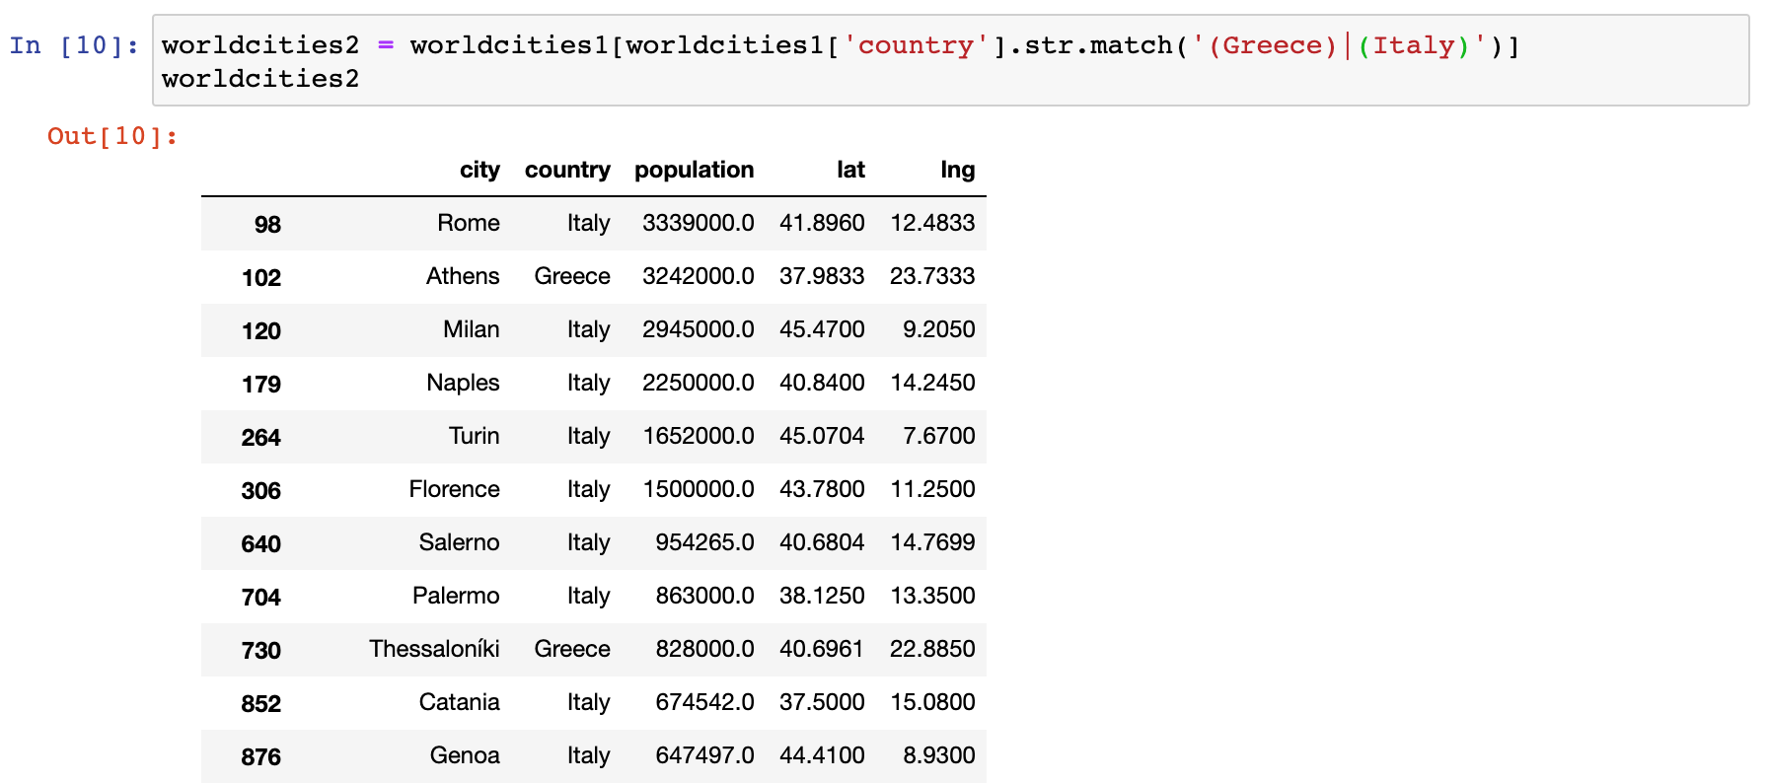
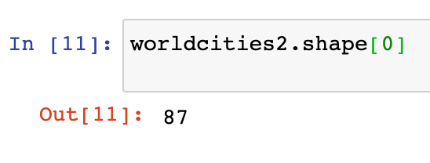
Data shorting (by country)
Since the customer asked for cities in Greece or Italy, shorting data by the country is essential.
In total, there are 87 cities in Greece or Italy

Slide 5
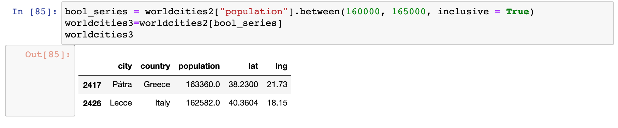
Data shorting (by population)
Since the customer asked for cities with population of about 160 to 165k people, population shorting is essential

Slide 6
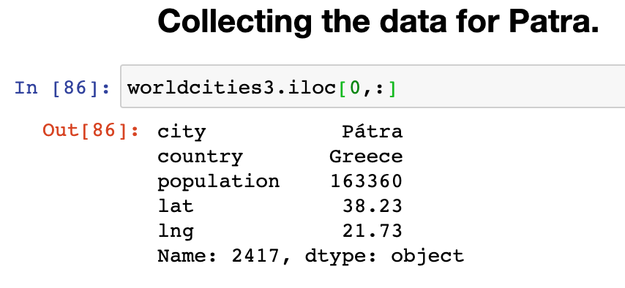
Result of the desired city
Collecting the data for the most appropriate city to the customer’s needs

Slide 7
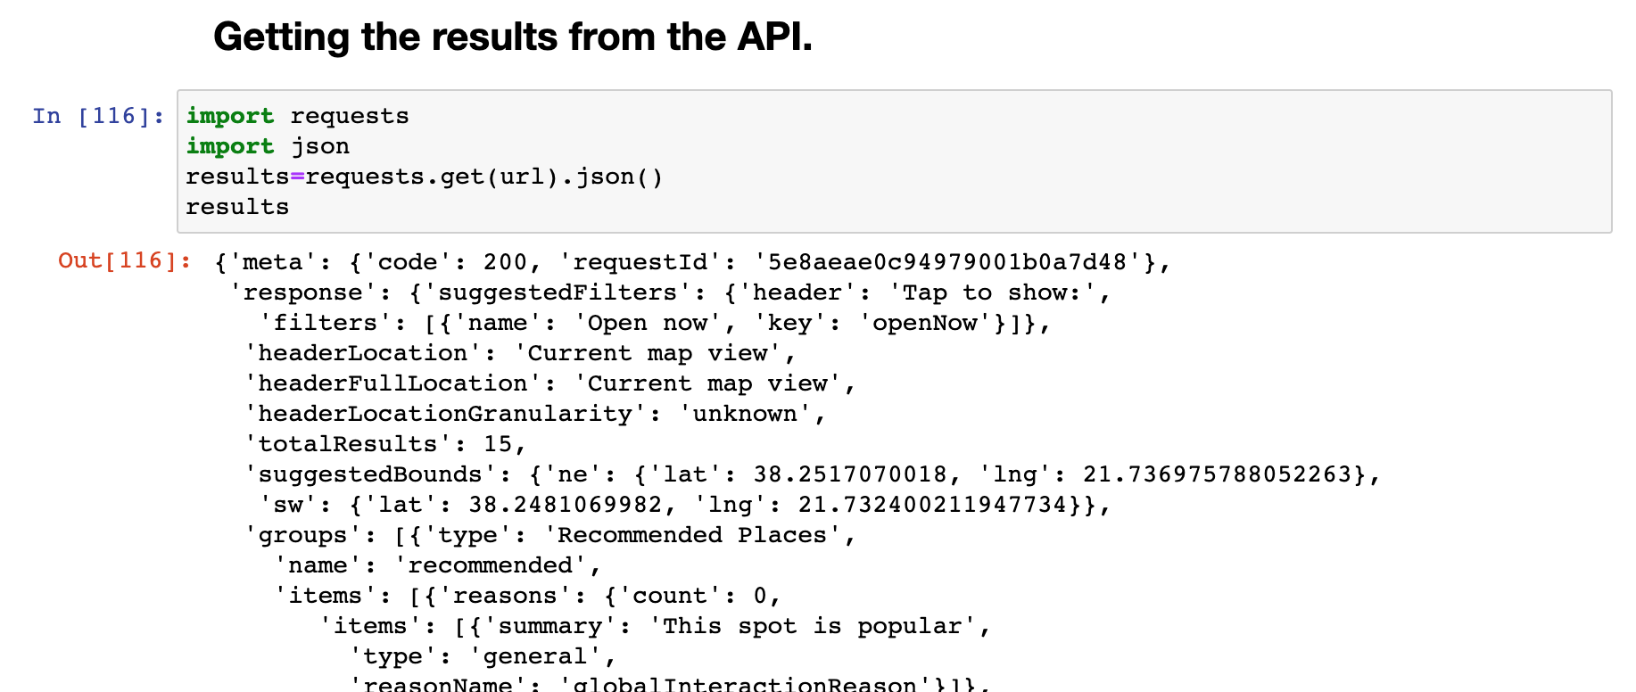
Importing data for the focus city
Data collectef from foursquare API, scrapped by https://foursquare.com/city-guide

Slide 8
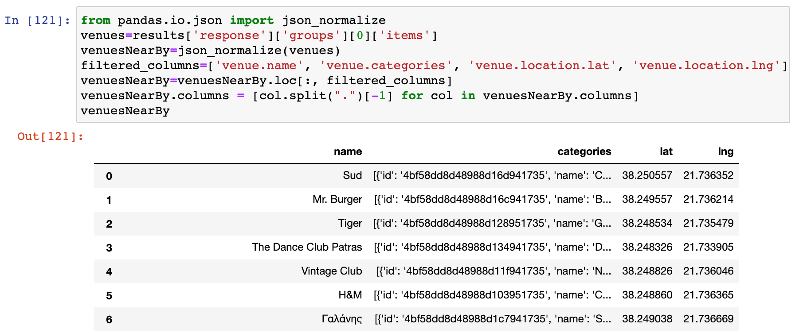
Shorting the foursquare data
From the foursquare data we are keeping the venue name and category along with the geo coordinations

Slide 9
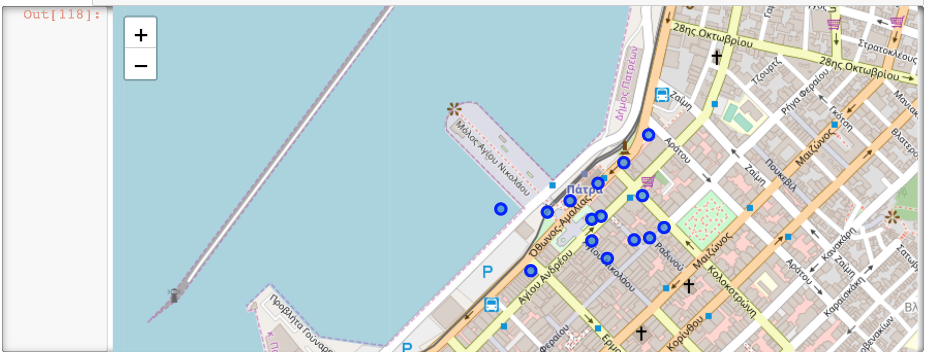
Constructing a Map
Merging the foursquare data and presenting them inside a map
Venues can be seen as the blue dots

Slide 10
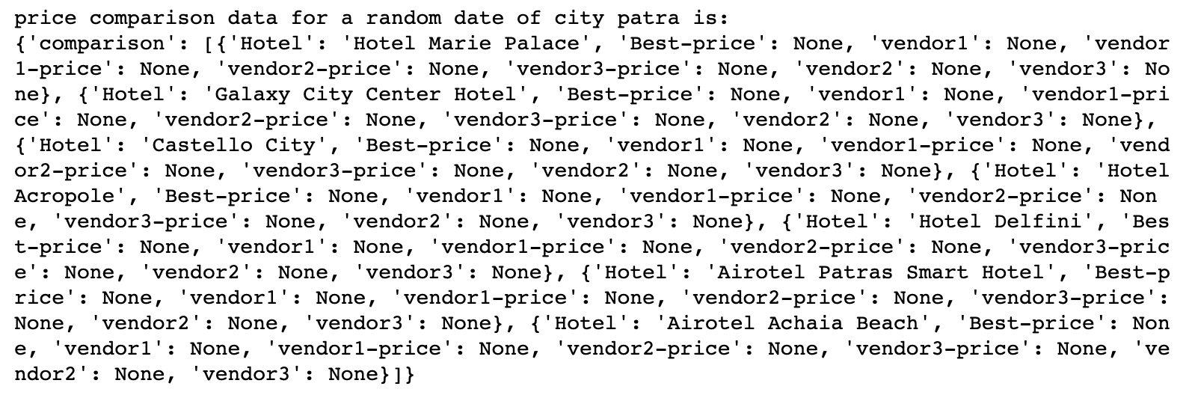
Hotel room search
Calling the API from the Makcorps, the hotel with a price of 200€ is presented.

Slide 11
Conclusion and future directions
Built useful models to predict desired cities for
Travellers
Travel agencies
Business people – Investors
Change or data for more demanding searches
Include google Maps API in order to attract more people

