Slide 1

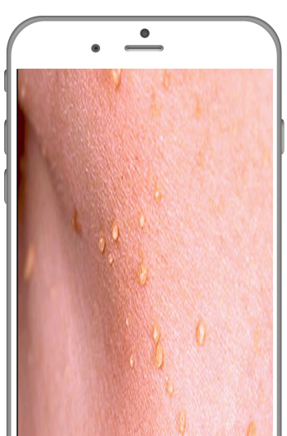



Skinalytics
Snap & Diagnose
Identifying skin diseases with deep learning
15,000 images scrapped from Google
Convolutional Neural Network
Web-based application and Facebook messenger
Notes:
Skinalytics is a Snap N Diagnose solution that can identify over 30 common skin diseases (including STDs) through the use of deep learning.
Research has shown that increasingly, people avoid visiting the doctor due to downplaying the severity of their condition, or being too embarrassed to., and skinalytics aim to address this.
To achieve this feat was a 3 step process.
1) We first scraped 15000 images, feature engineered by hand, and preprocessed to obtain a total of over 60000 images.
2) We researched and developed a customised CNN for this task alone, and repeatedly tuned the network to ensure maximum accuracy
3) Finally, we developed both a webapp and a facebook messenger bot for user accessibility.
<demo>
To further value add to the identification, our app is able to provide additional information such as possible symptoms as well as expected time for recovery. This will tell the person if it’s a potentially series problem that requires a visit to the doctor.
< if time, talk about future potential?>

