Slide 1
Forecasting Rossmann Sales via Gradient Boosting
Qian Wang Liang Zhang Xiang Huang

Slide 2
Introduction
Rossmann is a drug giant that operates over 3000 stores in 7 European countries.
Our goal is to forecast sales based on 2.5 years of sales history.

Slide 3
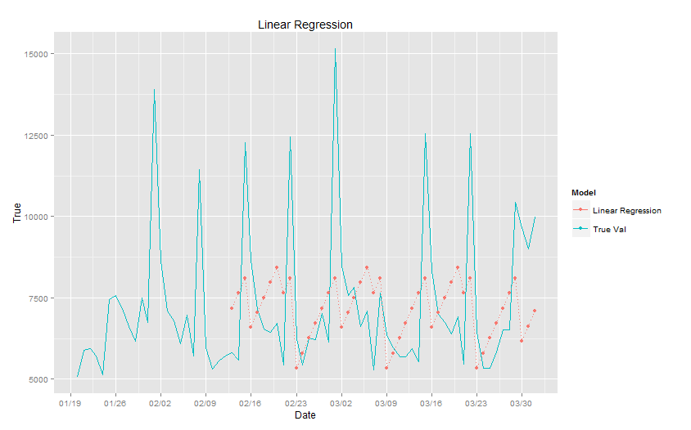
Methodology
Multiple Linear Regression did not yield satisfying results.
We decided to use boosting, a meta-learning algorithm.

Slide 4
What is boosting?
It is an ensemble algorithm that iteratively learns weak-learners and add them to a strong one.
Complementary weak-learners are generated according to the mistakes from previous learners.
One way of combining them is via gradient descent boosting

Slide 5
How to train weak-learners?
We use simple linear regression to train weak-learners.
- Each feature
If we choose the SSE as the accuracy metric, then the residual from previous model is indeed the gradient.
By regressing the residual on each feature, we obtain many weak-learners that corresponds to many refining directions.

Slide 6
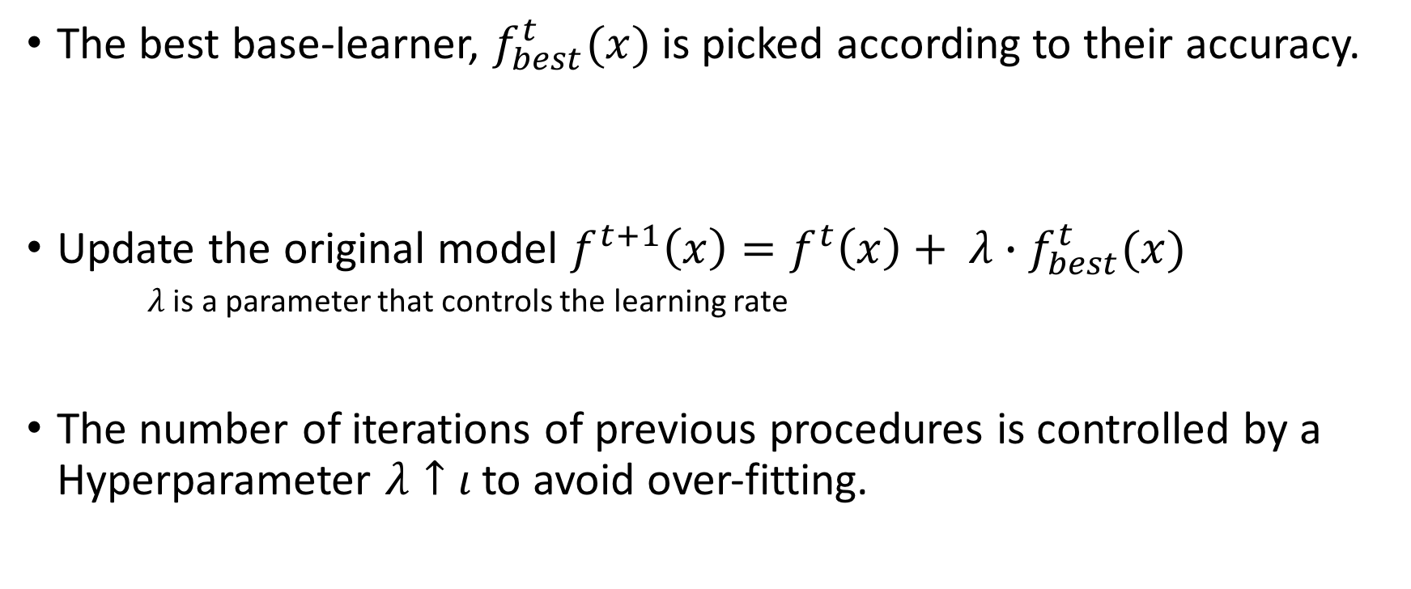
How to combine weak-learners?
The best base-learner, $f_{best}^{t}(x)$ is picked according to their accuracy.
Update the original model $f^{t+1}\left(x\right)=f^{t}\left(x\right)+ λ∙f_{best}^{t}(x)$
$λ$ is a parameter that controls the learning rate
The number of iterations of previous procedures is controlled by a Hyperparameter $λ↑ι$ to avoid over-fitting.

Slide 7
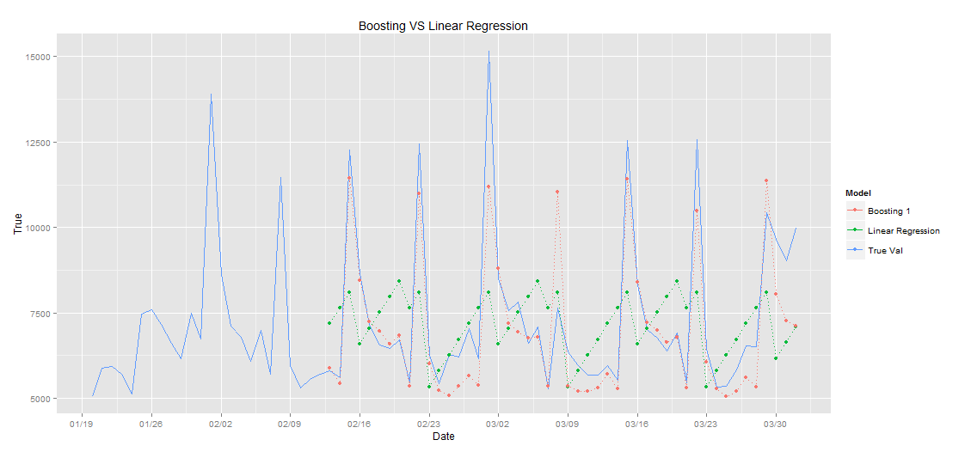
Results
Boosting has done a far better job than a single learner

