Slide 1
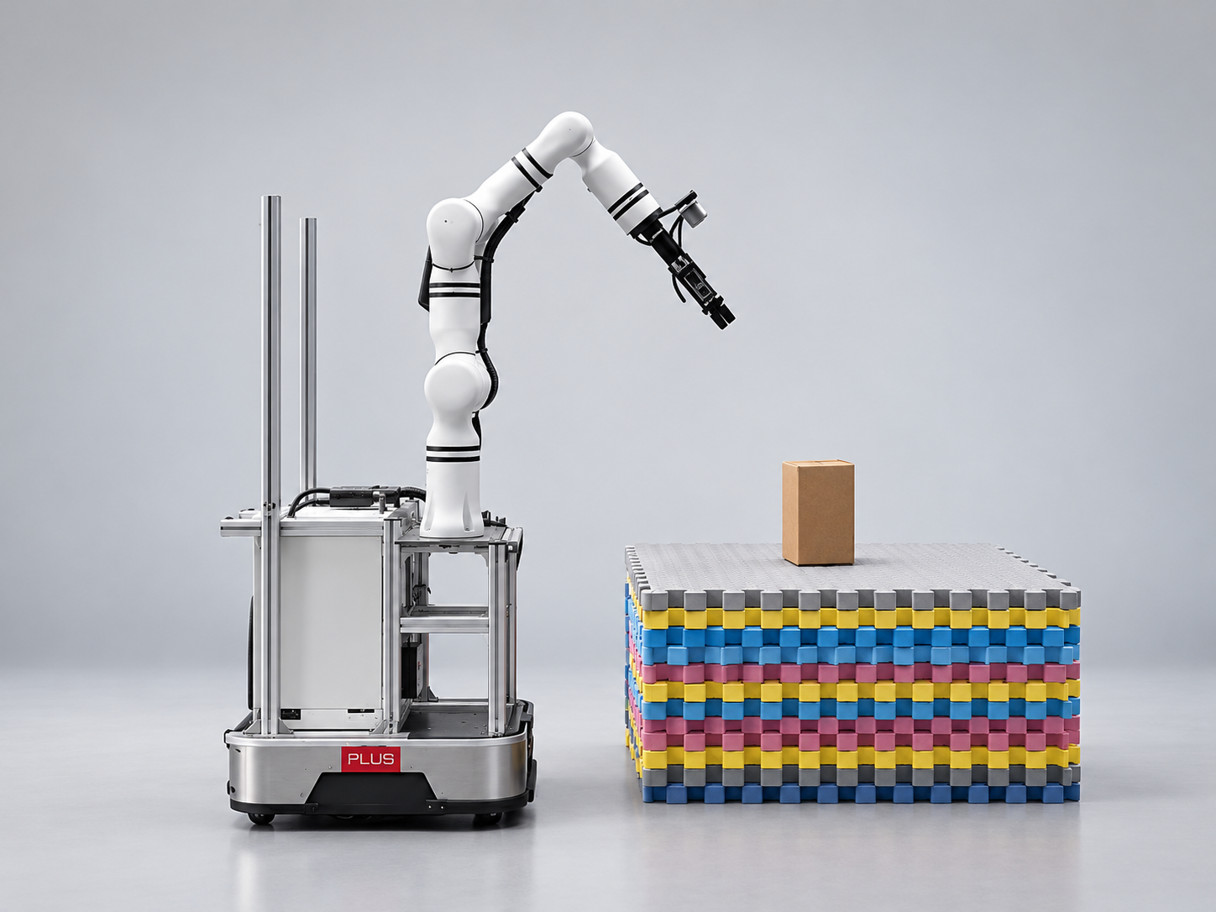
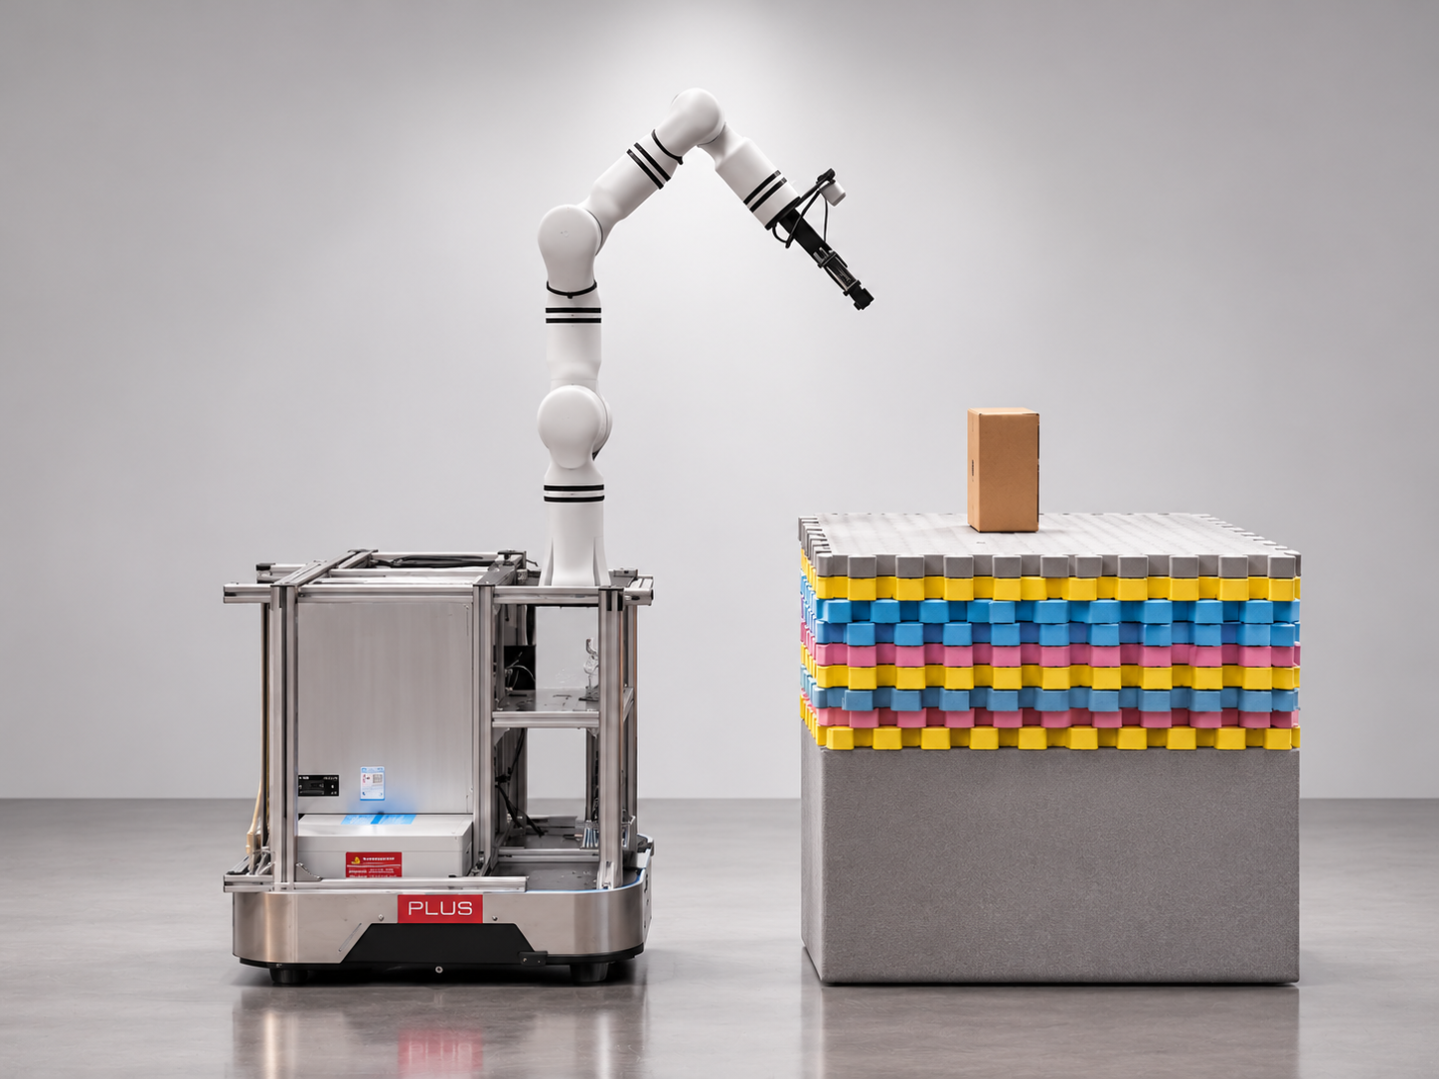
INTERIM ASSESSMENT · 28 OCTOBER 2026
GAPPLER
High-Readiness Mobile Manipulation via Gaze-Speech Interaction and Continuous Pre-Alignment
Look at it, name it, and the robot fetches.
Dion · Sherman · Zongzhe
Supervisors: Prof Xie Lihua, Dr Yuan Shenghai

Slide 2
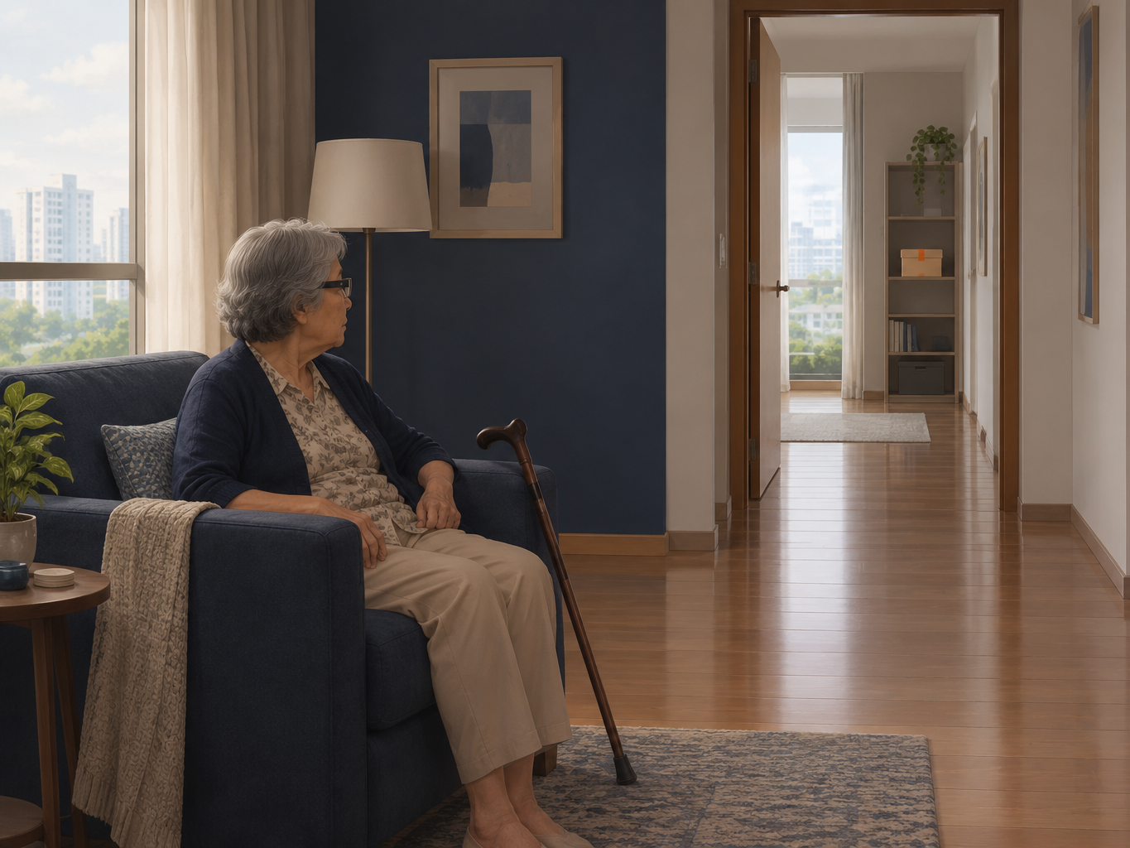
AT HOME · THE BOX IS ROOMS AWAY
PART 1 / 3 · WHY IT MATTERS
For older people, the hard part is getting there
Stay put. Look at it, ask for it.
1 in 4
1 in 5
Singapore citizens aged 65+ by 2030
seniors aged 65+ fall each year
NPTD, Population in Brief 2025
HealthHub, Ministry of Health
She stays seated, looks at the box and asks. The robot makes the trip.
Illustration (AI-generated)
Problem and plan
Results
Where we stand

Slide 3
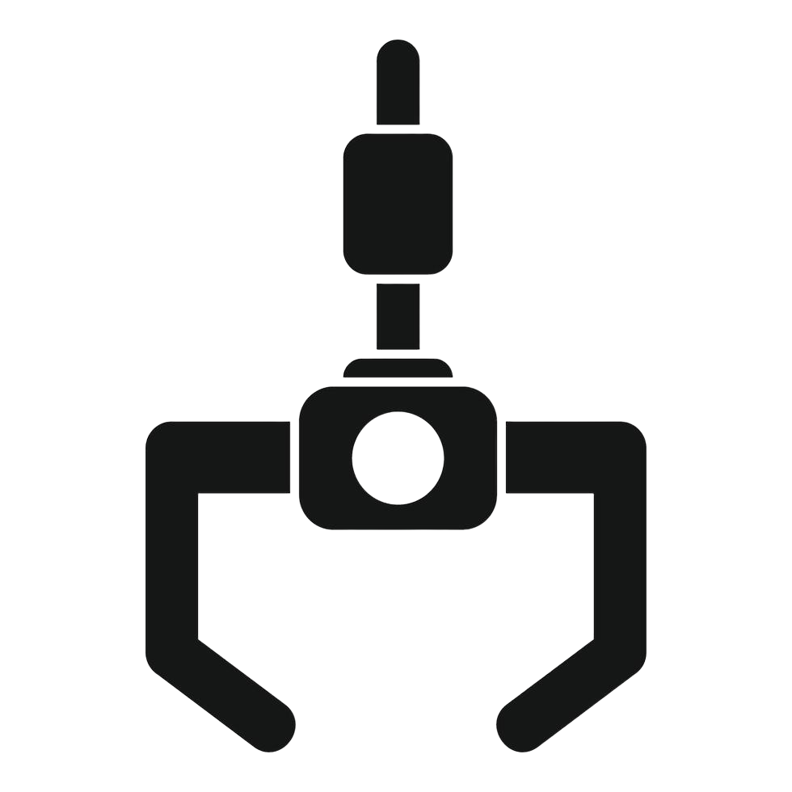


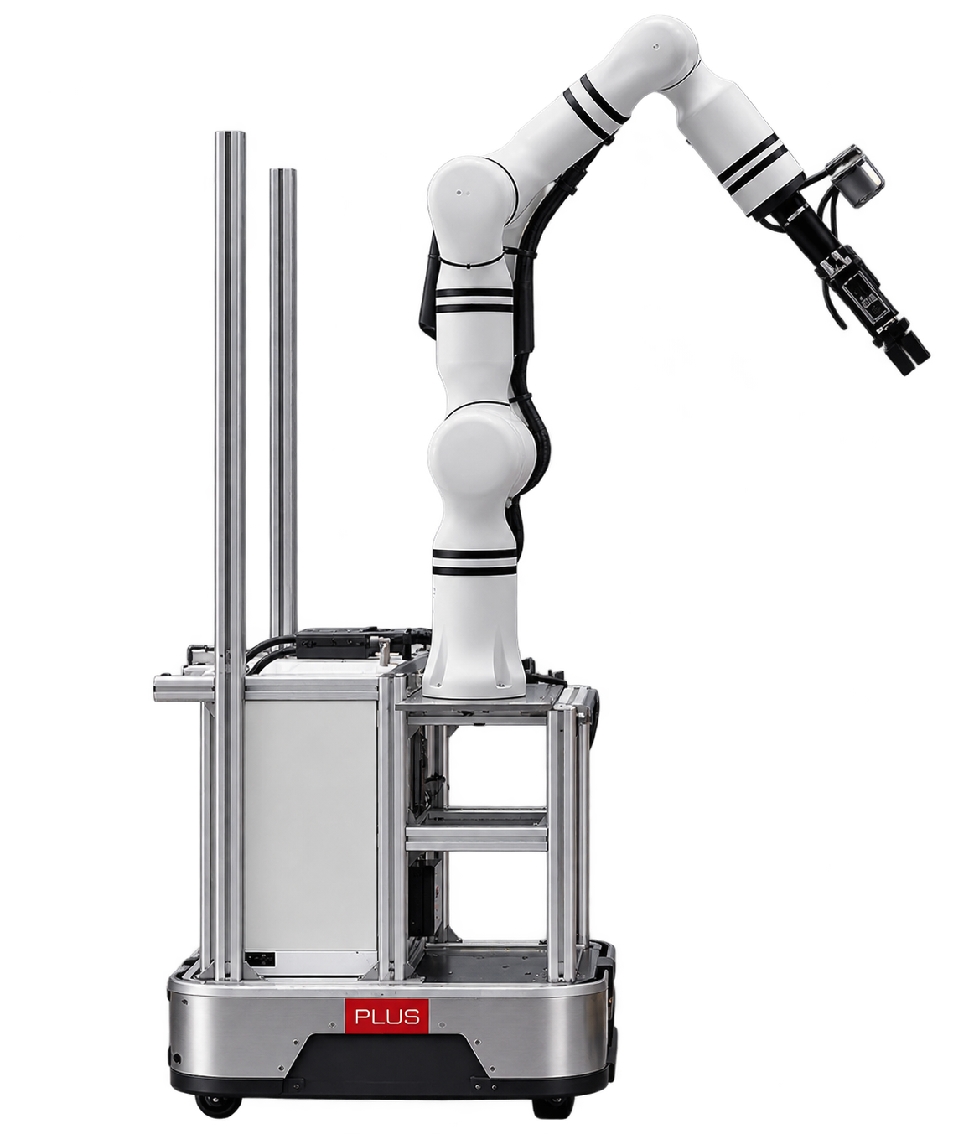







GAPPLER · DION
THE BIG PICTURE
The BIG Picture
Someone looks at an object and names it. The robot does the rest.
ROBOT'S ROOM
YOUR ROOM
your box
can't see your room
you, in smart glasses
look-alike
starting spot
no: keep looking
1
2
3
yes
4
5
Your box?
You look and ask
Robot comes over
Searches the room
is it the one you looked at
Picks it up
Brings it to you
“get me the box”
from another room
where you can see
with its arm
later, beyond this project

Slide 4


GAPPLER · DION
THE OBJECTIVE
Find, reach and grasp the object the user looked at
A new system, built on two published ones
FAM-HRI · LAI ET AL., 2025
HICO-NAV · XU ET AL., ICRA 2026
Gaze and speech from the glasses tell a table-mounted arm what to pick
Explores an unseen room and remembers each object's 3D position and image feature
ASSUMES
ASSUMES
The object is unobstructed, in front of the arm (fixed to table)
Fixed cameras: the wrist camera sees what the user sees
Finding is enough: no grasping, speech is the only input
“Find a box” returns any box, not the one you looked at
MILESTONES, EACH WITH A WRITTEN TEST (APPENDIX A10)
M1
M2
M3
M6
M7
M8
M11
M12
M10
Arm picks something up
Voice and gaze reach the arm
Base navigates
Memory graph
HiCo-Nav steers the search
Gaze picks the instance
Orchestrator runs every phase
Base parks within reach
Demo and paper
Evaluation: end-to-end trials, success per phase. Also M0, M4, M5 and M9.
4
Problem
System
Intent
Explore
Search
Confirm
Grasp
Plan

Slide 5


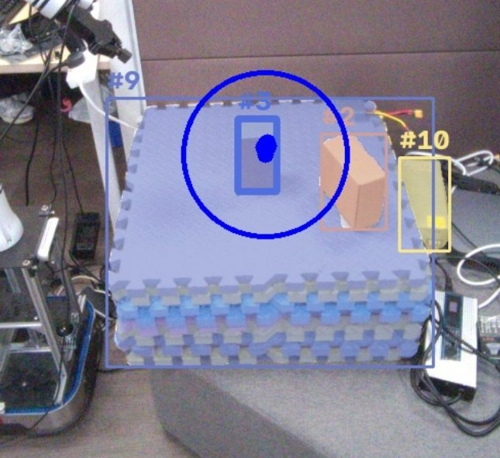
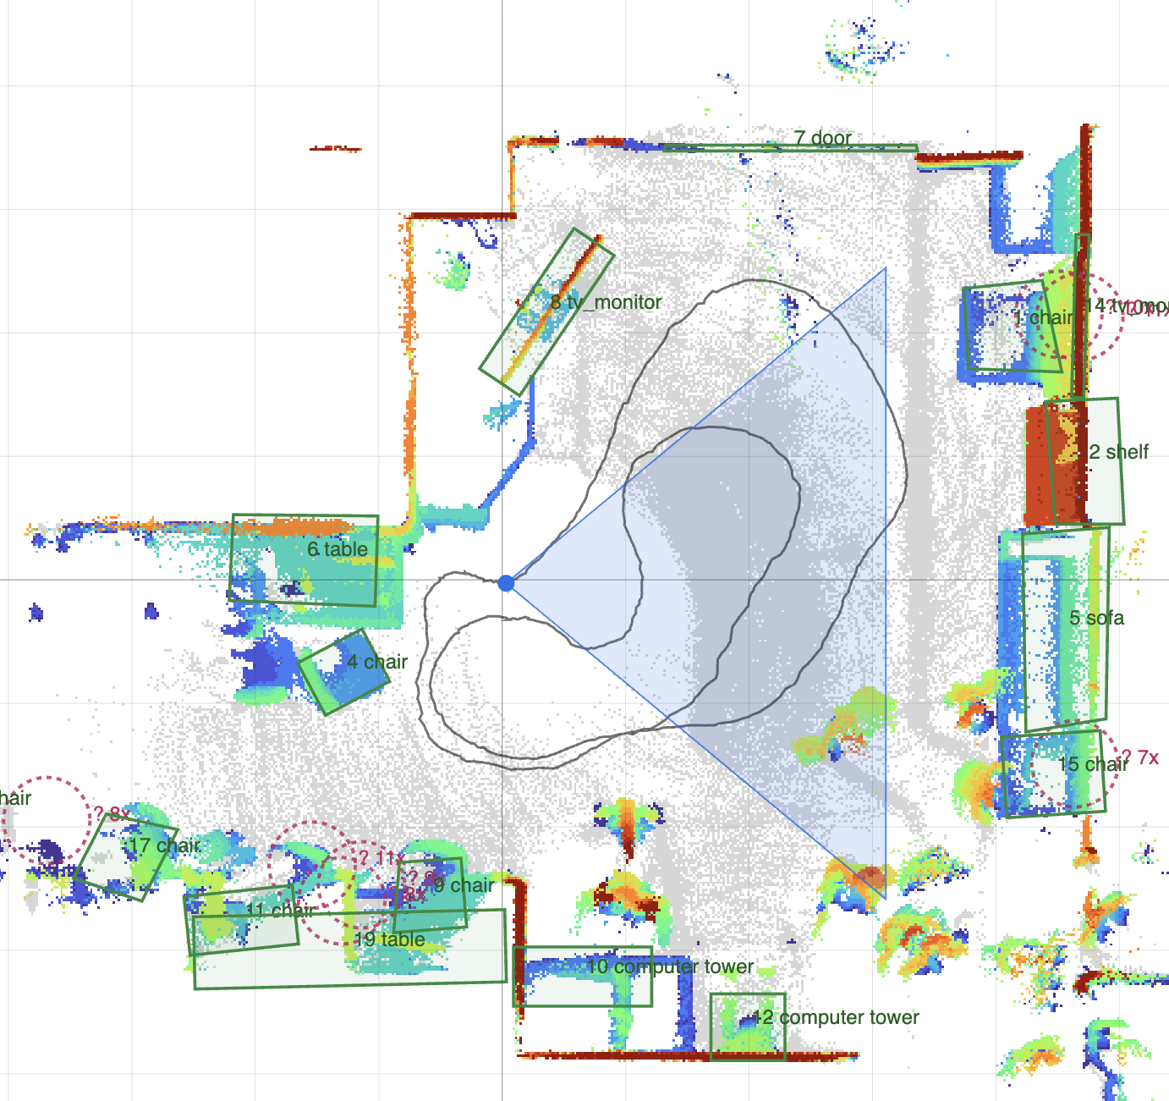
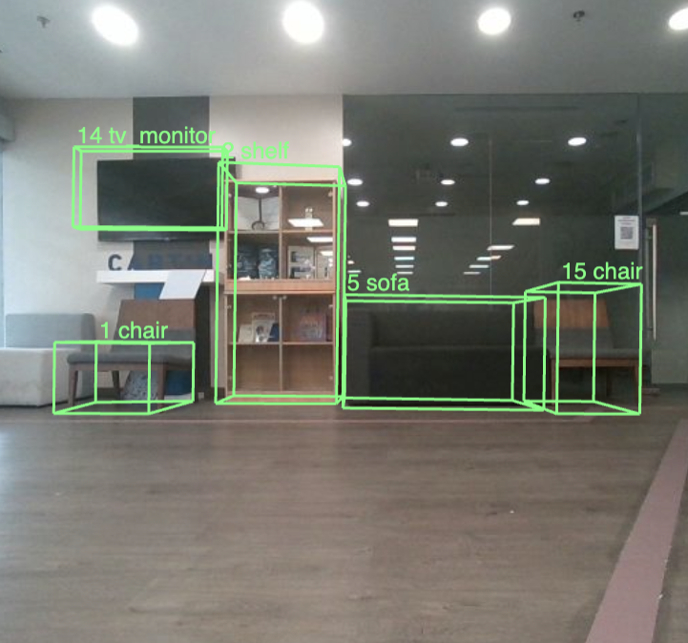
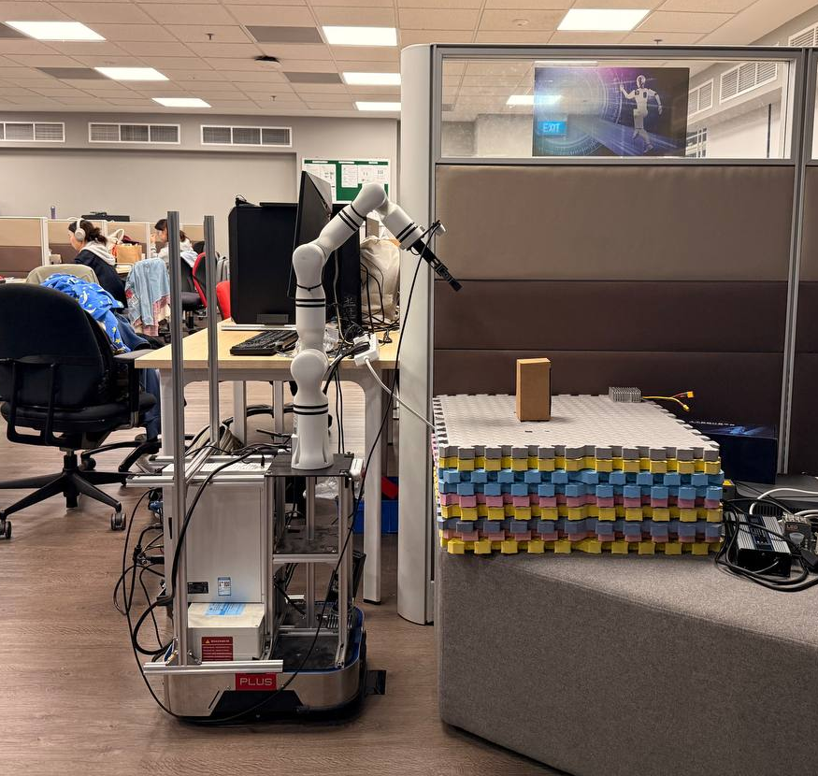
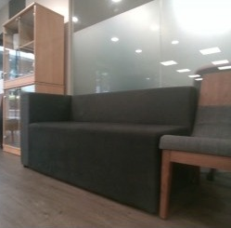
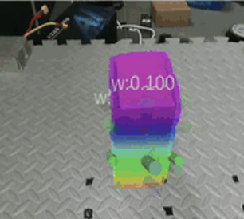
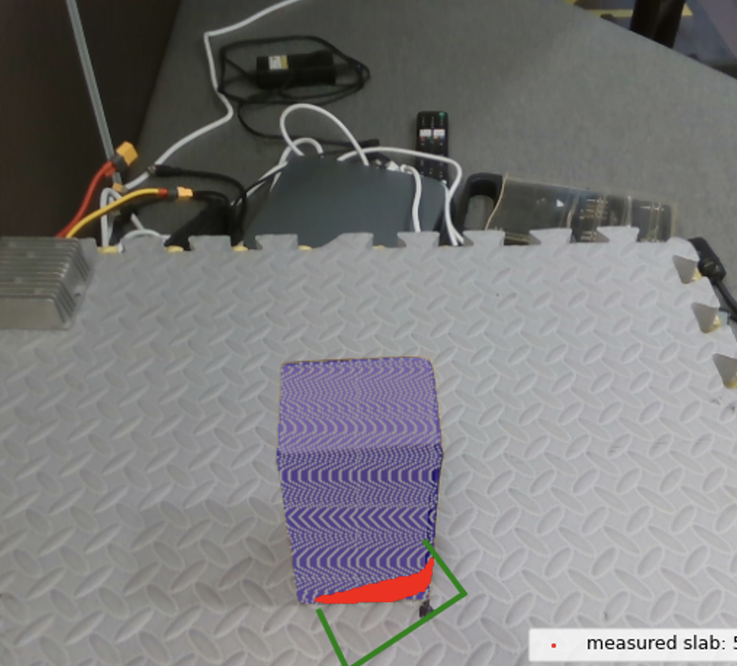
GAPPLER · ZONGZHE
THE SYSTEM
The target system works in five phases
From a spoken word and a glance to a grasp, in a room the robot has not seen
INTENT CAPTURE
EXPLORE AND MAP
SEARCH
APPROACH AND CONFIRM
GRASP
WHAT IT IS
WHAT IT IS
WHAT IT IS
WHAT IT IS
WHAT IT IS
Obtain user prompt from speech and target object from gaze
›
Explore and map room, remembers objects and finds user
›
Match stored objects to the target object, output object list and their positions ranked by confidence
›
Drive close to the possible item, wrist camera verifies, repeat until target object verified
›
Choose, plan and execute the grasp if verified
5
Problem
System
Intent
Explore
Search
Confirm
Grasp
Plan

Slide 6



GAPPLER · SHERMAN
OUR APPROACH
Open-source parts, plus what was missing
Every phase starts from published work we reviewed. Below each tool is what we added
INTENT CAPTURE
EXPLORE AND MAP
SEARCH
APPROACH AND CONFIRM
GRASP
Aria SDK, SAM 3
FAST-LIVO2,
HiCo-Nav graph
HiCo-Nav, CLIP,
Qwen2.5
CLIP
AnyGrasp,
MoveIt 2
›
›
›
›
WE ADDED
WE ADDED
WE ADDED
WE ADDED
WE ADDED
A gaze vote picks one object
Three port bugs fixed, graph written fresh
Sentence to object classes, with a fall-back
Glasses-to-wrist match, after keypoints failed
Grasp filters, safe state machine, stop
RESULT · SLIDE 8
RESULT · SLIDE 9
RESULT · SLIDE 13
RESULT · SLIDE 14
RESULT · SLIDE 15
BETWEEN THE PARTS
The gaze match
Clear ownership
One step at a time
joins the two papers
one owner for every connection
two people at the robot
6
Problem
System
Intent
Explore
Search
Confirm
Grasp
Plan

Slide 7
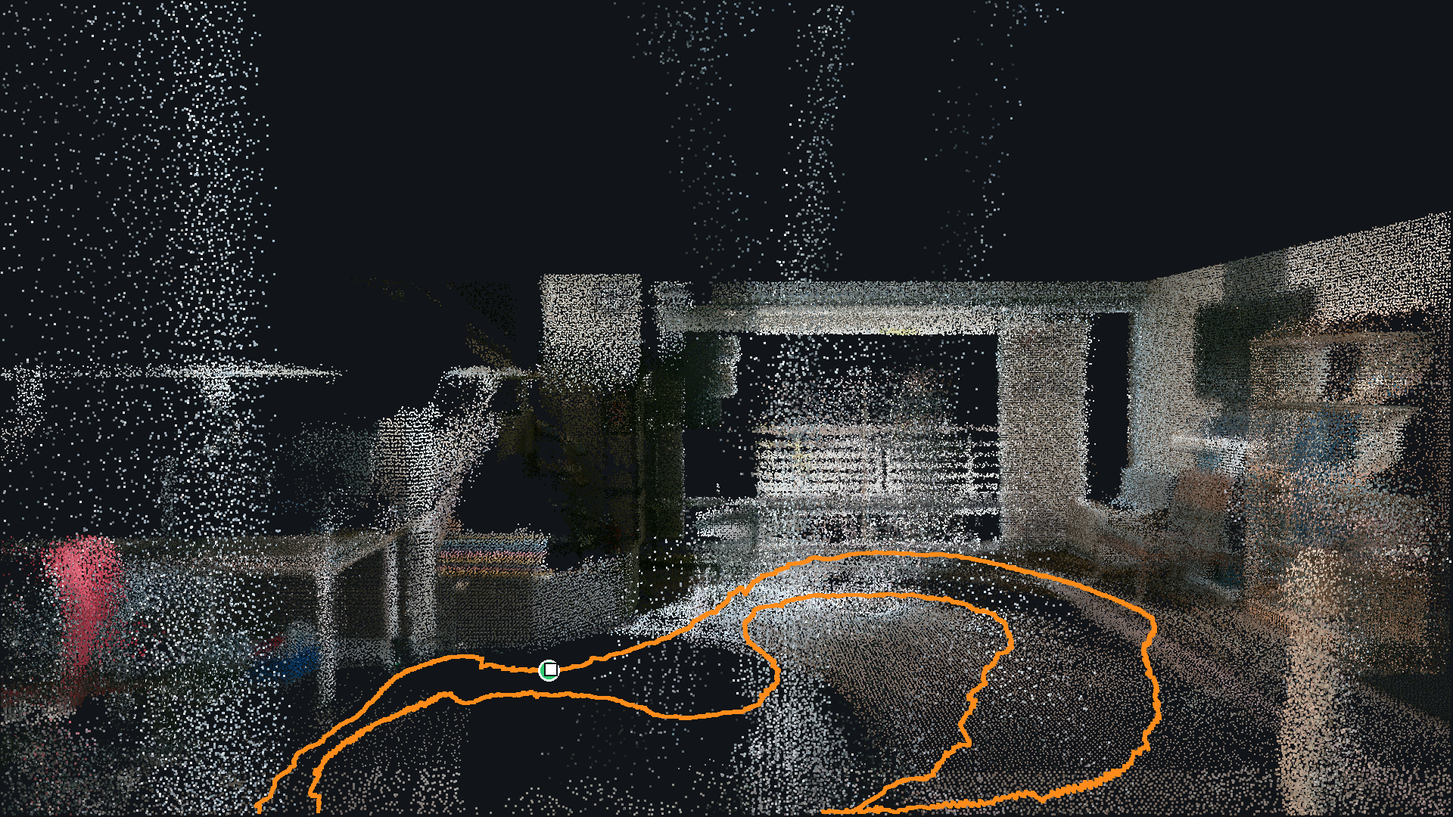
MOBILE BASE · FAST-LIVO2 MAP
PART 2 / 3
Results, phase by phase
Every stage measured on real hardware or real recordings
Inside the lab map. Orange: the 26 m hand-pushed path.
Problem and plan
Results
Where we stand

Slide 8

GAPPLER · DION
PHASE 1 · INTENT CAPTURE
Speech gives the word, gaze picks the object
A one-second gaze vote over SAM 3 masks makes the reference crop sent to the robot
PHASE 1
“Find the box.”
RIGHT BOX, STEADY STARE
Voice
60 of 61
1
one word per sentence
Speech detector
waits until you finish
Gaze
recorded frames, at 1.4 to 2.4 m
2
streams simultaneously
Whisper
audio to text
Segment
3 of 4
3
SAM 3 finds every “box”
spoken words at 4 different locations with varying depth and angles found correct crop
Small language model
pulls out the object name
Vote
4
gaze picks a mask, then crop it
box
LIMIT
Hard to maintain gaze at fixed point for a long time and gaze estimation errors.
8
Problem
System
Intent
Explore
Search
Confirm
Grasp
Plan

Slide 9
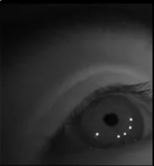
GAPPLER · DION
PHASE 1 · INTENT CAPTURE
Speech gives the word, gaze picks the object
A one-second gaze vote over SAM 3 masks makes the reference crop sent to the robot
PHASE 1
Eye cameras
track your pupils
Gaze point
where you are looking
RIGHT BOX, STEADY STARE
Voice
60 of 61
1
one word per sentence
Gaze
recorded frames, at 1.4 to 2.4 m
2
streams simultaneously
Segment
3 of 4
3
spoken words at 4 different locations with varying depth and angles found correct crop
SAM 3 finds every “box”
Vote
4
gaze picks a mask, then crop it
LIMIT
Hard to maintain gaze at fixed point for a long time and gaze estimation errors.
The gaze point is placed on the RGB image from the glasses, shown here.
9
Problem
System
Intent
Explore
Search
Confirm
Grasp
Plan

Slide 10
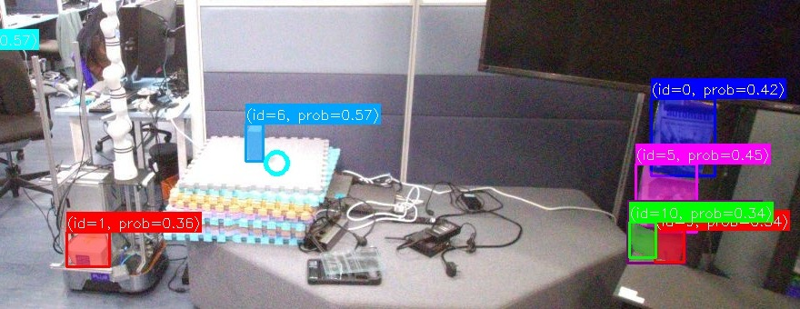
GAPPLER · DION
PHASE 1 · INTENT CAPTURE
Speech gives the word, gaze picks the object
A one-second gaze vote over SAM 3 masks makes the reference crop sent to the robot
PHASE 1
RIGHT BOX, STEADY STARE
Voice
60 of 61
1
one word per sentence
Gaze
recorded frames, at 1.4 to 2.4 m
2
streams simultaneously
SAM 3 PROMPT “BOX” · ONE MASK AND SCORE PER BOX
Segment
3 of 4
3
SAM 3 finds every “box”
Word
“box”
Image
from when you spoke
SAM 3
segmentation model
Masks
every box, with a score
spoken words at 4 different locations with varying depth and angles found correct crop
Vote
4
gaze picks a mask, then crop it
Many boxes in one frame. Which one did the user mean? Next: the gaze vote
LIMIT
Hard to maintain gaze at fixed point for a long time and gaze estimation errors.
10
Problem
System
Intent
Explore
Search
Confirm
Grasp
Plan

Slide 11
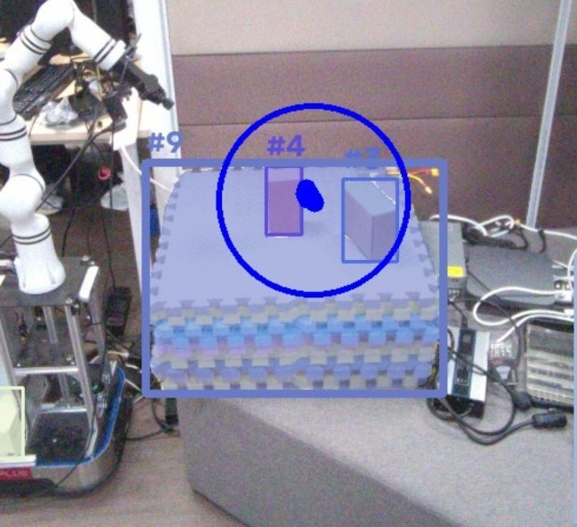
GAPPLER · DION
PHASE 1 · INTENT CAPTURE
Speech gives the word, gaze picks the object
A one-second gaze vote over SAM 3 masks makes the reference crop sent to the robot
PHASE 1
RIGHT BOX, STEADY STARE
Voice
60 of 61
1
one word per sentence
Gaze
recorded frames, at 1.4 to 2.4 m
2
streams simultaneously
Segment
3 of 4
3
SAM 3 finds every “box”
spoken words at 4 different locations with varying depth and angles found correct crop
Vote
4
gaze picks a mask, then crop it
1.0 M · BOX PICKED
1.5 M · GAZE ON THE MATS
LIMIT
Hard to maintain gaze at fixed point for a long time and gaze estimation errors.
Blue ring: gaze vote window. The mask closest to the gaze point wins the vote.
Tested on recordings and replay. Live stream still throttled.
11
Problem
System
Intent
Explore
Search
Confirm
Grasp
Plan

Slide 12
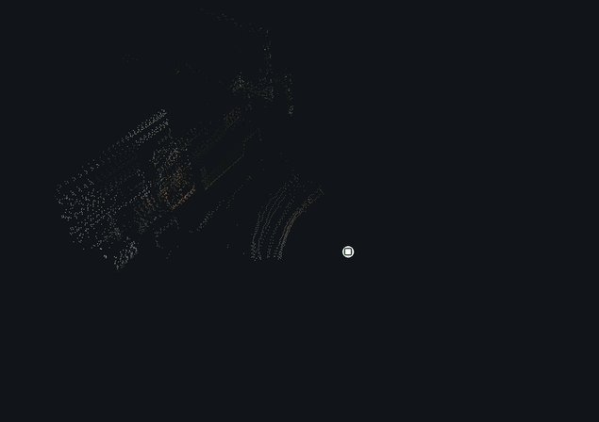


GAPPLER · SHERMAN
PHASE 2 · EXPLORE AND MAP
A 3D map that closes within 12 mm
FAST-LIVO2 fuses LiDAR, IMU and colour camera into one 3D pose
PHASE 2
3D SLAM
LOOP CLOSURE
1
12 mm
2
Sensor Calibration
back to start after 26 m
6.7 cm
LIMIT
Pushed by hand, not yet driven by Nav2
worst error mid-route
NEXT STEPS
11–14 ms
Nav2 drives it. The memory graph picks where to explore
per frame on CPU (budget 100)
Hand-pushed 26 m loop, 20 Oct. Orange = path, ring = start and end.
9
Problem
System
Intent
Explore
Search
Confirm
Grasp
Plan

Slide 13
GAPPLER · SHERMAN
PHASE 2 · EXPLORE AND MAP
One link left to calibrate, and the graph depends on it
Each missing calibration blocks a specific later step
PHASE 2
1
Base to arm
1
3D SLAM
Measured
User + glasses
Arm and base agree on where things are
2
Sensor Calibration
Wrist camera
Wrist camera to arm
2
2
Calibrated
Arm
3
A grasp the camera sees, the arm can reach
4
Glasses to robot
LIMIT
1
3
LiDAR
Planned
Base camera not yet calibrated
Gaze picks between identical objects
Mobile base
Base camera
NEXT STEPS
4
Base camera to LiDAR
Calibrate on a target, check by overlaying LiDAR points
Mount measured, not calibrated
Gives each object its depth in the graph
done
part way
planned
10
Problem
System
Intent
Explore
Search
Confirm
Grasp
Plan

Slide 14
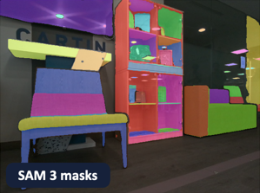





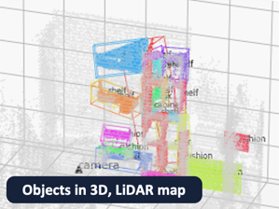

GAPPLER · ZONGZHE
PHASE 3 · SEARCH
As the robot drives, it builds a memory of objects
Each object gets a 3D position and a CLIP image feature, built from the recorded drive
PHASE 3
HOW THE GRAPH IS BUILT
ONE KEPT PHOTO, FRAME 700
1
Build memory
2
Check accuracy
Keep a photo
Find objects
Place in 3D
Describe
Merge repeats
3
Search memory
every 1 m or 45°
SAM 3
LiDAR depth
CLIP feature
mostly by position
LIMIT
29 of 3,536
5.7× faster
Built offline from a recorded drive. Not yet live while driving
photos kept
30 classes in one SAM 3 pass
How accurate these are: Check accuracy, two slides on
11
Problem
System
Intent
Explore
Search
Confirm
Grasp
Plan

Slide 15


GAPPLER · ZONGZHE
PHASE 3 · SEARCH
As the robot drives, it builds a memory of objects
Built once from the drive, then asked for every new prompt
PHASE 3
1 BUILDING THE GRAPH
1
Build memory
Recorded photos
MEMORY GRAPH
Objects in 3D
Check accuracy
29 kept from the drive
chair
each with a CLIP feature and position
2
Search memory
table
3
2 ANSWERING A PROMPT
box
LIMIT
User prompt
Ranked list
Built offline from a recorded drive. Not yet live while driving
“find the box”
Anchor: kept photo + camera pose
of objects and their positions
Object: 3D box, CLIP feature, class
12
Problem
System
Intent
Explore
Search
Confirm
Grasp
Plan

Slide 16
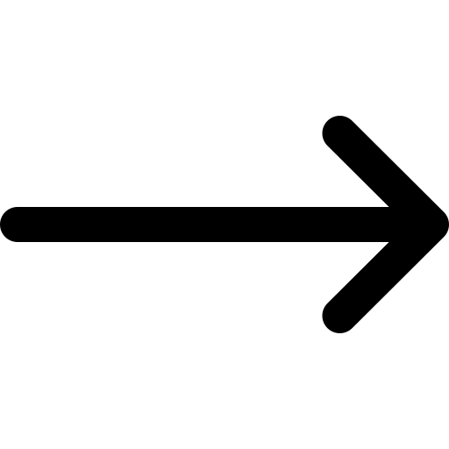

GAPPLER · ZONGZHE
PHASE 3 · SEARCH
Three changes keep the graph accurate when building it
Each one departs from HiCo-Nav and is measured on the lab drive
PHASE 3
Noise Filters
floor → seat
1
DUPLICATES AT 10 CM
1
Build Memory
chair centre height,
−0.02 → 0.58 m
8 3
LiDAR sees the floor through a chair's gaps
Prevents objects from being mapped to backgrounds or floors
2
Check Accuracy
with no false merges
2
One pixel, one object
5.4 % → 0
3
Search Memory
Graph decides merges based on overlap
pixels in two masks
Removing overlaps prevents wrong merges
Why not merge by look?
LIMIT
3
Determining merges
Duplicates by radius (cm)
Same chair
0.93
Two drives, 16 objects: a difference of one is noise
8
Same-model chairs
0.81–0.85
Graph needs to balance between minimising duplicates and preventing wrong merges
4
4
3
3
2
Other objects
0.56
At 15 cm, wrong merges occur
2.5
5
7.5
10
15
20
CLIP image similarity, 0 to 1
12
Problem
System
Intent
Explore
Search
Confirm
Grasp
Plan

Slide 17
GAPPLER · ZONGZHE
PHASE 3 · SEARCH
The robot then asks its memory where to go
Today the query is a sentence. In the full system, the gaze crop is the query (M8)
PHASE 3
1
LLM determines target object’s class based on prompt
Build Memory
SENTENCE TO CLASSES
1
›
20 of 22
“Find the chair”
chair
table
desk
2
Check Accuracy
2
Obtain prompt embedding
test instructions, checked by hand
3
Search Memory
Keep objects of target or related class, and rank by cosine similarity with prompt embedding
BY LANGUAGE MODEL
3
Qwen2.5 1.5B (used)
20/22
LIMIT
Full query on the recorded drive not run yet: T6.8, weeks 7 to 8
Return 2 ranked lists with respective 3D positions
No model, fallback
15/22
4
Target classes first, related classes second, each by score. Each hit has a 3D centre and its best photo. A wrong hit can be rejected.
Qwen2.5 0.5B
12/22
0.28 to 0.32 s per reply, on the lab machine
13
Problem
System
Intent
Explore
Search
Confirm
Grasp
Plan

Slide 18
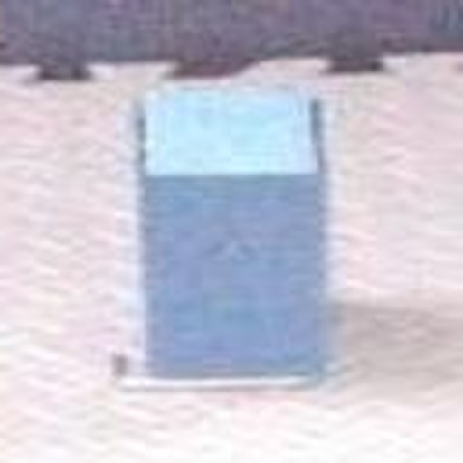
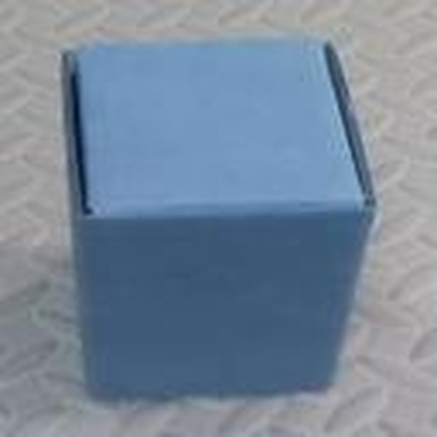
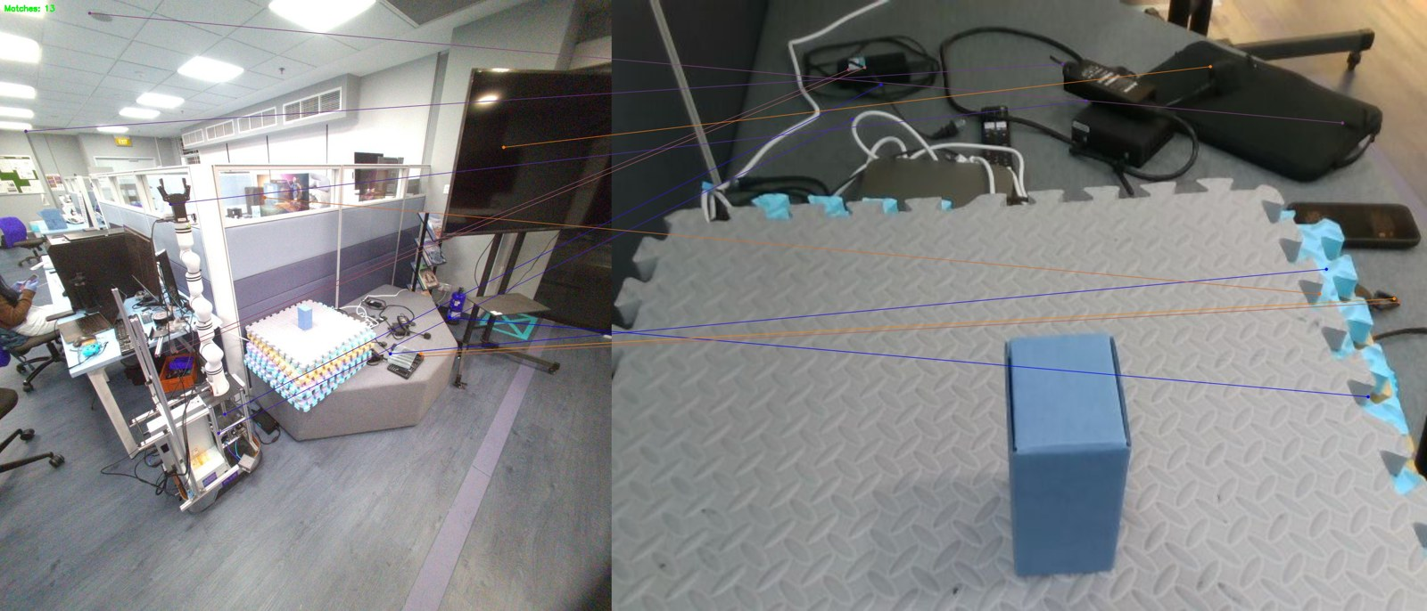
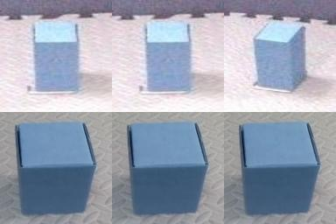

GAPPLER · DION
PHASE 4 · APPROACH AND CONFIRM
Keypoints fail across cameras. CLIP picks the right box
Which wrist-camera mask is the object in the glasses crop?
PHASE 4
Method
Selection
THE QUESTION
CLIP RANKS THE BOX FIRST
1
25 of 25
Are they the same box?
2
Grasp Loop
GLASSES CROP
Different camera, angle and distance
WRIST CAMERA
glasses vs wrist pairs, whole-object image features
LIMIT
BOX RANKED FIRST, BY METHOD
A wrong gaze crop gives a wrong match (the mats at 1.5 m)
Keypoints
0 of 15
SAM 3 + text
7 of 25
NEXT STEPS
SAM 3 image
15 of 25
Glasses refuse weak gaze picks before sending a crop
KEYPOINTS
CLIP Image Embedding
CLIP image
25 of 25
Matches land on the ceiling and floor
Right box in every pair
17
Problem
System
Intent
Explore
Search
Confirm
Grasp
Plan

Slide 19
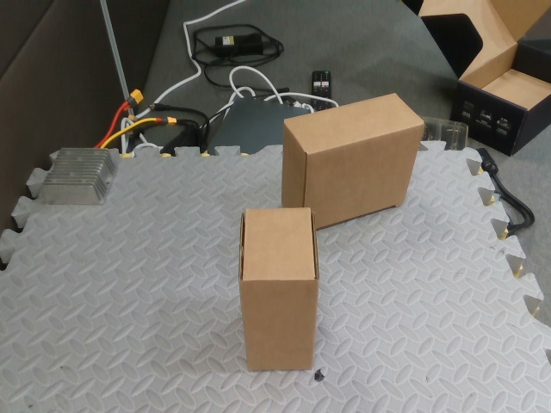
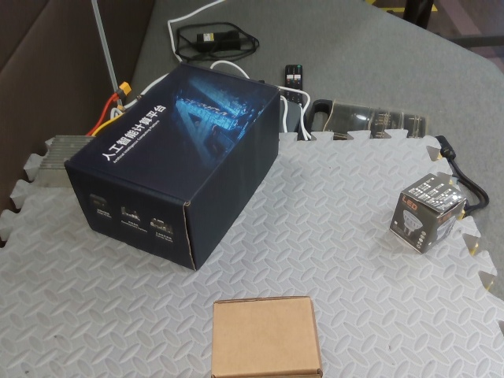

GAPPLER · DION
PHASE 4 · APPROACH AND CONFIRM
In the grasp loop, the arm goes for the box you looked at
CLIP now picks the grasp target, not SAM 3's most confident mask
PHASE 4
TWO LOOK-ALIKE BOXES
THREE DIFFERENT BOXES
Method Selection
TWO LOOK-ALIKE BOXES
1
266 of 268
0.97
2
Grasp Loop
0.98
wrist targets on the box you looked at. The old pick got 0 of 114
334 of 334
LIMIT
1
Target
Identical boxes: 6 of 12. Appearance alone can't separate them
three different boxes. Old pick: 105 of 115
glasses mask the user looked at
3
CLIP
4
Compare
5
Pick best
NEXT STEPS
crop and embed each mask
cosine to the target
over 0.56, no tie
2 misses
Run it on the real arm, then add the gaze ray in the robot's frame
2
Candidates
every wrist-camera mask
both from a wrong gaze crop
otherwise the arm waits
14
Problem
System
Intent
Explore
Search
Confirm
Grasp
Plan

Slide 20
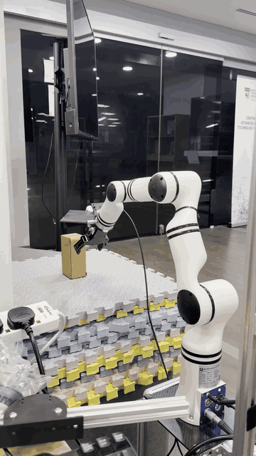

GAPPLER · DION
PHASE 5 · GRASP
The real arm grasps on a spoken command
First real grasp on 13 Oct 2026, with a tested software stop
THIS PART
Idle
› Approach
› Grasp
› Hold
Live Grasp
checks request
steps to 30 cm
close and lift
until “release”
WITHIN REACH
1
5 of 6
GRASPS BY DISTANCE
2
AnyGrasp
44.5 cm
4 of 4
grasps succeeded when target was within reach (5 of 8 overall).
3
Challenges
49.5 cm
1 of 2
LIMIT
< 1 ms
Fixed grasp orientations with dynamic positioning
0 of 2
software stop cancels motion
54.5 cm
NEXT STEPS
A learned model proposes the grasp
out of reach
13 OCT · REAL ARM
● grasped ○ failed · one dot per attempt, started by a recorded voice command
15
Problem
System
Intent
Explore
Search
Confirm
Grasp
Plan

Slide 21
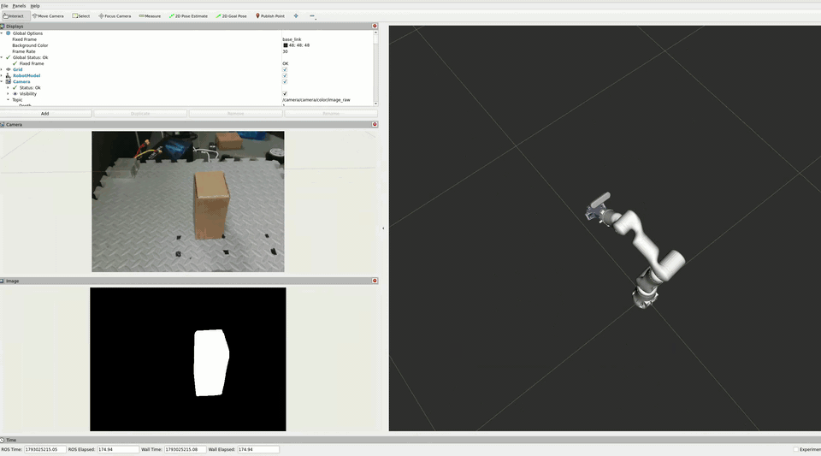
GAPPLER · DION
PHASE 5 · GRASP
AnyGrasp proposes grasps from one point cloud
One depth view in, hundreds of ranked grasps out, with no training on our box
THIS PART
Live Grasp
ARM + PROPOSED GRASPS
BOX IN ONE PLACE · REAL ARM
1
3 of 4
WRIST VIEW
2
AnyGrasp
grasps held, box not pushed
3
Challenges
SAM 3 MASK
HOW IT PICKS A GRASP
1
Stop at 30 cm one 3D snapshot
LIMIT
2
SAM 3 mask this object, within 10°
Box in one orientation only
3
Propose grasps ranked by confidence
NEXT STEPS
RViz on the real arm at the 30 cm stop. Point cloud is drawn as a rainbow, coloured by depth, Grasp candidates in green.
4
Stay best grasp for 5 frames then commit
Generalize to different box orientation x positions
5
Motion Planner IK solve, collision-free path
6
Line up, go in 10 cm out, straight in
16
Problem
System
Intent
Explore
Search
Confirm
Grasp
Plan

Slide 22
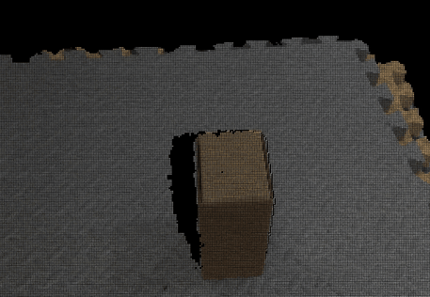
GAPPLER · DION
PHASE 5 · GRASP
The grasps work at one spot. Four problems limit the rest
Found on the real arm on 26 Oct 2026
THIS PART
FOUR CHALLENGES
1
Live grasp
1
One face visible
front + top
AnyGrasp guesses the hidden sides
2
AnyGrasp
2
Out of reach
0 of 5
3
Challenges
steeper angles the arm can't reach
3
Late updates
2–4 s
NEXT, CHEAPEST FIRST
box position arrives late
A
Check reach first
B
More view angles
4
Edge grasps
1 miss
C
Fuse several views
landed near the box's edge
WRIST CLOUD UP CLOSE · FRONT AND TOP ONLY
D
Test 12 positions
Real arm, 26 Oct. C is built, still to test.
17
Problem
System
Intent
Explore
Search
Confirm
Grasp
Plan

Slide 23
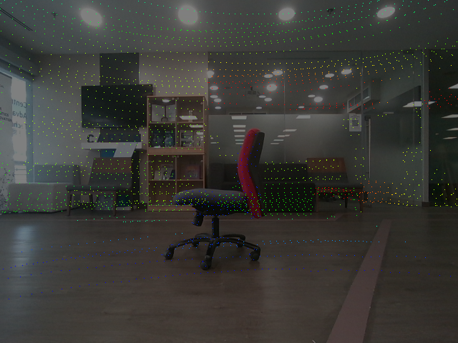
BASE CAMERA + LIDAR · NOT YET CALIBRATED
PART 3 / 3
Where we stand
Joins, schedule, budget and next steps
Two sensors, one scene: the parts work, the joins come next.
Problem and plan
Results
Where we stand

Slide 24
GAPPLER · SHERMAN
WHAT WAS BUILT
Each of us built a working piece. Four joins remain
Green links work today, grey ones are wired but not yet run. Orange links are still to build
1 Intent
2 Explore
3 Search
4 Confirm
5 Grasp
Dion
Voice + gaze crop
glance crop, on replay
Wrist camera check
Grasp on real arm
intent to grasp
tested on replay
best candidate selected
tested on the real arm
gaze target
Zongzhe
Memory graph
Find the object
memory and search
works alone, offline
CLIP search, built
arrive, check
recorded drive
where to look
match → goal
Sherman
FAST-LIVO2 map
Nav2 drives base
map and driving
built from recording
built, not driven
works today
wired, not yet run
still to join
tested
works alone
In progress
18
Problem
System
Intent
Explore
Search
Confirm
Grasp
Plan

Slide 25
GAPPLER · SHERMAN
SCHEDULE
Ahead on memory and gaze, behind on driving
Final dates unchanged
Sep
Oct
Nov
Dec
Jan
Feb
Mar
Apr
Build and run
exams, break
Arm picks something up
Voice and gaze to arm
Base navigates
Closed loop
first full run
Calibrated base camera
Memory graph offline
HiCo-Nav steers the search
Gaze picks the instance
Semantic vs nearest-first
Demo and paper
Orchestrator, all phases
Park within arm reach
done
forecast
today
19
Problem
System
Intent
Explore
Search
Confirm
Grasp
Plan

Slide 26
GAPPLER · ZONGZHE
BUDGET AND COMPUTE
SGD 1,500 for compute, approved
Where compute fell short, we cut scope instead of solving it
COMPUTE LIMIT
WHAT WE DID INSTEAD
APPROVED · 5 OCT 2026
The paper's 8B vision-language model does not fit beside SAM 3
Small local Qwen2.5-1.5B, text only: right class for 20 of 22
1,500 SGD
1
2
SAM 3 on every camera frame is too slow
Segment one photo per 1 m or 45° moved: 29 of 3,536 frames
both items for compute
3
32 phrases in one SAM 3 pass run out of memory
16 per pass: 40 phrases in 1.69 s, peak 10.3 GiB
1,000
500
Hardware GPU
API credits
4
All the models never fit on the card at once
Each part is tested alone, one bench run at a time
WHY: ONE SHARED 16 GB GPU
10.3 GiB: batched SAM 3 alone
16 GB
WHAT WE COULD NOT AFFORD
3090, new
~2,800
Also AnyGrasp, CLIP, Whisper, 2 language models: 3 people + CI
A dedicated RTX 3090 with 24 GB: room for an 8B model next to SAM 3, off the shared lab card
3090, used
1,100–1,500
GPU budget
1,000
21
Problem
System
Intent
Explore
Search
Confirm
Grasp
Plan

Slide 27
GAPPLER · ZONGZHE
NEXT STEPS
Next: close the grasp, drive the base, query the graph
Then explore with gaze, to end-to-end trials in March 2027
1
NAVIGATE TO OBJECT
2
ORCHESTRATION LAYER
Drive to the object and park within reach
One node decides what happens next
• The graph's position becomes the approach goal
• Park where the arm can reach the object
• The wrist camera re-finds it from above
• Each phase reports an outcome and a reason
• On failure: next candidate, second view, or ask
• The only node that starts motion
3
RECLARIFICATION NODE
4
END-TO-END TESTING
Ask the user when the request is unclear
Success counted per phase
• An LLM loop: search the graph, list candidates, ask
• Ends with one object or a lead, at most 3 questions
• Asked by phone. It never moves the robot
• First run: speak, look, drive, grasp
• Planted failures: does the right recovery fire?
• Trials with look-alikes, then a recorded demo
21
Problem
System
Intent
Explore
Search
Confirm
Grasp
Plan

Slide 28
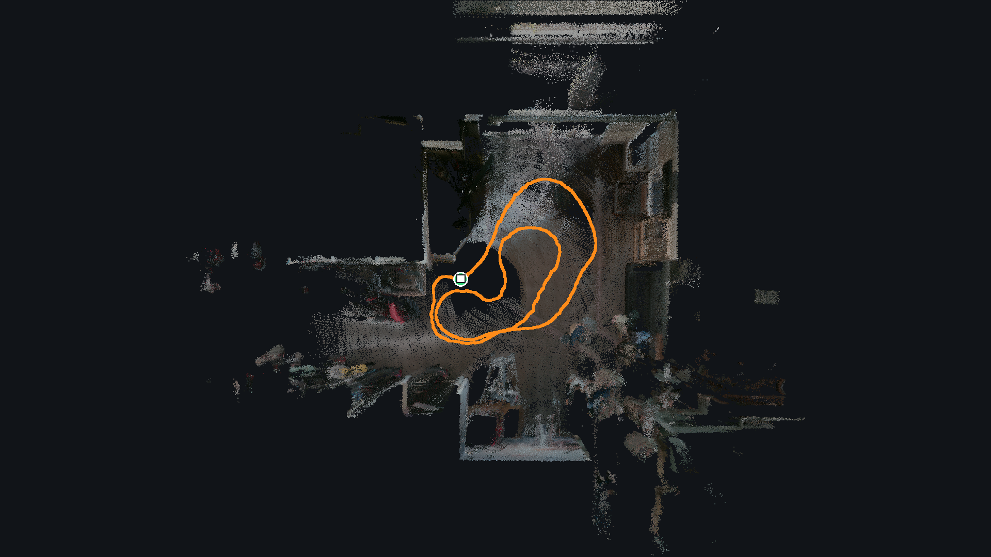
MOBILE BASE · TOP VIEW OF THE LAB
THANK YOU
Questions
Look at it, name it, and the robot fetches that one.
Dion · Sherman · Zongzhe
Backup: wiring, frames, matching, grasp options, map accuracy, limitations, plan, evaluation.
Backup slides A1 to A10 follow.
Problem and plan
Results
Where we stand

Slide 29
BACKUP · NOT IN THE 20 MINUTES
Appendix
WHOLE SYSTEM
GAZE, MATCHING AND GRASP
MAP AND MEMORY GRAPH
A1
Topic-level wiring today
A3
Matching rule and thresholds
A5
FAST-LIVO2 defects, accuracy
A2
Coordinate frames
A4
Grasp filters, five options
A16
Our graph vs HiCo-Nav's code
A6
Limitations, risks, failures
A8
Why gaze, not a class name
A17
The photo gate: 29 photos
A7
September plan vs now
A11
The grasp sequence, step by step
A18
LiDAR depth, occlusion filter
A9
End-to-end evaluation plan
A12
Matching across cameras
A19
Answer key, match radius sweep
A10
Milestone tests
A13
What narrows grasp candidates
A20
How the graph is tested
A15
What we inherited, what we fixed
A14
Gaze at the moment of speech
A21
Sentence to classes check
A22
Why a 24 GB card would help
A23
Reclarification node (planned)

Slide 30
GAPPLER · APPENDIX
BACKUP · A1
A1 Topic-level wiring today
Answers: “What exactly is connected?” Only links that exist in code. Grey rows exist but have not run
From | To | Channel | State
Voice: Silero VAD, faster-whisper, Qwen2.5-0.5B | aria_segmentation_client | /aria/audio/prompt (String) | Ran (replay)
Eye model | aria_segmentation_client | /aria/eye_tracking/gaze_estimate | Ran (recording)
aria and grasp segmentation clients | SAM 3 service (one copy on GPU) | /segmentation/segment | Ran
aria_segmentation_client | grasp_segmentation_client | /grasp/target: word, then word plus reference crop | Ran on replay (T8.9a)
aria_segmentation_client | grasp_state_machine | /manipulator/grasp_request | Ran
grasp_segmentation_client | grasp_state_machine | /object_centroid_2d (pixel plus depth) | Ran
anygrasp_detection_node | grasp_state_machine | /grasp_candidates | Ran
grasp_state_machine | MoveIt and rm_driver | real arm | Ran on the real arm
Livox MID-360, base D455 | FAST-LIVO2, then fastlivo_odom_bridge | odom to robot_base_link | Ran live
fastlivo_odom_bridge | SLAM Toolbox, mapping mode | map to odom, /map | Ran live
SLAM Toolbox | Nav2 | frame tree | Never run on this
object_recognition_pipeline | object_approach_node | /manipulation/goal_pose (call commented out) | Not run
object_approach_node | Nav2 | /goal_pose | Not run
Recorded drive handdriven1 | Memory graph S0 to S13, then TargetFinder | offline | Graph built. Query not run
Source: COMBINED_PROGRESS_REPORT_2026-10.md §3.3
24

Slide 31
GAPPLER · APPENDIX
BACKUP · A2
A2 Coordinate frames
Answers: “How do grasp poses reach the arm?”
map
›
odom
›
robot_base_link
›
base_link
›
Link1 to Link6
›
camera_link
›
camera_color_optical_frame
plus livox_frame under robot_base_link
Parent to child | Published by | Value or note
map to odom | SLAM Toolbox | Nav2 plans in this map frame
odom to robot_base_link | Wheel driver, or the FAST-LIVO2 bridge (odom_source:=fastlivo) | Bridge: T_odom_base(t) = Tb x P0^-1 x P(t) x Tb^-1, Tb = (0.191, 0.02329, 0.15588) m. Refuses to start above 2° start tilt
robot_base_link to base_link | Static (arm mount) | (0.18, 0, 0.48) m, yaw 180°. Measured, tf2_echo matched
robot_base_link to livox_frame | Static | LiDAR mount
base_link through Link1 to 6 to camera_link | URDF | Wrist camera to arm calibrated (Dion, 24 Oct)
camera_link to camera_color_optical_frame | RealSense driver | AnyGrasp candidates arrive in this frame
Open question for P2 and T7.1: the memory graph stores positions in FAST-LIVO2's camera_init frame, while Nav2 drives in SLAM Toolbox's map frame. How graph positions reach map at run time is a design question, not a defect.
Source: COMBINED_PROGRESS_REPORT_2026-10.md §6.7, §5.4
25

Slide 32
GAPPLER · APPENDIX
BACKUP · A3
A3 Matching rule and thresholds
Answers: “Why 0.56? Is CLIP cosine a probability?”
THE RULE
NOT A PROBABILITY
Cosine between each wrist mask crop (box plus 20 px) and the reference crop. Cutoff 0.56, tuned on 20 pairs (T8.7). Masks within 0.01 of the best count as a tie, and a tie returns no match. Same model in both places: open_clip ViT-B-32 laion2b_s34b_b79k.
CLIP cosine is not calibrated. Thresholds are empirical: 0.56 for the matcher, 0.6 on the graph's 1.5 x overlap + 0.5 x appearance score. float16 shifts a vector by up to 0.0039 across batch sizes. Crop padding differs between glasses, wrist and graph.
Where | Method | Confidence handling
Glasses mask | Gaze vote | Winner needs half the votes, else word only
Wrist mask (matcher) | CLIP cosine | Cutoff 0.56, wrist tie returns no match
Wrist mask (grasp) | CLIP cosine when a reference exists (T8.9a), else SAM 3 score | Cutoff 0.56 and no tie, else nothing published
Graph association | 3D overlap plus CLIP | Score over 0.6, greedy
Graph query | CLIP text vs image | Ranking only
No stage carries a confidence forward to the next (see A6).
Source: COMBINED_PROGRESS_REPORT_2026-10.md §5.4, §6.4, §6.6
26

Slide 33
GAPPLER · APPENDIX
BACKUP · A4
A4 Grasp filters and the five options
Answers: “Why not just lower the score floor?”
FILTERS ON EVERY CANDIDATE
Option | Idea | Cost
A. Grasp from the view pose | AnyGrasp once at 0.4 to 0.5 m with the whole box in view, one planned motion | Small, the pieces exist
B. Fused views (T1.47) | Several views in one cloud, grasp on that | Built, retest owed
C. New AnyGrasp SDK (T1.45) | Native mask and angle steering | Waiting on licence
D. Closed-loop tracking | AnyGrasp's tracking mode updates the grasp while the arm moves | Medium, old node parked
E. Two-phase (shelved, T1.33) | Stop just before the depth blind zone, set the angle, move straight in and close | Small
On the SAM 3 mask
Inside the approach cone
Score at least 0.3
Width under 68 mm
Fingertips at most 45 mm past the near face
Pose stable for 5 frames
Of the 180° twins, the smaller wrist turn (T1.33)
WHY THE FLOOR IS NOT THE FIX
The top-down grasp scores at most 0.25, but the problem is the view. The 30° cone around the camera axis dropped every top-down grasp, because the camera axis is 44° from vertical. AnyGrasp was also used against its README: masked points only, 0.10 m width.
Source: COMBINED_PROGRESS_REPORT_2026-10.md §5.5. Options: DION_PROGRESS_REPORT_2026-10.md §7
27

Slide 34
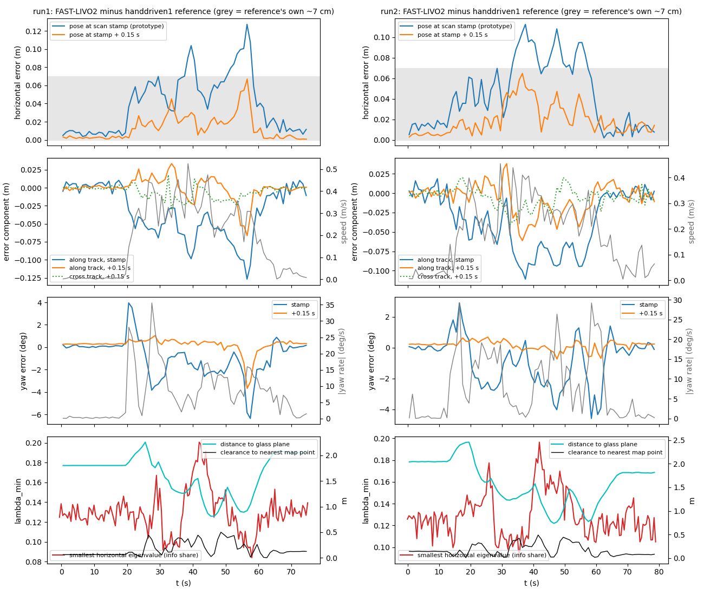
GAPPLER · APPENDIX
BACKUP · A5
A5 FAST-LIVO2 port defects and mid-route accuracy
Answers: “How do you know the map is right?”
Defect (found by reading the source, confirmed against a control run) | Before | After the fix
Range gate cannot act (F2): blind_sqr never assigned, the port dropped upstream's line | Median 19,968 points per scan, the full packet | Median 9,607. Removed 52.06 % against 51.84 % audited zero-range points
LiDAR to IMU offset has the wrong sign (F3) | About 10.2 cm of geometric inconsistency in every replay before 19 Oct | Configs carry (-0.011, -0.02329, 0.04412) m. handdriven1 recorded after the fix
Voxel key mismatch: insertion and retrieval round negative coordinates differently | Key hits 1,392,458 vs 1,878,707 shadow hits | Hits match, 1,855,269. Retrieval points 112,980 to 128,385
MID-ROUTE ACCURACY (T3.5F)
Within 6.7 cm (run 1) and 6.5 cm (run 2) for the whole route, against the handdriven1 map, 0.15 s lag removed. The reference carries about 7 cm of its own error.
The mapper stamps its pose about 0.15 s late: surfaces smear about 4 cm at 0.28 m/s. Fix prepared, off by default.
Floor marks did not close as ground truth. A tape-measured check is owed.
Source: COMBINED_PROGRESS_REPORT_2026-10.md §8.4. SHERMAN_PROGRESS_REPORT_2026-10.md §9.3, §11.4, §11.5
28

Slide 35
GAPPLER · APPENDIX
BACKUP · A6
A6 Limitations (1 of 3): confirmed in the code
Answers: “What fails today?” Most are links the plan schedules for later milestones
Limitation | End-to-end implication
A wrong gaze pick becomes a confident reference (at 1.5 m the reference was the mat) | The arm would go for the wrong box. T2.24 refuses weak gaze picks
/manipulation/goal_pose has no live publisher (inherited) | Nothing can start navigation to an object yet. T7.1, the ApproachObject action, will call Nav2 directly
No graph query service, no T7.1 node | The graph cannot drive the robot
No gaze-target trigger on graph objects | The exploring robot cannot tell it has found the target. Glasses vs base-camera features untested
Graph built offline from a hand-pushed recording | No live graph. No depth camera data
No calibration between any cameras | Graph positions and the gaze ray carry unknown rotation error, about 6.7 px per degree
Software-only stops on arm and base | Every hardware test needs two people and the power button
No automatic grasp success check | Outcome judged by people. Planned: the grasp reports an outcome (T11.2) and the wrist checks the target (T12.3), so the orchestrator knows when to retry
Source: COMBINED_PROGRESS_REPORT_2026-10.md §9.1. T7.1, T11.2, T12.3 in task-tree.html
29

Slide 36
GAPPLER · APPENDIX
BACKUP · A6
A6 Limitations (2 of 3): risks when the parts join
Answers: “What could break when the parts join?”
Risk | What to watch
No confidence crosses a stage boundary | A wrong gaze pick gives a confident reference, a wrong graph hit a goal, a wrong wrist mask a grasp. The matcher caught one by luck of score (0.51 vs 0.56)
Crop mismatch | Fixed 20 px glasses crop against the graph's relative padding, when the gaze match (P3) lands
Frame of graph positions | camera_init against Nav2's map frame, to settle when P2 and T7.1 are built
Standoff vs reach | 0.6 m camera standoff against the 35 to 46 cm tested grasp band
GPU contention | SAM 3 service, batched graph SAM 3 (up to 10.3 GiB), AnyGrasp, CLIP, Whisper, two Qwen models on one 16 GB card. Never run together
0.15 s pose lag | Anything pairing a scan with a pose by stamp, including graph depth
Viewpoint change between graph and wrist | Graph features from the base camera, reference from the glasses, confirmation from the wrist. Glasses to base camera untested
Source: COMBINED_PROGRESS_REPORT_2026-10.md §9.3
30

Slide 37
GAPPLER · APPENDIX
BACKUP · A6
A6 Limitations (3 of 3): observed failures
Answers: “What has gone wrong on hardware or data?”
Failure | Where | Source
AnyGrasp's confident grasps go across the too-wide face. Fit check passes edge slices | Wrist, 0.21 m | T1.44
Live OK-Robot trials 0 of 4: one pushed the box, two stuck, one found nothing in 3 s | Real arm | T1.44
Wrist spun 180° and knocked the box off (fixed) | First AnyGrasp grasp | T1.33
Wide wrist twist (j4 146°, j5 29°, j6 274°) | AnyGrasp grasp B | T1.40
Look-alike boxes: 148 of 180, and 6 of 12 | Matcher | T8.5, T8.8
Gaze landed on the mat stack at 1.5 m | Glasses | T8.5
Keypoint matching 0 of 15 | Cross camera | T8.4
Mapper teardown aborts 2 of 4. LiDAR driver SIGBUS | Base | S§10.3
Ethernet flap caused 8.1 s and 15.1 s IMU time jumps | Base, live | T3.5d
Lab box silent hangs (6 Oct, 20 Oct) | Shared box | S§15
Glass walls: about 42 % of 5 cm map points are ghosts outside the glass box | Map | S§15
Glass door and both computer towers missed in every graph setting | Graph | Z§3.5
Source: COMBINED_PROGRESS_REPORT_2026-10.md §9.2. Lab visitors' faces appear in the coloured map: re-render before any external showing
31

Slide 38
GAPPLER · APPENDIX
BACKUP · A7
A7 September plan vs now
Answers: “How does this compare with your original plan?”
Milestone | September plan window | Now (actual to 24 Oct, forecast end) | Change
M0 Everyone can build and run | 14 to 27 Sep 2026 | Done 24 Sep | On time
M1 The arm picks something up | 5 Oct to 1 Nov 2026 | Started 21 Sep. Forecast 8 Nov | About one week later (AnyGrasp)
M2 Voice and gaze reach the arm | 26 Oct 2026 to 3 Jan 2027 | Started 8 Oct. Forecast 10 Jan | Started early, ends about a week later
M3 The base navigates | 12 Oct to 27 Dec 2026 | Started 14 Sep. Forecast 10 Jan | Two weeks later
M4 Closed loop | 28 Dec 2026 to 17 Jan 2027 | Forecast 11 to 31 Jan | Two weeks later
M5 Calibrated base camera | 5 Oct 2026 to 17 Jan 2027 | Started 16 Sep. Forecast 24 Jan | One week later
M6 Memory graph offline | 28 Dec 2026 to 7 Feb 2027 | Started 21 Sep. Forecast 31 Jan | One week earlier
M7 The graph drives the robot | 1 to 28 Feb 2027 | Forecast 18 Jan to 28 Feb | Can start earlier, end unchanged
M8 Gaze picks the instance | 8 Feb to 14 Mar 2027 | Started 19 Oct. Forecast 14 Mar | Started early, end unchanged
M9 Frontier scoring (optional) | 2 Nov 2026 to 21 Feb 2027 | Not started. 18 Jan to 21 Feb if kept | First on the cut list
M10 Demonstration and paper | 1 to 21 Mar 2027 | Forecast 1 to 21 Mar | Unchanged
Source: 1cde0ec:docs/PROJECT_PLAN.md §5 and §6 headings. COMBINED_PROGRESS_REPORT_2026-10.md §0.2, §0.6
32

Slide 39


GAPPLER · APPENDIX
BACKUP · A8
A8 Why gaze, not just a class name
Answers: “Isn't identical-object picking niche?”
Two identical objects are the hardest test case, not the pitch. The capability is knowing where the user is looking in the robot's own 3D space.
Similar objects
Two chairs of the same model score 0.81 to 0.85 in CLIP, close to the same chair at 0.93
Partly hidden objects
The robot may see only part of the object the user sees
Uncertain image features
Appearance alone is not a reliable identity
A robot that does not see what the user sees
The base camera is at knee height, the glasses at eye level
Assistive use
A user who can look but cannot easily point or speak, among mugs, pill bottles and cans
Source: COMBINED_PROGRESS_REPORT_2026-10.md §0.3 (D§5.5). CLIP values: §8.5
33

Slide 40
GAPPLER · APPENDIX
BACKUP · A9
A9 End-to-end evaluation plan
Answers: “How will you measure the final system?” Today every measurement is per stage
Metric | Definition | Needs | Milestone
Glasses target accuracy | Reference crop is the intended object, scenes with 2 to 4 objects at 1 to 3 m | Live glasses | M2
Wrist confirmation accuracy | Matcher picks the intended object, with and without look-alikes. Refusals counted apart | P0 item 1 | M2
False acceptance rate | Wrong object accepted, per stage (glasses, graph, wrist) | Labelled trials | M2, M8
Graph target retrieval | First hit lands on the intended marked object, and distance to it | T6.8 | M6
Gaze-target trigger accuracy | The robot stops exploring at the intended object. Wrong stops counted | T8.2 | M8
User discovery and search distance | User found, and distance driven before the target is matched | T7.5, T7.6 | M7
Without gaze (stretch) | Same trials, voice only | T8.11 | M8
Drive-to-point repeatability | Ten drives, landing error, 10 cm circle | T3.6, T5.8 | M3
Handover success | Base stops with the object inside the grasp band | T3.7 | M4
Grasp success | 12-trial grid, pass bar 9 of 12 | T1.35 | M1
End-to-end success | Speak, look, drive, grasp. Counted only when the intended object is lifted | All above | M4, M10
Per-stage timing | 99th percentile per stage | T4.2 | M4
Recovery | Share of failures that end safely instead of a wrong grasp | T11.10 | M11
Source: COMBINED_PROGRESS_REPORT_2026-10.md §11. Recovery row: PROJECT_PLAN.md §5.1, M11
34

Slide 41
GAPPLER · APPENDIX
BACKUP · A10
A10 Milestone tests
Answers: “How do you know a milestone is done?”
 | Milestone | Done means | Lead
M0 | Everyone can build and run | Two people other than Dion clone, build and pass the bench | Zongzhe
M1 | Arm picks something up | 5 grasp attempts on a box, success rate recorded, stop verified first | Dion
M2 | Voice and gaze reach the arm | Two boxes, the arm picks the one you looked at, 3 times in 4 | Dion
M3 | Base navigates | Map, localisation, ten drives to a point with error recorded | Sherman
M4 | Closed loop | One recorded run: speak, look, drive, grasp, per-stage timing | Dion
M5 | Calibrated base camera | LiDAR points land on the right objects in the camera image, pose error as a number | Sherman mount, Dion calibration
M6 | Memory graph offline | Objects from a recorded drive, no duplicates, a sentence query returns the right one | Zongzhe
M7 | Graph drives the robot | Object out of view: the robot explores, finds the user, builds the graph live, drives to it | Dion
M8 | Gaze picks the instance | A gaze match ends exploration. N end-to-end trials, success per phase | Dion
M9 | Smarter exploration order (optional) | The paper's exploration order beats our nearest-first exploration | Zongzhe
M10 | Demonstration and paper | Recorded end-to-end run, paper whose central table is the end-to-end trials | All
M11 | Orchestrator runs every phase | Each phase returns an outcome and a reason. Every failure in the table gets its response. Clarification ends in one object or a lead | Dion, Zongzhe clarification
M12 | Base parks within arm reach | Parks inside the measured reach, the wrist re-finds the object from above, the arm grasps | Sherman, Dion wrist look
Source: COMBINED_PROGRESS_REPORT_2026-10.md §0.2. PROJECT_PLAN.md §5.1 (M11, M12)
35

Slide 42
GAPPLER · APPENDIX
BACKUP · A11
A11 The grasp sequence, step by step
Answers: “What does the arm do after it hears a command?”
1
Wait
2
Go home
3
Approach
4
Grasp
5
Hold
IDLE
HOME
SELECTING
EXECUTING
HOLD
For a grasp request and the object's position from the wrist camera
Clear the old target, move the arm to its home pose
Step 2 cm at a time toward the object until it is 30 cm away
Open the gripper, wait for a steady grasp, plan the path and move in
Close the gripper, move to the hand-over pose, wait for “release”
After “release”: open the gripper, go home, wait for the next command
WHEN A STEP FAILS, BACK TO WAIT
STOP, AT ANY STEP
Approach: the object's position is over 7 s old, so the object counts as lost
Grasp: no grasp holds steady for 25 s
Grasp: 5 grasps in a row could not be planned. Each failed one is skipped next time
A stop key halts the arm at once and drops the request
Nothing moves again until a person resumes it, then the sequence restarts at Wait
Source: grasp/grasp_state_machine/src/grasp_state_machine.cpp (workerLoop), grasp/grasp_config.yaml
37

Slide 43
GAPPLER · APPENDIX
BACKUP · A12
A12 Matching the looked-at object across cameras
Answers: “How does the robot know which box the user meant?”
1 · USER'S GLASSES
2 · MATCHER
3 · ROBOT'S WRIST CAMERA
CLIP turns the reference and each wrist mask into a feature vector. Cosine similarity compares them: 1 means they look the same
SAM 3 masks with their confidence. The ring is the gaze
SCORES, THREE-BOX SCENE
Match
0.632
SAM 3 finds every object matching the spoken word
Gaze votes for 1 s: each gaze sample votes for the mask under it, or the nearest within 80 px
The winner needs half the votes. Its cut-out is the reference sent to the robot
Other mask
0.623
0.98
Other mask
0.249
0.56
+- 0.01
Candidate masks. Orange: matched (detection 0.98)
TWO RULES, ELSE THE ARM WAITS
SAM 3 finds candidates for the same word
Kept if detection confidence is 0.5 or more, at most 5
The match guides the approach and grasp
Minimum score 0.56. Below it, no wrist mask matches
Tie margin 0.01. Two masks this close to the best are a tie, so no match (identical boxes)
Source: grasp/grasp_segmentation_client/cross_camera_mask_match_rule.py, aria/aria_config.yaml. Scores: three-box replay, 20 Oct 2026
38

Slide 44
GAPPLER · APPENDIX
BACKUP · A13
A13 What narrows the grasp candidates
Answers: “Why was a grasp rejected?” Each box can remove or restrict candidates
INPUTS
GRASP SUGGESTER
DECIDER
MOTION PLANNER
AnyGrasp node
Grasp state machine
MoveIt
Depth image from the wrist camera
Scene cut to 15 cm around the object
Approach at least 20° above horizontal (parallel to table)
Pre-grasp 10 cm in front: joint angles solved (IK) from the current joints
The object's outline from SAM 3
AnyGrasp: grasps on the object only, within 10° of the camera's view
Grasps that already failed to plan are skipped
Path around obstacles, the box included
Arm moves
The arm's joint angles
Collision check: the gripper may not hit the table or neighbours
Same best grasp for 5 frames, within 15 mm and 10°
The straight move in must finish completely
Settings: approach within 10°, gripper opens 71 mm
Near-duplicates merged, best 5 kept
Object position under 7 s old while approaching
Wrist guard: joints 4 to 6 turn at most 90°
Fit check: object at most 68 mm wide, fingertips at most 45 mm in
Gives up after 25 s or 5 failed plans
Twin choice: of two mirror-image wrist turns, the one nearer the gripper
Source: anygrasp_detection_node.py, anygrasp_to_grasp_frame.py, grasp_state_machine.cpp, mtc_planner.cpp, grasp_config.yaml
39

Slide 45
GAPPLER · APPENDIX
BACKUP · A14
A14 Sampling the gaze at the moment the user spoke
Answers: “How do you know where the user looked when they said the word?”
User says
pick up the
box
the word is stamped with when it was said
gaze window
Gaze
Processing ideally ends here
Images
segmented: nearest the window's middle
Reaches robot
word arrives: 0.7 s of quiet ends the sentence + speech-to-text processing latency
Client
decides, then SAM 3 and the vote
waits up to 3 s if gaze or the image is late
-2 s
-1 s
0 s
+1 s
+2 s
+3 s
+4 s
Every sample is placed by when the glasses captured it, not when it reached the robot.
1.0 s Gaze window
3.0 s Wait for late data
0.5 s Valid Voters
80 px Vote reach
50 % Winning share
starts this long before the word, ends at the word's end
for gaze up to the word's end and an image from the window
Only gaze taken within 0.5 s of the segmented image votes, so it matches what that image shows
a gaze sample votes for the mask under it, or the nearest this close
below it, no pick: the word alone stands
gaze_before_word_s
matching_image_wait_s
gaze_to_image_max_s
pick_radius_px
vote_min_share
Source: aria_segmentation_client.py, aria/aria_config.yaml, stamped-word branch (T2.21, PR open). Gaze Pick Timing page
40

Slide 46
GAPPLER · APPENDIX
BACKUP · A11
A15 What we inherited, and what we fixed
Answers: “What did you add beyond the earlier team's code?”
Area | What we inherited | What we did, and the evidence | Task
Grasp | No grasp could reach the arm: AnyGrasp ran only when idle, the state machine took grasps only when executing (A1 to A3) | Gate fixed. Replay 41 grasp sets while executing, 0 idle. AnyGrasp path now grasps on the real arm | T1.8, T1.17
Grasp | Arm moved as if the box were not there, curved into it and pushed it away (A4) | Box added to the planning scene, straight final approach. 3 of 3 grasps, first plan, no push | T1.48
Safety | E-stop lost its stop message (0 to 5 of 5 trials), ignored Ctrl+C, dropped fast keys. Launcher promised a “q” stop that did not exist (B1, B2) | Every stop path checked on the bench. Launcher text corrected | T1.2
Safety | Arm driver launched twice (I1). Any detection started the arm, no request needed (B6) | Duplicate removed behind a new static check. The arm starts only on a grasp request | T1.2, T1.25
Arm code | Unlocked reads, non-atomic state, a queue that grew without limit after each grasp (C2 to C4, C7) | Locks and atomic state. A second request now runs in simulation | T1.9, T1.14, T1.24
Nav | After any failed drive the goal bridge never sent another goal. All five nav nodes crashed on Ctrl+C (F1, F4, F5) | Failure paths answer, clean exit. Checked by the nav-node bench | T3.8
Voice | Word repeated many times per sentence. Arm's target word fixed as “box” in the source (B7, L1) | One word per finished sentence (31 messages to 3 on replay). Voice sets the arm's target | T2.10, T2.1
Wiring | 38 of 54 channel names scattered through the code | All 53 owned channels in config. 7-level bench and CI on every PR | T0.14
FOUND IN THE AUDIT
62 findings
Line-by-line read of the inherited code. No tests, no CI
27 fixed
or closed, with evidence
STILL OPEN
Voice “stop” halts the base, not the arm (B3). Return leg lands 2 m off (E1). 9 more in the audit
Source: Gappler docs/CODE_AUDIT.md (audit of main @ 2d36a89, Sept 2026), task-tree.html, bench-runs/. Status as of 27 Oct
36

Slide 47
GAPPLER · APPENDIX
BACKUP · A16
A16 Our memory graph vs HiCo-Nav's code
Answers: “Why not just run their code? What did you change?”
Part | HiCo-Nav | Ours | Why
Where it runs | Habitat simulator (public code). A D455 depth camera on their robot | A recorded drive of our robot. Depth drawn from the LiDAR | We have LiDAR. No depth camera recording yet (T6.2)
Find objects | YOLO-World on every frame, MobileSAM on kept photos | SAM 3, all 30 classes in one pass | Already on our box (D-MG6). 5.7× faster batched
When to keep a photo | A detection, or the camera moved | The camera moved 1 m or turned 45° | No extra model on the shared GPU (D-MG12, tentative)
Language model | Qwen3-Omni API, or Qwen3-VL-8B offline | Qwen2.5-1.5B, local, text only | Theirs do not fit our 16 GB card
Match radius | 2.5 cm, hard-coded | 10 cm, in config | Two views of one object land 4 to 9 cm apart (A19)
Photos kept per object | 1 in the code | 3 | Keeps more than one viewpoint (D-MG1, tentative)
ALSO FIXED OR AVOIDED, FROM READING THEIR CODE
• Each graph link stored twice, synced by hand → stored once, with a consistency check
• No time limit on the language model → 10 s, then a CLIP fall-back
• Class ids from a Python set, can change between runs → an append-only list
• Task score on objects never set → set on insert, merge and new task
• Sort that depends on input order → sorted once by confidence, tested shuffled
• Fixed 20 px crop around each object → padding relative to the box
Their repo has no licence file, so the code was read, never copied.
Source: ZONGZHE_PROGRESS_REPORT_2026-10.md §1.2, §2.2. hico-nav/PAPER_REPORT.md §4.8, §5.6. MEMORY_GRAPH_DESIGN.md D-MG1, D-MG2, D-MG6, D-MG12
48

Slide 48
GAPPLER · APPENDIX
BACKUP · A17
A17 The photo gate: 29 photos, and what it costs
Answers: “What do you lose by keeping so few photos? Why 26 photos in one place and 29 in another?”
GATE SETTINGS ON THE LAB DRIVE (3,536 FRAMES, 1.85 S PER SAM 3 CALL)
Moved (m), turned (°) | Photos kept | Per minute | SAM 3 time | Saved vs every frame
0.5, 30 | 52 | 26.5 | 96 s | 98.5 %
0.5, 45 | 45 | 22.9 | 83 s | 98.7 %
1.0, 45 (used) | 29 | 14.8 | 54 s | 99.2 %
1.0, 90 | 22 | 11.2 | 41 s | 99.4 %
2.0, 45 | 24 | 12.2 | 44 s | 99.3 %
2.0, 90 | 14 | 7.1 | 26 s | 99.6 %
PHOTOS KEPT
29 of 3,536
54 s of SAM 3 instead of 6,542 s
26 OR 29?
29: the 1 m / 45° rule run over every frame.
26: the same rule applied to the 103 photos saved at a finer gate (0.25 m / 15°). The merge tuning (A19) used those 26. The conclusions hold at both 26 and 103 photos.
Every frame through SAM 3 would take 6,542 s. HiCo-Nav reports 30 to 60 photos a minute [paper]. We keep 14.8.
WHAT IT COSTS
A target coming into view does not add a photo by itself. HiCo-Nav runs a cheap detector (YOLO-World) on every frame for that. We chose the pose check alone for now: no new model, no GPU time on the shared card. Revisit after the talk (T6.10).
Source: bench-runs/2026-10-22-labbox-t6.5-pose-gate-sweep.txt. bench-runs/2026-10-21-labbox-t6.4-drive-run.txt (correction of 2026-10-22). D-MG12, T6.10
49

Slide 49
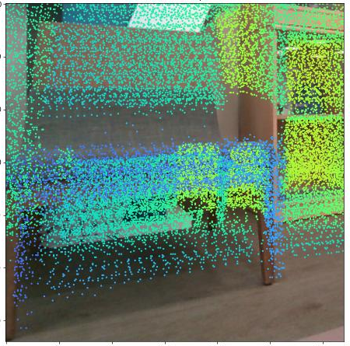
GAPPLER · APPENDIX
BACKUP · A18
A18 LiDAR depth and the occlusion filter
Answers: “How sparse is the LiDAR? What does the filter do, and what does it cost?”
PIXELS WITH A DEPTH READING
FRAME 700, THE CHAIR
LiDAR scans used | Pixels
0.2 s | 1.6 to 2.4 %
1 s | about 7 %
1 s either side (used) | 12.8 to 14.4 %
1.08 to 2.08 m
depth readings inside its outline
z −0.02 → 0.58 m
its centre: a floor patch, then seat height
7 cm
THE RULE
Clear a pixel if any pixel in its 7 × 7 block is more than 10 % nearer.
from the same chair seen in frame 2200, so they merge
WHAT IT COSTS
ON A DEPTH CAMERA
• Coverage 13.8 → 12.3 % on frame 700
• Something thin on a surface (paper on a wall) is within 10 % and keeps its background
• A few true far pixels at a near object's edge are cleared
Not needed. A D455 depth image is dense and already shows only the nearest surface.
Frame 700, before the filter. LiDAR points coloured by distance:
farther points show between the chair's own.
Source: ZONGZHE_PROGRESS_REPORT_2026-10.md §3.1, §3.4. MEMORY_GRAPH_DESIGN.md D-MG11. memory_graph/geometry.py drop_occluded, replay_loader.py
50

Slide 50
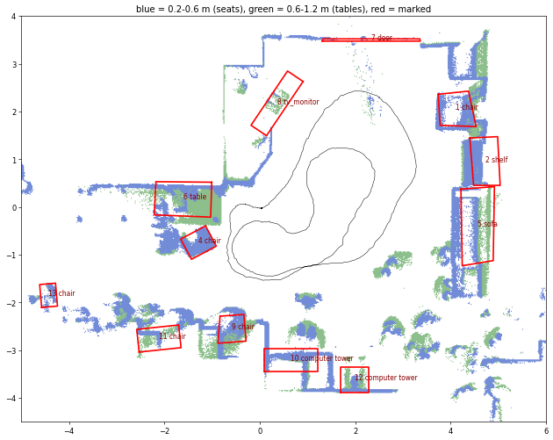
GAPPLER · APPENDIX
BACKUP · A19
A19 The answer key and the match radius sweep
Answers: “How do you know 8 to 3 is real? What is a false merge?”
DUPLICATES / FALSE MERGES / MISSES, OUT OF 16 REAL OBJECTS
Match radius | Drive 1 (26 photos) | Drive 2 (14 photos)
1 cm | 31 / 1 / 3 | not run
2.5 cm (HiCo-Nav) | 8 / 0 / 4 | 2 / 0 / 7
5 cm | 4 / 0 / 3 | not run
7.5 cm | 4 / 0 / 3 | not run
10 cm (used) | 3 / 0 / 3 | 1 / 0 / 8
15 cm | 3 / 0 / 3 | 1 / 0 / 8, but a chair merged into its desk*
20 cm | 2 / 0 / 3 | not run
Merge by look only (2.5 cm) | 0 / 0 / 12 | not run
* Found by looking: the false-merge count misses some over-merging. Drive 2 lined up with drive 1 by ICP.
Top-down LiDAR map, drive 1. Red: objects marked by hand.
First 12 shown, 16 in the final key.
DUPLICATE
FALSE MERGE
MISS
Marked from the map and photos only. No SAM 3 or merge code used.
An extra graph object of the same kind on one real object
Two real objects stored as one graph object
A real object with no graph object on it
Source: ZONGZHE_PROGRESS_REPORT_2026-10.md §3.5. bench-runs/2026-10-21-labbox-t6.4-drive-run.txt. MEMORY_GRAPH_DESIGN.md D-MG2. memory_graph/eval/, score_drive.py
51

Slide 51
GAPPLER · APPENDIX
BACKUP · A20
A20 How the memory graph is tested
Answers: “Did you test it? What do the tests check?”
Stage | Tests | Example checks (test names, shortened)
Read the recording | 49 | Same wall from two poses lands in the same place. A wrong pose or depth scale misses by 20 cm or more
Keep a photo | 10 | A straight drive keeps a photo past every metre. Turning on the spot keeps one past every 45°
Find objects, masks | 86 | Detections sort the same when the input is shuffled. Batched SAM 3 gives the one-call answer
CLIP feature | 19 | Same chair scores above chair against other objects. Text and image vectors share one space
Merge sightings | 46 | Same chair from views 30° apart matches. Two identical chairs side by side do not merge
Keep photos, clean up | 53 | Every object keeps enough photos. A second pass does not grow the photo count
Ask the graph | 111 | A related object never outranks a target. A rejected object is skipped next time
Whole photo and drive | 25 | Three stored lab photos replayed through every stage still give the same objects
ON THE LAB BOX GPU
399 pass
None skipped, 23 Oct 2026. Real SAM 3, CLIP and Qwen models
CODE QUIZZES
After each task. The M6 quiz found 11 code issues: 3 correctness fixes landed (T6.9). The T6.7 quiz found 6, all fixed.
NOT SHOWN YET
The whole query on the full recorded drive, against the answer key (T6.8).
Grouped by test file. Stored lab photos with SAM 3's real output let most tests run without a GPU.
Source: memory_graph/tests/ (23 files, 399 tests). bench-runs/2026-10-23-labbox-t6.7-step5-tests.txt. ZONGZHE_PROGRESS_REPORT_2026-10.md §3.9
52

Slide 52
GAPPLER · APPENDIX
BACKUP · A21
A21 From a sentence to classes: the reasoning check
Answers: “What if the model hangs? Why a small local model? What does “find a chair” really give?”
22 INSTRUCTIONS, FROZEN BEFORE THE RUN
REAL REPLIES TO “FIND A CHAIR”
Model | Right, scored by script | Right, by hand | Reply time
Qwen2.5-1.5B (used) | 19 of 22 | 20 of 22 | 0.28 to 0.32 s
Qwen2.5-0.5B | 12 of 22 | not marked | 0.11 to 0.35 s
CLIP fall-back alone | 15 of 22 | 13 of 22
1.5B: chair. No related classes
0.5B: chair + cabinet, desk, shelf
Fall-back: chair
1.5B named related classes for 1 of 22. The prompt now asks for 2 to 5. Not re-run since.
FAILURES BY KIND (SCRIPT SCORE)
 | In list (5) | Synonym (4) | Attribute (3) | Indirect (4) | Relation (2) | Not in list (4)
1.5B | 0 | 2 | 0 | 0 | 0 | 1
0.5B | 0 | 4 | 3 | 2 | 0 | 1
Fall-back | 0 | 1 | 0 | 2 | 0 | 4
SAFETY RULES
• Over 10 s, or an empty or unusable reply: CLIP picks the closest class
• Targets always rank before related objects
• Local: no API key, no network, nothing leaves the lab
• The paper's Qwen3-Omni needs 20 to 24 GB run locally [paper]
The slide's 20 of 22 is the hand score. Its 15 (fall-back) and 12 (0.5B) are script scores.
Source: bench-runs/2026-10-23-labbox-t6.7-reasoning-check.txt, local/t6.7/out/check_reasoning.json, 2026-10-23-labbox-t6.7-step5-tests.txt. memory_graph/config.py
53

Slide 53
GAPPLER · APPENDIX
BACKUP · A22
A22 Why a 24 GB card would help
Answers: “Why would 24 GB help? Why not run the paper's model?”
GPU MEMORY, GIB
ALSO ON THE SAME CARD
Our card (RTX 4060 Ti)
16
• The SAM 3 service
• AnyGrasp
• CLIP
• Whisper (speech)
• Two Qwen models
Shared by 3 people and the CI runner. They have never all run together: each part is tested alone.
A 24 GB card
24
SAM 3 + 8B model
SAM 3 10.3
8B model, 8
+8 uncompressed
0
8
16
24
SAM 3: measured peak, all phrases batched 16 per pass. 8B model: estimate, 8 to 16 GB depending on compression.
READING IT
SAM 3 plus a compressed 8B model (up to about 13 GB) fits in 24 GB, never in 16. Uncompressed (16 GB) it does not fit in 24 either.
Source: ZONGZHE_PROGRESS_REPORT_2026-10.md §3.3 (measured peaks). hico-nav/PAPER_REPORT.md §6.4 (8B estimate, [inferred]). COMBINED_PROGRESS_REPORT_2026-10.md §9.3 item 5
54

Slide 54
GAPPLER · APPENDIX
BACKUP · A23
A23 The reclarification node (planned)
Answers: “What is the reclarification node? How does it talk to the user?”
Orchestrator
USER_CLARIFICATION_NODE · AN LLM LOOP (T11.8)
Request unclear, e.g. two identical boxes
Search the graph
List candidates
by text
Phone web page (T11.7)
IT NEVER MOVES
Describe one
Ask the user
Speaks the question with the phone's own voice, can show pictures of the candidates. No app. The glasses have no speaker
Only the orchestrator acts on its answer. It is the only node that starts motion (T11.4).
position, nearby objects
one question
The model picks a tool each turn, until it can end. At most 3 questions for now.
IT ENDS WITH ONE OF
CHOSEN
LEAD
NEW_REQUEST
USER_GAVE_UP
one graph object id
where to look next, sent to exploration
the user asked for something else
Source: task-tree.html T11.4, T11.7, T11.8. PROJECT_PLAN.md §5.1 (M11). Not started: about 10 hours, M11 forecast 21 Dec 2026 to 21 Feb 2027
55

