Slide 1
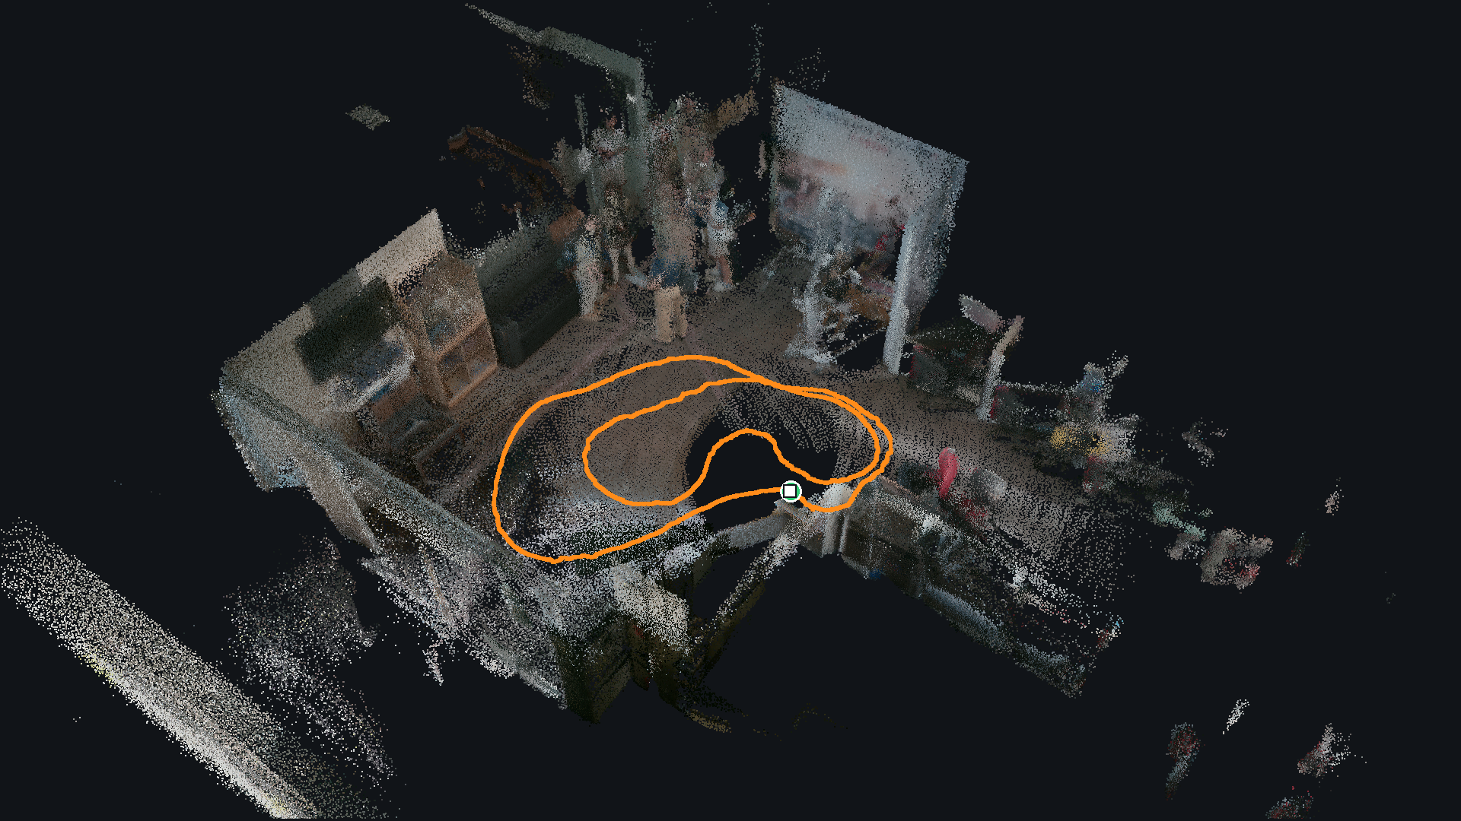
INTERIM ASSESSMENT · 28 OCTOBER 2026
GAPPLER
High-Readiness Mobile Manipulation via Gaze-Speech Interaction and Continuous Pre-Alignment
Look at it, name it, and the robot fetches that one.
Dion · Sherman · Zongzhe
Supervisors: Prof Yuan Shenghai, Prof Xie Lihua
FAST-LIVO2 map of the lab · 26 m loop · 20 Oct
Notes:
Good afternoon. We are Dion, Sherman and Zongzhe. Our project is a mobile robot that fetches the specific object a person looked at and named, even when the robot cannot see that object at the start.
(Presenter: Dion. Transition: "Here is the situation we want the robot to handle.")

Slide 2
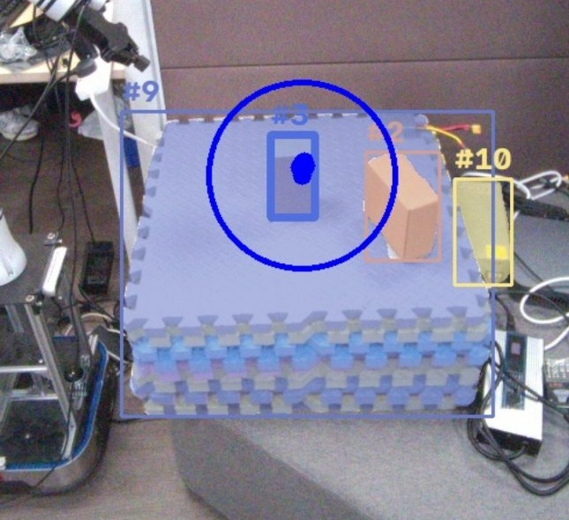
ARIA GLASSES · WHAT THE USER SEES
PART 1 / 3
The problem and our plan
Why this is hard, what we build, how we work
#1
Dion the problem and the objective
#2
Zongzhe the five-phase system
#3
Sherman where we started and how we work
The user looks and speaks. The robot has to find that one object.
Problem and plan
Results
Where we stand

Slide 3
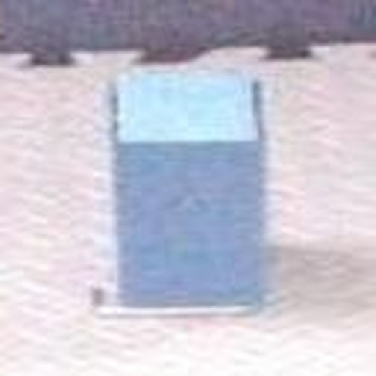
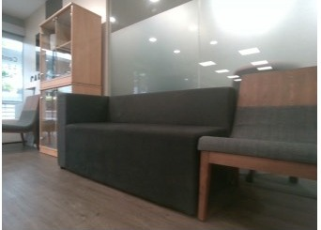
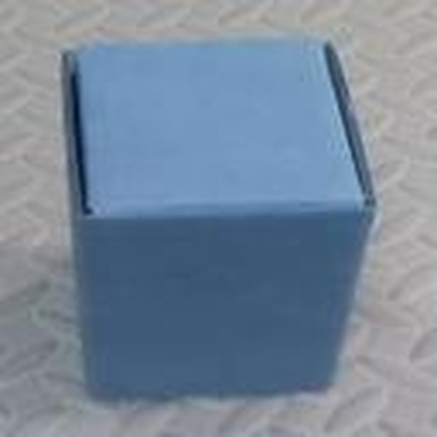
GAPPLER · DION
THE PROBLEM
The user sees the object. The robot does not
Same box, three viewpoints, almost nothing in common pixel for pixel
USER'S GLASSES · 1 TO 3 M, FRONT ON
ROBOT BASE CAMERA · KNEE HEIGHT
ROBOT WRIST CAMERA · 0.2 TO 0.5 M
FAM-HRI · LAI ET AL., 2025
HICO-NAV · XU ET AL., ICRA 2026
WHY IT MATTERS
Gaze and speech pick an object, if it is already in front of the arm
Searches a room by memory, for a class, not the one you mean
Users who can look but not easily point or speak
Base camera: the lab from knee height. A frame of the box is still to be taken.
3
Problem
System
Intent
Explore
Search
Confirm
Grasp
Plan
Notes:
Picture a user wearing Meta's Aria glasses. They look at a box on a table and say 'find the box'. The robot is somewhere else in the room. It has never seen the user's view.
These three images show why that is hard. On the left is what the glasses see: the box from a metre or two away, front on. In the middle, the robot's base camera, at knee height. On the right, the wrist camera on the arm, looking down from twenty centimetres. Same object, but the images have almost nothing in common.
Two published systems each solve half of this. FAM-HRI uses gaze and speech from the same glasses to tell an arm what to pick, but it assumes the object is already in front of the arm. HiCo-Nav lets a robot search a room using a memory of what it has seen, but it finds a class, any box, not the one you looked at. Our project joins the two: the robot explores like HiCo-Nav, and the user's gaze tells it which object to stop for.
Transition: "So what exactly are we building, and how will we know it works?"

Slide 4



GAPPLER · DION
THE OBJECTIVE
Find, reach and grasp the object the user looked at
In a room the robot cannot see at the start
HICO-NAV · WE TAKE
+
WHAT WE ADD
+
FAM-HRI · WE TAKE
Explore a room, remember every object in 3D
The gaze target tells the robot when to stop
Gaze and speech from the glasses pick the object
MILESTONES, EACH WITH A WRITTEN TEST (APPENDIX A10)
where the two systems meet
M1
M2
M3
M6
M7
M8
M10
Arm picks something up
Voice and gaze reach the arm
Base navigates
Memory graph
Graph drives the robot
Gaze picks the instance
Demo and paper
Evaluation: end-to-end trials, success per phase. Without gaze is a stretch goal. Also M0, M4, M5 and M9.
4
Problem
System
Intent
Explore
Search
Confirm
Grasp
Plan
Notes:
Our main objective is a mobile manipulator that takes what the user says and where they look, explores a room it cannot see at the start, finds the user and then the object they looked at, drives to it, checks it with the wrist camera and grasps it.
Gaze is what ties this together. From the glasses we cut out the object the user looked at and turn it into a CLIP image feature. While the robot explores, it compares every object it sees with that feature. A good enough match is the signal to stop exploring and go to that object. Without it, the robot has no way to know it has found the right one. We will measure the whole pipeline end to end, with gaze, phase by phase. A comparison without gaze is a stretch goal.
To make progress measurable we broke the project into eleven milestones. Each has a written test. For example, M2 is done when, with two boxes on the table, the arm picks the one you looked at three times out of four.
Handover: "Here is the full behaviour we are building towards. Zongzhe will walk through it."

Slide 5






GAPPLER · ZONGZHE
THE SYSTEM
The target system works in five phases
From a spoken word and a glance to a grasp, in a room the robot has not seen
1
2
3
4
5
Intent capture
Explore and find the user
Search
Approach and confirm
Grasp
›
›
›
›
Word from speech, object from gaze
Map the room, remember objects, find the user
Match objects to the gaze target
Drive close, wrist camera confirms
Choose, plan and execute the grasp
Tested on replay
Map tested live
Sentence search built
Confirm on replay
Tested on real arm
Graph offline
Gaze match planned
Driving planned
Exploring planned
Dion
Sherman, Zongzhe, Dion
Zongzhe, Dion
Dion, Sherman
Dion
Exploration is the core
M9 cut first if late
Not in scope: bringing it back
March 2027 final demonstration (M10)
5
Problem
System
Intent
Explore
Search
Confirm
Grasp
Plan
Notes:
The finished system works in five phases. First, the user speaks and looks. Speech gives us the word, gaze tells us which object, and we cut an image crop of it and turn it into a CLIP feature. Second, the robot explores. It maps the room and builds a memory of the objects it sees, each with a 3D position and an image feature. It looks for the user first, because the object is somewhere the user can see. Third, it compares what it sees with the user's target. A good match tells it to stop exploring. Fourth, it drives close and the camera on the arm confirms that this is the object the user meant. If not, it goes back to exploring. Fifth, it grasps.
Exploration is the core of the search. HiCo-Nav also has a smarter way to choose where to explore next. That part is optional and the first thing we cut if time runs short. Bringing the object back to the user is out of scope.
The badges show where each phase stands seven weeks in. The next eleven minutes go through them in order.
Handover: "Before the results, Sherman covers where we started and how we work."

Slide 6



GAPPLER · SHERMAN
OUR APPROACH
The inherited code did not run, so we built a test bench first
Rebuilt from tested open-source parts, with a baseline measured before every change
SEPTEMBER 2026 · WHERE WE STARTED
D
Dion
S
Sherman
Z
Zongzhe
No tests, no CI
Glasses
Matching
Base
LiDAR
Mount
Memory graph
Reasoning
Arm moved on its own at start-up
Arm, grasp
Bench, CI
Mapping
Nav goals
BUILDS ON
BUILDS ON
BUILDS ON
AnyGrasp path unreachable
Aria SDK, SAM 3, AnyGrasp, MoveIt 2
FAST-LIVO2, Nav2, SLAM Toolbox
HiCo-Nav method, open_clip, Qwen2.5
Leads M1 M2 M4 M7 M8
Leads M3, M5 mount
Leads M0 M6 M9
Navigation ran only from another user's folder
SHARED BASE
No memory graph code
Channel contract
7-level test bench
CI on every PR
an owner for every topic
L0 static to L6 robot
plus a GPU runner
6
Problem
System
Intent
Explore
Search
Confirm
Grasp
Plan
Notes:
We did not start from a working system. The inherited code had no tests and no CI, and none of it ran from a fresh copy. One program homed the real arm within seconds, with no prompt. Navigation ran only from another user's workspace, and our copy did not build. There was no memory graph.
So we built foundations first. Dion took the glasses and the arm, I took the base and mapping, and Zongzhe the memory graph. A channel contract says who owns every message and frame, and a seven-level test bench runs on every pull request. We measure a baseline before replacing anything, and on the real robot we move one step at a time, with two people present.
Handover: "Phase one: turning a sentence and a glance into a target. Over to Dion."

Slide 7
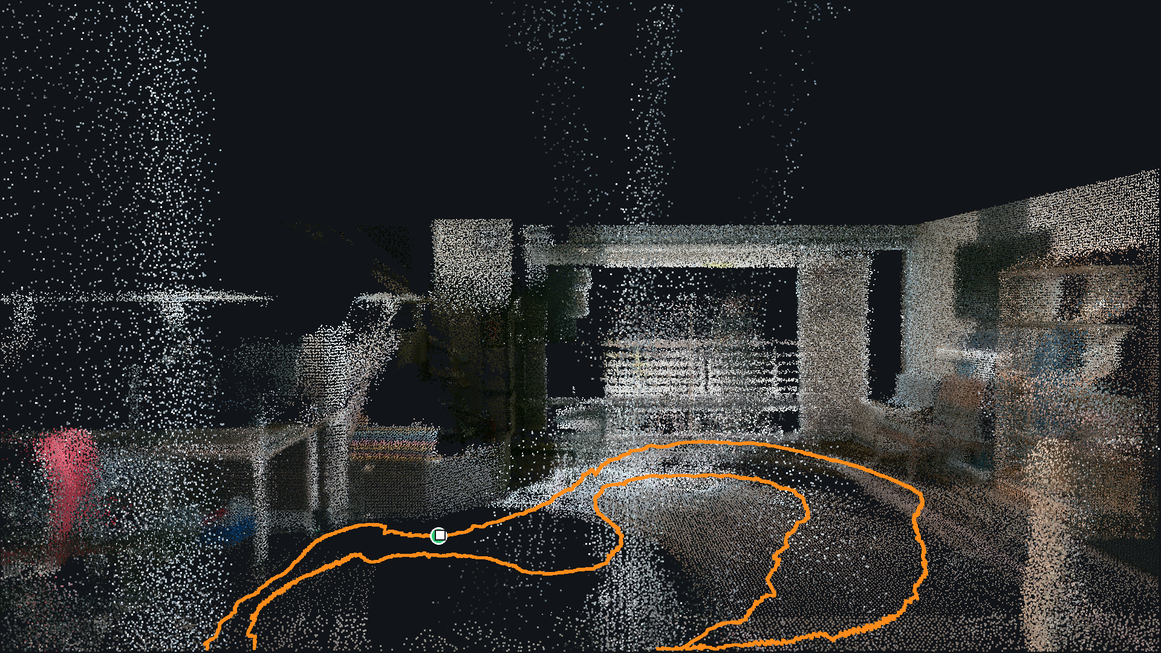
MOBILE BASE · FAST-LIVO2 MAP
PART 2 / 3
Results, phase by phase
Every stage measured on real hardware or real recordings
#1
Dion intent capture
#2
Sherman the 3D map and the camera frames
#3
Zongzhe the memory graph and search
#4
Dion confirm and grasp
Inside the lab map. Orange: the 26 m hand-pushed path.
Problem and plan
Results
Where we stand

Slide 8


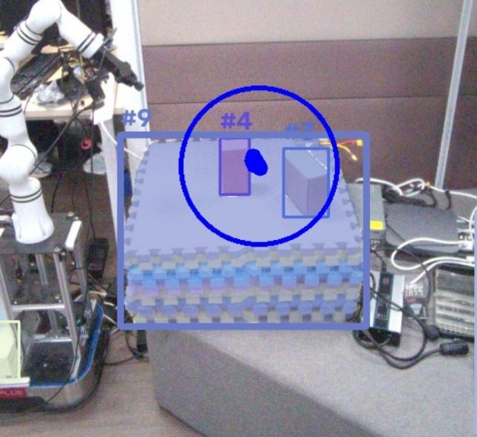
GAPPLER · DION
PHASE 1 · INTENT CAPTURE
Speech gives the word, gaze picks the object
A one-second gaze vote over SAM 3 masks makes the reference crop sent to the robot
Voice
Moment
Segment
Vote
RIGHT BOX, STEADY STARE
one word per sentence
the frame from when you spoke
SAM 3 finds every “box”
gaze picks a mask, then crop it
60 of 61
recorded frames, at 1.4 to 2.4 m
4 of 4
spoken words gave a crop (replay)
LIMIT
Gaze is off by about 5.6 degrees: about 15 cm at 1.5 m
1.0 M · GAZE ON THE BOX, BOX PICKED
1.5 M · GAZE LANDED ON THE MATS
Blue ring: gaze vote window. Tested on recordings and replay; live stream still throttled.
8
Problem
System
Intent
Explore
Search
Confirm
Grasp
Plan
Notes:
The user says 'find the box'. A speech detector waits for the sentence to finish, Whisper turns it into text, and a small language model pulls out the object word. Before this, the old pipeline produced thirty-one messages per phrase. Now it produces one.
Gaze runs at the same time. We keep the last twenty seconds of glasses images and gaze points, so we can go back to the moment the user was speaking. SAM 3, a segmentation model you prompt with a word, finds every box in that one frame. Then gaze votes. Each gaze sample in a one-second window votes for the mask it lands on, and the winner needs half the votes. We crop that mask with a small margin. That crop is what we send to the robot.
On a recording at 1.4 to 2.4 metres, this picked the right box in 60 of 61 frames. On a full replay, all four spoken words produced a crop.
The limit is gaze accuracy. The eye model is off by about five and a half degrees, roughly 15 centimetres at 1.5 metres. Here, at 1.5 metres, it landed on a stack of mats that SAM 3 also called a box. Keep that case in mind. It comes back on the CLIP slide.
Handover: "That crop now has to be found by a robot that has never seen this view. Sherman will show how the robot knows where it is."

Slide 9


GAPPLER · SHERMAN
PHASE 2 · EXPLORE AND MAP
A 3D map that closes within 12 mm
FAST-LIVO2 fuses LiDAR, IMU and colour camera into one 3D pose
THIS PART
3D map
LOOP CLOSURE
1
12 mm
2
Camera frames
back to start after 26 m
6.7 cm
worst error mid-route
LIMIT
Pushed by hand, not yet driven by Nav2
11–14 ms
per frame on CPU (budget 100)
Hand-pushed 26 m loop, 20 Oct. Orange = path, ring = start and end.
9
Problem
System
Intent
Explore
Search
Confirm
Grasp
Plan
Notes:
Before the robot can remember where objects are, it needs to know where it is. We use FAST-LIVO2, the method the HiCo-Nav paper uses, from the University of Hong Kong. It fuses the LiDAR, its motion sensor and the colour camera into one pose, and paints a coloured 3D map.
Why 3D? 2D SLAM knows only where the base is on the floor and which way it faces. The memory graph places each object in 3D from the camera's pose, so an unmeasured tilt moves objects by centimetres. Nav2 still drives on a 2D grid built from this pose.
FAST-LIVO2 is published for ROS 1. We run a community ROS 2 port, and getting it to work was most of the effort. I proved it on the authors' own recording first, then on our sensors with every message checked. I found three defects that fail silently: no crash, just a wrong map. Each was found by reading the source and confirmed against a control run.
The result: I pushed the base by hand around a 26-metre loop. The path returns to its start within 12 millimetres, and the mid-route error is within about 7 centimetres, the limit of our reference. The pose now feeds Nav2's frame tree. Nav2 driving the base is the next test.
Source: recording handdriven1, 20 Oct 2026. Closure 4 mm LiDAR-only, 7 mm odometry (0.03 %). CR 8.4.
Transition: "A map is only useful to the arm and the memory if every camera's position on the robot is known."

Slide 10
GAPPLER · SHERMAN
PHASE 2 · EXPLORE AND MAP
Four camera links, four states of calibration
Each missing calibration blocks a specific later step
THIS PART
1
Base to arm
1
3D map
Measured
User + glasses
Arm grasps in the base's map
2
Camera frames
Wrist camera
Base camera to LiDAR
2
3
Mount measured, not calibrated
Arm
4
Graph objects. Rig planned (T5.5)
2
3
Wrist camera to arm
1
LiDAR
Calibrated
Mobile base
Camera grasp becomes an arm goal
LIMIT
Base camera
Base camera not yet calibrated: about 6.7 px of error per degree
4
Glasses to robot
Planned (T8.8)
Gaze ray in robot frame, look-alikes
Camera calibration is a separate problem from the robot's frame tree (appendix A2).
10
Problem
System
Intent
Explore
Search
Confirm
Grasp
Plan
Notes:
There are four places where we need to know how one part of the robot sits relative to another.
The arm on the base is measured. We set the transform from the mount drawings and checked it on the robot. The base's own origin, on the floor under the drive axle, matches the vendor's manual.
The base camera relative to the LiDAR is measured but not calibrated. I designed and fitted the mount, measured to the camera's mounting hole, and took the rest from Intel's published camera dimensions. It sits flush on vertical aluminium extrusions, so it points straight by construction. What is left is a calibration against the LiDAR itself, because one degree of error moves a point by about seven pixels. The rig for that is planned.
The wrist camera relative to the arm is calibrated, so a grasp it sees becomes an arm goal.
The last one is different in kind. To use gaze to separate two identical objects, the robot needs the user's gaze ray in its own frame, which means locating the glasses relative to the robot. That is planned for January.
None of these blocks today's results, but each one blocks a specific later step.
Handover: "With poses and camera images from that drive, Zongzhe builds the robot's memory of the room."

Slide 11



GAPPLER · ZONGZHE
PHASE 2 · EXPLORE AND MAP
The memory graph turns a drive into a map of objects
Each object gets a 3D position and a CLIP image feature, built from the recorded drive
THIS PART
HOW IT IS BUILT · 14 TESTED STAGES
Memory graph
PHOTOS KEPT
1
Keep a photo every 1 m or 45°
SAM 3 finds all 30 classes
LiDAR gives depth
29 of 3,536
1
2
3
2
Merge tuning
Lift each mask to 3D
CLIP feature per object
Merge repeat sightings
99.2 % less segmentation time
4
5
6
3
Search
1.69 s vs 9.70 s
WHAT IT STORES
batched SAM 3, 5.7 times faster
399 tests
LIMIT
chair
Anchor
Built offline from a recorded drive. Not yet live while driving
kept photo + camera pose
pass on the lab GPU
table
Object
9 problems
box
3D box, CLIP feature, class
in upstream code, fixed or avoided
11
Problem
System
Intent
Explore
Search
Confirm
Grasp
Plan
Notes:
The memory graph is HiCo-Nav's idea. As the robot moves, it keeps a photo now and then, finds the objects in it, and stores each object with its position in 3D and a CLIP image feature. CLIP is a model that turns an image into a vector, so that similar-looking things get similar vectors. The photos are kept too, linked to the objects they show. That link is the 'graph'.
HiCo-Nav published code, but with no licence, so I read it and wrote a fresh implementation as fourteen separate stages, each with its own tests. Reading it also turned up nine problems, such as a language-model call with no timeout, which we fixed or avoided.
Here is the graph built from Sherman's hand-pushed drive. Two choices keep it fast. A photo is kept only after the robot moves a metre or turns 45 degrees, so 29 of 3,536 frames go to segmentation, which saves over 99 % of that time. And all thirty object classes go through SAM 3 in one batch, 5.7 times faster than one at a time.
It is built offline from a recording. Building it live while the robot explores is next (T7.2, T7.5).
[Artefact owed by Zongzhe: a Rerun 3D screenshot of the graph can replace the 'What it stores' cards.]
Transition: "The hardest part of building it is deciding when two sightings are the same object."

Slide 12

GAPPLER · ZONGZHE
PHASE 2 · EXPLORE AND MAP
A 10 cm merge radius removes duplicates safely
Tuned against a hand-made answer key: 16 real objects marked on the LiDAR map
THIS PART
Duplicates left, by match radius (cm)
Memory graph
DUPLICATES AT 10 CM
1
8→3
2
Merge tuning
with no false merges
3
Search
Why not merge by look?
LIMIT
Same chair
0.93
Two drives, 16 objects: a difference of one is noise
Same-model chairs
0.81–0.85
Other objects
0.56
upstream
chosen
chair merges
into desk
CLIP image similarity, 0 to 1
12
Problem
System
Intent
Explore
Search
Confirm
Grasp
Plan
Notes:
The robot sees the same chair from many places. Each sighting must merge into one object, and two chairs side by side must stay two.
To measure that, I made an answer key by hand: sixteen real objects marked on the LiDAR map, without using any of the code being tested. Then I swept the settings.
The lever is the match radius, how close two sightings' points must be. With our sparse LiDAR depth, two views of one object land 4 to 9 centimetres apart, so upstream's 2.5 centimetres split objects. At 10 centimetres duplicates fall from 8 to 3 with no false merges. On a second drive, 2 to 1. At 15, a chair merges into the desk next to it, so we chose 10.
Why not just merge things that look alike? Because look-alikes are exactly the problem. CLIP scores two chairs of the same model at 0.81 to 0.85, close to the same chair at 0.93. Merging on appearance removes every duplicate by merging nearly everything. That is also why the class alone cannot find the user's object.
Chart: drive 1. The 1 cm setting (31 duplicates) is left off the chart.
Transition: "Once the objects are in the graph, the robot has to find the right one from a sentence."

Slide 13
GAPPLER · ZONGZHE
PHASE 3 · SEARCH
A sentence becomes a ranked list of objects
Today the query is a sentence. In the full system, the gaze crop is the query (M8)
THIS PART
Sentence to classes
1
SENTENCE TO CLASSES
1
Memory graph
20 of 22
“Find the chair”
›
chair
table
desk
2
Merge tuning
test instructions, checked by hand
Search
2
Score each object
3
Its CLIP image feature against the sentence's CLIP text vector
BY LANGUAGE MODEL
Qwen2.5 1.5B (used)
20/22
LIMIT
Full query on the recorded drive not run yet: T6.8, weeks 7 to 8
3
Rank the hits
No model, fallback
15/22
Target classes first, then related, each by score. Each hit has a 3D centre and its best photo. A wrong hit can be rejected.
Qwen2.5 0.5B
12/22
0.28 to 0.32 s per reply, on the lab machine
13
Problem
System
Intent
Explore
Search
Confirm
Grasp
Plan
Notes:
To search the graph, the robot first turns the sentence into classes. A small language model, running locally, returns the target class and some related ones. 'Find the chair' gives chair, plus table and desk, because chairs are usually near them. The 1.5 billion parameter model got 20 of 22 test instructions right and answers in about a third of a second.
Then every object is scored by comparing its stored image feature with the sentence, using CLIP again. Target classes rank first, related ones after. Each hit comes with a 3D position and the best photo of it, and a wrong hit can be rejected so the robot tries the next one.
The ranking has been tested on stand-in data and a few photos. Running the full query on the recorded drive, checked against the answer key, is the next milestone, in the next two weeks.
Today the query is a sentence. In the full system, the robot matches each object against the gaze crop, and a good match tells it to stop exploring and go to the user's chair, not just any chair.
[VERIFY: Zongzhe to confirm the 'table, desk' example against check_reasoning.json.]
Handover: "Dion now picks up the object at close range."

Slide 14
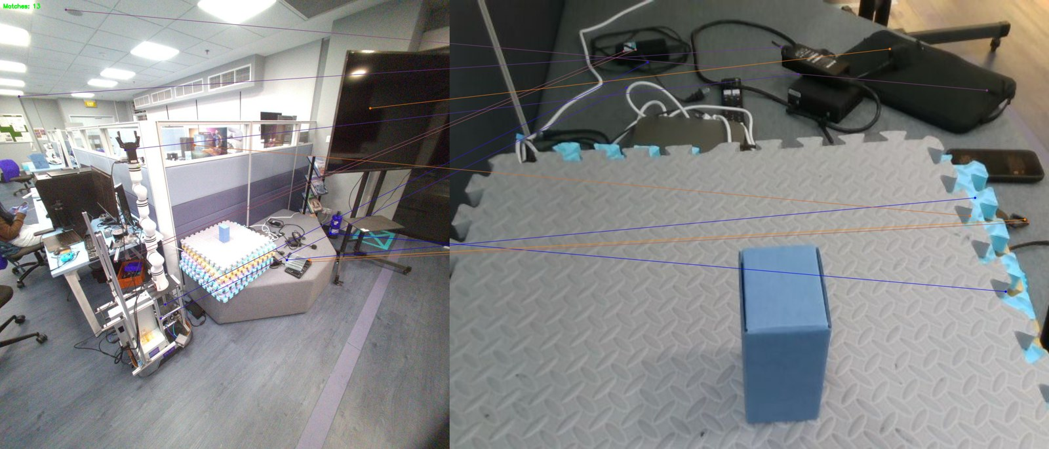
GAPPLER · DION
PHASE 4 · APPROACH AND CONFIRM
CLIP finds the looked-at box, and now steers the grasp
Which wrist-camera mask is the object in the glasses crop?
1 · CHOOSE THE METHOD
2 · IN THE GRASP LOOP
Box ranked first, glasses vs wrist pairs
600 of 602
wrist targets on the box the user looked at
GLASSES CROP
TWO LOOK-ALIKE CARDBOARD BOXES
Old pick
0 of 114
Glasses crop
266 of 268
Keypoints match the ceiling and floor, not the box
LIMIT
Same-colour boxes: 6 of 12. Needs the gaze ray in the robot's frame (T8.8)
WRIST VIEW
Replayed recordings, arm not moved. Below 0.56, or a tie, the arm waits.
14
Problem
System
Intent
Explore
Search
Confirm
Grasp
Plan
Notes:
This is the central perception problem. We have the glasses crop from the intent slide, and the wrist camera sees several objects. Which one is it?
The obvious approach is keypoint matching: find distinctive points in both images and pair them. We measured that first. It ranked the box first in none of 15 pairs. The viewpoints differ too much. So we compared whole-object features, and CLIP ranked the right box first in all 25.
This week we put it where it matters, inside the grasp client. The arm now goes for the box you looked at, not the box SAM 3 is most confident about. On a scene with two cardboard boxes, the old pick took the wrong box in every one of 114 frames. With the glasses crop, 266 of 268 targets were the right box. With three boxes, 334 of 334. If nothing matches well enough, the arm waits.
The two misses are instructive. They came at 1.5 metres, where gaze landed on the mat. The crop was wrong before the matcher ever saw it. So the next step is to refuse weak gaze picks at the glasses (T2.24).
The real limit is identical objects: two boxes of the same colour, 6 of 12. Appearance cannot separate them. That needs the gaze ray in the robot's frame, the glasses calibration from the camera-frames slide.
All of this is on replayed recordings. The real arm run comes next.
Transition: "Once the target mask is chosen, the arm has to pick it up."

Slide 15

GAPPLER · DION
PHASE 5 · GRASP
The real arm grasps on a spoken command
First real grasp on 13 Oct 2026, with a tested software stop
Idle
›
Approach
›
Grasp
›
Hold
WITHIN REACH
at home
wrist camera steps 2 cm to 0.21 m
choose and execute
until “release”
5 of 6
Grasps by distance
grasps (5 of 8 overall), started by a recorded voice command
< 1 ms
software stop cancels motion
Video of the first real grasp
Dion: drop in grasp_real_arm.mp4 (15 s or less)
LIMIT
Narrow band of positions. Two people and a hand on the power button
54.5 cm is out of reach
15
Problem
System
Intent
Explore
Search
Confirm
Grasp
Plan
Notes:
Grasping is a state machine. A grasp request opens a short gate. The arm then steps the wrist camera towards the target mask, two centimetres at a time, re-checking at each step, until it is 21 centimetres away. This is a simple form of visual servoing: small corrections absorb calibration and depth errors. Then it grasps, lifts, returns home, and holds the object until the user says 'release'.
Our first real grasp was on 13 October. Started from a recorded spoken command, the arm made 5 of 8 grasps. Both failures at 54.5 centimetres were out of reach, so within reach it was 5 of 6. In one run it grasped, held, refused two requests while busy, released, and grasped again.
Safety came first. The arm's hardware stop is rejected by its controller, so we wrote a software stop. On the real arm it cancels motion within a millisecond. Every motion test still has two people and a hand on the power button.
These grasps used a simple path, one blind step and close. The learned grasp model is the harder part.
Transition: "The learned grasp model, AnyGrasp, is where the current blocker sits."

Slide 16
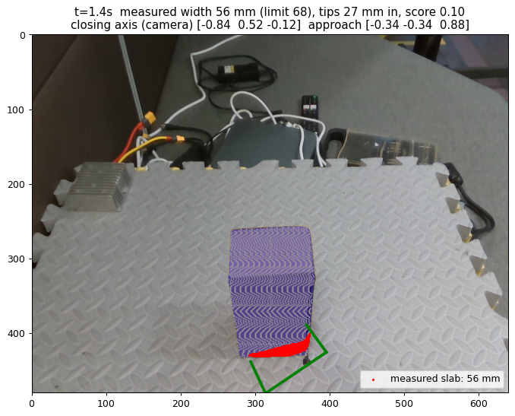

GAPPLER · DION
PHASE 5 · GRASP
AnyGrasp works at only one ideal spot
Up close, the wrist camera sees only one face of the box
WHY IT FAILS UP CLOSE
AT THE IDEAL SPOT
Side face
2 of 3
75 mm
Top
60 mm
grasps at 44.5 cm, centred and square
Dashed: gripper opens to 71 mm
0 of 4
Top grasp: proposed in 49 of 75 frames, but scores ≤ 0.25, under the 0.3 floor
live, with the OK-Robot recipe
Fit check reads the 75 mm face as 56 mm, so it passes (369 of 369 on replay)
NEXT, CHEAPEST FIRST
Grasp from 0.4 to 0.5 m, whole box in view
Fused views: built, retest owed
New SDK: licence pending
A
B
C
16
Problem
System
Intent
Explore
Search
Confirm
Grasp
Plan
Notes:
AnyGrasp is a learned model that looks at a point cloud and proposes grasps: where to put the gripper and at what angle. At the ideal spot it worked twice in three tries. Anywhere else it failed.
We traced why. The arm runs AnyGrasp when the camera is 21 centimetres from the box, and from there it sees mostly one face. AnyGrasp's most confident grasps go across the 75-millimetre face, but our gripper opens to 71. Our own fit check should catch that, but it measures width from the points it can see, so a grasp on an edge looks narrow enough and passes. On replay every one of 369 grasps passed it. The grasp we want, from the top across 60 millimetres, is proposed in most frames, but scores 0.25, under our floor.
So the problem is not the model. It is where we ask it. The cheapest fix is to run AnyGrasp once from further back, 40 to 50 centimetres, with the whole box in view, then make one planned move. The second is to fuse several views into one cloud, which is built and needs a retest. This decides when M1 closes.
Handover: "Sherman will now step back from the parts and show what is connected today."

Slide 17
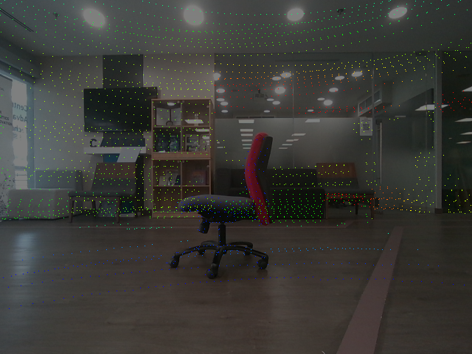
BASE CAMERA + LIDAR · NOT YET CALIBRATED
PART 3 / 3
Where we stand
Joins, schedule, budget and next steps
#1
Sherman the full flow and the schedule
#2
Zongzhe budget, risks and next steps
Two sensors, one scene: the parts work, the joins come next.
Problem and plan
Results
Where we stand

Slide 18
GAPPLER · SHERMAN
THE FULL FLOW
Every phase has a working part. Two links are still to join
No end-to-end run yet, as planned: the first full run is M4, January 2027
1 Intent
2 Explore, find the user
3 Search
4 Approach, confirm
5 Grasp
Voice and gaze to a crop
gaze reference crop (replay)
Wrist camera confirms
Grasp on the real arm
tested on replay
600 / 602 on replay
tested on the real arm
gaze target
arrive, hand over (T3.7)
Memory graph
Gaze match on graph
Drive and hand over
works alone, offline
planned (T8.2)
planned (T7.1)
graph grows live (T7.5)
Nav2 drives the base
Find the user
NEXT ON THIS PATH
built, never driven (T3.6)
planned (T7.6)
Nav2 drives the base
pose, checked live
1
starts after this presentation (T3.6)
recorded drive, offline
FAST-LIVO2 map and pose
2
First full run, speak to grasp
tested, pushed by hand
M4, January 2027
works today
still to join
tested
built, not validated
works alone
planned
18
Problem
System
Intent
Explore
Search
Confirm
Grasp
Plan
Notes:
Here is the full flow from the five-phase slide again, with each part we have just shown placed where it sits.
Built and connected today: a recorded voice command starts a real grasp on the real arm, and since this week the glasses crop also chooses which object the arm goes for, on replayed recordings. My map feeds the navigation frame tree, and the memory graph is built from my recorded drive.
Two links are still to join. The robot has to explore with a live memory graph, match what it sees against the gaze target, and turn a match into a navigation goal. Nav2 has to drive the base, which I start right after this presentation.
So there is no end-to-end run yet. That matches the plan: the first closed-loop run is milestone M4, in January. Here is how we stand against that schedule.
(Phases 2 and 3 form a loop: Nav2 explores, the graph grows, a gaze match becomes the next goal; a wrist-camera reject sends the robot back to exploring. Topic-level wiring is in appendix A1.)

Slide 19
GAPPLER · SHERMAN
SCHEDULE
Ahead on memory and gaze, behind on driving
Final dates unchanged. Forecasts re-estimated on 24 Oct, weeks counted from 14 Sep 2026
Sep
Oct
Nov
Dec
Jan
Feb
Mar
Apr
M0 Build and run
M1 Arm picks something up
M2 Voice and gaze to arm
M3 Base navigates
M4 Closed loop
M5 Calibrated base camera
M6 Memory graph offline
M7 Graph drives the robot
M8 Gaze picks the instance
M9 Exploration order (optional)
M10 Demo and paper
done
forecast
optional
no work
today
report
oral
Started early: M2 voice and gaze, M6 memory graph, M8 gaze instance
Behind 1 to 2 weeks: M5 camera calibration, M3 drive-to-point
Progress: 97 of 171 task rows done
19
Problem
System
Intent
Explore
Search
Confirm
Grasp
Plan
Notes:
This chart shows every milestone by week. Solid bars are work done so far, light bars are our forecast, and the grey bands are recess, exams and the winter break, when we are not working.
Our September plan expected, at this point, only the build milestone finished and the arm and base under way. We have that. The build milestone closed in week two. The arm picks up a box on the simple path. My map and localisation are done.
Three milestones started well ahead of their windows: voice and gaze to the arm, the memory graph, and the gaze-instance work. The memory graph should finish a week early.
Two things are behind, and both are mine: calibrating the base camera, because the rig is not built yet, and the test drives, because bring-up has taken twice my estimates. They slip one to two weeks into January. M8 and the final dates do not move.
The weeks after the break carry most of the integration: closed loop in January, the robot exploring in February, and the end-to-end trials in March.
(Bars that cross exam and break weeks are calendar time, not working time. Key dates: interim 28 Oct, final report 28 Mar 2027 (week 28), oral weeks 30 and 31.)
Handover: "Zongzhe will cover what the plan costs and what could go wrong."

Slide 20
GAPPLER · ZONGZHE
BUDGET AND RISKS
SGD 1,500 for compute, approved
Risks are mostly schedule and shared hardware
RISKS AND STATUS
controlled
ongoing
APPROVED · 5 OCT 2026
Critical path runs through one person
Cut list fixed in advance
1,500 SGD
AnyGrasp licence tied to a hardware ID
New licence requested
both items for compute
Shared, throttled lab machine
Throttling, 2 hangs, disk 89 % full
1,000
500
Hardware GPU
API credits
No hardware stop on arm or base
Software stop, two people at every test
WHY: ONE SHARED 16 GB GPU
10.3 GiB: batched SAM 3 alone
16 GB
Duplicate objects in the graph
8 → 3, no false merges
Also AnyGrasp, CLIP, Whisper, 2 language models: 3 people + CI
Cut order if late: M9 exploration order, without-gaze comparison, reasoning layer, graph pruning, two-stage trigger, fewer trials.
20
Problem
System
Intent
Explore
Search
Confirm
Grasp
Plan
Notes:
Our budget is small and approved: a thousand Singapore dollars for a GPU and five hundred for API credits for AI services, both for compute. The reason is concrete. Everything runs on one 16 gigabyte GPU in the lab, shared by the three of us and by the CI runner. Segmentation, grasping, CLIP, speech and two language models all need it, and the memory graph's segmentation alone peaks at over 10 gigabytes. We have never run them all at once.
The main risks are about schedule and shared hardware. The critical path runs almost entirely through one person, so we fixed a cut list in advance. The paper's smarter exploration order goes first. Exploration itself and the gaze match stay, because the system does not work without them. The grasp model's licence is tied to a machine ID, and a new one is requested. The lab machine is shared and has hung twice. And neither the arm nor the base has a working hardware stop, so every motion test has two people and a hand on the power button.
[TEAM INPUT: whether the GPU has been bought yet and any spend to date, in case an examiner asks.]
Transition: "To close, what happens next and what we want you to remember."

Slide 21
GAPPLER · ZONGZHE
NEXT STEPS
Next: close the grasp, drive the base, query the graph
Then explore with gaze, to end-to-end trials in March 2027
WEEKS 7 TO 8 · BEFORE EXAMS
THREE TAKEAWAYS
1
Refuse weak gaze picks, gaze grasp on the real arm T2.24, T8.9
1
Identity across viewpoints is the hard part
2
New SDK, 12-trial validation: M1 by 8 Nov T1.45, T1.35
3
Nav2: first drives to a point T3.6
4
Graph query on the recorded drive T6.8
2
Every subsystem is measured on real hardware or data
AFTER THE BREAK
Jan
Feb
Mar
The links are scheduled, with a cut list ready
3
M2 two-box gaze grasp, M5 calibration, M4 closed loop
M7 the robot explores and finds the user
M8 a gaze match ends exploration: end-to-end trials
21
Problem
System
Intent
Explore
Search
Confirm
Grasp
Plan
Notes:
In the next two weeks, before exams, we close four specific gaps. The glasses learn to refuse a weak gaze pick, and the gaze-matched grasp runs on the real arm. The new AnyGrasp version and the fused views are tested, then a twelve-trial validation closes the grasp milestone. Sherman starts driving the base with Nav2. And I run the full memory graph query on the recorded drive, checked against the answer key.
After the break, the pieces join: the two-box gaze test on the real arm, the camera calibrations, the first closed-loop run in January, and the robot exploring on its own in February, with a gaze match telling it when to stop. In March we run the end-to-end trials.
Three things to take away. The hard part of this problem is keeping the object's identity across very different viewpoints. Every subsystem now has measured results on real hardware or real data. And the remaining links are scheduled, with a cut list fixed in advance. Thank you. We are happy to take questions.

Slide 22
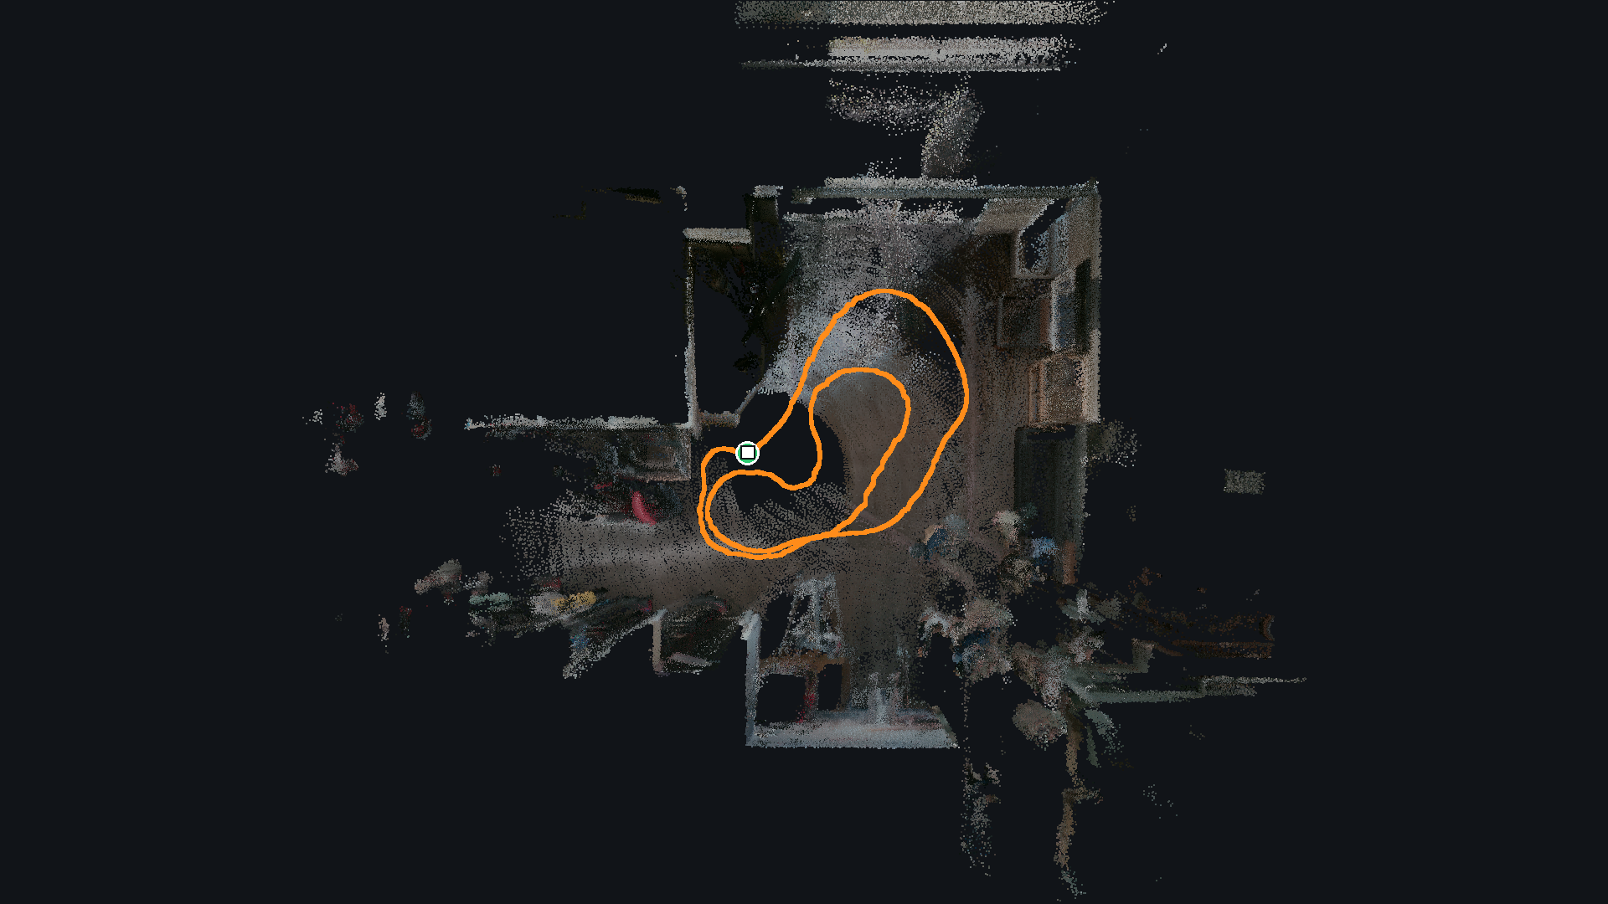
MOBILE BASE · TOP VIEW OF THE LAB
THANK YOU
Questions
Look at it, name it, and the robot fetches that one.
Dion · Sherman · Zongzhe
Backup: wiring, frames, matching, grasp options, map accuracy, limitations, plan, evaluation.
Backup slides A1 to A10 follow.
Problem and plan
Results
Where we stand
Notes:
Questions. Backup slides A1 to A10 follow for detailed answers.

Slide 23
BACKUP · NOT IN THE 20 MINUTES
Appendix
A1 Topic-level wiring today
A6 Limitations, risks and observed failures
A2 Coordinate frames
A7 September plan vs now
A3 Matching rule and thresholds
A8 Why gaze, not just a class name
A4 Grasp filters and the five options
A9 End-to-end evaluation plan
A5 FAST-LIVO2 port defects and mid-route accuracy
A10 Milestone tests
Notes:
Appendix divider. Backup slides for questions only.

Slide 24
GAPPLER · APPENDIX
BACKUP · A1
A1 Topic-level wiring today
Answers: “What exactly is connected?” Only links that exist in code. Grey rows exist but have not run
From | To | Channel | State
Voice: Silero VAD, faster-whisper, Qwen2.5-0.5B | aria_segmentation_client | /aria/audio/prompt (String) | Ran (replay)
Eye model | aria_segmentation_client | /aria/eye_tracking/gaze_estimate | Ran (recording)
aria and grasp segmentation clients | SAM 3 service (one copy on GPU) | /segmentation/segment | Ran
aria_segmentation_client | grasp_segmentation_client | /grasp/target: word, then word plus reference crop | Ran on replay (T8.9a)
aria_segmentation_client | grasp_state_machine | /manipulator/grasp_request | Ran
grasp_segmentation_client | grasp_state_machine | /object_centroid_2d (pixel plus depth) | Ran
anygrasp_detection_node | grasp_state_machine | /grasp_candidates | Ran
grasp_state_machine | MoveIt and rm_driver | real arm | Ran on the real arm
Livox MID-360, base D455 | FAST-LIVO2, then fastlivo_odom_bridge | odom to robot_base_link | Ran live
fastlivo_odom_bridge | SLAM Toolbox, mapping mode | map to odom, /map | Ran live
SLAM Toolbox | Nav2 | frame tree | Never run on this
object_recognition_pipeline | object_approach_node | /manipulation/goal_pose (call commented out) | Not run
object_approach_node | Nav2 | /goal_pose | Not run
Recorded drive handdriven1 | Memory graph S0 to S13, then TargetFinder | offline | Graph built. Query not run
Source: COMBINED_PROGRESS_REPORT_2026-10.md §3.3
24
Notes:
BACKUP SLIDE, not in the 20 minutes. Answers: “What exactly is connected?” Only links that exist in code. Grey rows exist but have not run

Slide 25
GAPPLER · APPENDIX
BACKUP · A2
A2 Coordinate frames
Answers: “How do grasp poses reach the arm?”
map
›
odom
›
robot_base_link
›
base_link
›
Link1 to Link6
›
camera_link
›
camera_color_optical_frame
plus livox_frame under robot_base_link
Parent to child | Published by | Value or note
map to odom | SLAM Toolbox | Nav2 plans in this map frame
odom to robot_base_link | Wheel driver, or the FAST-LIVO2 bridge (odom_source:=fastlivo) | Bridge: T_odom_base(t) = Tb x P0^-1 x P(t) x Tb^-1, Tb = (0.191, 0.02329, 0.15588) m. Refuses to start above 2° start tilt
robot_base_link to base_link | Static (arm mount) | (0.18, 0, 0.48) m, yaw 180°. Measured, tf2_echo matched
robot_base_link to livox_frame | Static | LiDAR mount
base_link through Link1 to 6 to camera_link | URDF | Wrist camera to arm calibrated (Dion, 24 Oct)
camera_link to camera_color_optical_frame | RealSense driver | AnyGrasp candidates arrive in this frame
Open question for P2 and T7.1: the memory graph stores positions in FAST-LIVO2's camera_init frame, while Nav2 drives in SLAM Toolbox's map frame. How graph positions reach map at run time is a design question, not a defect.
Source: COMBINED_PROGRESS_REPORT_2026-10.md §6.7, §5.4
25
Notes:
BACKUP SLIDE, not in the 20 minutes. Answers: “How do grasp poses reach the arm?”

Slide 26
GAPPLER · APPENDIX
BACKUP · A3
A3 Matching rule and thresholds
Answers: “Why 0.56? Is CLIP cosine a probability?”
THE RULE
NOT A PROBABILITY
Cosine between each wrist mask crop (box plus 20 px) and the reference crop. Cutoff 0.56, tuned on 20 pairs (T8.7). Masks within 0.01 of the best count as a tie, and a tie returns no match. Same model in both places: open_clip ViT-B-32 laion2b_s34b_b79k.
CLIP cosine is not calibrated. Thresholds are empirical: 0.56 for the matcher, 0.6 on the graph's 1.5 x overlap + 0.5 x appearance score. float16 shifts a vector by up to 0.0039 across batch sizes. Crop padding differs between glasses, wrist and graph.
Where | Method | Confidence handling
Glasses mask | Gaze vote | Winner needs half the votes, else word only
Wrist mask (matcher) | CLIP cosine | Cutoff 0.56, wrist tie returns no match
Wrist mask (grasp) | CLIP cosine when a reference exists (T8.9a), else SAM 3 score | Cutoff 0.56 and no tie, else nothing published
Graph association | 3D overlap plus CLIP | Score over 0.6, greedy
Graph query | CLIP text vs image | Ranking only
No stage carries a confidence forward to the next (see A6).
Source: COMBINED_PROGRESS_REPORT_2026-10.md §5.4, §6.4, §6.6
26
Notes:
BACKUP SLIDE, not in the 20 minutes. Answers: “Why 0.56? Is CLIP cosine a probability?”

Slide 27
GAPPLER · APPENDIX
BACKUP · A4
A4 Grasp filters and the five options
Answers: “Why not just lower the score floor?”
FILTERS ON EVERY CANDIDATE
Option | Idea | Cost
A. Grasp from the view pose | AnyGrasp once at 0.4 to 0.5 m with the whole box in view, one planned motion | Small, the pieces exist
B. Fused views (T1.47) | Several views in one cloud, grasp on that | Built, retest owed
C. New AnyGrasp SDK (T1.45) | Native mask and angle steering | Waiting on licence
D. Closed-loop tracking | AnyGrasp's tracking mode updates the grasp while the arm moves | Medium, old node parked
E. Two-phase (shelved, T1.33) | Stop just before the depth blind zone, set the angle, move straight in and close | Small
On the SAM 3 mask
Inside the approach cone
Score at least 0.3
Width under 68 mm
Fingertips at most 45 mm past the near face
Pose stable for 5 frames
Of the 180° twins, the smaller wrist turn (T1.33)
WHY THE FLOOR IS NOT THE FIX
The top-down grasp scores at most 0.25, but the problem is the view. The 30° cone around the camera axis dropped every top-down grasp, because the camera axis is 44° from vertical. AnyGrasp was also used against its README: masked points only, 0.10 m width.
Source: COMBINED_PROGRESS_REPORT_2026-10.md §5.5. Options: DION_PROGRESS_REPORT_2026-10.md §7
27
Notes:
BACKUP SLIDE, not in the 20 minutes. Answers: “Why not just lower the score floor?”

Slide 28
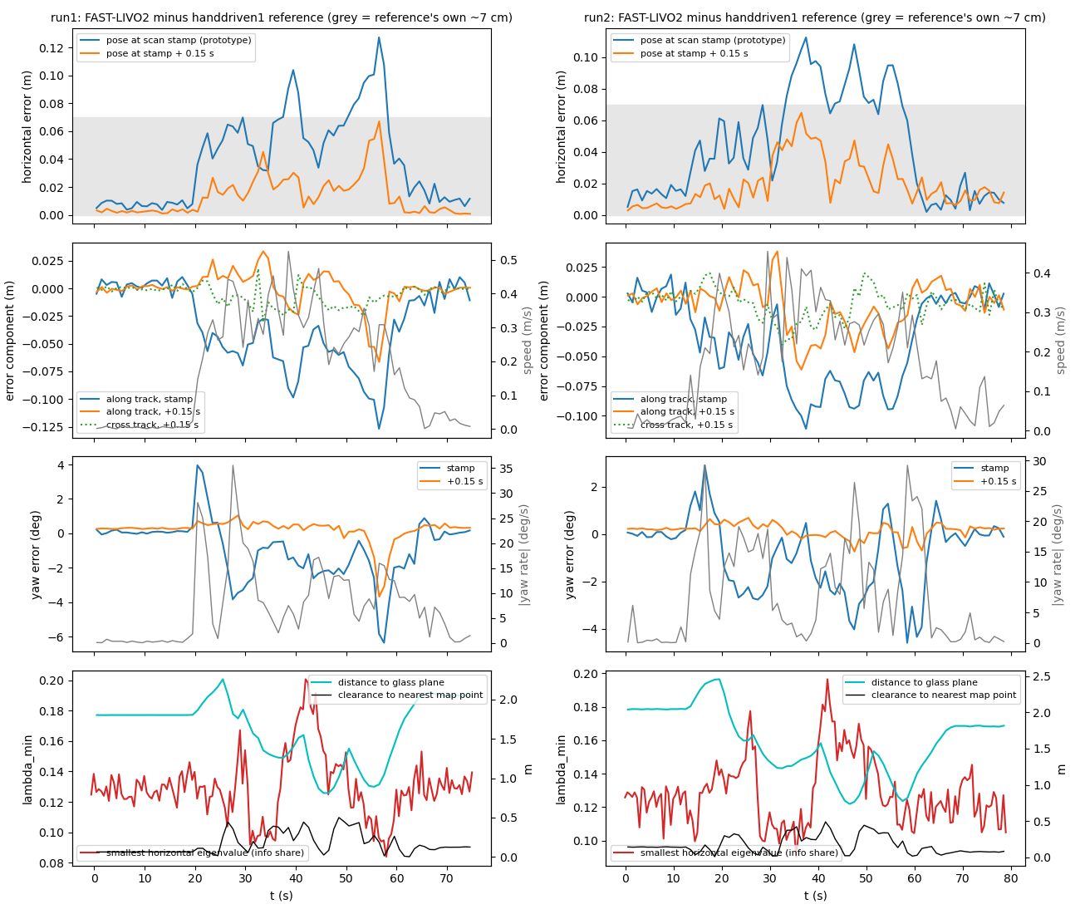
GAPPLER · APPENDIX
BACKUP · A5
A5 FAST-LIVO2 port defects and mid-route accuracy
Answers: “How do you know the map is right?”
Defect (found by reading the source, confirmed against a control run) | Before | After the fix
Range gate cannot act (F2): blind_sqr never assigned, the port dropped upstream's line | Median 19,968 points per scan, the full packet | Median 9,607. Removed 52.06 % against 51.84 % audited zero-range points
LiDAR to IMU offset has the wrong sign (F3) | About 10.2 cm of geometric inconsistency in every replay before 19 Oct | Configs carry (-0.011, -0.02329, 0.04412) m. handdriven1 recorded after the fix
Voxel key mismatch: insertion and retrieval round negative coordinates differently | Key hits 1,392,458 vs 1,878,707 shadow hits | Hits match, 1,855,269. Retrieval points 112,980 to 128,385
MID-ROUTE ACCURACY (T3.5F)
Within 6.7 cm (run 1) and 6.5 cm (run 2) for the whole route, against the handdriven1 map, 0.15 s lag removed. The reference carries about 7 cm of its own error.
The mapper stamps its pose about 0.15 s late: surfaces smear about 4 cm at 0.28 m/s. Fix prepared, off by default.
Floor marks did not close as ground truth. A tape-measured check is owed.
Source: COMBINED_PROGRESS_REPORT_2026-10.md §8.4. SHERMAN_PROGRESS_REPORT_2026-10.md §9.3, §11.4, §11.5
28
Notes:
BACKUP SLIDE, not in the 20 minutes. Answers: “How do you know the map is right?”

Slide 29
GAPPLER · APPENDIX
BACKUP · A6
A6 Limitations (1 of 3): confirmed in the code
Answers: “What fails today?” Most are links the plan schedules for later milestones
Limitation | End-to-end implication
A wrong gaze pick becomes a confident reference (at 1.5 m the reference was the mat) | The arm would go for the wrong box. T2.24 refuses weak gaze picks
/manipulation/goal_pose has no live publisher (inherited) | Nothing can start navigation to an object yet. T7.1 will publish it
No graph query service, no T7.1 node | The graph cannot drive the robot
No gaze-target trigger on graph objects | The exploring robot cannot tell it has found the target. Glasses vs base-camera features untested
Graph built offline from a hand-pushed recording | No live graph. No depth camera data
No calibration between any cameras | Graph positions and the gaze ray carry unknown rotation error, about 6.7 px per degree
Software-only stops on arm and base | Every hardware test needs two people and the power button
No automatic grasp success check | Outcome judged by people. A retry loop cannot know when to retry
Source: COMBINED_PROGRESS_REPORT_2026-10.md §9.1
29
Notes:
BACKUP SLIDE, not in the 20 minutes. Answers: “What fails today?” Most are links the plan schedules for later milestones

Slide 30
GAPPLER · APPENDIX
BACKUP · A6
A6 Limitations (2 of 3): risks when the parts join
Answers: “What could break when the parts join?”
Risk | What to watch
No confidence crosses a stage boundary | A wrong gaze pick gives a confident reference, a wrong graph hit a goal, a wrong wrist mask a grasp. The matcher caught one by luck of score (0.51 vs 0.56)
Crop mismatch | Fixed 20 px glasses crop against the graph's relative padding, when the gaze match (P3) lands
Frame of graph positions | camera_init against Nav2's map frame, to settle when P2 and T7.1 are built
Standoff vs reach | 0.6 m camera standoff against the 35 to 46 cm tested grasp band
GPU contention | SAM 3 service, batched graph SAM 3 (up to 10.3 GiB), AnyGrasp, CLIP, Whisper, two Qwen models on one 16 GB card. Never run together
0.15 s pose lag | Anything pairing a scan with a pose by stamp, including graph depth
Viewpoint change between graph and wrist | Graph features from the base camera, reference from the glasses, confirmation from the wrist. Glasses to base camera untested
Source: COMBINED_PROGRESS_REPORT_2026-10.md §9.3
30
Notes:
BACKUP SLIDE, not in the 20 minutes. Answers: “What could break when the parts join?”

Slide 31
GAPPLER · APPENDIX
BACKUP · A6
A6 Limitations (3 of 3): observed failures
Answers: “What has gone wrong on hardware or data?”
Failure | Where | Source
AnyGrasp's confident grasps go across the too-wide face. Fit check passes edge slices | Wrist, 0.21 m | T1.44
Live OK-Robot trials 0 of 4: one pushed the box, two stuck, one found nothing in 3 s | Real arm | T1.44
Wrist spun 180° and knocked the box off (fixed) | First AnyGrasp grasp | T1.33
Wide wrist twist (j4 146°, j5 29°, j6 274°) | AnyGrasp grasp B | T1.40
Look-alike boxes: 148 of 180, and 6 of 12 | Matcher | T8.5, T8.8
Gaze landed on the mat stack at 1.5 m | Glasses | T8.5
Keypoint matching 0 of 15 | Cross camera | T8.4
Mapper teardown aborts 2 of 4. LiDAR driver SIGBUS | Base | S§10.3
Ethernet flap caused 8.1 s and 15.1 s IMU time jumps | Base, live | T3.5d
Lab box silent hangs (6 Oct, 20 Oct) | Shared box | S§15
Glass walls: about 42 % of 5 cm map points are ghosts outside the glass box | Map | S§15
Glass door and both computer towers missed in every graph setting | Graph | Z§3.5
Source: COMBINED_PROGRESS_REPORT_2026-10.md §9.2. Lab visitors' faces appear in the coloured map: re-render before any external showing
31
Notes:
BACKUP SLIDE, not in the 20 minutes. Answers: “What has gone wrong on hardware or data?”

Slide 32
GAPPLER · APPENDIX
BACKUP · A7
A7 September plan vs now
Answers: “How does this compare with your original plan?”
Milestone | September plan window | Now (actual to 24 Oct, forecast end) | Change
M0 Everyone can build and run | 14 to 27 Sep 2026 | Done 24 Sep | On time
M1 The arm picks something up | 5 Oct to 1 Nov 2026 | Started 21 Sep. Forecast 8 Nov | About one week later (AnyGrasp)
M2 Voice and gaze reach the arm | 26 Oct 2026 to 3 Jan 2027 | Started 8 Oct. Forecast 10 Jan | Started early, ends about a week later
M3 The base navigates | 12 Oct to 27 Dec 2026 | Started 14 Sep. Forecast 10 Jan | Two weeks later
M4 Closed loop | 28 Dec 2026 to 17 Jan 2027 | Forecast 11 to 31 Jan | Two weeks later
M5 Calibrated base camera | 5 Oct 2026 to 17 Jan 2027 | Started 16 Sep. Forecast 24 Jan | One week later
M6 Memory graph offline | 28 Dec 2026 to 7 Feb 2027 | Started 21 Sep. Forecast 31 Jan | One week earlier
M7 The graph drives the robot | 1 to 28 Feb 2027 | Forecast 18 Jan to 28 Feb | Can start earlier, end unchanged
M8 Gaze picks the instance | 8 Feb to 14 Mar 2027 | Started 19 Oct. Forecast 14 Mar | Started early, end unchanged
M9 Frontier scoring (optional) | 2 Nov 2026 to 21 Feb 2027 | Not started. 18 Jan to 21 Feb if kept | First on the cut list
M10 Demonstration and paper | 1 to 21 Mar 2027 | Forecast 1 to 21 Mar | Unchanged
Source: 1cde0ec:docs/PROJECT_PLAN.md §5 and §6 headings. COMBINED_PROGRESS_REPORT_2026-10.md §0.2, §0.6
32
Notes:
BACKUP SLIDE, not in the 20 minutes. Answers: “How does this compare with your original plan?”

Slide 33



GAPPLER · APPENDIX
BACKUP · A8
A8 Why gaze, not just a class name
Answers: “Isn't identical-object picking niche?”
Two identical objects are the hardest test case, not the pitch. The capability is knowing where the user is looking in the robot's own 3D space.
Similar objects
Two chairs of the same model score 0.81 to 0.85 in CLIP, close to the same chair at 0.93
Partly hidden objects
The robot may see only part of the object the user sees
Uncertain image features
Appearance alone is not a reliable identity
A robot that does not see what the user sees
The base camera is at knee height, the glasses at eye level
Assistive use
A user who can look but cannot easily point or speak, among mugs, pill bottles and cans
Source: COMBINED_PROGRESS_REPORT_2026-10.md §0.3 (D§5.5). CLIP values: §8.5
33
Notes:
BACKUP SLIDE, not in the 20 minutes. Answers: “Isn't identical-object picking niche?”

Slide 34
GAPPLER · APPENDIX
BACKUP · A9
A9 End-to-end evaluation plan
Answers: “How will you measure the final system?” Today every measurement is per stage
Metric | Definition | Needs | Milestone
Glasses target accuracy | Reference crop is the intended object, scenes with 2 to 4 objects at 1 to 3 m | Live glasses | M2
Wrist confirmation accuracy | Matcher picks the intended object, with and without look-alikes. Refusals counted apart | P0 item 1 | M2
False acceptance rate | Wrong object accepted, per stage (glasses, graph, wrist) | Labelled trials | M2, M8
Graph target retrieval | First hit lands on the intended marked object, and distance to it | T6.8 | M6
Gaze-target trigger accuracy | The robot stops exploring at the intended object. Wrong stops counted | T8.2 | M8
User discovery and search distance | User found, and distance driven before the target is matched | T7.5, T7.6 | M7
Without gaze (stretch) | Same trials, voice only | T8.11 | M8
Drive-to-point repeatability | Ten drives, landing error, 10 cm circle | T3.6, T5.8 | M3
Handover success | Base stops with the object inside the grasp band | T3.7 | M4
Grasp success | 12-trial grid, pass bar 9 of 12 | T1.35 | M1
End-to-end success | Speak, look, drive, grasp. Counted only when the intended object is lifted | All above | M4, M10
Per-stage timing | 99th percentile per stage | T4.2 | M4
Recovery | Share of failures that end safely instead of a wrong grasp | P1 items | M4
Source: COMBINED_PROGRESS_REPORT_2026-10.md §11
34
Notes:
BACKUP SLIDE, not in the 20 minutes. Answers: “How will you measure the final system?” Today every measurement is per stage

Slide 35
GAPPLER · APPENDIX
BACKUP · A10
A10 Milestone tests
Answers: “How do you know a milestone is done?”
 | Milestone | Done means | Lead
M0 | Everyone can build and run | Two people other than Dion clone, build and pass the bench | Zongzhe
M1 | Arm picks something up | 5 grasp attempts on a box, success rate recorded, stop verified first | Dion
M2 | Voice and gaze reach the arm | Two boxes, the arm picks the one you looked at, 3 times in 4 | Dion
M3 | Base navigates | Map, localisation, ten drives to a point with error recorded | Sherman
M4 | Closed loop | One recorded run: speak, look, drive, grasp, per-stage timing | Dion
M5 | Calibrated base camera | LiDAR points land on the right objects in the camera image, pose error as a number | Sherman mount, Dion calibration
M6 | Memory graph offline | Objects from a recorded drive, no duplicates, a sentence query returns the right one | Zongzhe
M7 | Graph drives the robot | Object out of view: the robot explores, finds the user, builds the graph live, drives to it | Dion
M8 | Gaze picks the instance | A gaze match ends exploration. N end-to-end trials, success per phase | Dion
M9 | Smarter exploration order (optional) | The paper's exploration order beats our nearest-first exploration | Zongzhe
M10 | Demonstration and paper | Recorded end-to-end run, paper whose central table is the end-to-end trials | All
Source: COMBINED_PROGRESS_REPORT_2026-10.md §0.2
35
Notes:
BACKUP SLIDE, not in the 20 minutes. Answers: “How do you know a milestone is done?”

