Slide 1

Image ©carbonism
Dionysis Zindros
National Technical University of Athens 2012

Slide 2

What is bitcoin?
Digital currency
For very real online payments
Replacement (?) for € and $

Slide 3
History
Wei Dai, 1998: “Bmoney” (cypherpunks)
Satoshi Nakamoto, 2009: ”Bitcoin: A Peer-to-Peer Electronic Cash System"
2009: bitcoind open source in C++

Slide 4
Problem: Online payments
A trusted authority is required
Payments with credit cards
e.g. Visa, MasterCard
Or services such as PayPal
No anonymity
Cost for the services
Inability for small amounts

Slide 5

Problem
We could use gold – objective value
Hard to use
Slow
Inconvenient
Dangerous

Slide 6
Problem
People dislike central control
€ and $ are centrally controlled
Government control of the economy may be undesired
Centrally controlled inflation
Many people do not trust their government for managing the economy.

Slide 7
Solution
A digital currency bitcoin
Peer-to-peer network

Slide 8
Advantages
Fast payments (< 10’)
No central authority
Free market exchange rates
Secure transactions
Anonymity

Slide 9
Disadvantages? From a government perspective…
People are going to use bitcoin anyway
Because bitcoin is a fundamentally good idea
Its technology makes it hard to illegalize
It’s hard to track
People don’t want to be tracked by the government
But bad things can happen
Fraud
Money laundering
How can a government
Ensure safety and security?
Avoid fraud?
Maintain a growing economy for the nation?

Slide 10
Purpose of this talk
Present bitcoin as it is today
Illustrate what it is from the point of its creators and users
What problems it solves and how
Discuss how the government fits into this scheme
In an evolving crypto-economy
What can a government do?

Slide 11
From a government perspective…
Some of the bitcoin creators and users don’t like governments
Bitcoin is inherently an economy based on anarchy
Many governments don’t like bitcoin
But a government needs to know what bitcoin is
It cannot be ignored; it cannot be easily illegalized
If bitcoin creates problems for the government, we need to discuss how to solve them

Slide 12
The basic idea
Modern currencies $ and €
They’re virtual – no real value
They can be any object
Providing it cannot be cloned
We agree, as a nation, to make a piece of paper into a currency
This doesn’t require a central authority!

Slide 13

...cryptography replaces
the central authority
Image ©FL1P51D3

Slide 14
The bitcoin peer-to-peer network
Peter
Dio
Ares
George
Alex
Helen
Maria
Nick
Stathis
Kosta

Slide 15
Authentication
Every node has a private/public key
This ensures that whoever has the money, it’s them who make payments
Public key is broadcasted to the network
Private key is stored locally on the node

Slide 16
Bob
Alice
Has 12BTC
m ← “Send 12BTC to Alice”
h ← H ( m )
s ← sign_{SB}( h )
Has 0BTC
s
verify_{PB}( h )
Has 12BTC
Has 0BTC

Slide 17
Validity
How do we ensure that the coin came from a valid source and is not self-made?

Slide 18
Who has what
The network stores collectively who has how much money
Everyone knows how rich Bob is
Everyone knows how rich Alice is
Therefore, Bob cannot send money he doesn’t have
To give money, I have to have received it

Slide 19
Broadcasting
Every transaction is published to the network
Whenever I send or receive money, I communicate it to my neighbors

Slide 20
Peter
Ares
Dio
George
Alex
Helen
Maria
Nick
Stathis
Kosta

Slide 21

Anonymity
For every transaction the participants use a new private key
The nodes don’t have names – only keys

Slide 22
Anonymity
#137
#152
#312
5BTC
5BTC
#111
#222
#555
2BTC
2BTC
Who knows if this is the same person?

Slide 23
Bob
Charlie
Genearates a new key
For this transaction
PC, SC
ver_{PA}( s2 )
Uses the key with which he
received the money
PB, SB
m1 ← “12BTC to PA”
h1 ← H( m1 )
s1 ← sign_{SB}( h1 )
s2 ← sign_{SA}( h2 )
Alice
Generates a new key
For this transaction
PA, SA
ver_{PB}( s1 )
m2 ← “12BTC to PC”
h2 ← H( m2 )

Slide 24


Currency
The measure according to which financial values are expressed or valuated.
A chain of digital signatures.

Slide 25
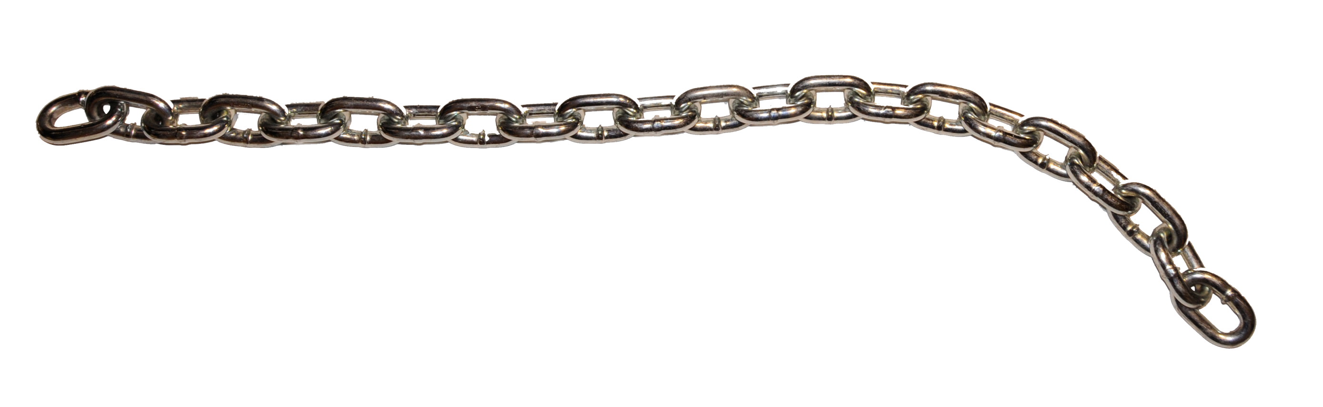
Currency = Chain of digital signatures
…
coin1 ← sign_{S0}( H( coin0 || P1 ) )
coin2 ← sign_{S1}( H( coin1 || P2 ) )
coin3 ← sign_{S2}( H( coin2 || P3 ) )
…
Image ©1Dyslexia1

Slide 26
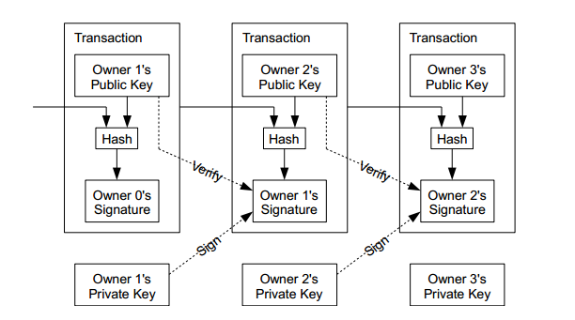
Image ©Satoshi Nakamoto

Slide 27
Double spending
Here’s the same 12BTC
Peter
Eve
Here’s 12BTC
Nick

Slide 28
Double spending
Undesired
How can we avoid it?
Valid transactions
=
Transactions that have not been acted out >= twice?
This would mean I can cancel a transaction I don’t like!

Slide 29
Cancelling a transaction
Bob pays 1BTC to Alice for a cup of coffee
Alice delivers the cup of coffee to Bob
Bob pays the same 1BTC to Charlie
Charlie rejects the transfer
The network considers both transactions invalid
Alice loses her money
Bob loses his money too – but he doesn’t care
We need a better way to prevent double spending!

Slide 30
The arrow of time
Valid is the first transaction in the chain
Later transactions are invalid

Slide 31
The arrow of time
When did a transaction take place?
I cannot trust a signature
The date may be forged

Slide 32
Blocks
Recent transactions are accumulated into a block
Calculate the hash of each block
Every new block includes the hash of its previous block
Every block is published
Every next block is in the future with respect to its previous block
Otherwise it could not have known its hash

Slide 33
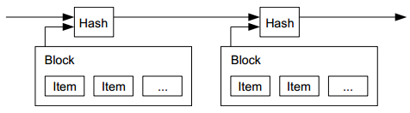
Image ©Satoshi Nakamoto

Slide 34
Proof of work
We cannot just publish blocks
We’d need a trusted party
Blocks are calculated at the node level and broadcasted
We introduce an artificial difficulty to block generation
It’s hard to generate a block

Slide 35
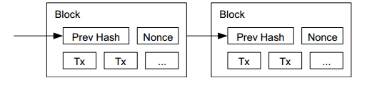
Image ©Satoshi Nakamoto

Slide 36
nonce ← 000000
while H( block || nonce ) ≠ “000000”:
nonce ← nonce + 1
broadcast( block )

Slide 37
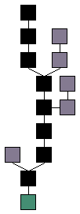
Proof of work
Each block validates the transactions it includes
A block chain is generated
Every valid block inherits from genesis
Image ©theymos
genesis
(2009)
today

Slide 38
Proof of work
All nodes try to generate the block
The first node to do so publishes
The next block continues from there

Slide 39
Transaction validation
A transaction is validated when included in the next block
It becomes exponentially difficult to construct fraudulent blocks as time passes
Every next block secures all previous blocks
A transaction change incurs a change in all the next blocks

Slide 40
Transaction validation
An adversary would need the majority of the network CPU to alter the chain
Altering becomes exponentially harder as a transaction becomes validated by more and more blocks

Slide 41
Bitcoin mining
Block generation = bitcoin earnings for the lucky CPU
Controlled, mathematically predictable inflation

Slide 42
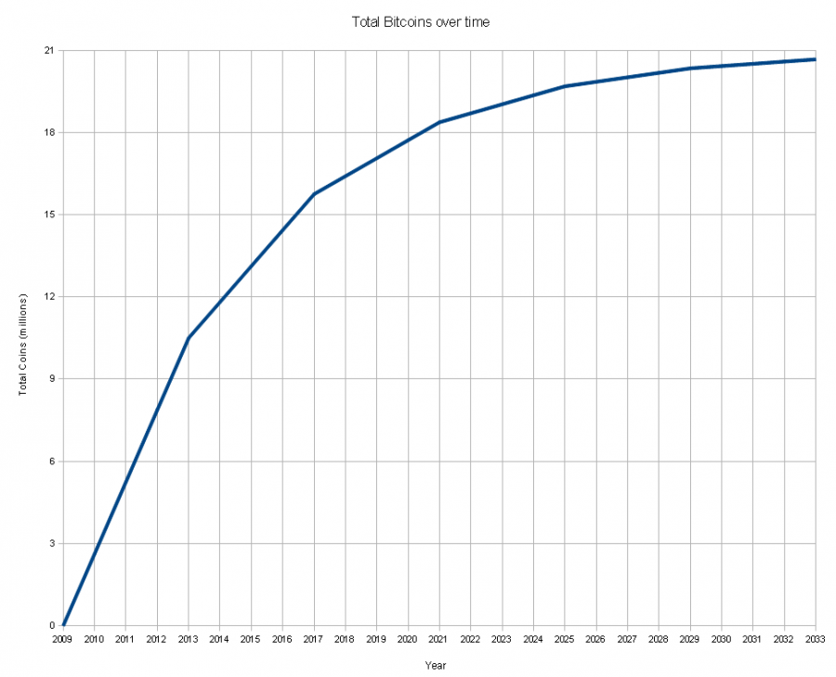
Image ©theymos

Slide 43
Technical details
Digital signatures
Based on Elgamal (DSA)
Using elliptic curves
Hash function
SHA256( SHA256( _ ) )
Work function
SHA256( _ )

Slide 44
Bitcoin today
25 March 2012:
172,000 blocks
1BTC = 3.40€
8,642,700 BTC in circulation
~29,000,000€ in value
Network hashing frequency: > 10THz

Slide 45
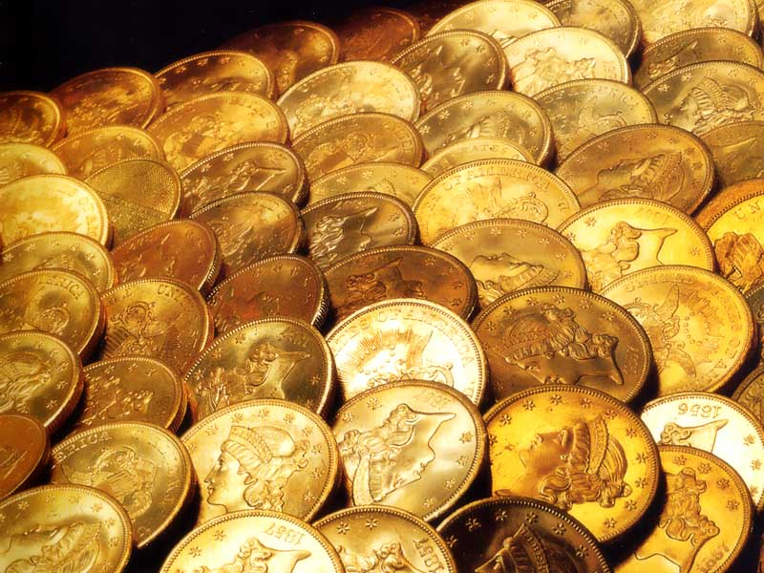
Thank you! Questions?
These slides are:
CreativeCommons 3.0 Attribution
bitcoin.org
Twitter: @dionyziz

