Slide 1
Capstone Battle of Neighborhoods (Week 2)
Aldieno Pribadi

Slide 2
1)Business Problem
In this project we will try to find an optimal location(s) for a bakery in Downtown Toronto, Canada.
We will try to detect neighborhoods with :
no/least frequency of bakeries
no/least frequency of bread related shops eg: bagel shop, donut shop, and sandwich place
bakery is not top 5 venues in the neighborhood
We will use our data to generate a few most promising neighborhoods based on this criteria. Advantages of each area will then be clearly expressed so that best possible final location can be chosen by stakeholders.

Slide 3
2)Data Processing
Based on definition of our problem, factors that will influence our decision are:
number of existing bread related shops in the neighborhood
number of bakeries in the neighborhood, if any
rank of bakery among venues existing in the neighborhood
Following data sources will be needed to extract/generate the required information:
number of restaurants and their type and location in every neighborhood will be obtained using Foursquare API

Slide 4
3)Methodology
In this project we will direct our efforts on detecting areas of Toronto that have low bread-related shops, particularly those with low number of bakery.
The steps are:
Data gathering and cleanup on Toronto neighborhoods dataset
Exploration of Downtown Toronto: get top 100 venues within 200 meters
Analyze frequency of bread-related shops in neighborhoods of Downtown Toronto
Find ranking of bakery among venues in Downtown Toronto neighborhood
After working on the steps above, we should be able to determine the optimal location(s) to open a bakery in Downtown Toronto, which is the central spot in Toronto.

Slide 5
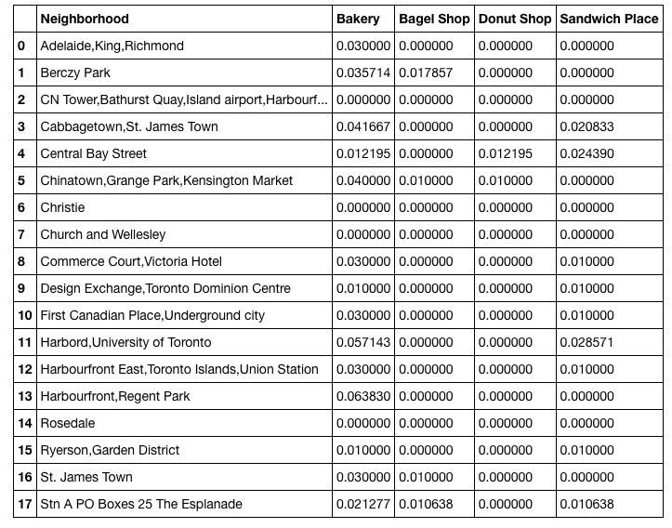
4)Results

Slide 6
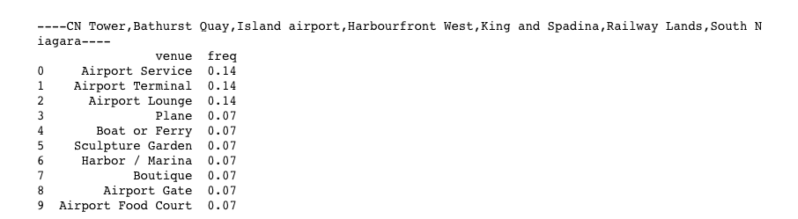
4)Results

Slide 7
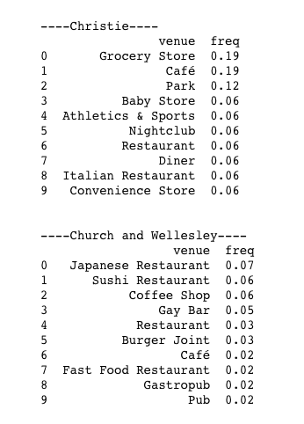
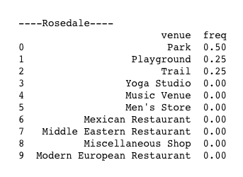
4)Results

Slide 8
5)Discussions
Our analysis shows that overall, neighborhoods in Downtown Toronto do not have high number of bakery or any bread-related shops available. Indeed, there are neighborhoods with relatively high frequency of bakery, however it's only a few of them. One can notice that there is a disparity in distribution of bakery in Downtown Toronto. There are even neighborhoods with 0 frequency of bakery such as CN Tower,Bathurst Quay,Island airport,Harbourfront West,King and Spadina,Railway Lands,South Niagara,Christie,Church, Wellesley, and Rosedale. These locations can be the contenders for a new place to open the bakery.
What is more interesting among the places with 0 frequency of bakery, they do not have any other bread-related shops such as bagel shop, donut shop, and sandwich shop as well. So from subtitution goods competition stand point, these places do not have any existing competition. Another advantage is the new place can get the so-called first-mover advantage by opening a new bakery in one of those places.

Slide 9
5)Discussions
Based on the ranking of venues among the aforementioned neighborhoods above, we believe that Christie, Church, and Wellesley are the top 3 neighborhoods for the new bakery location. This is because based on our venue ranking, we see that these places already have a well established food and beverages venues which can be an indicator of high consumer traffic within those areas. As bakery is a type of consumer good that is usually categorized as a complementary good, we think putting a bakery in areas with a busy traffic of people trying to get food from restaurants or cafe is a sensible strategy.
Nonetheless, the final decision is depending on the stakeholders and without a say, further studies of different factors should be considered in the final decision. Third party or expert opinion on those particular areas should be considered as well.

Slide 10
6)Conclusion
Purpose of this project was to identify Toronto areas close to center with low number of bread-related shops (particularly Downtown Toronto) in order to aid stakeholders in narrowing down the search for optimal location for a new bakery. From our analysis we came up with top 3 neighborhoods such as Chritie, Church, and Wellesley that should be considered for the new bakery. This is for reasons such as non-existing bread-related shops and potential consumer traffic within the areas.
Final decission on optimal restaurant location will be made by stakeholders based on specific characteristics of neighborhoods and locations in every recommended zone, taking into consideration various additional factors.

