Slide 1
DEEP LEARNING · PRECISION AGRICULTURE
GAF-Net for
Potato Leaf
Disease Detection
98.27%
Test Accuracy
3 classes · 405 test images
6.35M parameters
An adaptation of Cao et al.'s YOLOv8-based
GAF-Net architecture, applied to a 3-class potato
disease classification problem.
Reference Paper:
Cao, K. et al. (2025). GAF-Net: An Enhanced
Multidisease for Corn Leaves Detection Model
Based on YOLOv8. IEEE TAFE, 3(2), 420-432.

Slide 2
Why Potato Disease Detection?
The agricultural problem that motivates this work
1
2
3
A Critical Global Crop
Manual Inspection is Slow
Need for Robust AI
Potato is the world's fourth-largest food crop. Diseases like Early and Late Blight can wipe out entire harvests — Late Blight famously triggered the Irish Potato Famine of the 1840s.
Traditional detection relies on farmer inspection — labour-intensive, subjective, and inconsistent. Symptoms of Early vs Late Blight overlap visually in early stages, making correct triage hard.
Single-disease classifiers fail on co-infected leaves. A model must handle multi-scale lesion features, varying leaf morphology, and complex backgrounds at edge-deployable cost.
GAF-Net for Potato Leaf Disease Detection
2 / 14

Slide 3
The Original Paper: GAF-Net
Cao et al., IEEE Transactions on AgriFood Electronics, 2025
What problem did the authors tackle?
Reported Results (Corn Dataset)
Detecting four corn-leaf diseases under noisy field conditions:
Northern corn leaf blight
Pest damage
Brown spot
Downy mildew
Built on YOLOv8 with two key additions: GSConv in the Neck and an adaptive FASFF module for multiscale feature fusion.
80.8%
mAP@50 (+4.1% over baseline)
52.6%
mAP@50–95 (+3.3% over baseline)
4.23M params · 15.1 GFLOPs
Outperformed YOLOv5/7/9/10/11, RT-DETR,
Faster R-CNN, CenterNet, Mamba-YOLO.
GAF-Net for Potato Leaf Disease Detection
3 / 14

Slide 4
Our Adaptation: From Corn to Potato
Same architecture, new domain — testing GAF-Net's generalisation
ORIGINAL PAPER
OUR IMPLEMENTATION
Crop: Corn (maize)
Task: Object detection (bounding boxes)
Classes: 4 (blight, pest, brown spot, mildew)
Dataset: 1,219 images, custom-collected in Gansu, China
Annotation: LabelMe → YOLO bounding boxes
Output: mAP@50, mAP@50–95
Crop: Potato
Task: Image classification (whole-leaf label)
Classes: 3 (Early Blight, Late Blight, Healthy)
Dataset: PLD — Potato Disease Leaf Dataset (Kaggle)
Annotation: Class-folder labels (no boxes needed)
Output: Accuracy, Precision, Recall, F1
GAF-Net for Potato Leaf Disease Detection
4 / 14

Slide 5
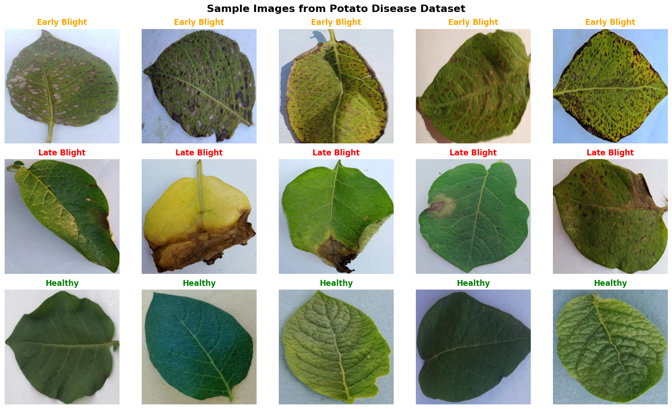
Dataset: Potato Disease Leaf (PLD)
3 classes · 4,072 images · 256×256 resolution · pre-split
Dataset Splits
Split | Images | %
Train | 3,251 | 80%
Validation | 416 | 10%
Test | 405 | 10%
Per-class distribution (train)
Early Blight
1,303
Late Blight
1,132
Healthy
816
Sample images per class (from training set)
GAF-Net for Potato Leaf Disease Detection
5 / 14

Slide 6
GAF-Net Architecture
YOLOv8 backbone + GSConv neck + FASFF fusion → classification head
Input
Backbone
Neck
FASFF
Head
224 × 224 × 3
Conv → C2f × 4
+ SPPF
GSConv blocks
(slim, efficient)
Adaptive multi-
scale fusion
GAP + FC
→ 3 classes
Two key components inherited from the paper
GSConv — combines standard + depthwise convolution with channel shuffle. Cuts cost while preserving feature richness; replaces vanilla convs in the neck.
FASFF — Feature-Adaptive Spatial Feature Fusion. Learns soft weights to merge feature maps from different scales, suppressing conflicting information.
GAF-Net for Potato Leaf Disease Detection
6 / 14

Slide 7
GSConv: Slim, Shuffled Convolution
Standard conv + depthwise + channel shuffle = efficient fusion
How it works
Data Flow
Standard Conv → produces half the output channels (rich features, but expensive)
Depthwise Conv → produces the other half from the SC output (cheap, per-channel)
Concatenate + Shuffle → permutes channels so SC and DSC features mix; output looks much closer to a full SC than to plain depthwise.
Input X (c1)
Standard Conv
→ X1 (c2/2)
DWConv on X1
→ X2 (c2/2)
Concat [X1, X2] (c2)
Channel Shuffle
Why we kept it: Even at 224×224 input, GSConv lets the neck process feature maps with depthwise efficiency without the accuracy collapse you'd see from naive lightweight convolution.
Output (c2)
GAF-Net for Potato Leaf Disease Detection
7 / 14

Slide 8
FASFF: Adaptive Spatial Feature Fusion
Lets the network choose how much to trust each scale, per spatial location
1. Align
2. Weight
3. Fuse
Three feature maps F₁, F₂, F₃ from different scales are channel-aligned and bilinearly resized to a shared spatial size.
A 1×1 conv produces a per-pixel score for each map; softmax across the 3 maps gives weights w₁ + w₂ + w₃ = 1 at every (i,j).
F_out = w₁·F₁ + w₂·F₂ + w₃·F₃. Weights are learned end-to-end, so noisy or conflicting features get down-weighted automatically.
F_out (i,j) = w₁(i,j)·F₁ + w₂(i,j)·F₂ + w₃(i,j)·F₃
Per-pixel weighted sum — weights learned, not fixed
Why it matters for potato
Late Blight lesions are large irregular patches; Early Blight produces small concentric rings. A fixed-weight pyramid would favour one scale or the other. FASFF lets the model use the right scale per region — small features highlighted from shallow maps, broad lesions from deeper maps.
GAF-Net for Potato Leaf Disease Detection
8 / 14

Slide 9
Training Setup
Single GPU, 25 epochs, AdamW + cosine schedule
IMAGE SIZE
BATCH SIZE
EPOCHS (MAX)
EARLY-STOP PATIENCE
224 × 224
32
25
7
OPTIMIZER
INITIAL LR
LR SCHEDULE
WEIGHT DECAY
AdamW
1e-3
Cosine → 1e-6
1e-4
Augmentations (training only)
Random horizontal & vertical flip · Random rotation ±15° · Color jitter (brightness, contrast, saturation 0.2) · ImageNet normalisation
GAF-Net for Potato Leaf Disease Detection
9 / 14

Slide 10
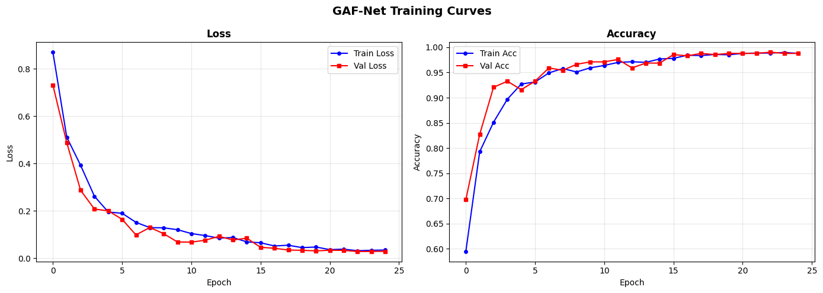
Training Behaviour
Smooth convergence — no overfitting
Observations
Val tracks train
throughout — no
overfitting gap.
Plateaus near
epoch 18 around
98% val accuracy.
Best checkpoint
at epoch 23,
val_loss = 0.0287.
Train loss 0.87 → 0.035 | Val loss 0.73 → 0.029 | Both curves close — no signs of overfitting on the held-out validation set.
GAF-Net for Potato Leaf Disease Detection
10 / 14

Slide 11
Test Set Results
Held-out 405 images, never seen during training or validation
98.27%
98.28%
98.27%
98.27%
Accuracy
Precision
Recall
F1-Score
Per-class performance
Class | Precision | Recall | F1-Score | Support
Early Blight | 0.99 | 0.98 | 0.98 | 162
Late Blight | 0.99 | 0.98 | 0.98 | 141
Healthy | 0.97 | 1.00 | 0.99 | 102
GAF-Net for Potato Leaf Disease Detection
11 / 14

Slide 12
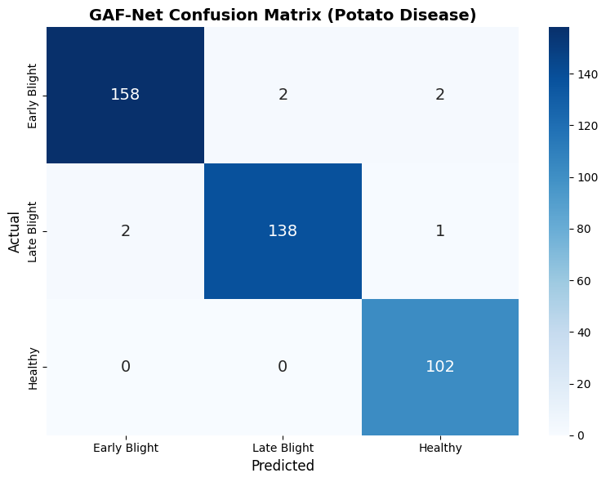
Confusion Matrix
Where the 7 misclassifications out of 405 test images fall
Reading the matrix
All 102 Healthy leaves classified correctly
Early Blight: 158 / 162 correct — 2 confused with Late Blight, 2 with Healthy
Late Blight: 138 / 141 correct — 2 confused with Early Blight, 1 with Healthy
Most errors swap Early ↔ Late Blight — visually similar at early infection stages
7 errors out of 405 → 98.27% accuracy
GAF-Net for Potato Leaf Disease Detection
12 / 14

Slide 13
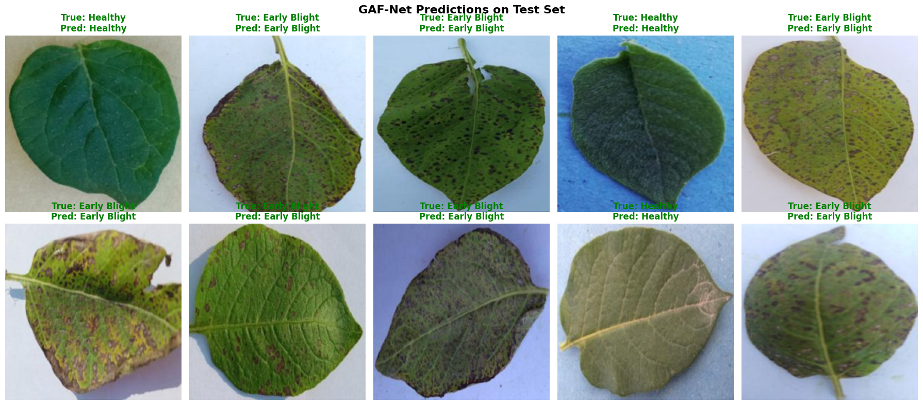
Sample Predictions
10 random test-set images — green labels = correct, red = error
All 10 samples shown were classified correctly. The model confidently distinguishes lesion patterns even on leaves with mixed lighting and varying backgrounds.
GAF-Net for Potato Leaf Disease Detection
13 / 14

Slide 14
Takeaways & Future Work
What worked
Where to go next
GAF-Net's GSConv + FASFF backbone, originally designed for object detection on corn, transfers cleanly to potato leaf classification.
98.27% test accuracy on a held-out set, with balanced precision and recall across all three classes.
Compact 6.35M-parameter model, trainable on a single GPU in under 25 epochs.
No overfitting — validation curve stayed close to training across the run.
Move from classification back to detection — re-attach the YOLOv8 head and add bounding-box labels to localise individual lesions.
Expand class set: add additional potato disorders (e.g. blackleg, common scab) and field-collected co-infection cases.
Cross-dataset evaluation: test on PlantVillage and field-captured images to stress-test generalisation.
Edge deployment: prune + quantise for sub-4GB devices for in-field inference.
Thank you · Questions welcome

