Slide 1
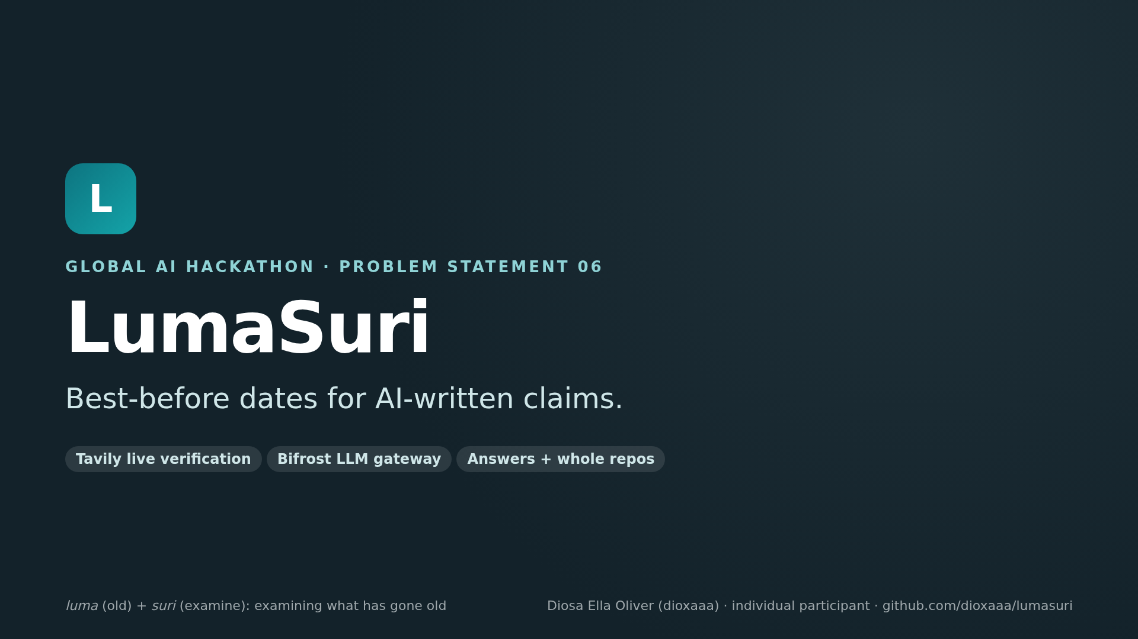
Notes:
LumaSuri: luma means old, suri means examine. It gives every claim an AI writes a best-before date. Built for Problem Statement 06 with Tavily and Bifrost.

Slide 2
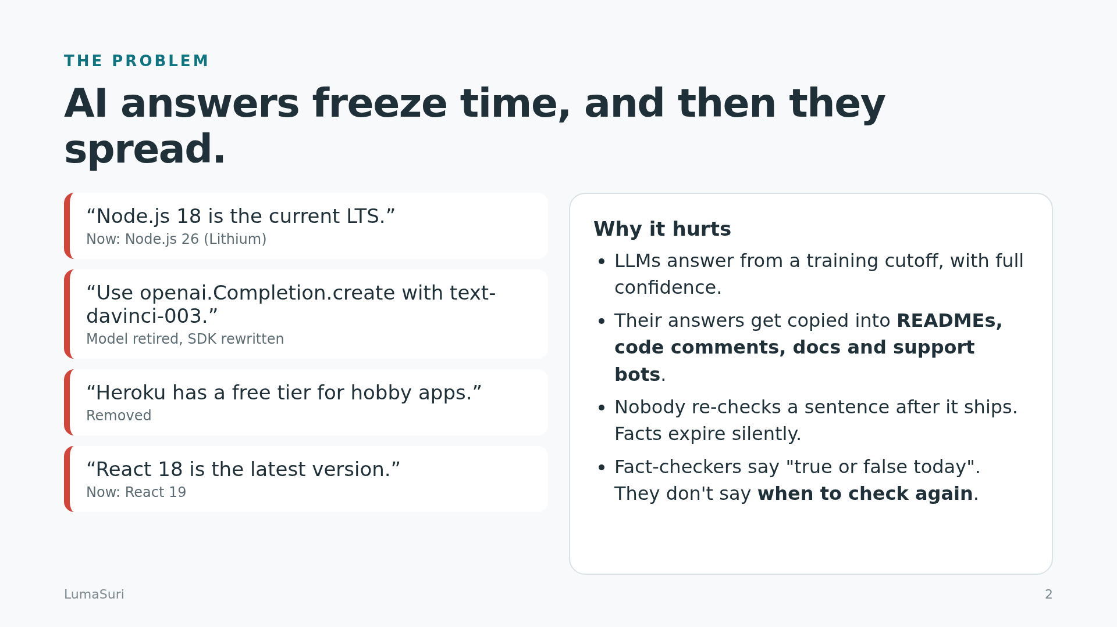
Notes:
AI answers come from a training cutoff, and they get copied into READMEs, comments and support bots. Nobody re-checks them, so they expire silently.

Slide 3
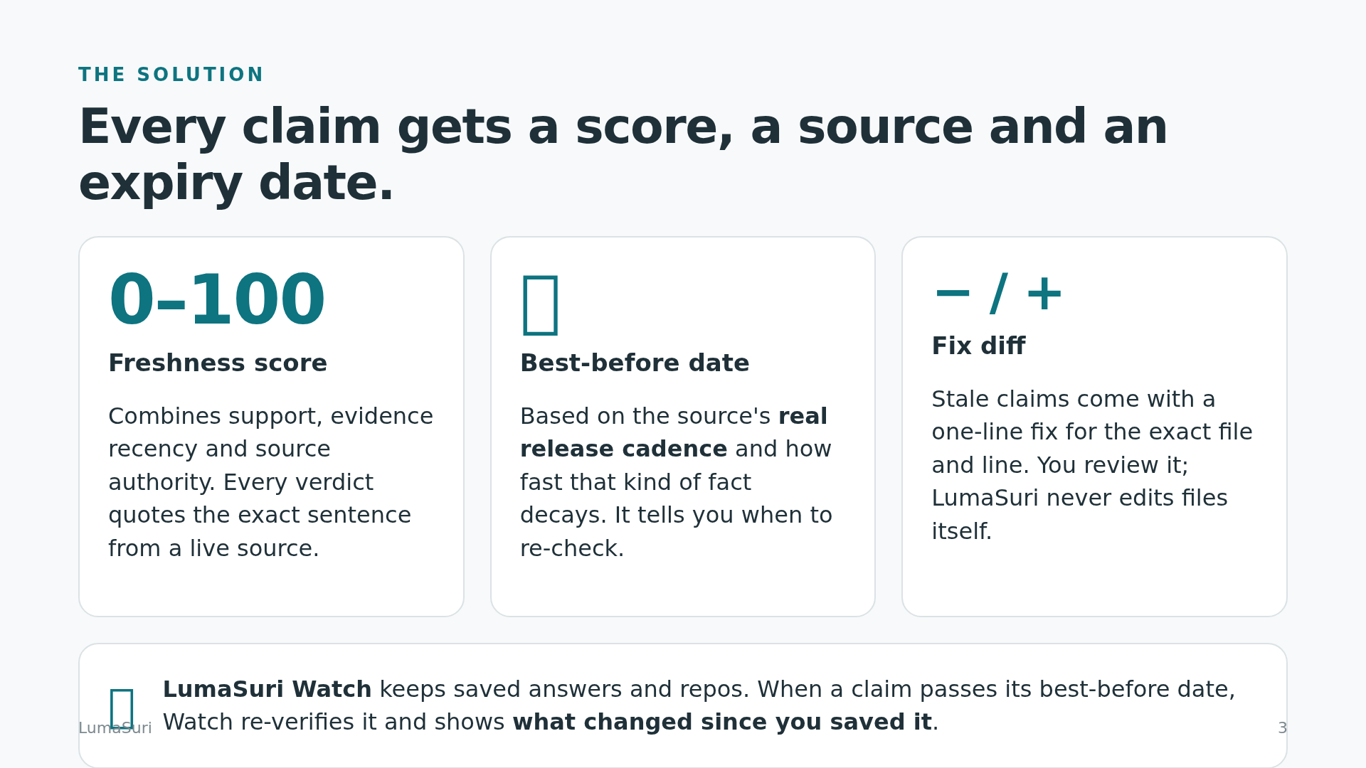
Notes:
For each claim: a freshness score backed by a quoted live source, a best-before date based on real release cadence, and a fix diff. Watch re-checks claims when they expire.

Slide 4
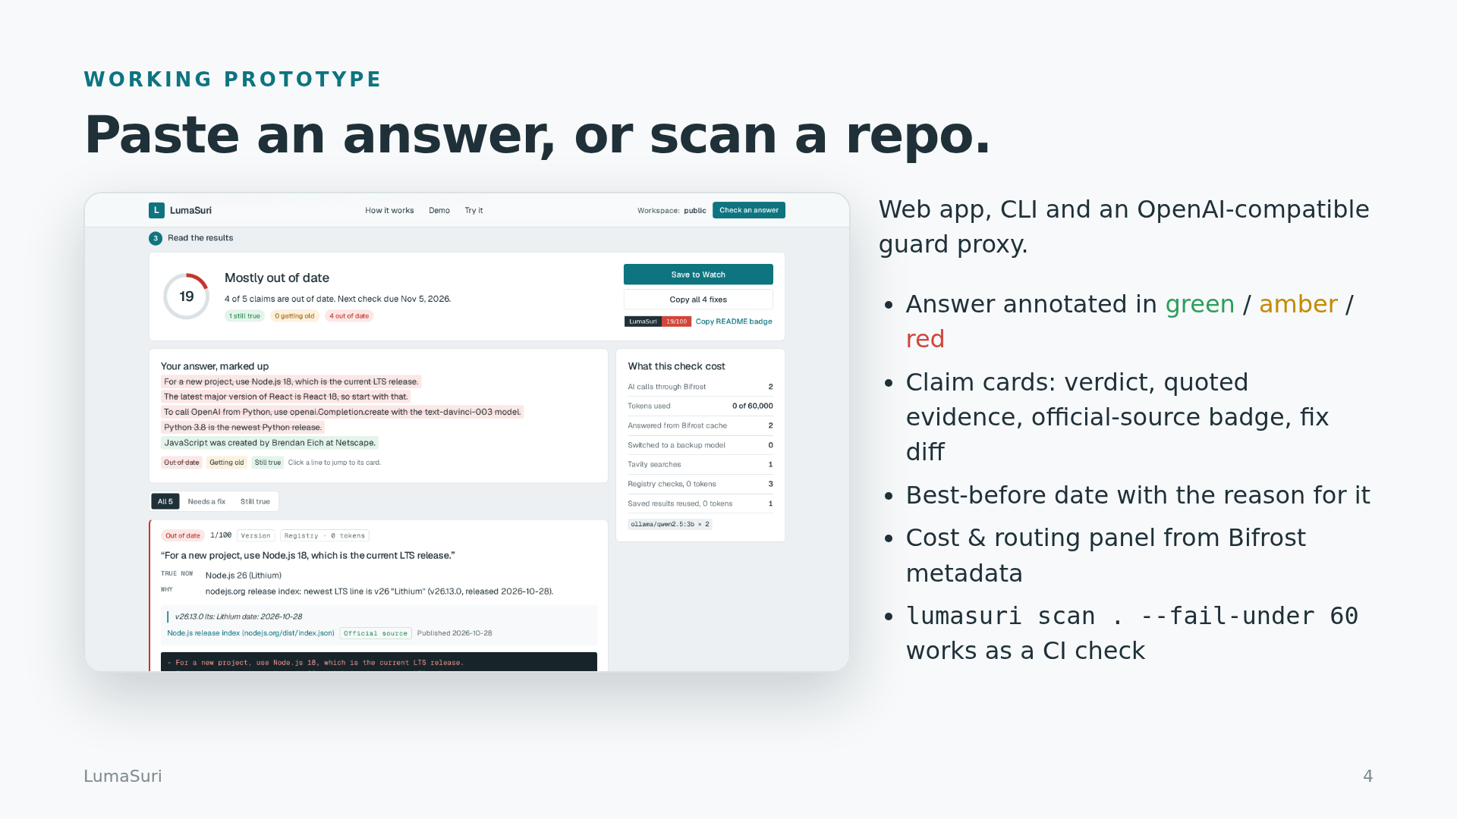
Notes:
The working prototype: web app, CLI and an OpenAI-compatible guard proxy. Here a pasted answer gets annotated and each claim gets a card.

Slide 5
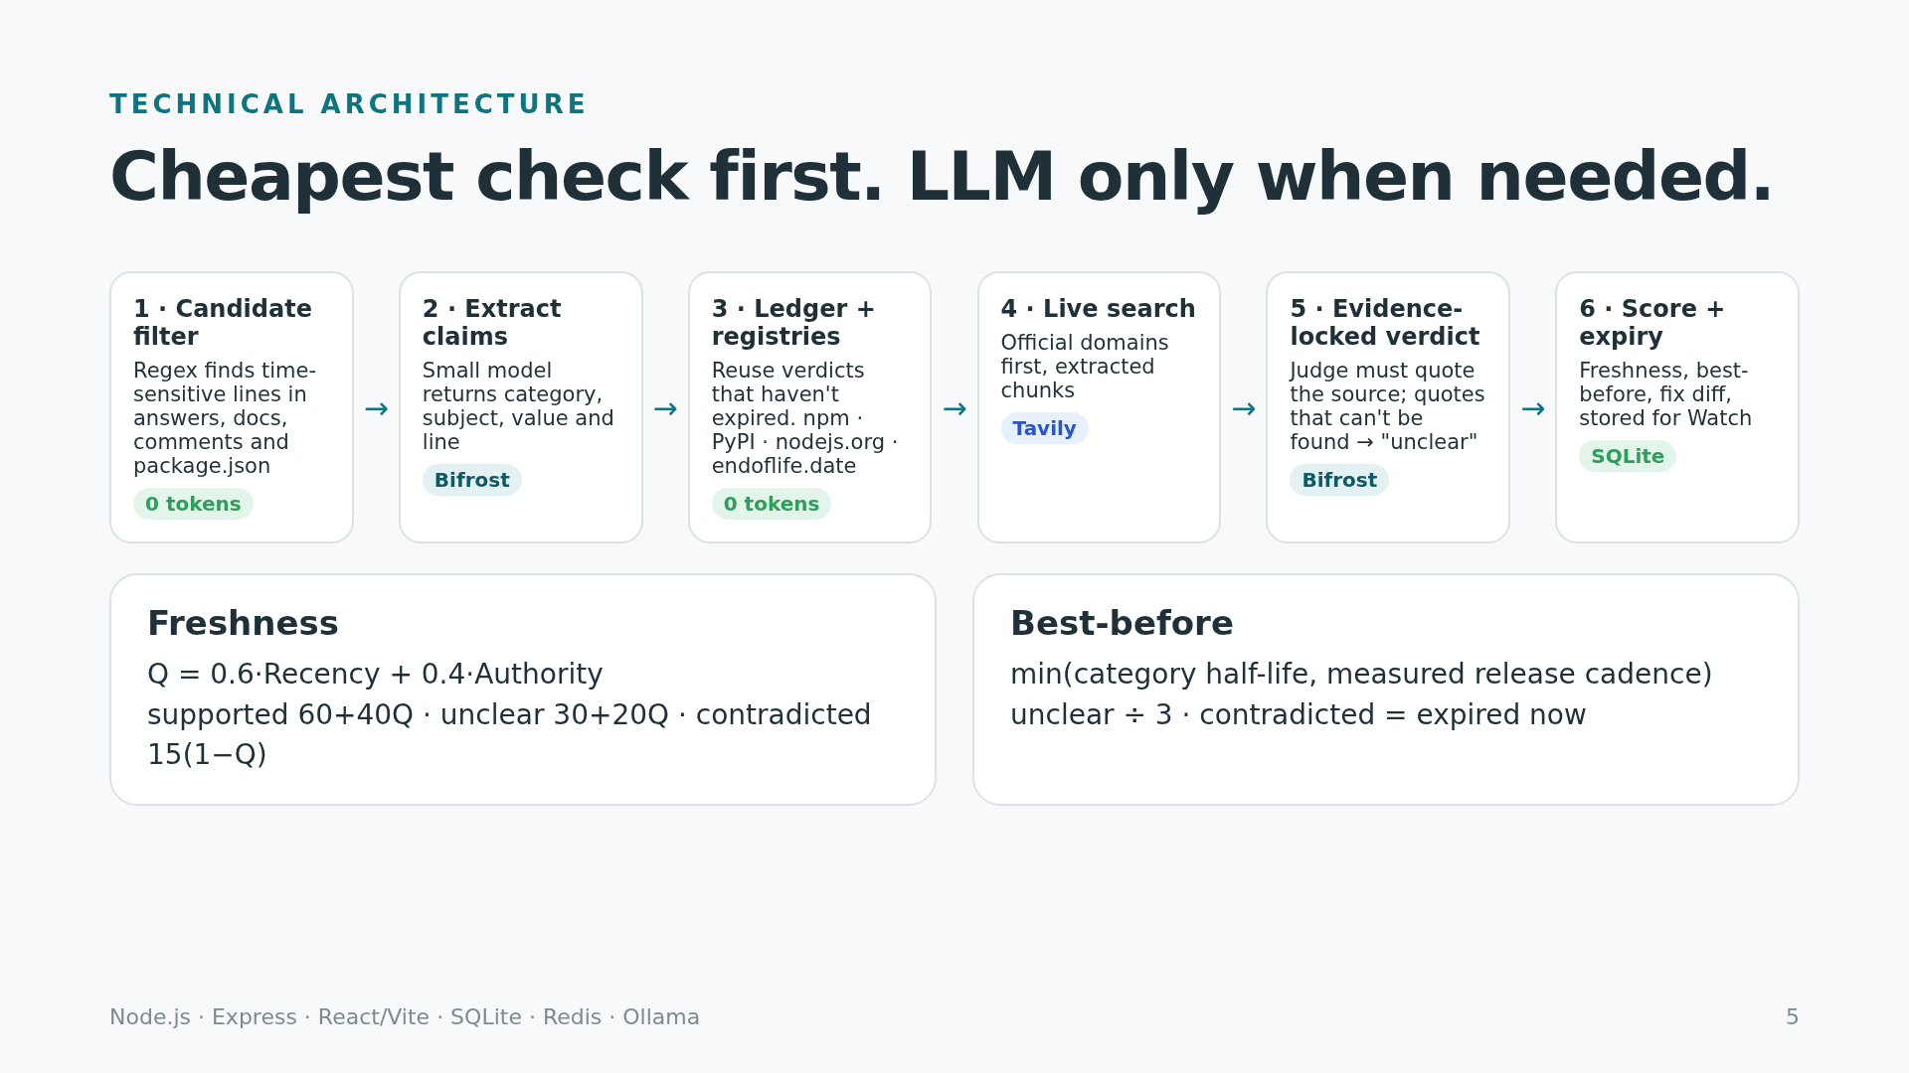
Notes:
Pipeline: cheapest check first. Regex filter, small-model extraction through Bifrost, ledger and registries at zero tokens, Tavily on official domains, then an evidence-locked verdict.

Slide 6
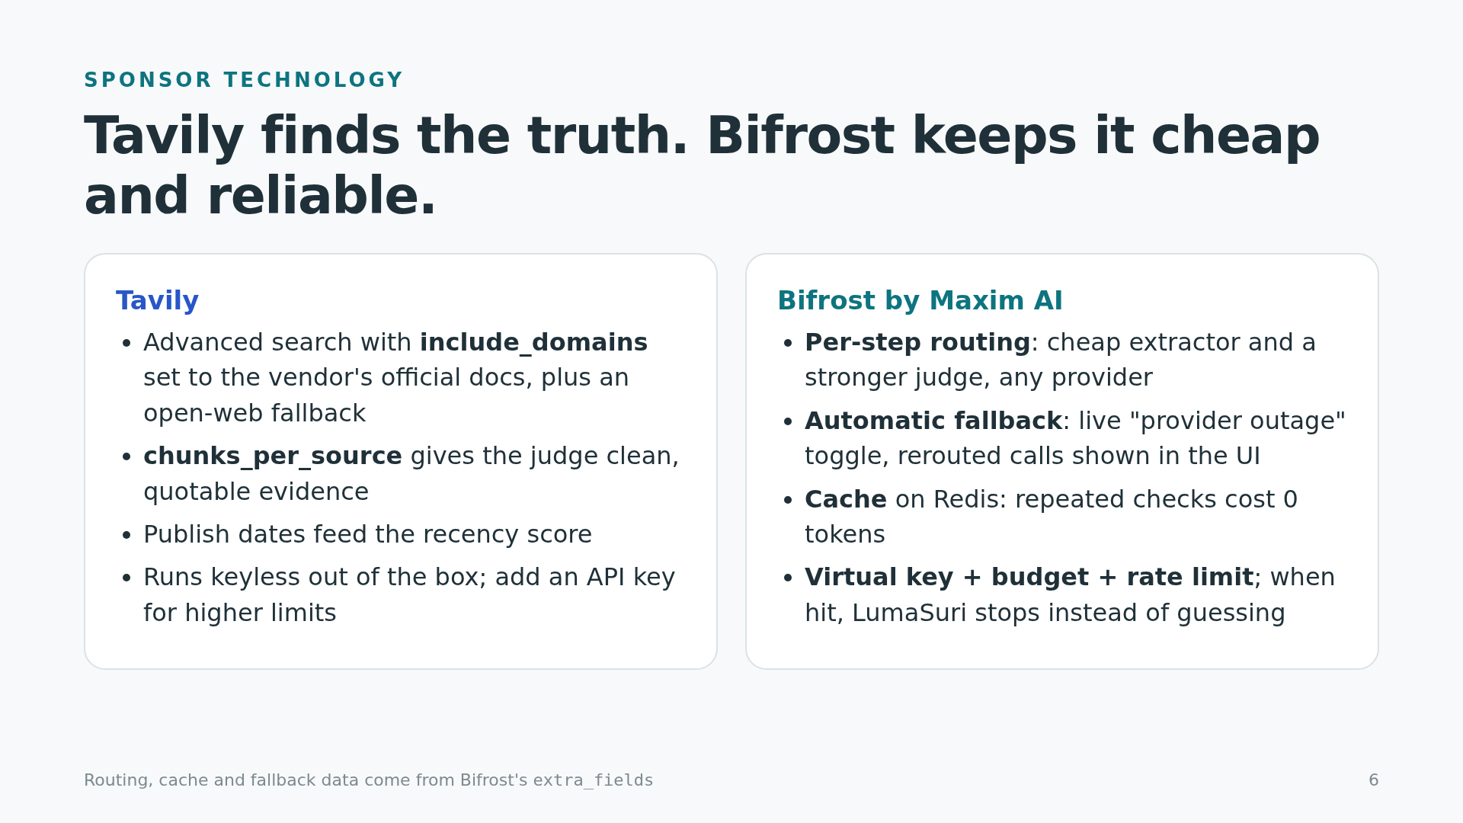
Notes:
Tavily provides domain-targeted, quotable live evidence. Bifrost provides per-step routing, automatic fallback, caching, and a virtual key with budget and rate limit.

Slide 7
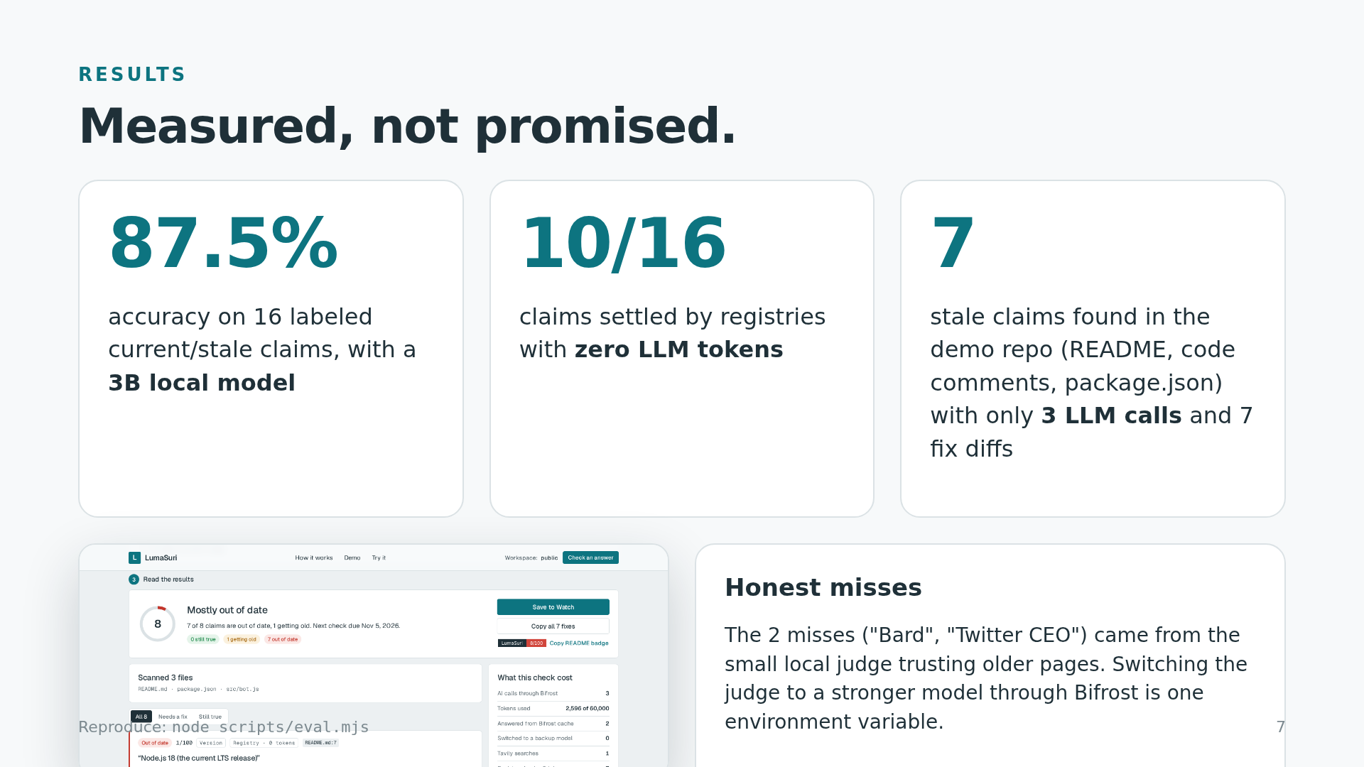
Notes:
Results: 87.5 percent on 16 labeled claims with a 3B local model, 10 of 16 settled with zero tokens, 7 stale claims in the demo repo with 3 LLM calls.

Slide 8
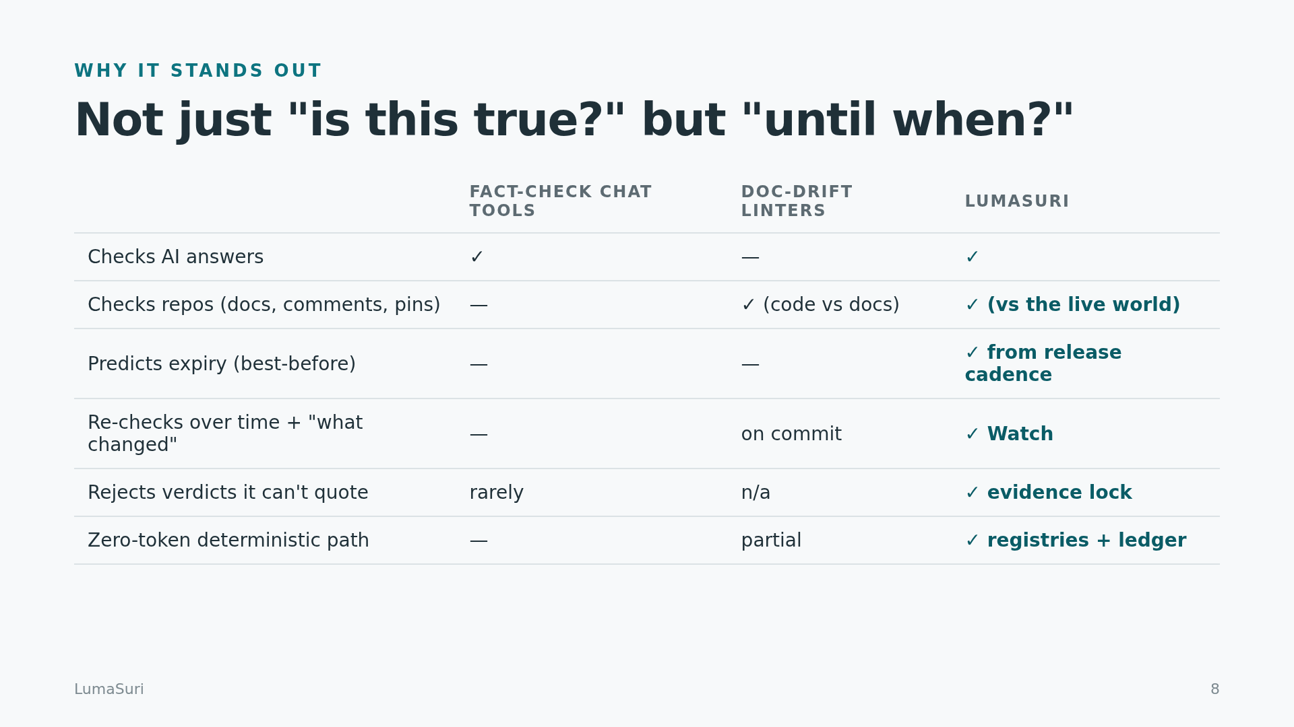
Notes:
Other tools tell you whether something is true today. LumaSuri also tells you until when, and re-checks it then.

Slide 9
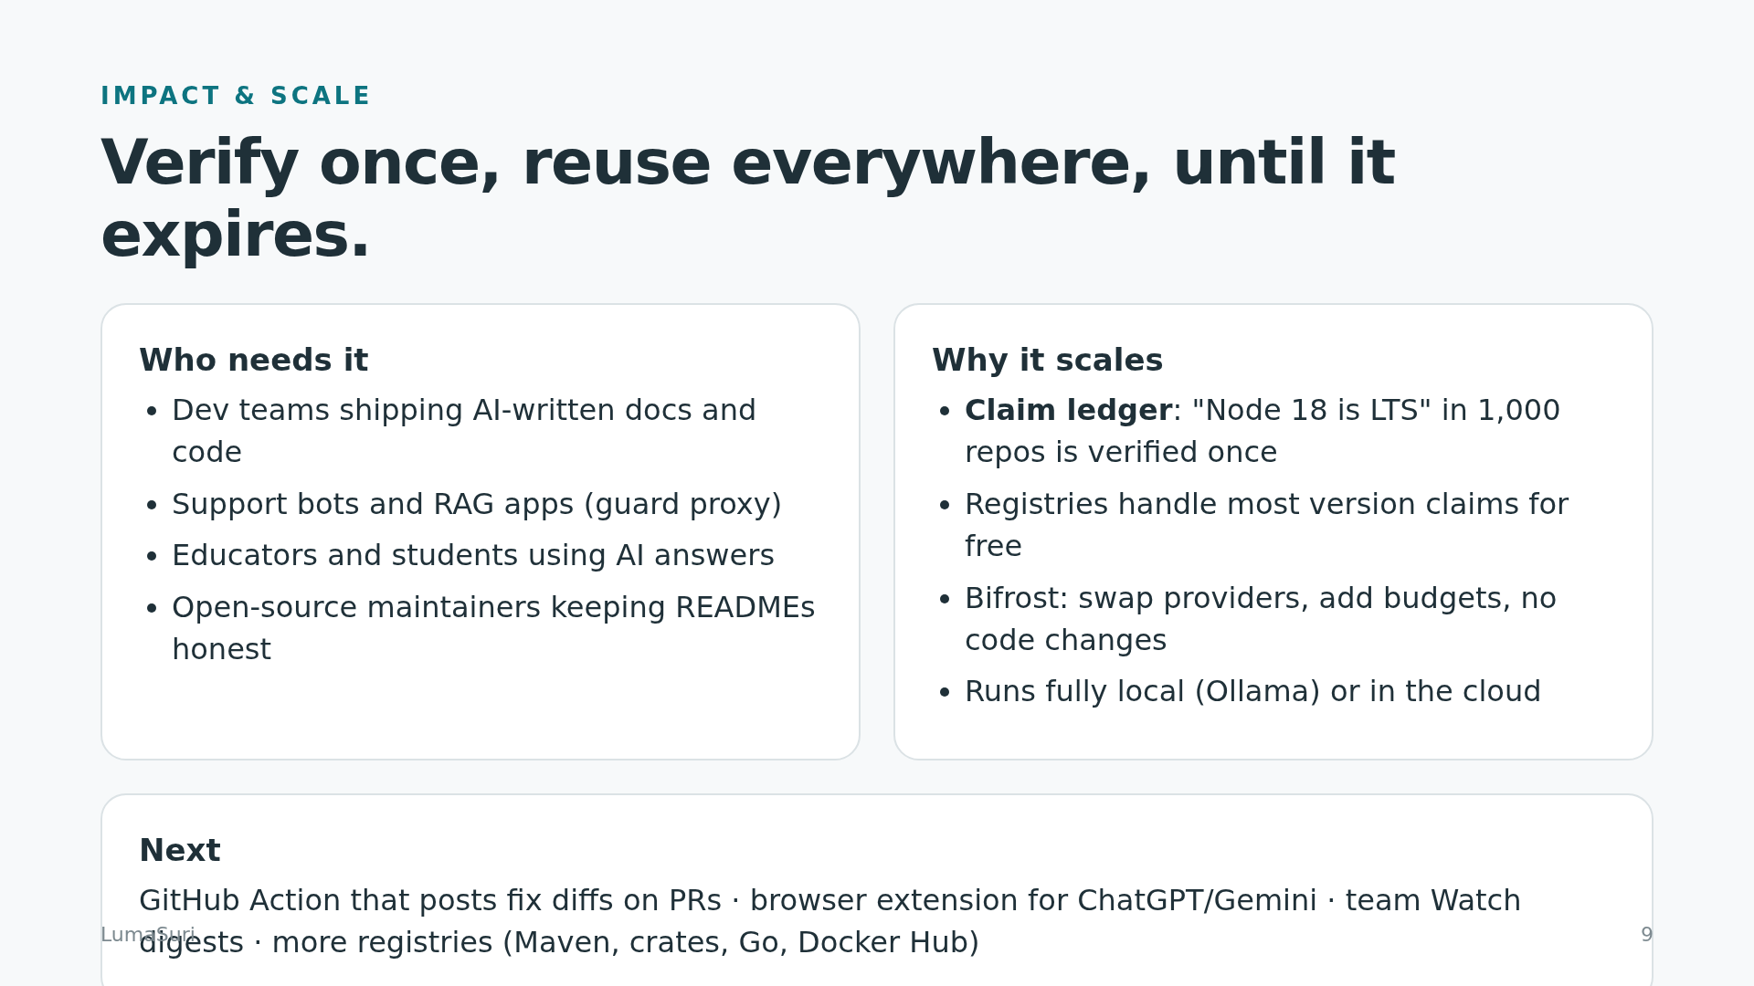
Notes:
The claim ledger verifies a claim once and reuses it across repos until it expires. Next: a GitHub Action, a browser extension and more registries.

Slide 10
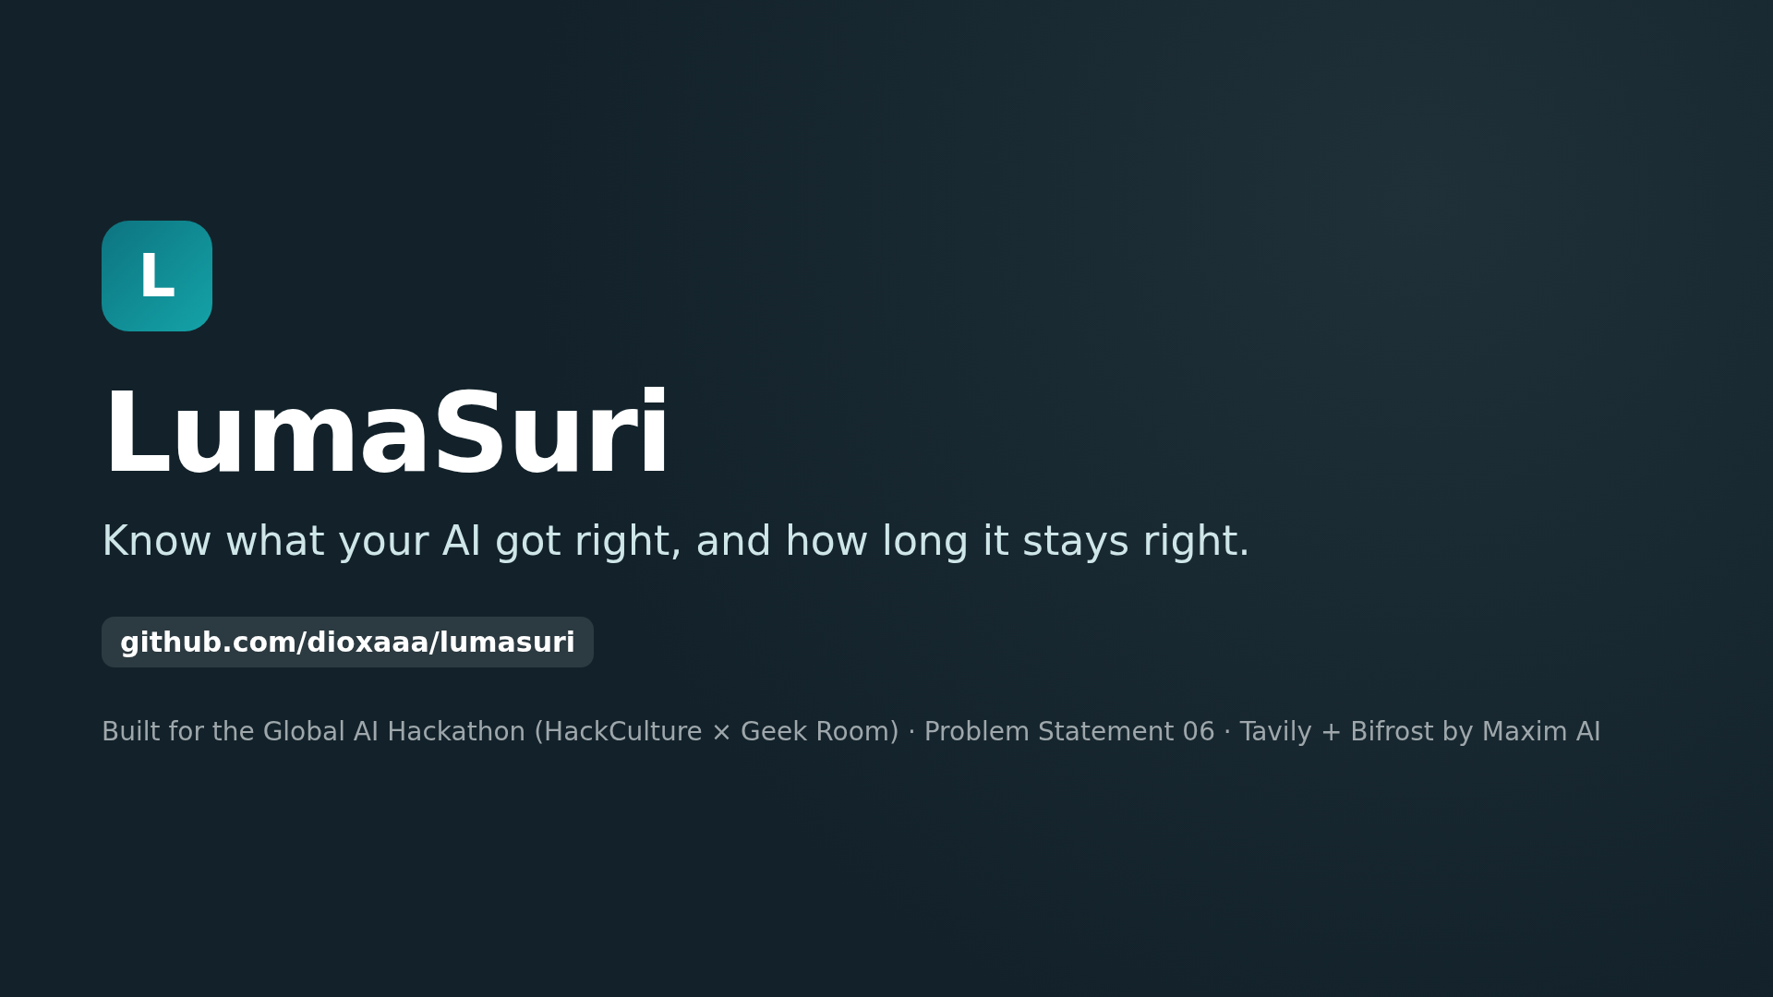
Notes:
Thank you. github.com/dioxaaa/lumasuri

