Slide 1

A PROJECT PRESENTATION
On
RAG-Based Loan Advisory Chatbot for Top Indian Banks
By
Atreyee Joardar - 2106020
Ayush Jana -2106021
Dipayan Goswami - 2106026
Pratibh Sinha - 2106043
Rion Sutradhar - 2106051
UNDER THE GUIDANCE OF
Dr. Murari Mandal
SCHOOL OF COMPUTER ENGINEERING
KALINGA INSTITUTE OF INDUSTRIAL TECHNOLOGY
BHUBANESWAR, ODISHA - 751024

Slide 2
Contents
Introduction
Problem statement and Defining the Problem
Functions and Features of Product
Architecture
Tech Stack and Requirements
System Design and Working
Testing and Implementation
Results
Conclusion and Future Scope

Slide 3
Introduction
The Indian banking industry is undergoing a transformation, driven by advancements in technology and increasing demand for customer-centric solutions, emphasizing efficiency, accessibility, and personalization.
With the rise of digital channels, banks are reimagining service delivery models to meet evolving customer expectations while streamlining operations using cutting-edge technologies like Artificial Intelligence (AI).
Traditional loan advisory services involve complex processes, such as navigating loan options, understanding eligibility criteria, and comparing repayment plans, which often lead to delays and customer dissatisfaction.
The RAG-based Loan Advisory Chatbot simplifies this process by using Retrieval, Augmentation, and Generation techniques to provide relevant, personalized, and real-time responses for customer queries.
By empowering customers to make informed decisions and improving the overall experience, this AI-driven solution boosts customer satisfaction and helps banks convert inquiries into successful loan applications.

Slide 4
Problem Statement and Defining the Problem
Diverse loan schemes and varying bank terms cause information overload, confusing users and hindering decision-making.
1
Information Overload
2
Lack of Centralized Information
Users face delays and missed opportunities due to scattered loan information across websites and bank representatives.
3
Complex Financial Jargon
Loan documents often contain complex terms and conditions that are difficult for an average user to interpret without guidance, leaving users at risk of misunderstanding loan commitments.
4
Limited Advisory Resources
Traditional advisory services are costly, biased, and often inaccessible to users in remote areas, limiting personalized guidance.
5
Time Consuming Comparisons
Manually comparing loans is time-consuming and effort-intensive, making it difficult for users to make informed decisions.
6
Lack Of Personalized Customer Assistance
Traditional loan advisory processes often lack personalization, ignoring individual profiles and diminishing customer satisfaction and trust.

Slide 5
Functions and Features of the Product
Document Ingestion and Processing: Extracts and processes loan-related documents from various banks. Organizes documents into manageable chunks for efficient retrieval.
Vector Storage and Embedding: Converts document chunks into high-dimensional embeddings using Google Generative AI. Stores embeddings in a scalable FAISS database for fast similarity-based search.
Loan Query Processing: Accepts user queries in simple text. Understands and categorizes queries by loan type (e.g., home, personal, car, education loans).
Answer Generation: Retrieves relevant document chunks using semantic search. Generates accurate, context-aware responses using ChatGroq’s LLaMA 3 model.
Bank-Specific Information Retrieval: Provides customized loan details, eligibility criteria, and interest rates for top Indian banks. Offers personalized loan options for authenticated users.
Loan Comparison and Transparency: Compares loan options across banks for similar loan types. Displays document chunks related to user queries for added transparency.
Loan Application Assistance: Guides users through the loan application process with step-by-step instructions. Validates inputs and prompts users for corrections when needed.
Transparency and Trust: Includes a document similarity search feature to show the basis of responses. Ensures responses align with Indian banking norms and regulations.

Slide 6
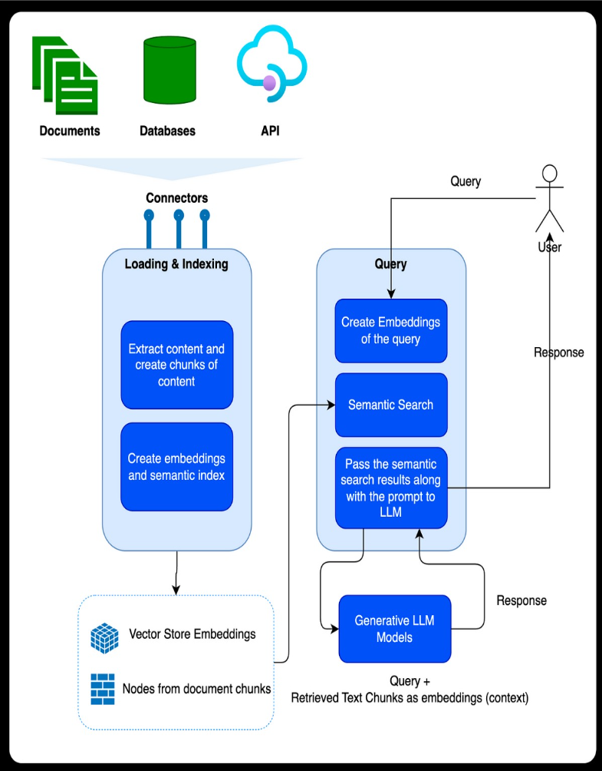
Architecture
Data Sources: Documents, Databases, and APIs serve as the primary data sources.
Loading & Indexing Stage: Content is extracted and divided into smaller chunks for efficient processing. Chunks are converted into high-dimensional embeddings, capturing semantic meaning, and indexed for quick retrieval.
Storage: Embeddings are stored in a scalable vector database for similarity-based search. Document chunks are organized and indexed for structured storage.
Query Processing Stage: User queries are converted into embeddings to match against stored document embeddings. Semantic Search retrieves the most relevant chunks based on the similarity of query embeddings.
Response Generation: Retrieved chunks and query are fed into the Generative LLM Model (e.g., ChatGroq) for response generation. The model produces contextually accurate and relevant answers using the document chunks as context.
User Interaction: The User sends queries to the system and receives responses through the integrated pipeline.

Slide 7
Tech Stack and Requirements
Backend:
Python: Core language for integrating components and data processing.
LangChain: Framework for document ingestion, text splitting, and RAG operations.
Data Ingestion and Processing:
PyPDF2: Parses and ingests PDF documents.
RecursiveCharacterTextSplitter: Splits documents into manageable chunks for efficient retrieval.
Vector Embeddings and Storage:
Google Generative AI Embeddings: Creates semantic vector representations of document chunks.
FAISS: Stores and retrieves embeddings for large-scale similarity searches.
Language Model and Prompting:
ChatGroq (LLaMA 3): Generates context-aware responses based on retrieved document data.
ChatPromptTemplate: Structures inputs for the language model, ensuring accurate and relevant outputs.
User Interface:
Streamlit: Builds an interactive web application for real-time user queries and response display.
Environmental Management:
dotenv: Manages environment variables and securely loads API keys (e.g., GROQ and Google API keys).

Slide 8
System Design and Working
Architecture Overview: The chatbot is built on a Retrieval-Augmented Generation (RAG) architecture that combines document-based retrieval with generative AI for accurate responses.
Core Components:
Data Sources: Documents, databases, and APIs for financial loan information.
Embedding Model: Google Generative AI embeddings for semantic representation of content.
Vector Store: FAISS (Facebook AI Similarity Search) for efficient similarity-based retrieval.
Language Model: ChatGroq (LLaMA 3) for contextual and concise response generation.
User Interface: Streamlit for interaction and visualization.
Stage 1 - Loading & Indexing:
Document Preparation: Content extraction using LangChain's RecursiveCharacterTextSplitter.
Embedding Generation: Creating vector embeddings for text chunks using Google Generative AI.
Indexing: Storing embeddings in FAISS for efficient similarity search.
Stage 2 - Query Processing:
Query Embedding: Query text converted into embeddings using the same model for compatibility.
Semantic Search: FAISS retrieves relevant document chunks based on vector similarity.
Response Generation: Retrieved chunks form a prompt for ChatGroq, ensuring responses are contextually accurate.
UI Display: Responses and document context are shown in the Streamlit interface.

Slide 9
Workflow Summary:
User submits a question in the Streamlit interface.
The query embedding is matched with relevant document chunks from FAISS.
Retrieved chunks are structured into a prompt for ChatGroq.
ChatGroq generates a response based solely on retrieved document context.
The response and related document excerpts are displayed in the interface.
Implementation Details:
Document Embedding: Financial documents are processed, split, and embedded into vector space.
Query Handling: Semantic search retrieves document chunks for query context.
Response Generation: ChatGroq uses a structured prompt for accurate answers.
Transparency: Expandable sections display document chunks for user verification.
Key Tools & Technologies:
LangChain: Document management and processing.
Google Generative AI: Embedding creation.
FAISS: Fast similarity search for document chunks.
Streamlit: Interactive user interface.
This system ensures efficient, accurate, and transparent handling of loan-related queries, providing users with a robust financial advisory tool.

Slide 10
Testing
Key testing methods applied include:
Relevance Testing: Sample queries with known relevant document segments are used to verify the retrieval component's accuracy. This helps ensure the chatbot consistently retrieves appropriate information aligned with user queries.
Groundedness and Factuality Checks: This testing method verifies that responses are grounded in source documents, ensuring that generated answers are factually correct and based on retrieved information, minimizing unsupported content.
Usability Testing: Real-user testing is essential for assessing interface ease-of-use and overall user experience. Collecting feedback from users highlights areas for improving navigation, engagement, and interface clarity
Scalability Testing: As the document repository expands, stress-testing the vector database, such as FAISS, is crucial to ensure sustained performance. This testing confirms that retrieval and processing remain effective with growing data volumes.

Slide 11
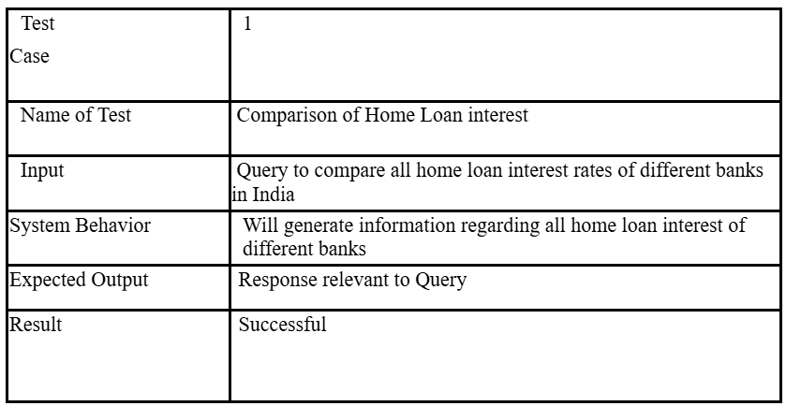
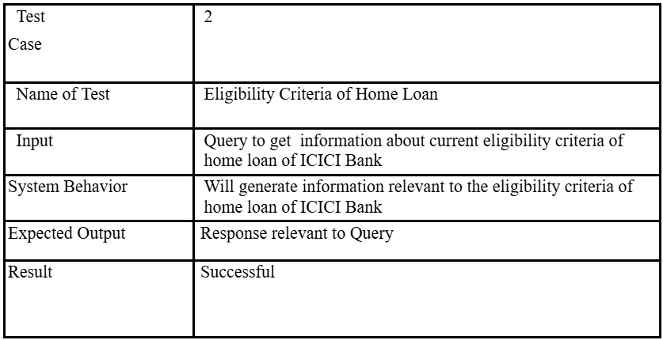
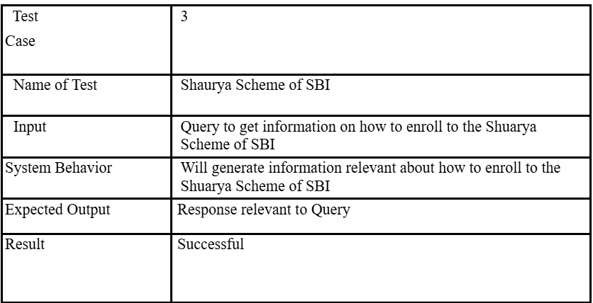
Sample Test Tables

Slide 12
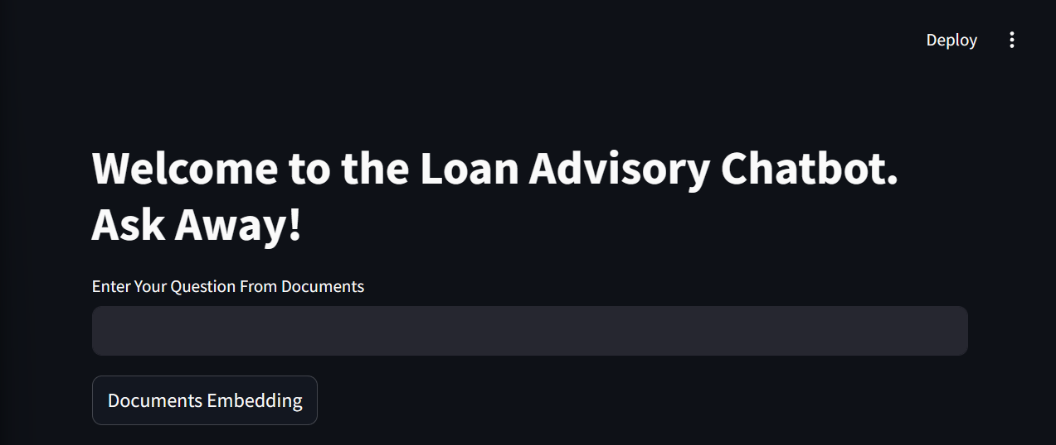
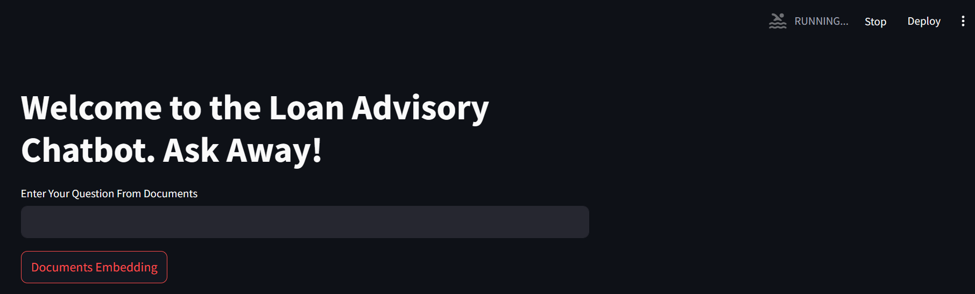
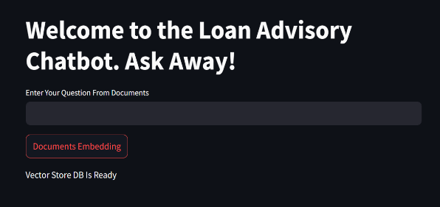
Results and Software Analysis:
Homescreen UI
Document Embeddings being created
Vector Store DB ready

Slide 13
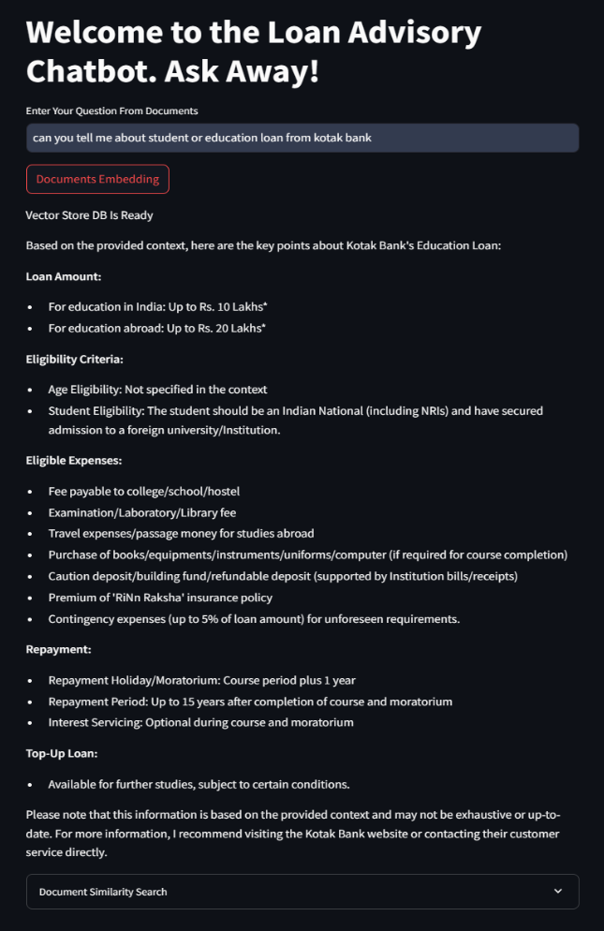
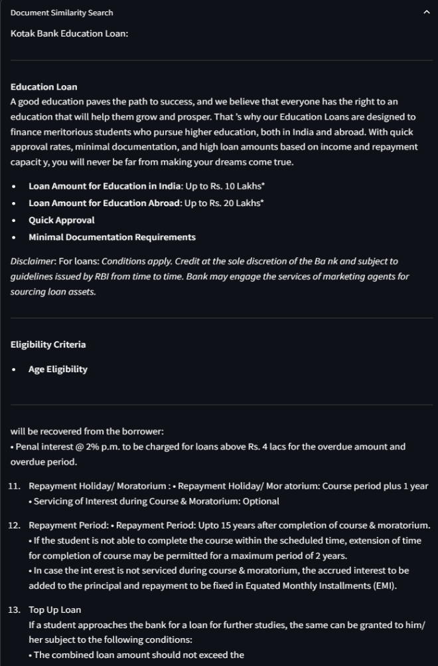
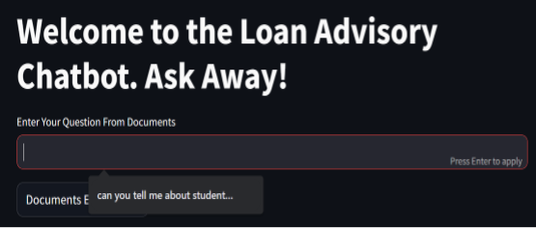
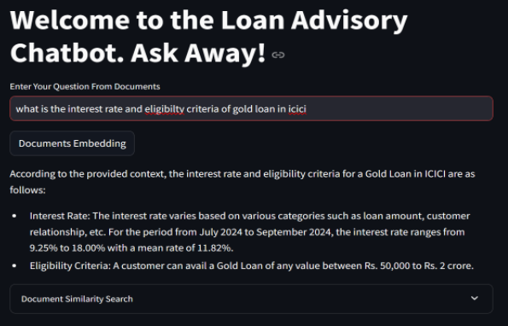
Results and Software Analysis:
Previous Query stored in memory
Prompt for Kotak Bank with Response
Document Similarity Search for the asked Question
Some more prompts and its responses

Slide 14
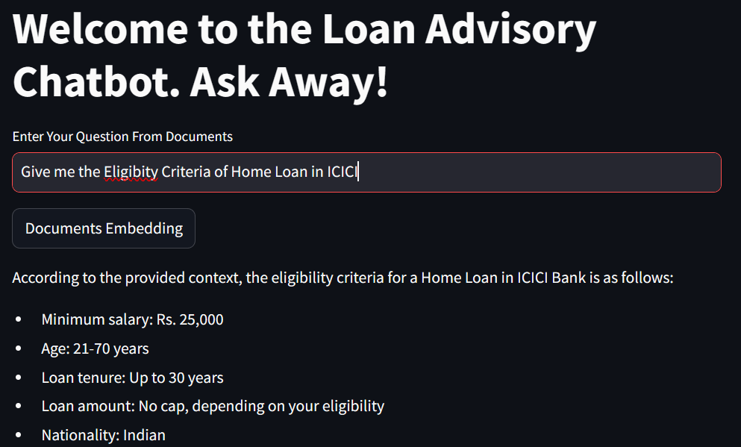
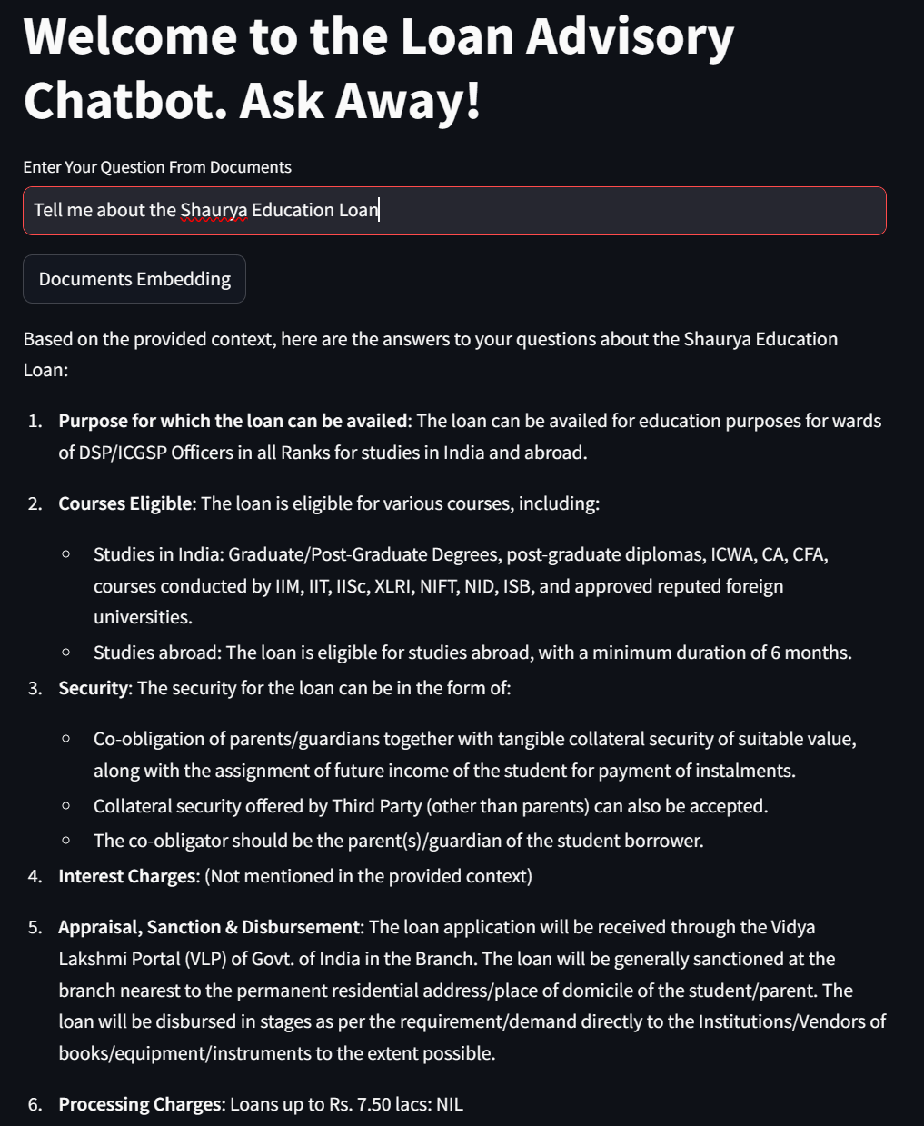
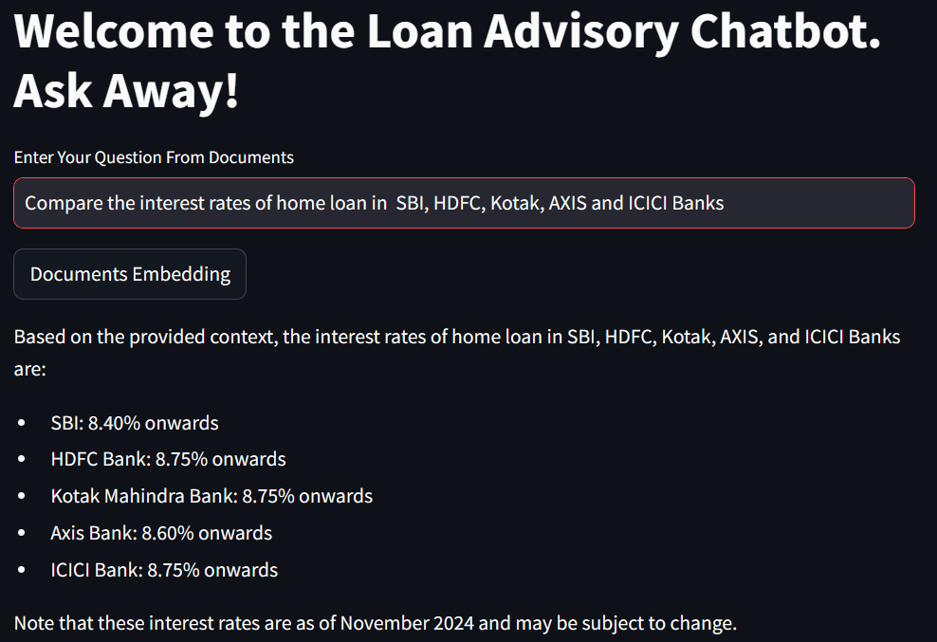
Results and Software Analysis:
Test Case 2
Test Case 1
Test Case 3

Slide 15
Conclusion and Future Scope
The project successfully developed a RAG chatbot that provides accurate, unbiased information on loan schemes from Indian banks. It combines LangChain, ChatGroq, and Streamlit to deliver contextually relevant responses by leveraging efficient document ingestion, FAISS-based retrieval, and Google Generative AI embeddings. Features like "Document Similarity Search" enhance transparency and trust. This chatbot simplifies complex financial decisions and demonstrates the potential of RAG frameworks in delivering reliable, data-driven insights.
Some future scopes for this project are:
Expand coverage to include financial products like investments, credit cards, and insurance.
Integrate real-time data for updated rates, policy changes, and offers.
Add multilingual support to reach a broader audience.
Improve natural language understanding for nuanced queries and personalized responses.
Enhance contextual memory for smoother multi-turn conversations.
Include feedback mechanisms for continuous improvement and user-centric insights.

