Slide 1
Hack O’ Holics
Microsoft data & ai hackathon
Diptendu mitra
Bindu Channachari
Smita Sidharth
Avinash Ajjana goud
Rajesh vennam

Slide 2
Theme, challenge & our hack
Theme: Save Environment - Global Landslide Assessment
Challenge:
Landslides are among the many natural disasters causing massive destructions to live and property across the globe. Seismic activities, volcanic eruption and adverse weather conditions have, for a long time contributed to landslides across the globe.
Hack & Benefits:
GIS based spatial data analysis for landslide susceptibility mapping to delineates the potential zones
Predictive analysis will benefit government authority to visualize take preventive measure
Natural disaster relief team (like, NDRF, Red Cross) to prepare for such disaster
Dashboard to identify the landslide prone zone & safe zone to relocate people

Slide 3


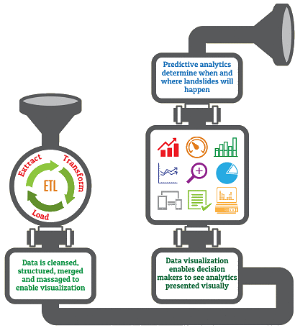




















The RISE against landslides: Big data to rescue
BETWEEN 2007 AND 2017, LANDSLIDES KILLED A TOTAL OF 30,364 PEOPLE AROUND THE WORLD
INDIA GLOBALLY TOPS THE LIST IN LANDSLIDE FATALITY, THOUGH US TOPS THE MAXIMUM LANDLISDE
KEDARNATH 2013
5,748 Persons Killed
BADAKHSHAN 2014
2,100 Persons Killed
MULTIPLE TRIGGERING FACTOR

Slide 4





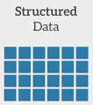







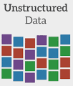
Solution architecture
To ingest & orchestrate the complete data flow
To store to unstructured/structured data
Access Token
Service Principal
Azure Logic App
SAS URI
Service Principal
Access Key
Azure Data Lake
To collaborate, analyze & aggregate data
To store the cleansed & transformed data
Azure Data Lake
To visualize the simplified data as a report
Azure Logic App
To trigger email to the stakeholders

