Slide 1
Weekly Anomaly Detection — Project & Model
Design, NB2 modeling, and runbook | Last updated 2025-09-30 04:30

Slide 2
Executive Summary
Detect unusual weekly behavior in target_key hits grouped by (target_type, insight_type).
Use 1-year synthetic weekly data with realistic seasonality & injected anomalies (spikes, drops, shifts).
Model counts with Negative Binomial (NB2) regression + seasonality to produce prediction-interval based anomaly flags.
Two pipelines: Lightweight (Statsmodels) and Hierarchical (PyMC).

Slide 3
Data Design (Weekly Refresh)
One raw CSV of hits; each row = one weekly hit event.
Columns: insight_id, insight_type, target_type, target_key, metric name, metric_type, metric_value, run_id, insight_date_time, insights_category.
Weekly cadence: events timestamped on a weekly refresh (e.g., Monday ~06:00).
Seasonality: yearly (Fourier); Drift: small stochastic; Anomalies: spikes, drops, sustained shifts.
Notes:
Data reflects overdispersed weekly counts; motivates NB2 over Poisson.

Slide 4
Why Negative Binomial (NB2)?
Poisson assumes Var(Y|X) = μ; real weekly counts show over-dispersion.
NB2: Var(Y|X) = μ + α μ² with α>0 ⇒ calibrated, wider PIs; fewer false alarms.
Works well for sparse series and heavy tails; preserves interpretability (GLM).

Slide 5
Seasonality + Trend
Seasonality: Weekly Fourier terms with period ~52 (K=1–2).
Trend: Lightweight pipeline uses a light linear term; PyMC uses a Gaussian Random Walk.
Additive structure on log-mean: log μ_t = intercept + Fourier(t) + trend.

Slide 6
Anomaly Rule
Compute high-confidence prediction intervals (e.g., 99%).
Flag week as anomalous if observed count is outside [PI_low, PI_high].
Rank by # flagged weeks and max deviation ratio (count / μ̂).

Slide 7
Lightweight Pipeline (Statsmodels)
Per-key NB2 GLM with Fourier seasonality and light trend; pair-level aggregate model mirrors the same form.
Fallback: 8-week rolling mean ± 3σ when NB2 fails or series is too small.
Outputs: light_nb_flags_by_key_weekly.csv, light_nb_flags_by_pair_weekly.csv.
Visualization: top-N per-key & pair charts with μ̂ and PI bands.
Notes:
Use --fourier_K 1..2, --pi_level 0.95..0.995; cap scope with --max_pairs/--max_keys.

Slide 8
Hierarchical Pipeline (PyMC)
Per (target_type, insight_type) pair: random intercepts per key (partial pooling).
Shared pair-specific seasonality (Fourier) and trend (GRW) across keys.
Posterior predictive intervals for anomalies; better calibration for sparse keys.
Outputs: per-key & pair flags + distribution-shift metrics (active_keys, top_share, HHI, KL).
Notes:
Requires compiler; tune draws/tune/chains; start with fourier_K=1–2.

Slide 9
Heterogeneity: Different Change Curves per Pair
Model each (target_type, insight_type) with its own seasonal/trend curve.
Hierarchical pooling lets keys borrow strength from the pair baseline.
Also track distribution-shift signals: active_keys, top_share, HHI, KL divergence.

Slide 10
Evaluation & Thresholds
PI coverage check: with 99% PI, ~99% of non-anomalous weeks should be in-band.
Adjust PI level or Fourier complexity to hit your alert budget.
If ground truth exists, tune via precision/recall and severity ranking.

Slide 11
PyCharm Runbook (Fast)
Install deps: pip install -r requirements_light.txt
Run: python lightweight_nb_anomaly.py --input synthetic_insights_weekly_1y.csv --outdir out_lightweight --fourier_K 1 --pi_level 0.99 --viz_top 10
Outputs: CSV flags + figs/*.png for top-N series.

Slide 12
PyCharm Runbook (Hierarchical)
Conda env: conda env create -f environment.yml && conda activate hier-nb
Run: python hierarchical_nb_pymc.py --input synthetic_insights_weekly_1y.csv --outdir out_hier_nb --draws 800 --tune 800 --chains 2 --cores 2 --fourier_K 2 --pi_level 0.99 --viz_top 10
Outputs: per-key & pair flags + distribution-shift metrics + figs.

Slide 13
Next Steps
Add exposure/holiday covariates if available; include as offsets or regressors.
Add change-point detector to reset baselines on regime shifts.
Productionize: schedule weekly, write to tables, wire to dashboards/alerts.

Slide 14
Examples — Top Anomalies
Per‑key and aggregate examples from the latest run

Slide 15
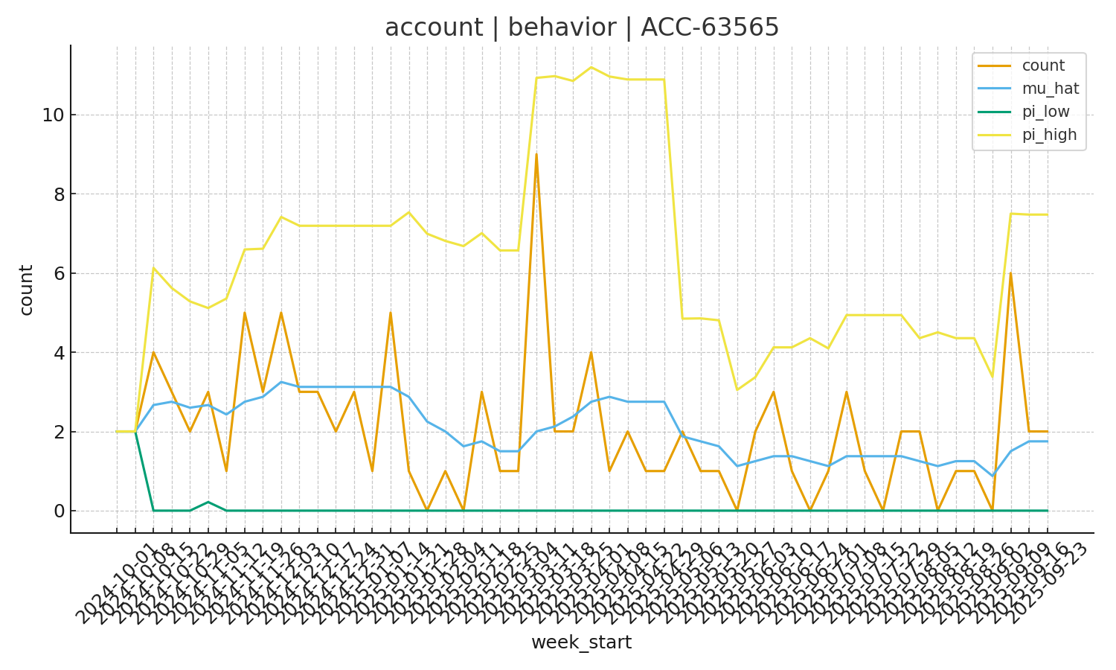
Per‑key: account | behavior | ACC-63565

Slide 16
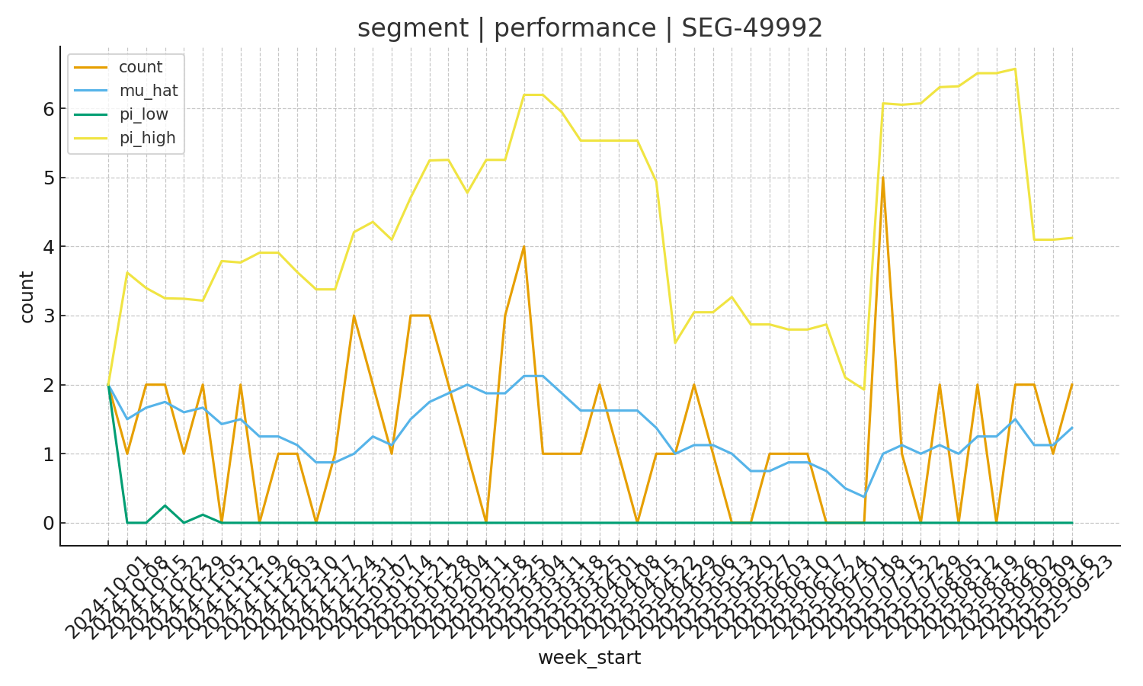
Per‑key: segment | performance | SEG-49992

Slide 17
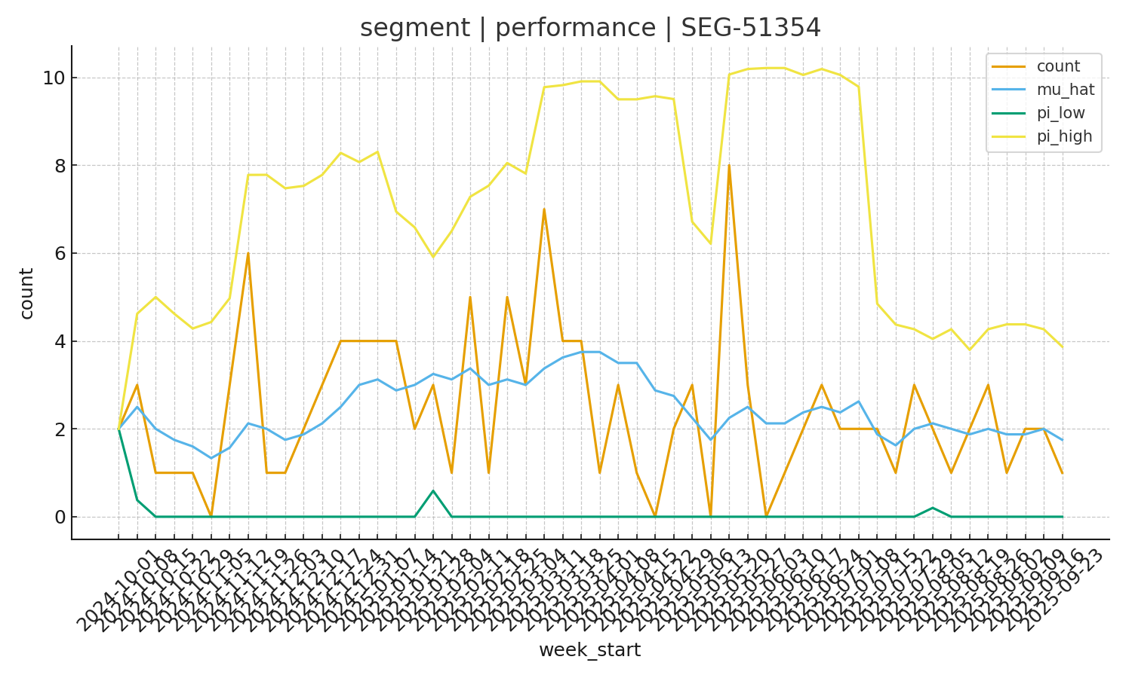
Per‑key: segment | performance | SEG-51354

Slide 18
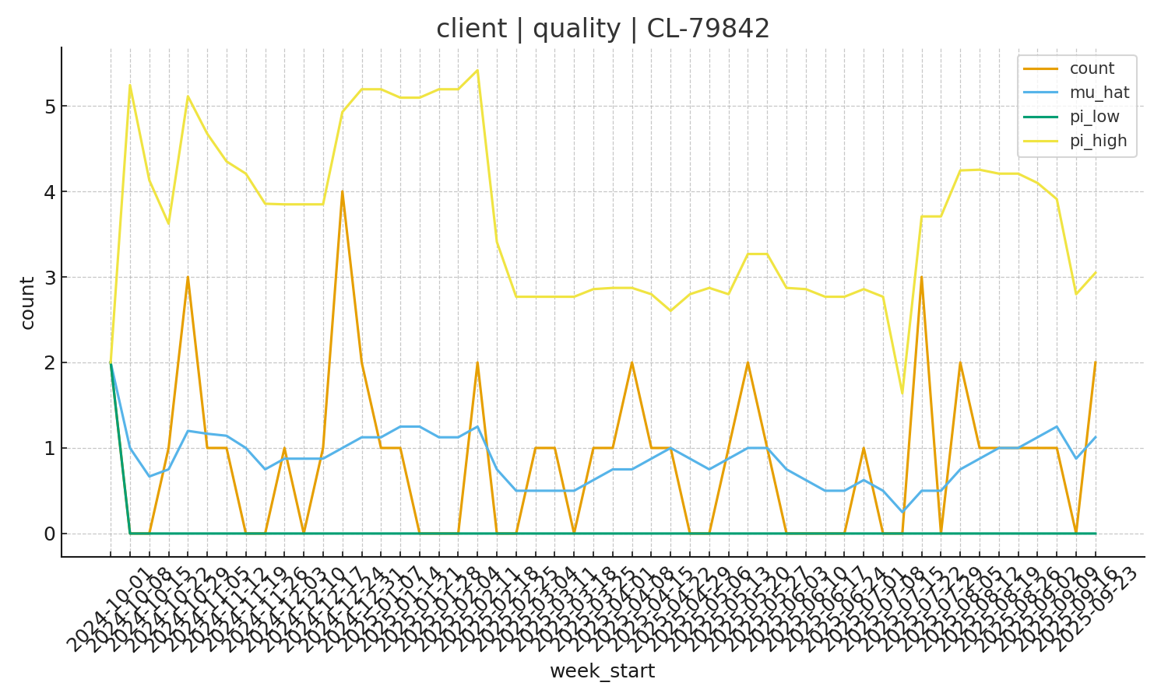
Per‑key: client | quality | CL-79842

Slide 19
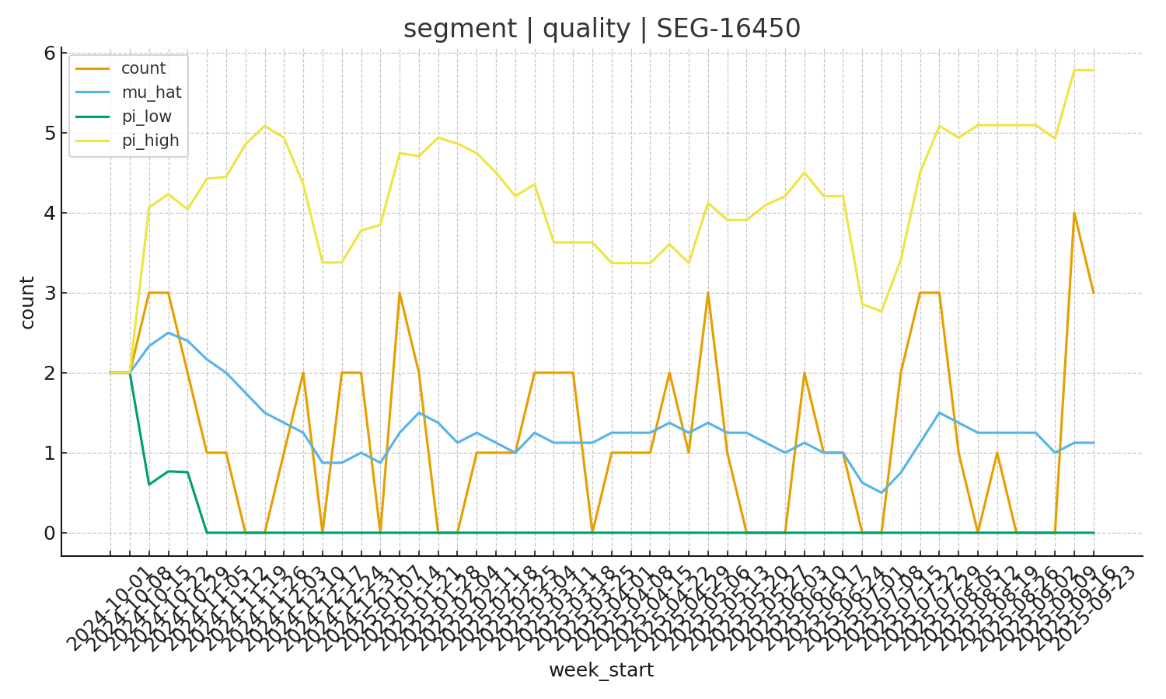
Per‑key: segment | quality | SEG-16450

Slide 20
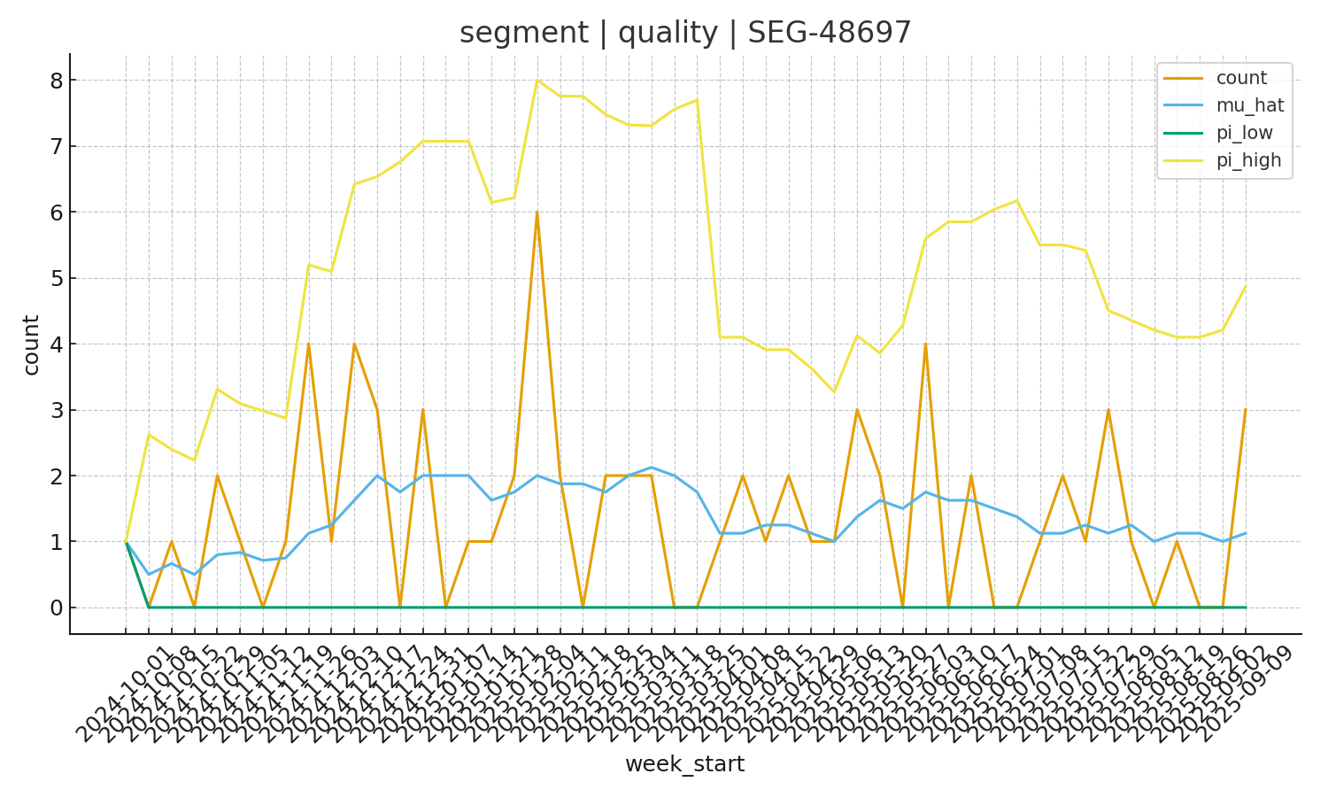
Per‑key: segment | quality | SEG-48697

Slide 21
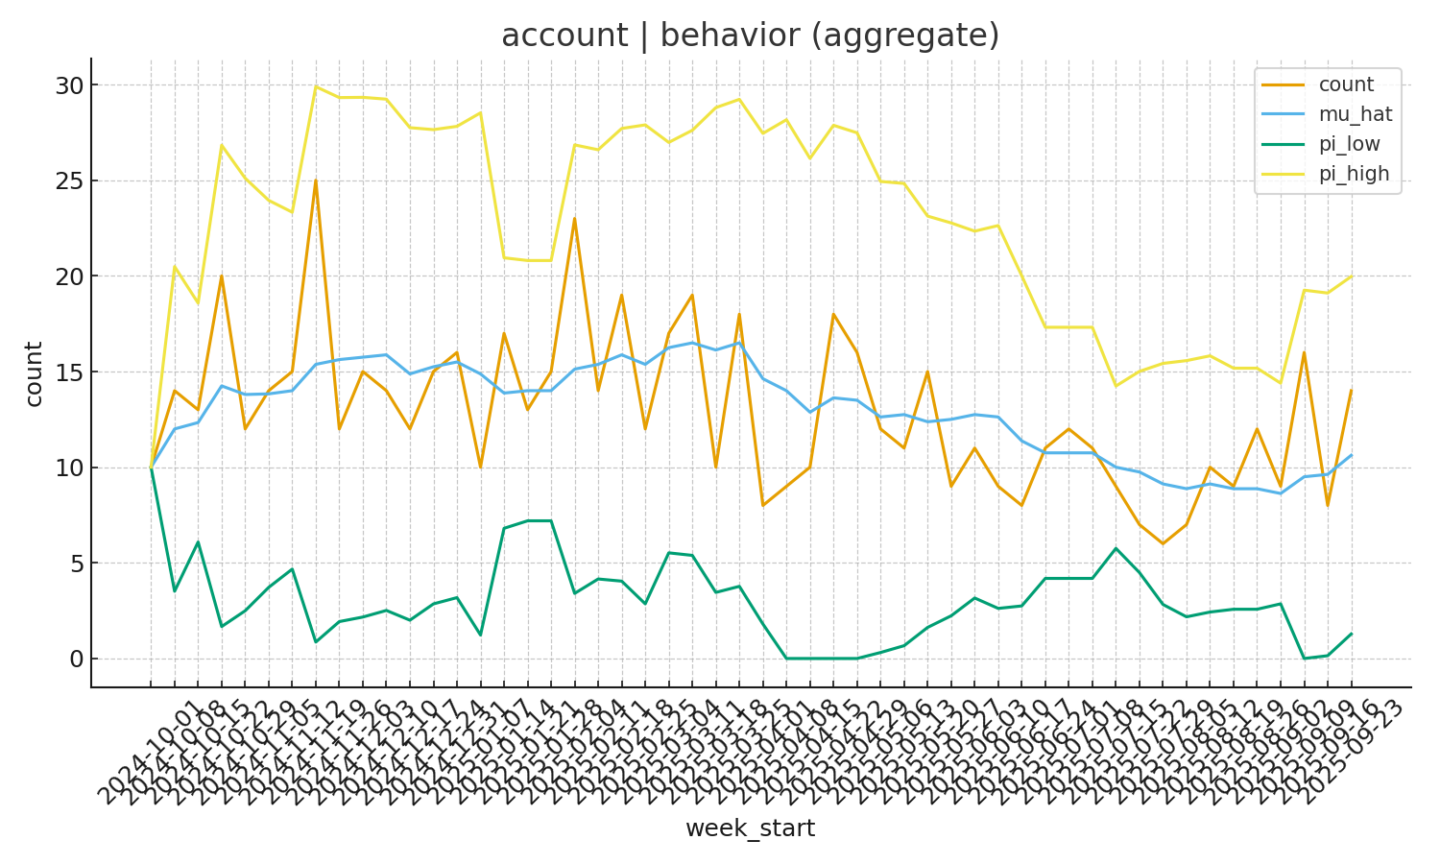
Pair: account | behavior

Slide 22
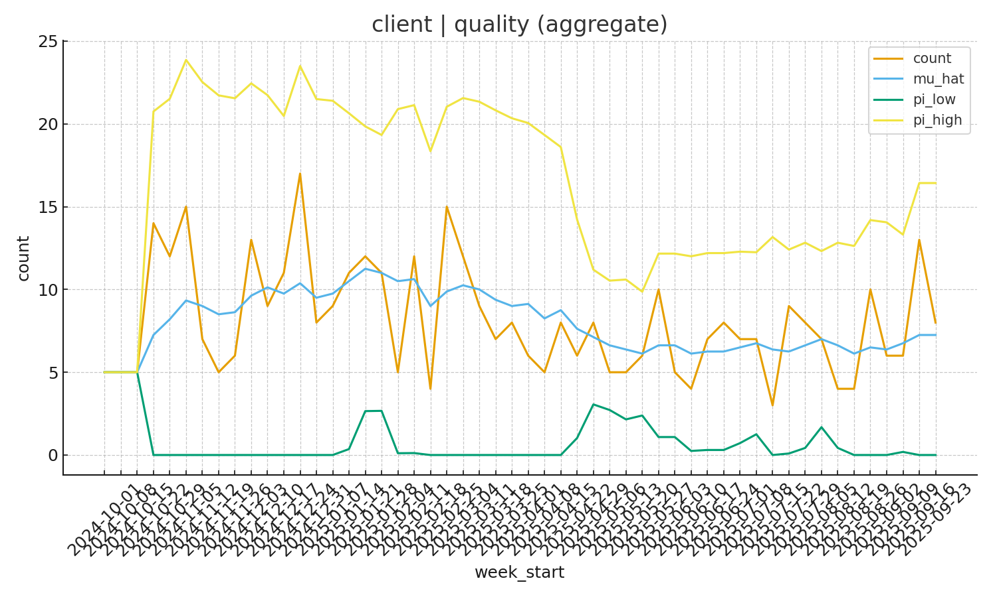
Pair: client | quality

Slide 23
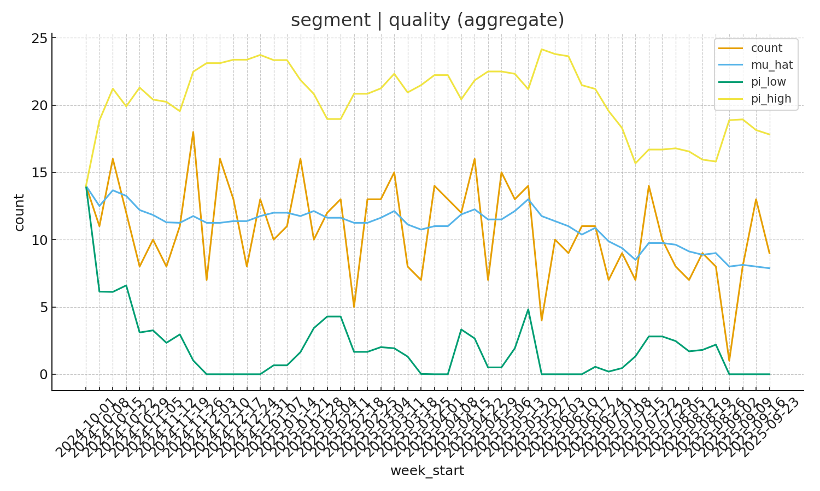
Pair: segment | quality

Slide 24
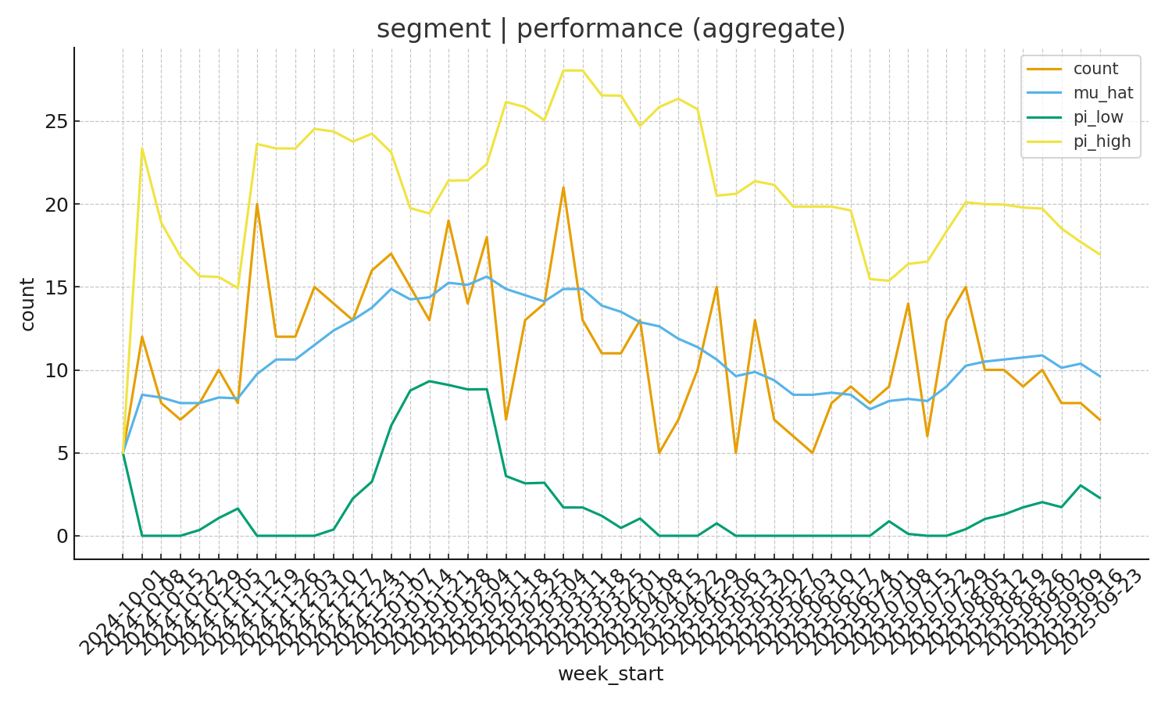
Pair: segment | performance

