Slide 1
Generics, Packages and Util Packages (UNIT-III)

Slide 2
List Implementations
All methods in the Collection interface are also available in the List interface.
You can choose between the following List implementation in the Java Collections API :
1) java.util.ArrayList
2) java.util.LinkedList
3) java.util.Vector
4) java.util.Stack
Here are a few examples of how to create a List instance:
List listA = new ArrayList();
List listB = new LinkedList();
List listC = new Vector();
List listD = new Stack();

Slide 3
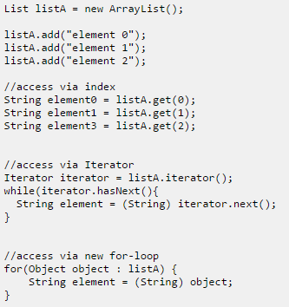
Adding and Accessing Elements :

Slide 4
Removing Elements :
You can remove elements in two ways:
1) remove(Object element) :-
removes that element in the list, if it is present.
2) remove(int index) :-
removes the element at the given index.
Clearing List :
clear() method which removes all elements from the list.
Ex :- list.clear();
List Size :
Size() is used to obtain number of elements in list.
Ex :- int size = list.size();

Slide 5
Generics
Before generics, we can store any type of objects in collection i.e. non-generic. Now generics, forces the java programmer to store specific type of objects.
classes like HashSet, ArrayList, HashMap, etc use generics very well. We can use them for any type.
we use <> to specify parameter types in generic class creation. To create objects of generic class, we use following syntax.
Syntax:- BaseType <Type> obj = new BaseType <Type>()
Advantages of Generics :-
Type-safety : We can hold only a single type of objects in generics. It doesn’t allow to store other objects.
Type casting is not required: There is no need to typecast the object.
Compile-Time Checking: It is checked at compile time so problem will not occur at runtime.

Slide 6
Type Parameters :-
The type parameters naming conventions are important
to learn generics thoroughly. The commonly type
parameters are as follows:
<T> - Type
<E> - Element
<K> - Key
<N> - Number
<V> - Value

Slide 7
Example :-
import java.util.*;
class Test
{
public static void main(String args[])
{
ArrayList<String> list=new ArrayList<String>();
list.add(“Prakash");
list.add(“Rohan");
String s=list.get(1); //type casting is not required
System.out.println("element is: "+s);
Iterator<String> itr=list.iterator();
while(itr.hasNext())
{
System.out.println(itr.next());
}
}
}
Output :-
element is: Rohan
Prakash
Rohan

Slide 8
Generic Types
A generic type is a generic class or interface.
Here, we are using T type parameter to create the generic class of specific type.
Example :-
class MyGen<T>
{
T obj;
void add(T obj)
{
this.obj=obj;
}
T get()
{
return obj;
}
}
class TestGenerics
{
public static void main(String args[])
{
MyGen<Integer> m=new MyGen<Integer>();
m.add(2);
//m.add("vivek");//Compile time error
System.out.println(m.get());
}
}

Slide 9
Generic Methods
Like generic class, we can create generic method that can accept any type of argument.
Example :-
public class Test
{
public static < E > void printArray(E[] elements) {
for ( E element : elements){
System.out.println(element );
}
System.out.println();
}
public static void main( String args[] ) {
Integer[] intArray = { 10, 20, 30, 40, 50 };
Character[] charArray = { 'J', 'A', 'V', 'A'};
System.out.println( "Printing Integer Array" );
printArray( intArray );
System.out.println( "Printing Character Array" );
printArray( charArray );
}
}

Slide 10
Diamond
In Java SE 7 and later, you can replace the type arguments required to invoke the constructor of a generic class with an empty set of type arguments (<>) as long as the compiler can determine the type arguments from the context.
This pair of angle brackets, <>, is informally called the diamond.
For example, you can create an instance of Box<Integer> with the following statement:
Box<Integer> i = new Box<>();

Slide 11
Raw Type
A raw type is the name of a generic class or interface without any type arguments. For example, given the generic Box class:
public class Box<T>
{
public void set(T t)
{
}
}
To create a parameterized type of Box<T>, you supply an actual type argument for the formal type parameter T:
Box<Integer> intBox = new Box<>();
If the actual type argument is omitted, you create a raw type of Box<T>:
Box rawBox = new Box();

Slide 12
Assigning a parameterized type to its raw type is allowed:
Box<String> stringBox = new Box<>();
Box rawBox = stringBox; // OK
But if you assign a raw type to a parameterized type, you get a warning:
Box rawBox = new Box
Box<Integer> intBox = rawBox; // warning
You also get a warning if you use a raw type to invoke generic methods defined in the corresponding generic type:
Box<String> stringBox = new Box<>();
Box rawBox = stringBox;
rawBox.set(8); // warning
The Type Erasure section has more information on how the Java compiler uses raw types.

Slide 13
Bounded Type
when you want to restrict the types that can be used as type arguments in a parameterized type. For example, a method that operates on numbers might only want to accept instances of Number or its subclasses. This is what bounded type parameters are for.
To declare a bounded type parameter, list the type parameter's name, followed by the extends keyword, followed by its upper bound, which in this example is Number. Note that, in this context, extends is used in a general sense to mean either "extends" (as in classes) or "implements" (as in interfaces).
public <U extends Number> void inspect(U u)
{
System.out.println("T: " + t.getClass().getName());
System.out.println("U: " + u.getClass().getName());
}

Slide 14
public static void main(String[] args)
{
Box<Integer> integerBox = new Box<Integer>();
integerBox.set(new Integer(10));
integerBox.inspect("some text"); // error: this is still String!
}
You have to enter number as parameter such as :
integerBox.inspect(10);
Multiple Bounds :-
The preceding example illustrates the use of a type
parameter with a single bound, but a type parameter can
have multiple bounds:
<T extends B1 & B2 & B3>

Slide 15
Inheritance and Subtypes
It is possible to assign an object of one type to an object of another type provided that the types are compatible. For example, you can assign an Integer to an Object, since Object is one of Integer's super types:
Object someObject = new Object();
Integer someInteger = new Integer(10);
someObject = someInteger; // OK
In object-oriented terminology, this is called an "is a" relationship. Since an Integer is a kind of Object, the assignment is allowed. But Integer is also a kind of Number, so the following code is valid as well:
public void someMethod(Number n) { /* ... */ }
someMethod(new Integer(10)); // OK
someMethod(new Double(10.1)); // OK

Slide 16
The same is also true with generics. You can perform a generic type invocation, passing Number as its type argument, and any subsequent invocation of add will be allowed if the argument is compatible with Number:
Box<Number> box = new Box<Number>();
box.add(new Integer(10)); // OK
box.add(new Double(10.1)); // OK

Slide 17
Wildcards
In generic code, the question mark (?), called the wildcard, represents an unknown type.
The wildcard can be used in a variety of situations: as the type of a parameter, field, or local variable; sometimes as a return type (though it is better programming practice to be more specific).
The wildcard is never used as a type argument for a generic method invocation, a generic class instance creation, or a super type.
If we write <? extends Number>, it means any child class of Number e.g. Integer, Float, double etc.

Slide 18
Packages

Slide 19
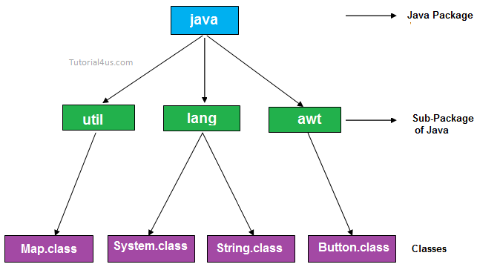
What is Package ?
A package is a collection of similar types of classes, interfaces and sub-packages.
The purpose of package concept is to provide common classes and interfaces for any program separately.
For example we store all movies in one folder and songs in other folder, here also we store same type of files in a particular package for example in awt package have all classes and interfaces for design GUI components.

Slide 20
Advantages Of Packages :-
Package is used to categorize the classes and interfaces so that they can be easily maintained
Application development time is less, because reuse the code
Application memory space is less (main memory)
Application execution time is less
Application performance is enhance (improve)
Redundancy (repetition) of code is minimized
Package provides access protection.
Package removes naming collision.

Slide 21
Type Of Packages :-
Package are classified into two type which are given
below:
1) Predefined or built-in package
2) User defined package
1) Predefined or built-in package
These are the package which are already designed by the
Sun Microsystem and supply as a part of java API, every
predefined package is collection of predefined classes,
interfaces and sub-package.
2) User defined package
If any package is design by the user is known as user
defined package. User defined package are those which
are developed by java programmer and supply as a part
of their project to deal with common requirement.

Slide 22
Rules to create user defined package:-
package statement should be the first statement of any package program.
Choose an appropriate class name or interface name and whose modifier must be public.
Any package program can contain only one public class or only one public interface but it can contain any number of normal classes.
Package program should not contain any main class (that means it should not contain any main())
modifier of constructor of the class which is present in the package must be public. (This is not applicable in case of interface because interface have no constructor.)
The modifier of method of class or interface which is present in the package must be public (This rule is optional in case of interface because interface methods by default public)
Every package program should be save either with public class name or public Interface name

Slide 23
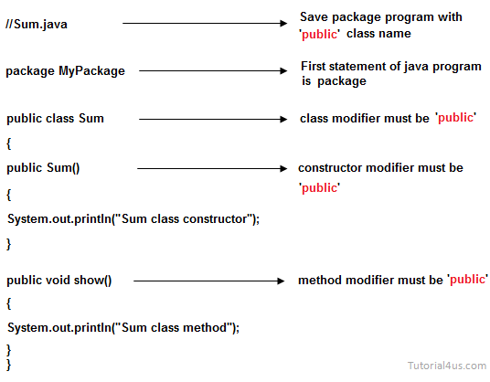
How to compile & run a java program inside the package :-
Syntax :-
javac -d directory javafilename
Java packagename.classname
Example :-
javac -d . Sum.java
java MyPackage.Sum
The -d switch specifies the destination where to put the generated class file. You can use any directory name like d:/abc (in case of windows) etc. If you want to keep the package within the same directory, you can use . (dot).

Slide 24
Import Statement :-
import keyword is used to import built-in and user-defined packages into your java source file so that your class can refer to a class that is in another package by directly using its name.
There are three ways to access the package from outside the package.
1) import package.*;
2) import package.classname;
3) fully qualified name.

Slide 25
1) import packagename.*; :-
If you use package.* then all the classes and interfaces of
this package will be accessible but not subpackages.
Example:
//save by A.java
package pack;
public class A
{
public void msg()
{
System.out.println("Hello");
}
}
//save by B.java
package mypack;
import pack.*;
class B
{
public static void main(String args[])
{
A obj = new A();
obj.msg();
}
}

Slide 26
2) Using packagename.classname :-
If you import package.classname then only declared
class of this package will be accessible.
Example :
//save by A.java
package pack;
public class A
{
public void msg()
{
System.out.println("Hello");
}
}
//save by B.java
package mypack;
import pack.A;
class B
{
public static void main(String args[])
{
A obj = new A();
obj.msg();
}
}

Slide 27
3) Using fully qualified name :-
If you use fully qualified name then only declared class
of this package will be accessible. Now there is no need
to import. But you need to use fully qualified name every
time when you are accessing the class or interface.
Example:-
//save by A.java
package pack;
public class A
{
public void msg()
{
System.out.println("Hello");
}
}
//save by B.java
package mypack;
class B
{
public static void main(String args[])
{
pack.A obj = new pack.A();
obj.msg();
}
}

Slide 28
Static Import Statement :-
The static import feature of Java 5 facilitate the java
programmer to access any static member of a class
directly. There is no need to qualify it by the class name.
Advantage :- Less coding is required if you have access any static member of a class.
Disadvantage :- If you overuse the static import feature, it makes the program unreadable and unmaintainable.
Example :-
import static java.lang.System.*;
class StaticImportExample
{
public static void main(String args[])
{
out.println("Hello");
out.println("Java");
}
}

Slide 29
Util Package

Slide 30
Random Class
Random class is part of java.util package.
An instance of java Random class is used to generate random numbers.
This class provides several methods to generate random numbers of type integer, double, long, float etc.
Java Random class has two constructors which are given below:
1) Random(): creates new random generator
2) Random(long seed): creates new random generator
using specified seed
Methods of java Random class :
1) nextBoolean(): This method returns next pseudorandom
which is a boolean value from random number generator
sequence.
2) nextDouble(): This method returns next pseudorandom
which is double value between 0.0 and 1.0.

Slide 31
3) nextFloat(): This method returns next pseudorandom
which is float value between 0.0 and 1.0.
4) nextInt(): This method returns next int value from
random number generator sequence.
5) nextInt(int n): This method return a pseudorandom
which is int value between 0 and specified value from
random number generator sequence.

Slide 32
import java.util.Random;
public class RandomNumberExample
{
public static void main(String[] args)
{
Random random = new Random();
System.out.println(random.nextBoolean());
System.out.println(random.nextDouble());
System.out.println(random.nextFloat());
System.out.println(random.nextInt());
System.out.println(random.nextInt(20));
}
}

Slide 33
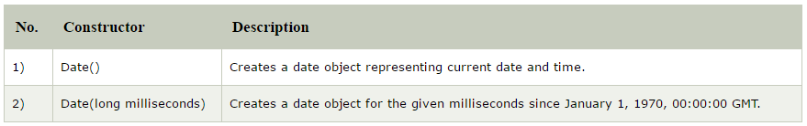
Date Class
The java.util.Date class represents date and time in java. It provides constructors and methods to deal with date and time in java.
Constructor :-

Slide 34
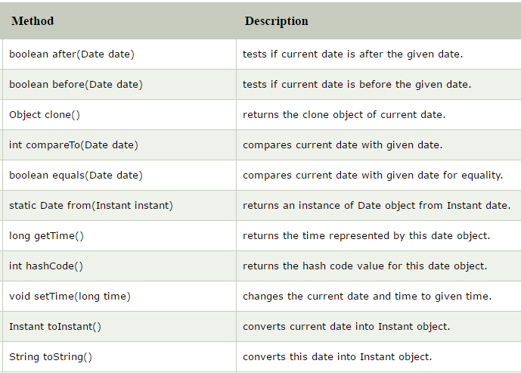
Methods :-

Slide 35
import java.util.*;
public class Main
{
public static void main(String args [])
{
// Creating date
Date d1 = new Date(2000, 11, 21);
Date d2 = new Date(); // Current date
Date d3 = new Date(2010, 1, 3);
boolean a = d3.after(d1);
System.out.println("Date d3 comes after " +"date d2: " + a);
boolean b = d3.before(d2);
System.out.println("Date d3 comes before "+"date d2: " + b);
int c = d1.compareTo(d2);
System.out.println(c);
System.out.println("Miliseconds from Jan 1 "+"1970 to date d1 is "
+ d1.getTime());
System.out.println("Before setting "+d2);
d2.setTime(204587433443L);
System.out.println("After setting "+d2);
}
}

Slide 36
Calendar Class
The Calendar class provides support for:
maintaining a set of calendar fields such as year, month, day_of_month, hour, minute, second, millisecond and
manipulating these calendar fields, such as getting the date of the previous week, roll forward by 3 days.
Calendar is a abstract class, and you cannot use the constructor to create an instance. Instead, you use the static method Calendar.getInstance() to instantiate an implementation sub-class.
1) Calendar.getInstance(): return a Calendar instance
based on the current time in the default time zone with
the default locale.
2) Calendar.getInstance(TimeZone zone)
3) Calendar.getInstance(Locale aLocale)
4) Calendar.getInstance(TimeZone zone, Locale aLocale)

Slide 37
The most important method in Calendar is get(int calendarField), which produces an int.
get(Calendar.DAY_OF_WEEK): returns 1 (Calendar.SUNDAY) to 7
(Calendar.SATURDAY).
get(Calendar.YEAR): year
get(Calendar.MONTH): returns 0 (Calendar.JANUARY) to 11
(Calendar.DECEMBER).
get(Calendar.DAY_OF_MONTH), get(Calendar.DATE): 1 to 31
get(Calendar.HOUR_OF_DAY): 0 to 23
get(Calendar.MINUTE): 0 to 59
get(Calendar.SECOND): 0 to 59
get(Calendar.MILLISECOND): 0 to 999
get(Calendar.HOUR): 0 to 11, to be used together with Calendar.AM_PM.
get(Calendar.AM_PM): returns 0 (Calendar.AM) or 1 (Calendar.PM).
get(Calendar.DAY_OF_WEEK_IN_MONTH): DAY_OF_MONTH 1 through 7 always
get(Calendar.DAY_OF_YEAR): 1 to 366

Slide 38
Calendar has these setters and operations:
1) void set(int calendarField, int value)
2) void set(int year, int month, int date)
3) void set(int year, int month, int date, int hour, int
minute, int second)
4) void add(int field, int amount): Adds or subtracts the
specified amount of time to the given calendar field,
based on the calendar's rules.
Other frequently-used methods are:
1) Date getTime(): return a Date object based on this Calendar's
value.
2) void setTime(Date date)
3) long getTimeInMills(): Returns this Calendar's time value in
milliseconds.
4) void setTimeInMillis(long millis)
5) void setTimeZone(TimeZone value)

Slide 39
Example :-
import java.util.*;
class Cal
{
public static void main(String[] args)
{
Calendar c = Calendar.getInstance();
System.out.println("Day : " +c.get(Calendar.DATE));
System.out.println("Month : " +c.get(Calendar.MONTH));
System.out.println("Year : " + c.get(Calendar.YEAR));
}
}
Output :-
Day : 1
Month : 8
Year : 2018

Slide 40
Gregorian Calendar Class
Gregorian Calendar is a concrete subclass of calendar so you can create object of this class.
It provides the standard calendar used by most of the world.
GregorianCalendar gcal = new GregorianCalendar();
an object named gcal of GregorianCalendar Class is
initialized with the current date and time
GregorianCalendar has the following constructors:
1) GregorianCalendar(): using the current time, with the
default time zone and locale.
2) GregorianCalendar(int year, int month, int
dayOfMonth): with the default time zone and locale.
3) GregorianCalendar(int year, int month, int
dayOfMonth, int hourOfDay, int minute, int second)

Slide 41
Example :-
Calendar cal1 = new GregorianCalendar();
Calendar cal2 = new GregorianCalendar(2010, 9, 26); cal2.get(Calendar.DAY_OF_WEEK);

Slide 42
Vector Class
Vector class contained in the package java.util.
Vector class can be used to create a generic dynamic array known as vector that can hold objects of any type and any number.
Syntax:
Vector vect1 = new Vector();
Vector list = new Vector (3);
In vector there is no need to define the size where as in array it is compulsory to give the size.
Difference between array and vector:
Vector is convenient to store the object without specifying its size. where as in array this is not possible.
A vector can be used to store a list of objects that may be vary in size where as in array store fixed size object.
We can add and delete object in vector but it is not possible in an array.

Slide 43
Constraint of vector class:
In vector we can store only object, we can not directly store the simple data type.
Therefore we need to convert simple data type to object.
Conversion from simple data type to object is possible by using wrapper class.
Methods of vector class:
Method call | Task performed
list.addElement (item) | Adds the item specified to the list at the end
List.elementAt (10) | Gives the name of the 10th object
List.size() | Gives the number of object present
List.removeElement (item) | Remove the specified item from the list
List.removeElementAt (n) | Remove the items stored in the nth position of the list
List.removeAllElements() | Removes all the elements from the list
List.copyInto (array) | Copies all items from list to arrays
List.insertElementAt (item, n) | Inserts the item at nth position

Slide 44
Example :-
import java.util.*;
class vector1
{
public static void main (String args[])
{
Vector list = new Vector();
list.add ("ADA");
list.add ("BASIC");
list.add ("C++");
list.add ("FORTRAN");
list.add ("JAVA");
System.out.println("No. of object in verctor class are:"+list.size());
list.insertElementAt("VB", 2);
Enumeration vEnum = list.elements();
System.out.println("\nElements in vector:");
while(vEnum.hasMoreElements())
System.out.print(vEnum.nextElement() + " ");
System.out.println("After Removing the element: ");
list.removeElementAt(2);
Enumeration e1 = list.elements();
while(e1.hasMoreElements())
System.out.print(e1.nextElement() + " ");
}
}

Slide 45
HashTable Class
A Hashtable is an array of list. Each list is known as a bucket. The position of bucket is identified by calling the hashcode() method. A Hashtable contains values based on the key.
It contains only unique elements.
It may not have any null key or value.
It is synchronized.
Methods :-

Slide 46
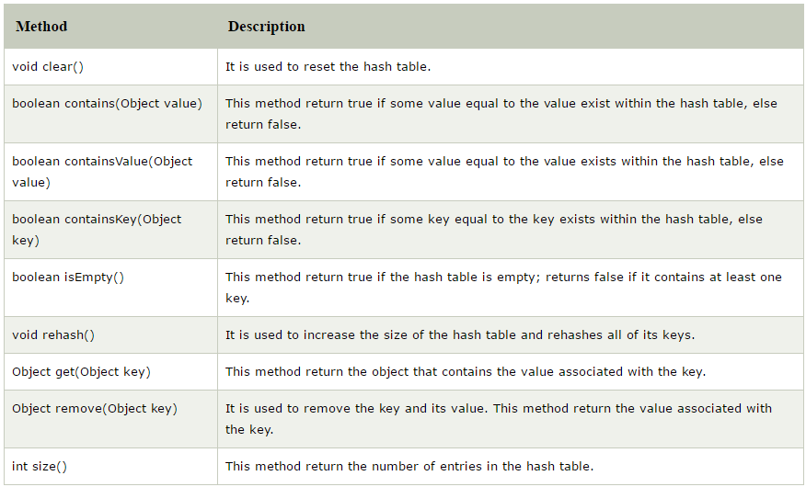

Slide 47
Example :-
import java.util.*;
public class HashtableExample
{
public static void main(String args[])
{
Hashtable<Integer, String> map = new Hashtable<Integer, String>();
map.put(102,"Let us C");
map.put(103, "Operating System");
map.put(101, "Data Communication and Networking");
System.out.println("Values before remove: "+ map);
map.remove(102);
System.out.println("Values after remove: "+ map);
}
}
Output :-
Values before remove: {103=Operating System, 102=Let us C, 101=Data Communication and Networking}
Values after remove: {103=Operating System, 101=Data Communication and Networking}

