Slide 1
JAVA Language Basics- Language Basics (UNIT-I)

Slide 2
DATA Type

Slide 3
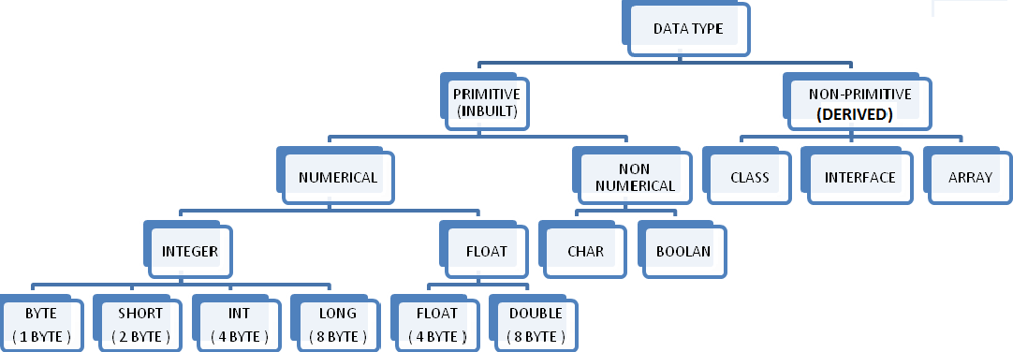

Slide 4
Primitive Data Types:
There are eight primitive data types supported by Java. Primitive data types are predefined by the language and named by a key word.
Byte
Short
Int
Long
Float
Double
Boolean
Char

Slide 5
byte:
Byte data type is a 8-bit(One byte) size integer.
Minimum value is -128 . Maximum value is 127 .
Default value is 0.
Byte data type is used to save space in large arrays, mainly in place of integers, since a byte is four times smaller than an int.
Example : byte a = 100 , byte b = -50
short:
Short data type is a 16-bit (Two byte) size integer.
Short data type can also be used to save memory as byte data type. A short is 2 times smaller than an int.
Default value is 0.
Example : short s= 10000 , short r = -20000

Slide 6
int:
Int data type is a 32-bit (Four Byte) size integer.
Int is generally used as the default data type for integral values unless there is a concern about memory.
The default value is 0.
Example : int a = 100000, int b = -200000
long:
Long data type is a 64-bit (Eight byte) size integer.
This type is used when a wider range than int is needed.
Default value is 0L.
Example : long a = 100000L, int b = -200000L

Slide 7
float:
Float data type is a single-precision 32-bit ( Four byte) IEEE 754 floating point.
Float is mainly used to save memory in large arrays of floating point numbers.
Default value is 0.0f.
Float data type is never used for precise values such as currency.
Example : float f1 = 234.5f
double:
double data type is a double-precision 64-bit(Eight byte) IEEE 754 floating point.
This data type is generally used as the default data type for decimal values. generally the default choice.
Double data type should never be used for precise values such as currency.
Default value is 0.0d.
Example : double d1 = 123.4

Slide 8
boolean:
boolean data type represents one bit of information.
There are only two possible values : true and false.
This data type is used for simple flags that track true/false conditions.
Default value is false.
Example : boolean one = true
char:
char data type is a single 8-bit Unicode character.
It can hold a single character.
Char data type is used to store any character.
Example . char letterA ='A'

Slide 9
Literals
Literals in Java are a sequence of characters (digits, letters and other characters) that characterize constant values to be stored in variables. Java language specifies five major types of literals are as follows:
1. Integer literals :
Integer data types consist of the following primitive
data types: int, long, byte, and short.
Ex: Int a, float b
2. Floating point literals :
Floating-point numbers are like real numbers in
mathematics, for example, 4.13179, -0.000001.
Java has two kinds of floating-point numbers: float
and double.

Slide 10
3. Character literals :-
We can specify a character literal as a single printable character in a pair of single quote characters such as 'a', '#', and '3'. You must know about the ASCII character set. The ASCII character set includes 128 characters including letters, numerals, punctuation etc.
4. String literals :-
The set of characters in represented as String literals in Java. Always use "double quotes" for String literals.
5. Boolean literals :-
The values true and false are treated as literals in Java programming. When we assign a value to a boolean variable, we can only use these two values. Unlike C, we can't presume that the value of 1 is equivalent to true and 0 is equivalent to false in Java.

Slide 11
Java Comments
The Java programming language supports three kinds of comments:
/* text */ The compiler ignores everything from /* to */.
/** documentation */ This indicates a documentation comment (doc comment, for short). The compiler ignores this kind of comment, just like it ignores comments that use /* and */. The JDK javadoc tool uses doc comments when preparing automatically generated documentation.
// text The compiler ignores everything from // to the end of the line.

Slide 12
Variables
A variable is an identifier that is used to store a data value.
Variables are nothing but reserved memory locations to store values. This means that when you create a variable you reserve some space in memory.
Variable is a name for a location in memory.
Variable may take different values at different times during the execution of program.
Declaring a variable:
datatype identifier [=value][,identifier [=value]….];
Example :- int x=10, y=100;
When a variable is not initialized, the value of that variable is undefined.

Slide 13
A variable name can be given by the programmer in a meaningful way.
For Example : average, height, salary etc.
Rules of variable
They can have alphabets, digits ,underscore and dollar sign characters.
They must not begin with digits.
Uppercase & lowercase are different this means that the variable SUM, sum, sUm are not same.
It should not be a keyword.
White space is not allowed.

Slide 14
Scope of Variables
The area of the program where the variable is usable is called scope. Java variables are divided into 3 types:
Instance variables
Class variables
Local variables
Instance and class variables are declared inside a class.
Class variables are global to class and belongs to entire set of objects that class creates. Only one memory location is created for each class variable. They are always static.
Instance variables belongs to objects as they are created when the objects are initialized. They take different value for each object.
Variables declared and used inside a method are called local variables.

Slide 15
Opearator
An Operator is a symbol that takes one or more arguments and operates on them to produce a result.
Arithmetic operators
Relational operators
Logical operators
Assignment operators
Increment/Decrement operators
Conditional operators
Bitwise operators
Special operators (instanceof, Dot operator) :-
This operator allows us to determine whether the object
belongs to a particular class or not.
Eg: person.age, person.salary()

Slide 16
Operator Type Conversion
Java automatically converts variables or literals of lower precison type to a higher precison type during the evaluation of expression or during assignment this is known as automatic promotion or widening.
When binary operation take place the type of operands if one of the operand is double the other will be converted to double, if one of the operand is float the other will be converted to float, if one of the operand is long the other will be converted to long.
For Ex:- byte b1=3;
byte b2=8;
int n=b1+b2;
Byte can directly be converted to int type.

Slide 17
BYTE
BYTE
BYTE
BYTE
SHORT
SHORT
SHORT
SHORT
INT
CHAR
INT
CHAR
LONG
LONG
FLOAT
FLOAT
DOUBLE

Slide 18
Type Casting
There are situation where incompatible type converison is needed where a higher precision type is being assign to or converted to a lower precision.
For Example:- It may be needed to get an integer type from a double type or byte from a float this process is known as narrowing or down casting or type casting.
The narrowing is to be done explicitly by using the keyword type.
Syntax :- TYPE variable = (TYPE) experssion;

Slide 19
Expression, Block And Statement
Numbers, symbols and operators (such as + and ×) grouped together that show the value of something. Example: 2×3 is an expression ...
Example: y = a + b*c / z
z= x + y / 100
A block is a group of statements (zero or more) that is enclosed in curly braces { }.
Example : class AssignmentOperator
{
public static void main(String[] args)
{
if (10 > 5)
{
// start of block
} // end of block
}
}
Statements are everything that make up a complete unit of execution. Example : int score = 9*5;

Slide 20
Decision Making Statement
There are following Decision making statement:
if statements
if…else statements
Elseif statements
Nested if statements
1) if Statement:-
An if statement consists of a Boolean expression followed by one or more statements.
Syntax:
if(Boolean_expression)
{
//Statements will execute if the Boolean expression is true
}

Slide 21
Example:
class Test
{
public static void main(String args[])
{
int x = 10;
if( x < 20 )
{
System.out.print("This is if statement");
}
}
}
2) if …. Else Statement:-
An if statement can be followed by an optional else statement, which executes when the Boolean expression is false.

Slide 22
Syntax:
if(Boolean_expression)
{ //Executes when the Boolean expression is true
}
Else
{ //Executes when the Boolean expression is false
}
3) Elseif statements :-
An if statement can be followed by an optional else if...else statement, which is very useful to test various conditions using single if...else if statement.
Syntax:
if(Condition 1)
{ //Executes when the Condition 1 is true }
else if(Condition 2)
{ //Executes when the Condition 2 is true }
else if(Condition 3)
{ //Executes when the Condition 3 is true }
else
{ //Executes when the none of the above condition is true. }

Slide 23
4) Nested if statements :-
It is used to check multiple condition. You can use if statement inside other if statement.
Syntax:
if(Boolean_expression 1)
{ //Executes when the Boolean expression 1 is true
if(Boolean_expression 2){ //Executes when the Boolean expression 2 is true }
Else { // Executes when all conditions are false} }

Slide 24
Switch Statement
A switch statement allows a variable to be tested for equality against a list of values. Each value is called a case, and the variable being switched on is checked for each case.
Syntax:
switch(expression)
{
case value :
//Statements break; //optional
case value :
//Statements break; //optional
//You can have any number of case statements.
default : //Optional Statements
}

Slide 25
Looping Statement
You can use one of the following three loops:
while Loop
do...while Loop
for Loop
1) while Loop :-
A while loop is a control structure that allows you to
repeat a task number of times.
The while loop is called Entry controlled loop
Syntax:
while(Condition)
{
//Statements
}

Slide 26
Example:
public class Test
{
public static void main(String args[])
{
int x = 10;
while( x < 20)
{
System.out.print("value of x : " + x );
x++;
System.out.print("\n");
}
}
}

Slide 27
2) do...while Loop:-
A do...while loop is similar to a while loop, except that a
do...while loop is guaranteed to execute at least one time.
do….while loop is called exit controlled loop.
Syntax:
do
{ //Statements
//Statements
//Statements
}while(Condition);
3) For loop :-
A for loop is a repetition control structure that allows you to efficiently write a loop that needs to execute a specific number of times.
Syntax:
for(initialization; Condition; Increment/decrement)
{
//Statements
}

Slide 28
Break and Continue
break statement in java is used to break the loop and transfers control to the line immediate outside of loop.
continue is used to escape current execution (iteration) and transfers control back to start of the loop.
Example:
if(numbers[i]<=0)
{
break;
}
else if (numbers[i]%2 != 0)
{
System.out.println(“ ignore odd number );
continue;
}

Slide 29
Array
There are situations where we might wish to store a group of similar type of values in a variable.
Array is a memory space allocated, which can store mutiple values of same data type, in contiguous locations.
This memory space, which can be perceived to have many logical contiguous locations, can be accessed with a common name.
A specific element in an array is accessed by the use of a subscript or index used in brackets, along with the name of the array.
For example, marks[5]
Arrays can be two types:
one dimensional array
Two dimensional array

Slide 30
1) One Dimensional Array :-
In one-dimensional array, a single subscript or index is used, where each index value refers to individual array element.
The indexation will start from 0 and will go up to n-1, i.e. the first value of the array will have an index of 0 and the last value will have an index of n–1, where n is the number of elements in the array.
So, if an array named marks has been declared to store the marks of 5 students, the computer reserves five contiguous locations in the memory, as shown below :

Slide 31
Creating an array, similar to an object creation, can
inherently involve three steps:
(i) Declaring an array
(ii) Creating memory locations
(iii) Initializing/assigning values to an array
Declaring Array :-
There can be two ways in which an array can be
declared.
type arrayname[ ];
type[ ] arrayname;
For Ex. int marks[ ]; or int[ ] marks;
Creating Memory Location :-
You assign memory to an array by specifying its
size. Interestingly, our same old new operator helps
in doing the job, just as shown below:
Arrayname = new type [size];
For Ex. marks = new int[5];

Slide 32
Assign Value to an Array :-
Assignment of values to an array, which can also be
termed as initialization of array, can be done as
follows,
Arrayname[index] = value;
For Example :
public class Array
{
public static void main(String[] args)
{
int[] marks = new int[5];
marks[0] = 60;
marks[1] = 58;
marks[2] = 50;
marks[3] = 78;
marks[4] = 89;
}
}

Slide 33
2) Two Dimensional Array :-
Sometimes values can be conceptualized in the form of table that is in the form of rows and columns.
Following statements create a two-dimensional array, named as marks, which would have 4 rows and 5 columns :
Int marks[ ][ ];
marks=new int [4] [5];
The first subscript inside the square bracket signifies the number of rows in the table or matrix and the second subscript stands for the number of columns.
This 4 × 5 table can store 20 values altogether.
Like a one-dimensional array, two-dimensional array may be initialized with values, at the time its creation. For example,
int marks[2][4] = {2, 3, 6, 0, 9, 3, 3, 2}; OR
int marks[ ][ ] = {(2, 3, 6, 0), (9, 3, 3, 2)};

Slide 34
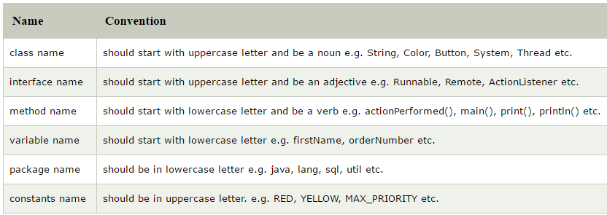
Naming Convention
Java naming convention is a rule to follow as you decide what to name your identifiers such as class, package, variable, constant, method etc.
But, it is not forced to follow. So, it is known as convention not rule.

Slide 35
Jdk
Java Development Kit (JDK) comes with a collection of tools that are used for developing and running java based programs.
The JDK is used to compile Java applications and applets.
JDK needs more Disk space as it contains JRE along with various development tools.
It includes JRE, set of API classes, Java compiler, Web start and additional files needed to write Java applets and applications.

Slide 36
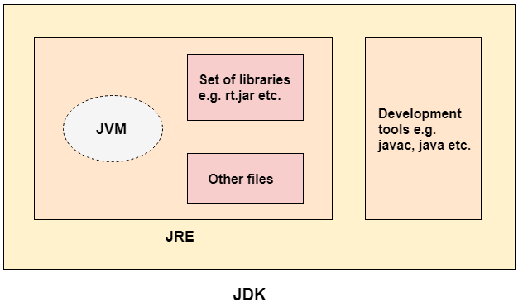

Slide 37
Jre
JRE is Java Runtime Environment which is required to run Java Applications also. JRE alone does not contains compiler etc for Java Development.
The java programming language adds the portability by converting the source code to byte code version which can be interpreted by the JRE and gets converted to the platform specific executable ones. Thus for different platforms one has corresponding implementation of JRE. But JRE has to meet the specification JVM (Java Virtual Machine) Concept that serves as a link between the Java libraries and the platform specific implementation of JRE. Thus JVM helps in the abstraction of inner implementation from the programmers who make use of libraries for their programs.

Slide 38
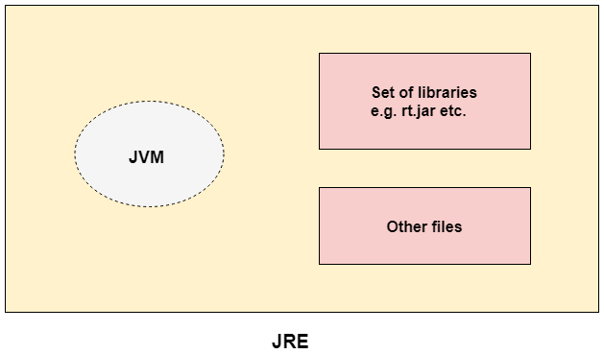
JRE is a subset of JDK.
- Two steps for a java program ie.,compile and interpret. - JDK does compilation but JRE can't. - Both JRE and JDK does interpretation.

Slide 39
Jvm
JVM(Java Virtual Machine) is machine dependent.
JVM is virtual because it is generally implemented in software on a top of a ‘real’ hardware platform and Operating System
All Java Programs are complied for the JVM
The use of the JVM is simple : - To change the byte code into the machine specific code. So the JVM converts the byte code(i.e the code which we get when we compile the .java class) into the code that your machine/OS understands.
JVM is machine specific. So JVM for windows will be different from JVM for Mac or Unix.
JVM is one of the most important part in the java engine. It is due to JVM only that we say java code is "Compile Once, Run Anywhere" programming language.

