Slide 1
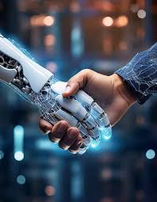
Context - Aware Personalized AI Debater
The Future of Context-Aware AI Debater
Photo by Pexels

Slide 2
Team Members
Roll Number | PRN | Name
381014 | 22210087 | Mrinmayee Deshpande
381020 | 22210638 | Dipali Gangarde
381017 | 22210283 | Aniket Dhage

Slide 3
Table of Contents
01
Problem Statement
02
Objectives
03
Benefits and Impact
04
Literature Survey
05
Idea Details
06
System Architecture
07
Flowchart
08
Tech Stack
09
USP
10
Conclusion

Slide 4
Problem Statement
Competitive exam aspirants and job seekers need structured debates to improve reasoning and articulation. However, existing AI debate systems lack personalization, contextual awareness, and real-time relevance, making them ineffective for adaptive learning. Their generic and rigid arguments fail to align with users’ knowledge, past debates, and industry needs, limiting deep analysis and logical rebuttals.
A context-aware personalized AI debater can adapt to users' debate styles, offer real-time insights, and provide interactive feedback. By using AI-driven learning, dynamic content updates, and tailored argumentation, it can boost engagement, enhance analytical thinking, and improve exam and interview preparation.

Slide 5
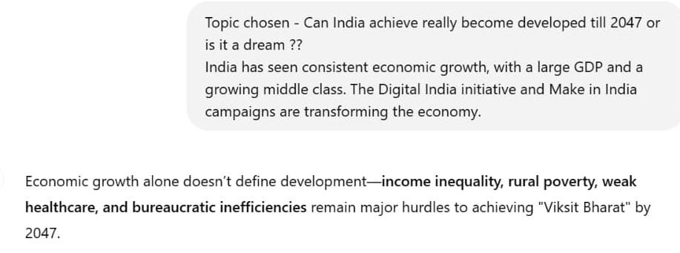
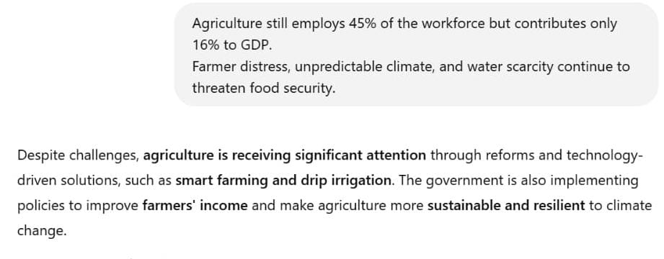
Objectives
Objectives -
Enhance Reasoning & Articulation - Structured debates to improve logical reasoning and communication.
Adaptability - Various debate formats (academic, casual)
Multi-Modal Support - Enables text and speech
Personalized Debates - Use NLP and GenAI to tailor topics and difficulty
Photo by Pexels

Slide 6
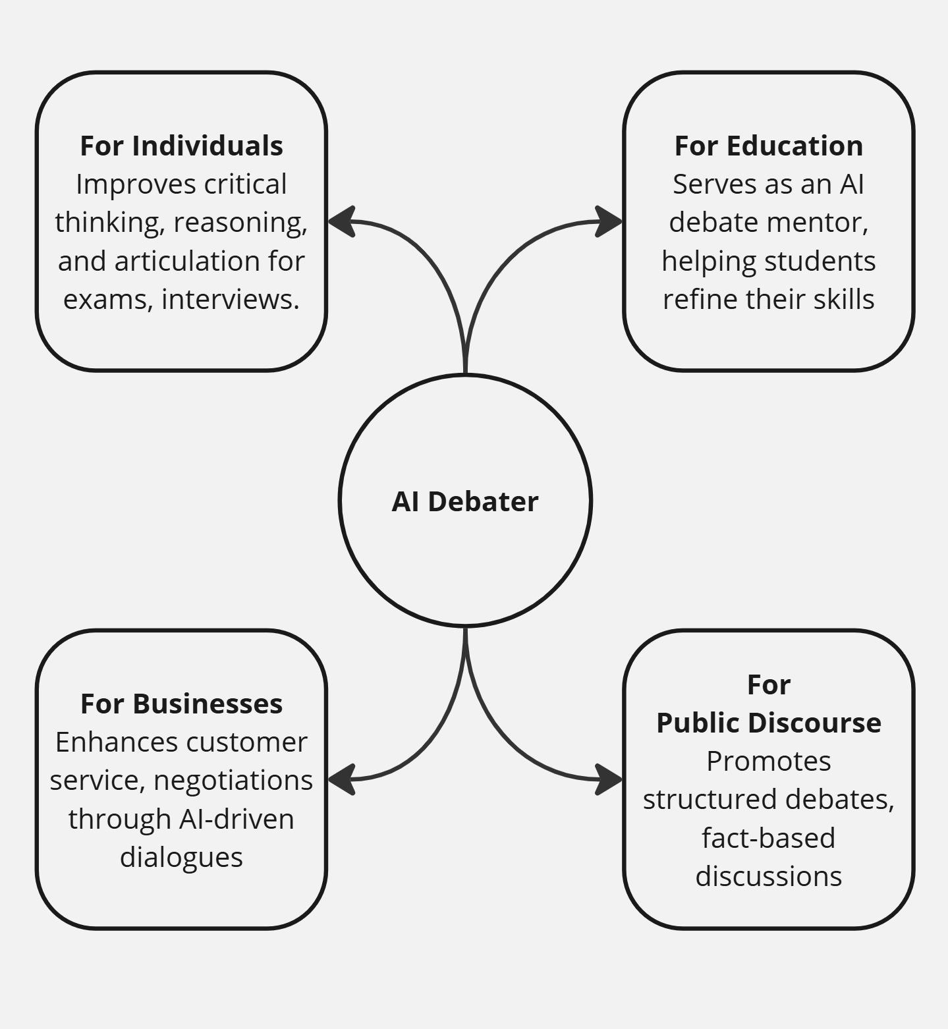
Benefits and Impact

Slide 7
Literature Survey
Sr. No. | Title of the paper | Main Findings
1. | Can ChatGPT be a debate partner? | Introduces DEBO which enhances critical thinking and provides performance analytics
2. | LLMs as debate partners | AI system performed similarly to human participants and achieved slightly high score
3. | Persona or Context? Virtual Sales Assistant | Introduced a new metric called Persuasiveness Measurement Rate (PMeR) to assess persuasive capabilities
4. | Advances in Debating Technologies: Building AI That Can Debate Humans | Advances in debating technologies, including the development of AI systems like Project Debater that can debate human experts on complex topics.

Slide 8
Idea Details
Input: User selects or provides a debate topic.
Processing: AI analyzes user’s past interactions, preferences, and retrieves relevant data.
Output: AI generates logical, personalized arguments and counters based on debate flow.
Feedback Loop: System refines responses based on real-time user feedback.

Slide 9
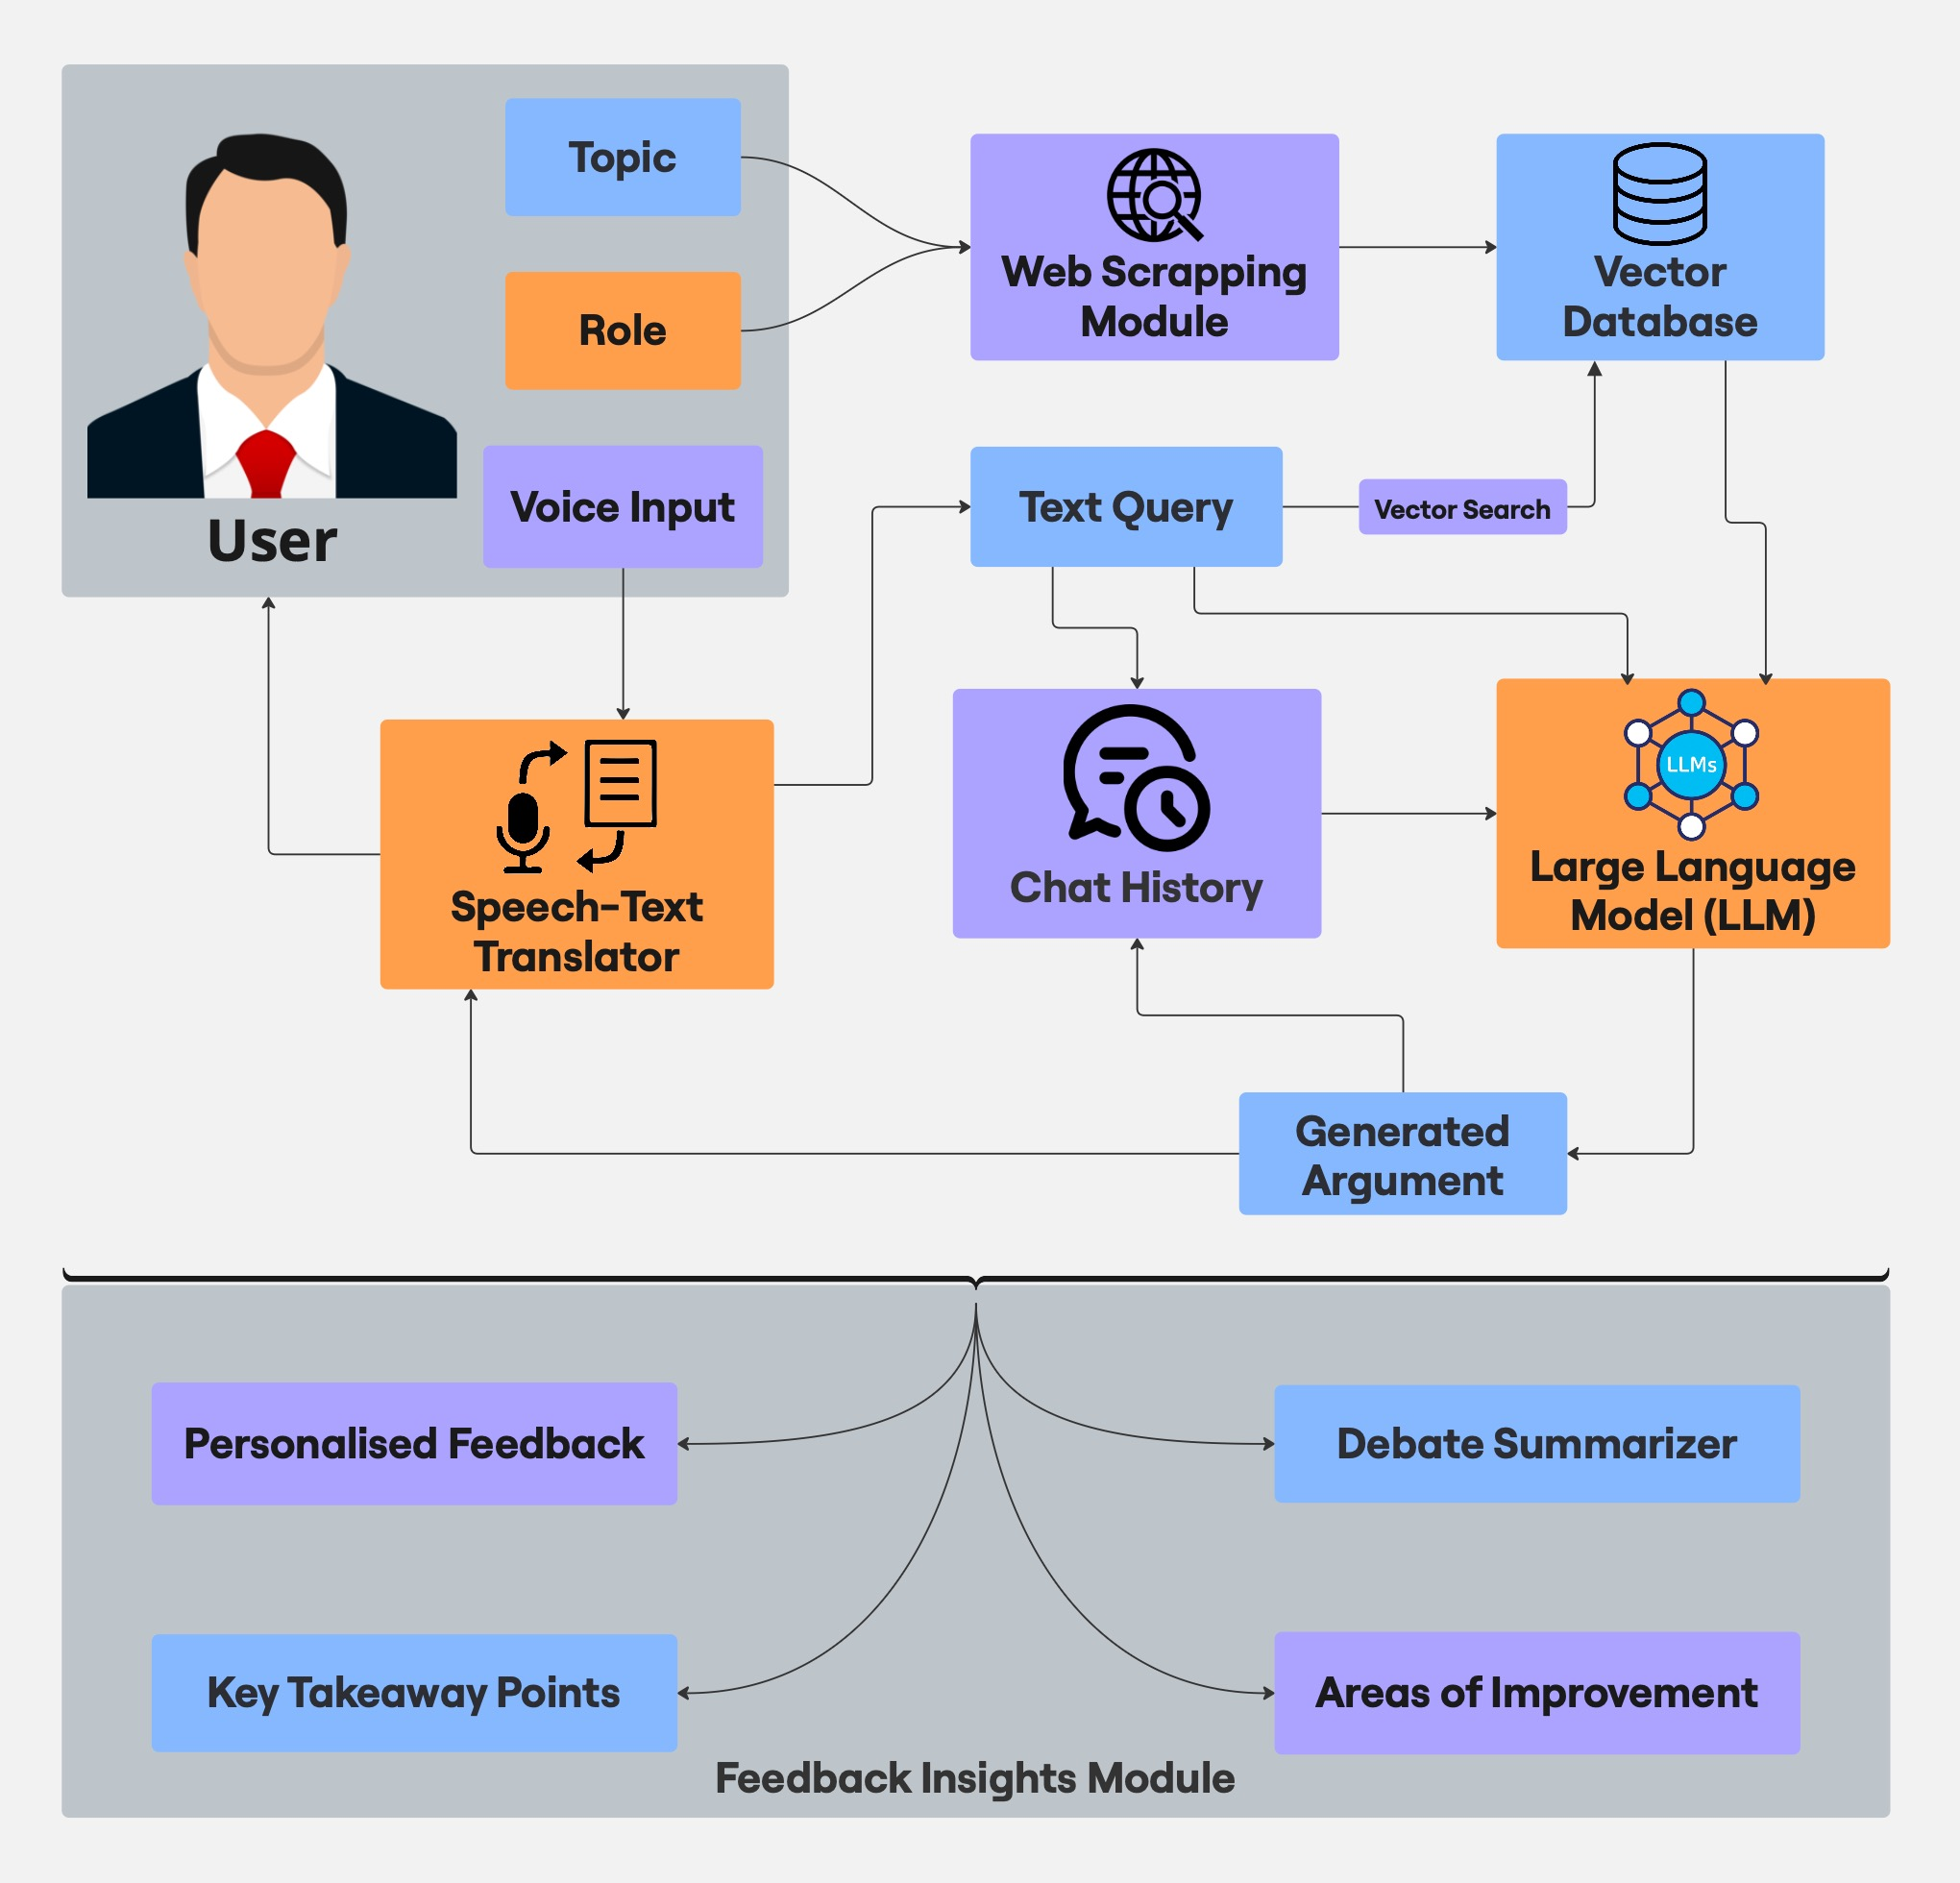
System Architecture

Slide 10
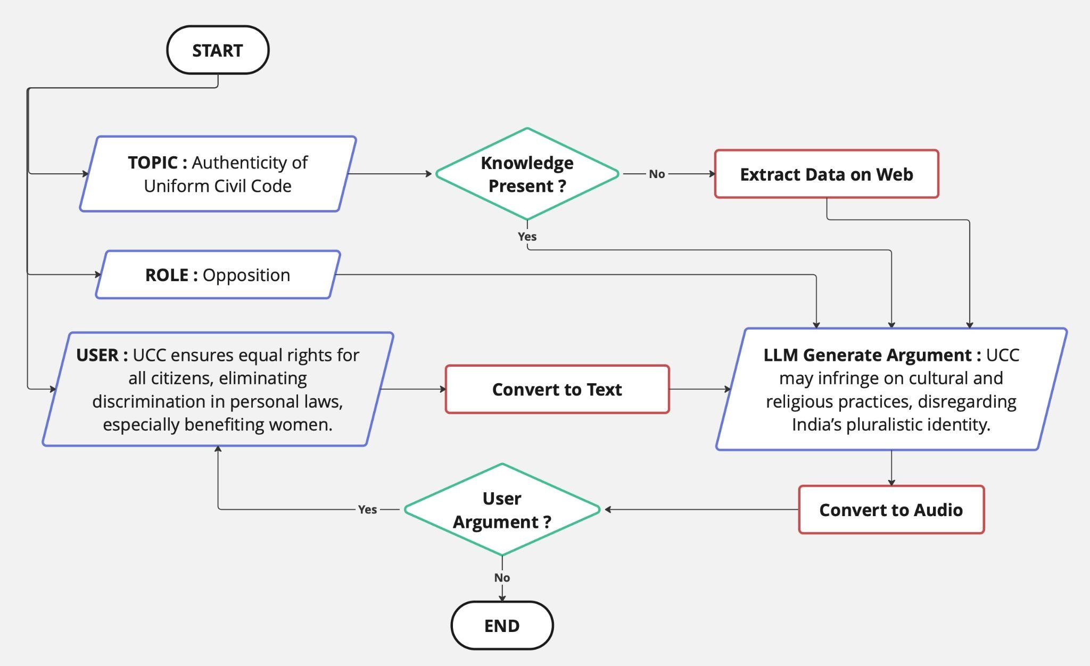
Flowchart

Slide 11
Tech Stack
Component | Tool/ Framework | Alternatives
Voice input | pyaudio, streamlit-webrtc | speech_recognition
Speech-to-Text | Whisper, Google Speech-to-Text | OpenAI Whisper API
Text Preprocessing | spaCy, NLTK, Hugging Face Tokenizers | Custom Preprocessing Code
LLM (Model) | OpenAI GPT, Llama 2 | Falcon, Bloom, GPT-J
LLM Hosting | OpenAI API, Hugging Face Inference API | Self-hosted LangChain Models
Text-to-Speech | Google Cloud TTS, pyttsx3 | Amazon Polly, Azure TTS
UI Framework | Streamlit, streamlit-webrtc | Flask, FastAPI + React
Real-Time Audio Streaming | streamlit-webrtc | Flask SocketIO

Slide 12
USP
Voice & Text-Based Interaction: Supports multimodal debate formats for a more immersive experience.
Real-Time Knowledge Integration: Retrieves and incorporates the latest facts, policies, and current affairs.
Multi-Perspective Analysis: Presents diverse viewpoints to enhance critical thinking.

Slide 13
Conclusion
Bridges the Gap: Adapts to users’ knowledge, debate style, and real-time events.
Enhances Preparation: Improves reasoning, articulation, and rebuttal skills.
Dynamic Learning: Evolves with user interactions and personalized feedback.
Real-Time Relevance: Integrates current affairs and industry updates.
Innovative Edge: AI-driven personalization for engaging debates.
Future Potential: Expandable to academics, corporate, and legal fields.

Slide 14
Thank You !!

