Slide 1

Triggers
This chapter contains the following topics:
Introduction to Triggers
Components of a Trigger
Types of Triggers
Trigger Execution

Slide 2
Introduction to Triggers
You can write triggers that fire whenever one of the following operations occurs:
DML statements (INSERT, UPDATE, DELETE) on a particular table or view, issued by any user
DDL statements (CREATE or ALTER primarily) issued either by a particular schema/user or by any schema/user in the database
Database events, such as logon/logoff, errors, or startup/shutdown, also issued either by a particular schema/user or by any schema/user in the database
Figure 22-1 :
Shows a database application with some SQL statements that implicitly fire several triggers stored in the database.

Slide 3
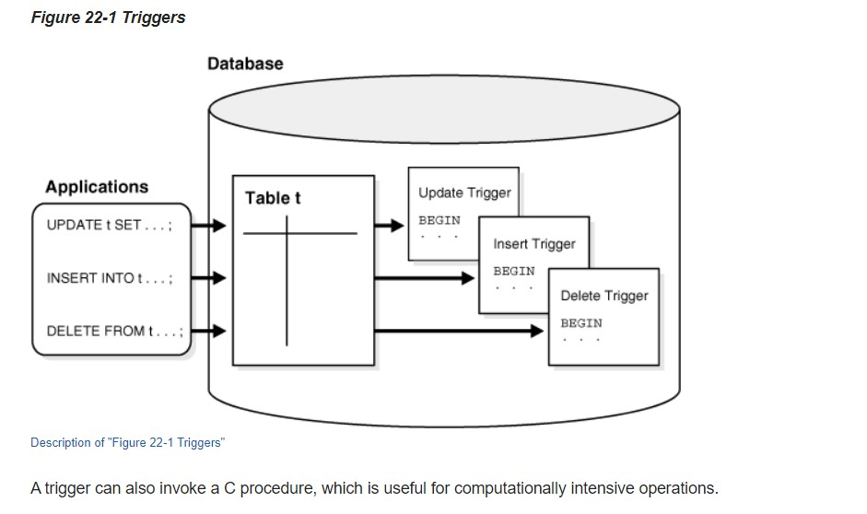

Slide 4
Components of a Trigger
A trigger has three basic components, each explained in this section:
The Triggering Event or Statement
Trigger Restriction
Trigger Action
Figure 22-2 :
Represents each of these trigger components and is not meant to show exact syntax. The sections that follow explain each trigger component in greater detail.

Slide 5
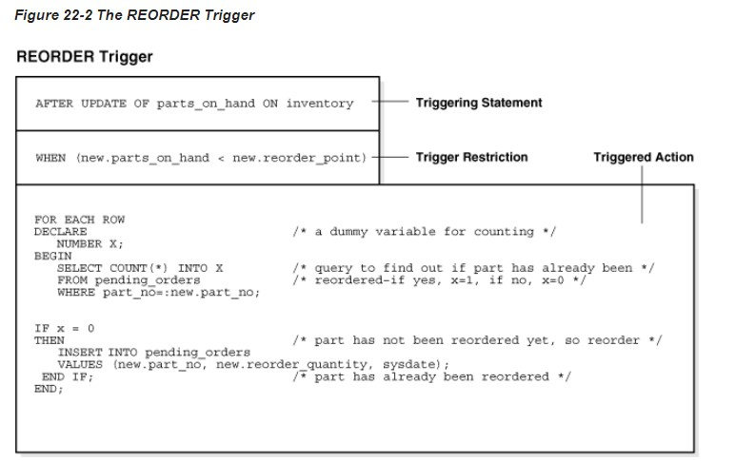

Slide 6
Types of Triggers
This section describes the different types of triggers:
Row Triggers and Statement Triggers
BEFORE and AFTER Triggers
Compound Triggers
INSTEAD OF Triggers
Triggers on System Events and User Events

Slide 7
Triggers on System Events and User Events
You can use triggers to publish information about database events to subscribers. Applications can subscribe to database events just as they subscribe to messages from other applications. These database events can include:
System events
User events

Slide 8
System events
Database startup and shutdown
Data Guard role transitions
Server error message events

Slide 9
User events
User logon and logoff
DDL statements (CREATE, ALTER, and DROP)
DML statements (INSERT, DELETE, and UPDATE)

Slide 10


Thank You

