Slide 1
Project title : JAVA PARSER
Made by : Dip Saha
Roll : 1001
Supervisor name : Abdus Sattar

Slide 2
Definition of Parser
A parser is a software component that takes input data (frequently text) and builds a data structure – often some kind of parse tree, abstract syntax tree or other hierarchical structure, giving a structural representation of the input while checking for correct syntax. [according to wikipedia]
1

Slide 3
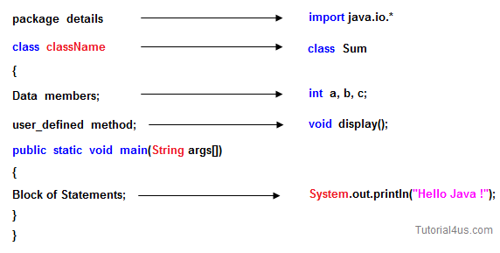
Structure of a simple java program
[image source : www.sitesbay.com] 2

Slide 4
Project description
A “Java Parser” is used to parsing a java file. That is, it separates the variables, method signatures, class name, package name from a java class.
It also analyzes the variables and method signatures. For example : it finds out the return type, access modifier, method name, parameter list of a method; data type, access modifier and other modifiers of a variable. So,
3

Slide 5
Input :
A valid java source code (more specifically, a java class).
4

Slide 6
Output/features
1. Separates the method signature, variable declaration, class name, package name of the class.
Finds out the access modifier, return type, method name, parameter list of a method.
Finds out data type, access modifier, variable name of a variable.
Finds out the super class of the input class and
5

Slide 7
also checks whether this input class is an abstract class or not and interface or not.
Prints the caller method of a method and line number of a method declaration.
6

Slide 8
Progress
I have just completed method separating from an input text file and can count how many methods exist in that input text file.
7

Slide 9
Challenges :
As the java code is semi-structured, it is difficult to separate variable or method signatures from a class.
If the data type or return type is not primitive then it takes more task to identify the data type and return type.
Has to be clear knowledge about java syntax.
8

Slide 10
Future plan :
If I get enough time after completing the project I will work with the whole java code.

Slide 11
Thank You

