Slide 1
Windows
Deepak K.C.|2016
Introduction to Windows 10 – Chapter 1

Slide 2
Contents
What is an Operating System?
Windows 10
New Features
System Requirements
References

Slide 3
What is an OS?
OS is an intermediary between users and computer hardware
Technically, OS is a software that manages hardware & software resources
OS controls the allocation of resources and services like memory, processors, devices and information
“The operating system is the most important program that runs on a computer. Every general-purpose computer must have an operating system to run other programs and applications. Operating systems perform basic tasks, such as recognizing input from the keyboard, sending output to the display screen, keeping track of files and directories on the disk, and controlling peripheral devices such as disk drives and printers.”
http://www.webopedia.com/TERM/O/operating_system.html

Slide 4
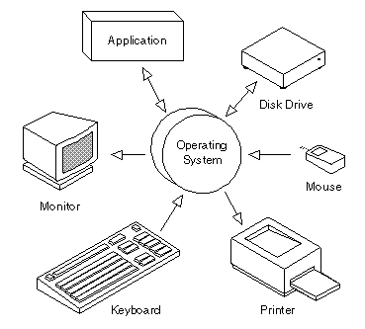
Important Functions of an operating system
Memory Management
Processor Management
Device Management
File Management
Security
http://www.webopedia.com/FIG/OPER-SYS.gif

Slide 5
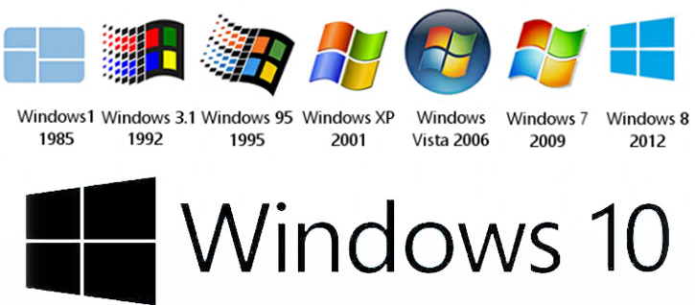
Windows
http://www.vembadiscu.com/2015/images/Win_bg_272661989.jpg

Slide 6
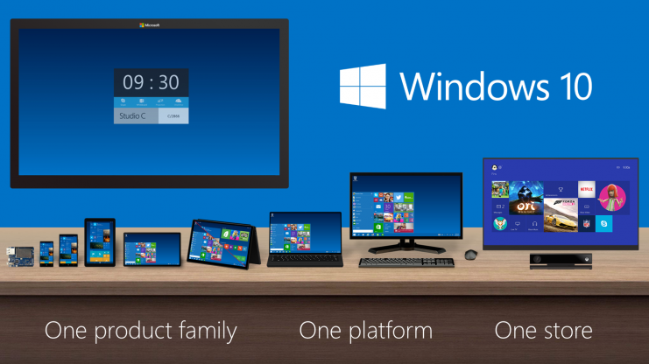
Windows 10
One product family
One platform
One store
Runs across devices from IoT to data centres

Slide 7
What’s new in Windows 10?
Start Menu
Get apps, musing and more
Cortana
Microsoft Edge for better browsing
Better Multitasking

Slide 8
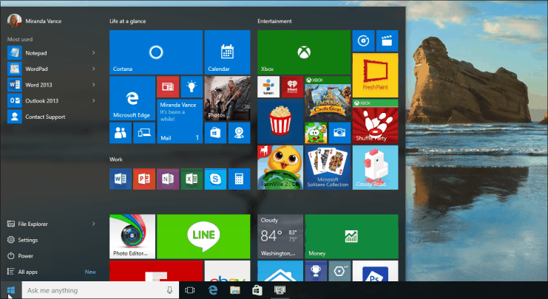
Start Menu
Start Menu is back
On selecting Start icon button on the taskbar, you will find
Most used Apps on the Left
All apps list
Shortcuts to other locations on your PC &
Settings
http://res1.windows.microsoft.com/resbox/en/6.4/main/ea5fe82a-880d-45bb-a4b6-2bb3dd8cb84e_37.gif

Slide 9
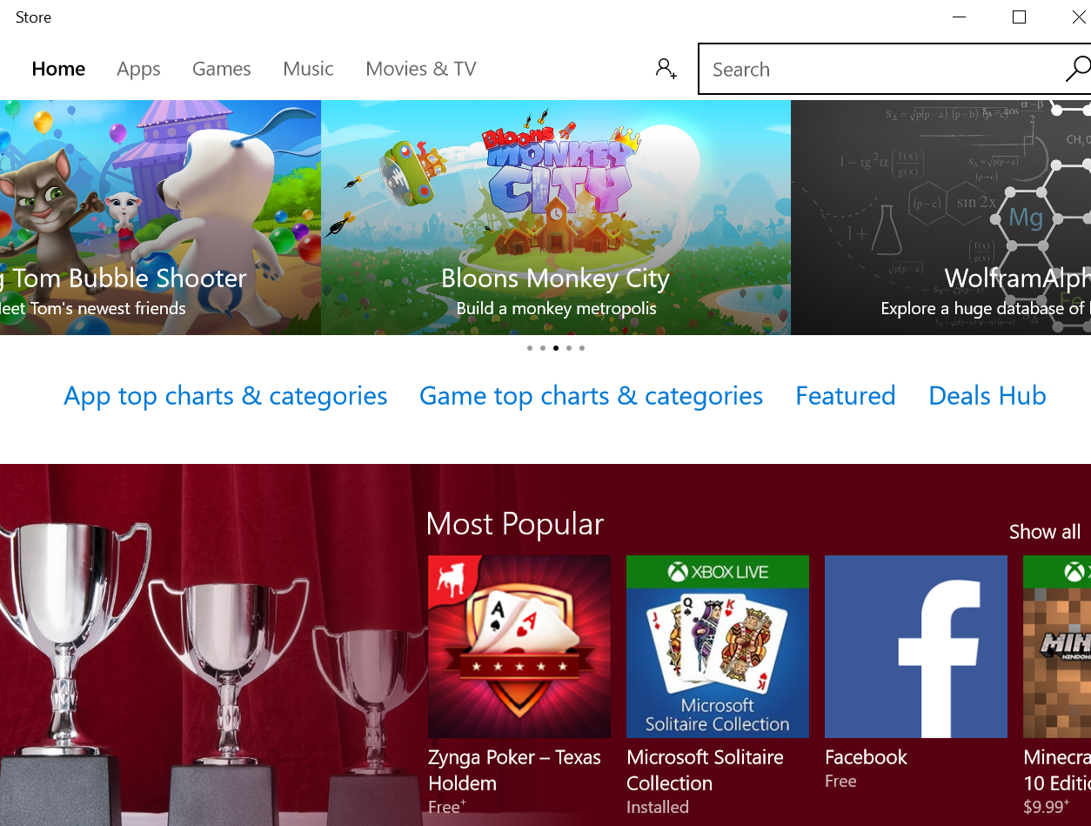
Store : Get apps, music, and more
A one-stop shop for music, videos, games, and apps
Try app before buying it or pick a free one
Windows 10 apps work on all Windows 10 devices

Slide 10
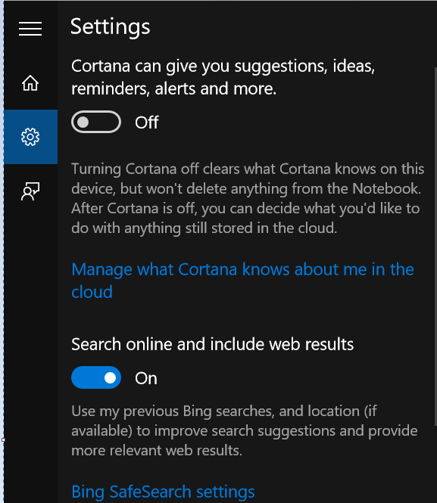
Cortana
Personal assistant
Select the search box and type what you want Cortana to do, or just select the microphone to talk with her instead.
Note: Cortana is only available in certain countries/regions, and some Cortana features might not be available everywhere. If Cortana isn't available or is turned off, you can still use search.

Slide 11
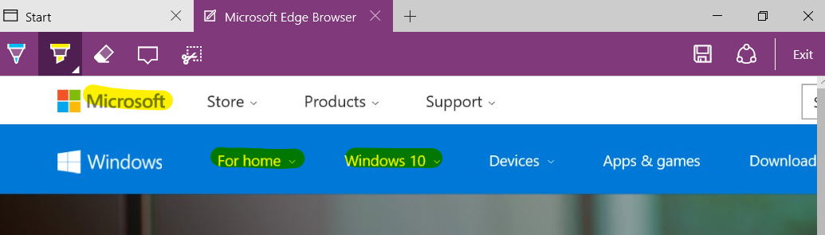
Microsoft Edge
The recommend browser for Windows 10
First browser that lets you take notes, write, doodle, and highlight directly on webpages

Slide 12

Better Multitasking
Multiple desktops feature lets you run another set of windows as if on another screen
Virtual desktop
To add a virtual desktop :
Step 1 : Open up the new Task View (Windows Key + Tab)
Select New Desktop
Click on the Task View button to switch between desktops
To quickly add a virtual desktop : Windows Key + CTRL + ADD
Task View
Notes:
Task view

Slide 13
System Requirements
Processor:
1 gigahertz (GHz) or faster processor
RAM:
1 gigabyte (GB) for 32-bit or 2 GB for 64-bit
Hard disk space:
16 GB for 32-bit OS 20 GB for 64-bit OS
Graphics card:
DirectX 9 or later with WDDM 1.0 driver
Display:
800x600
https://www.microsoft.com/en-US/windows/windows-10-specifications

Slide 14
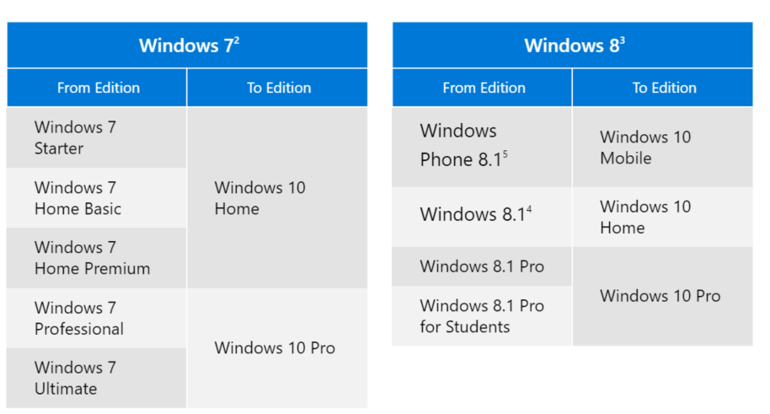
Upgrade editions
https://www.microsoft.com/en-US/windows/windows-10-specifications

Slide 15
Windows 10 Upgrade offer
Free
Valid for qualified and genuine Windows 7 and Windows 8.1 devices including devices you already own.
Some hardware/software requirements apply and feature availability may vary by device and market.
https://www.microsoft.com/en-US/windows/windows-10-specifications

Slide 16
References
http://windows.microsoft.com/en-us/windows-10/getstarted-get-to-know-windows-10
: Introducing Windows 10 for IT professionals – Preview Edition

