Slide 1
Managing User Accounts & Profiles – Chapter 5
Notes:
Lecture notes go here

Slide 2
Workgroups and Domains
Workgroups:
A collection of computers that interact with each other but have no centralized authority.
Domains:
They are based on the Active Directory directory service.

Slide 3
User Accounts
A user account is used by Windows to
Determine what changes you can make on the computer
Determine which files and folders you can have access to
Track personal preferences such as your choice of desktop wallpaper, color schemes, drive mappings, and/or screen savers

Slide 4
User Accounts
Each type of user account provides a different level of control over the computers in your network:
Microsoft user accounts: Enable you to synchronize your desktop across multiple Windows 10 devices.
Local user accounts: Are created on individual computers that are members of a workgroup to provide access to resources on that computer.

Slide 5
Microsoft User Accounts
When you set up a Windows 10 PC for the first time, you have the option of creating a Microsoft user account using an e-mail address that you provide.
Using a Microsoft user account provides a consistent experience when working with the Windows Store apps.
Microsoft user accounts can be synced with a domain account, but the capability to do so depends on Group Policy settings.

Slide 6
Settings >> Accounts

Slide 7
Local User Accounts
To create a local user account, you must be a member of the local administrators group.
If you use local accounts, you need to create a user account on each Windows 10 computer on which you want to access resources
To create a new local user account using the Computer Management console, right-click Users and choose New User.

Slide 8
Domain-Based Accounts
Domain-based accounts, also called Active Directory accounts, are stored as objects on a domain controller and provide access to resources on multiple systems.
To set up a domain user account, you must be a member of the Account Operators group, the Domain Admins group, or the Enterprise Admins group (or be delegated the authority by an Enterprise Admin).
The following information is required:
First name, Initials, Last name, Full name
User logon name
User logon name (pre-Windows 2000)
Password

Slide 9
Groups
A group is a collection of users, computers, contacts, and other group objects within the Active Directory forest.
There are two types of groups in Active Directory–based networks:
Security groups: Used to assign permissions to resources.
Distribution groups: Used for sending information (such as e-mail messages) to a select group of users in Active Directory.

Slide 10
Organizational Unit (OU)
The OU is a general-purpose container used to group other Active Directory objects together for administrative purposes.
When working with Active Directory, you will most likely structure your organization and departments around the OU container.

Slide 11
Deploying User Profiles
Notes:
Lecture notes go here

Slide 12
User Profile Centralization
User profiles contain network environment settings as well as desktop configurations.
Centralizing these settings along with their data enables users to access resources while working offline or over slow network connections.

Slide 13
Folder Redirection and Offline Files/Folders
By using Folder Redirection and Offline Files/Folders, you can redirect the path of one or more local folders to a shared folder on the network and then cache the files/folders on the local machine, making the resources available to the user from any computer on the network.

Slide 14
Always Offline Mode
On Windows Server 2012, a shared folder and its files are configured to be available for offline use.
Always Offline mode provides clients faster access to their files by always working offline, even when they are connected through a high-speed connection.

Slide 15
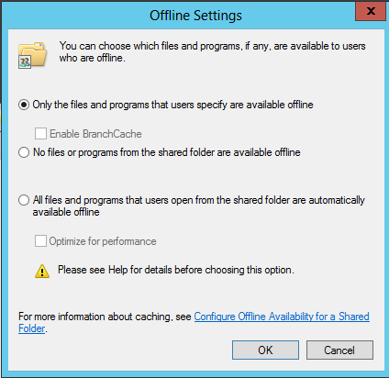
Offline Settings
In addition to the default option, you can configure the following offline settings:
No files or programs from the shared folder are available offline.
All files and programs that users open from the shared folder are automatically available offline.
Optimize for performance.
Notes:
No files or programs from the shared folder are available offline. This option should be used when you need to protect sensitive files from being cached offsite. It blocks Offline Files on client computers from making copies of the files and programs on the shared folder.
All files and programs that users open from the shared folder are automatically available offline. This option makes the file or program in the folder automatically available to the user offline whenever they access and open it from the shared folder. The files and programs remain in the Offline Files cache and are synchronized with the version on the server until the cache is full or the user deletes the files. Files and programs that are not opened are not available offline.
Optimize for performance: This options means that executable files downloaded from the server will be cached and run directly from the client the next time they are accessed.

Slide 16
User Profiles (Local/Roaming)
Roaming User Profiles, which support users who need to work on multiple computers, are local profiles that are stored on a shared network folder.
Local User Profiles allow much faster log in times because the data is stored locally, but a user’s settings will not follow them around.

Slide 17
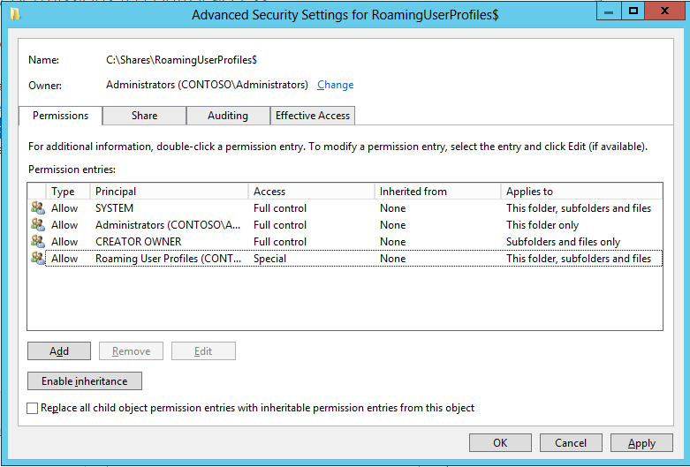

Slide 18
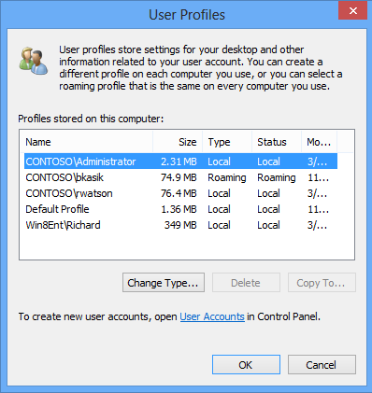

Slide 19
References:
Managing and Maintaining Windows 8 (Exam 70-688)

