Slide 1
Installing Windows 10 – Chapter 2
Deepak KC

Slide 2
Check list before installing Windows 10
Processor:
1 gigahertz (GHz) or faster processor or SoC
RAM:
1 gigabyte (GB) for 32-bit or 2 GB for 64-bit
Hard disk space:
16 GB for 32-bit OS 20 GB for 64-bit OS
Graphics card:
DirectX 9 or later with WDDM 1.0 driver
Display:
800x600

Slide 3
Clean Installation
Download Windows 10 Disc Image (ISO File)
https://www.microsoft.com/en-us/software-download/windows10ISO
Run the Media Creation Tool
Select Create Installation media for another PC
Choose the language, edition and architecture (64 or 32 bit)
Follow the steps to create the installation media, and then select Finish when it’s done.
When you’re ready to perform a clean installation, turn on your PC, insert the DVD or USB flash drive you created, and then shut down your PC.
https://www.microsoft.com/en-us/software-download/windows10
Notes:
Step 2: Run the media creation tool
Windows 7 – Windows USB/DVD Download Tool
https://www.microsoft.com/en-us/download/windows-usb-dvd-download-tool
Windows 8 – Media creation tool

Slide 4
Clean Installation
Restart your PC, and then press any key to boot from the DVD or USB flash drive.
Enter your language and other preferences, and then select Next
Select Install Windows
Enter the product key to activate Windows
Accept the license terms, and then select Next.
On the Which type of installation do you want? page, select Custom.
On the Where do you want to install Windows? page, select the partition that you want, select the formatting option you want to perform (if needed), and then follow the instructions.
When you've finished formatting, select Next.
Follow the rest of the setup instructions to finish installing Windows
https://www.microsoft.com/en-us/software-download/windows10

Slide 5
Upgrading to Windows 10
Windows 10 free for those running Windows 7, Windows 8 or Windows 8.1
Check the version of your computer by navigating to the link below
http://windows.microsoft.com/en-us/windows/which-operating-system
You have administrative rights on the computer that you want to upgrade to Windows 10
Make sure your current version of Windows is activated with a genuine license
Back up your computer
Update your current Windows version
Windows 7 : Start >> Control Panel >> System & Security >> Windows Update
Windows 8 & 8.1: Start >> PC Settings >> Update & Recovery >> Windows Update

Slide 6
Windows 7 Upgrade Advisor
“The Windows 7 Upgrade Advisor scans your PC for potential compatibility issues and lets you know about your Windows 7 upgrade options. Within minutes, you'll get a report that tells you if your PC meets the system requirements, if any known compatibility issues with your hardware, devices, and installed programs are found, and gives guidance on what to do to before installing Windows 7 on your PC.”
https://www.microsoft.com/en-us/download/details.aspx?id=20

Slide 7
Upgrading to Windows 10
Download the media creation tool
http://go.microsoft.com/fwlink/?LinkId=691209
Follow instructions to Upgrade to Windows 10 using the tool

Slide 8
After Installing windows 10

Slide 9
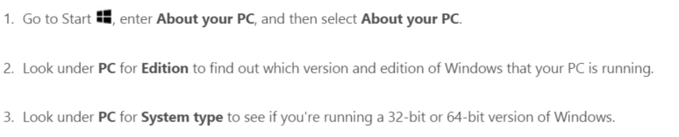
Check of operating system info in Windows 10
http://windows.microsoft.com/en-us/windows/which-operating-system

Slide 10
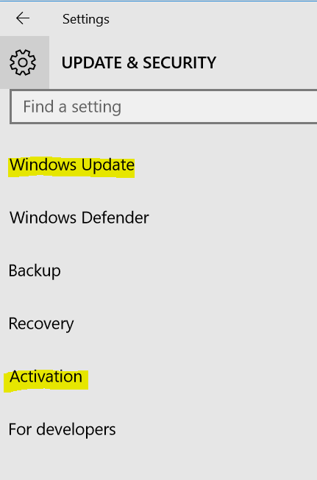
Run Windows Update
Settings >> Update & Security >> Windows Update

Slide 11
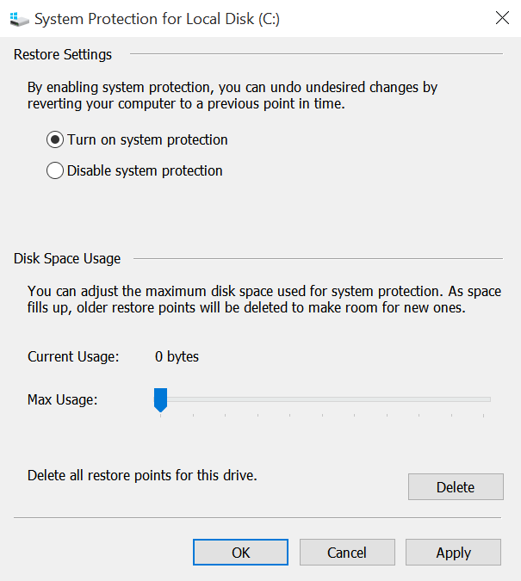
Turn on System Protection
System protection (System restore) is disable by default
System protection allows to revert your computer to a previous point in time.
Open an Explorer Window, Right Click This PC >> Properties >> System Protection >> Select C: drive >>Configure>> Turn on system protection

Slide 12
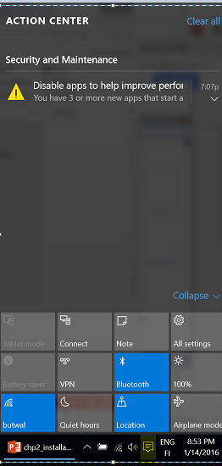
Action Center
Displays important system notifications

Slide 13
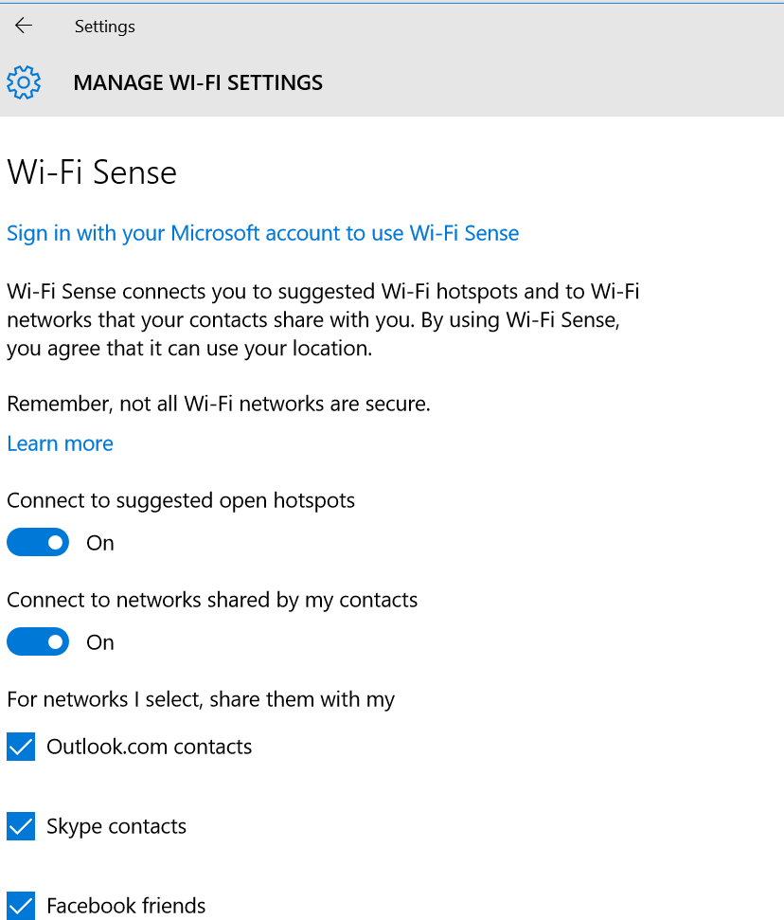
Disable Wi-Fi Sharing / Wifi Sense
Windows 10 is set up to share your Internet connection over Wi-Fi (By default)
It is better to disable this feature for security purpose
To disable
Seettings >> Network & Internet >> Wifi >> Manage Wifi Settings >> Uncheck the following
Connect to suggested open hotspots
Connect to networks shared by my contact
Notes:
By default, Windows 10 is set up to share your Internet connection over Wi-Fi. This is a nifty feature if you want it, and a dangerous one if you don’t. To be on the safe side, you should probably just disable it right from the get-go.

Slide 14
START MENU

Slide 15

Start Menu
Star button on the task bar
See What’s on the Menu
Love it ? Pin it
Make Start full Screen
Find all your apps and programs
Open the link below & customize your Start Menu
http://windows.microsoft.com/en-ph/windows-10/getstarted-see-whats-on-the-menu

