Slide 1
Managing Local Storage – Chapter 10 Windows 10
Deepak KC

Slide 2
Managing Disks
On installing Windows 10, the setup program will automatically perform all preparation tasks for the computer’s hard disk
If you add a new disk, you must
Choose a partition style
Choose a disk type
If needed divide the disk into partitions or volumes
Format the volume with a file system

Slide 3
Partition Styles
It refers to the method Windows operating systems use to organize partitions on the disk
Hard disk partition styles
MBR : Default partition style for x86-based and x64-based computers
GPT : First introduced in Windows Vista, you can now use the GPT partition style on x86-, as well as x64-based, Windows 8 computers

Slide 4
Disk Types
Basic Disks
It uses primary partitions, extended partitions, and logical drives to organize data
Dynamic Disks
The alternative to using a basic disk is to convert it to a dynamic disk.
The process of converting a basic disk to a dynamic disk creates a single partition that occupies the entire disk.
You can then create an unlimited number of volumes out of the space in that partition

Slide 5
Volume Types
Simple Volume
Consists of space from a single disk
Spanned Volume
Consists of space from at least two, to a maximum of 32, physical disks, all of which must be dynamic disks
Striped Volume
Consists of space from at least two, to a maximum of 32, physical disks, all of which must be dynamic disks
Mirrored Volume
Consists of an equal amount of space from two disks, both of which must be dynamic disks

Slide 6
File Systems
NTFS : the preferred file system
FAT

Slide 7
Disk Management Snap- in
To manage disk related tasks such as:
Initializing disks
Selecting a partition style
Converting basic disks to dynamic disks
Creating partitions and volumes
Extending, shrinking, and deleting volumes
Formatting partitions and volumes
Assigning and changing driver letters and paths
Examining and managing physical disk properties, such as disk quotas, folder sharing and error-checking

Slide 8
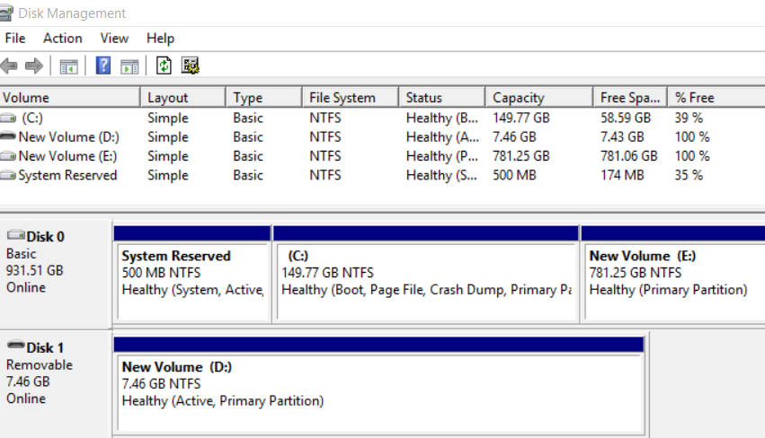

Slide 9
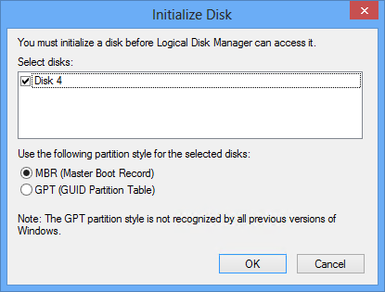
Add a new disk
You must initialize a disk before Logical Disk Manager can access it
Notes:
As soon as a new disk is added, on opening Disk Management wizard, you will get the window

Slide 10
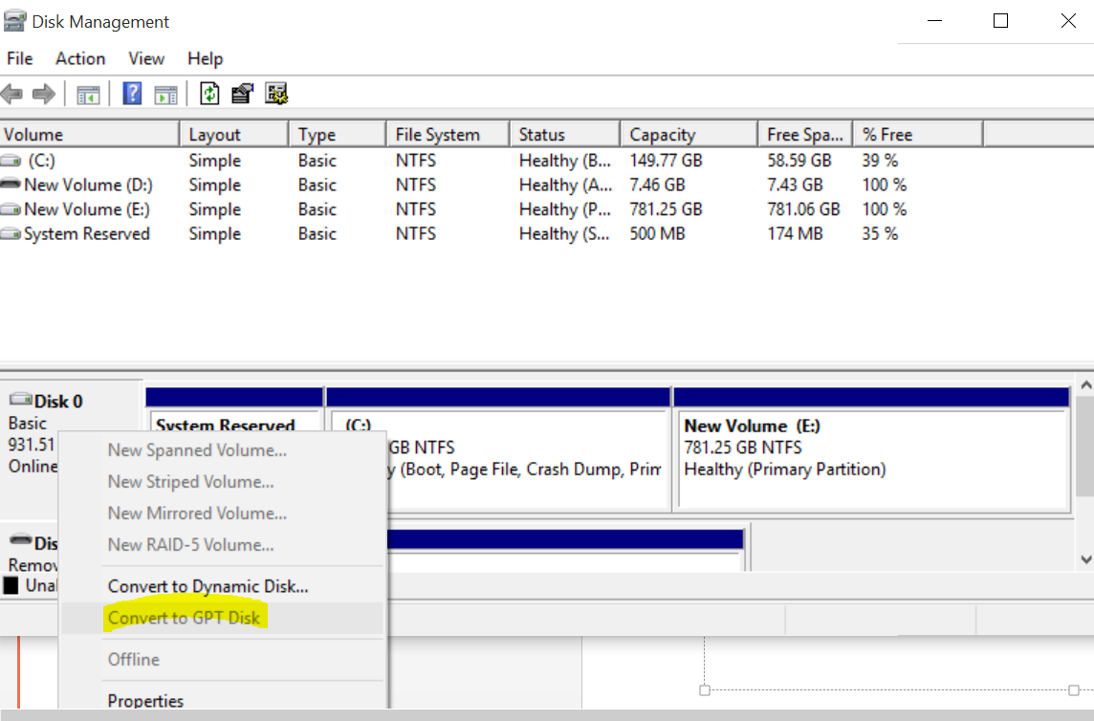
Changing the partition style
Right click the Disk to know the partition style of a disk
MBR partition style is the default partition style

Slide 11
Converting a basic disk to a Dynamic Disk
Before you convert a basic disk to a dynamic disk, you must be aware of the following conditions:
Make sure that you have enough hard disk space available for the conversion.
You should not convert a basic disk to a dynamic disk if you are multibooting the computer.
You cannot convert removable media to dynamic disks.

Slide 12
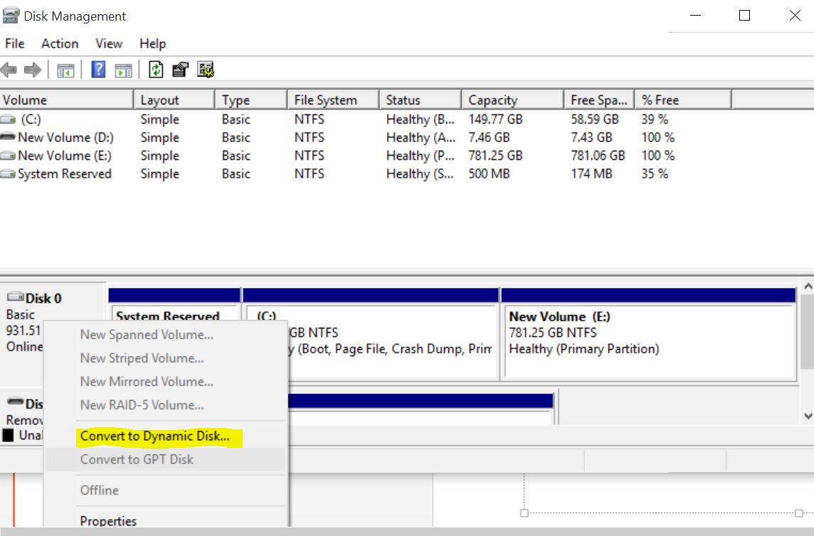
Converting a basic disk to a Dynamic Disk
You cannot convert drives that use an allocation unit size (sector size) greater than 512 bytes unless you reformat the drive with a smaller sector size before the conversion.
Once you change a basic disk to a dynamic disk, the only way you can change it back again is to back up the entire disk and delete the dynamic disk volumes.

Slide 13
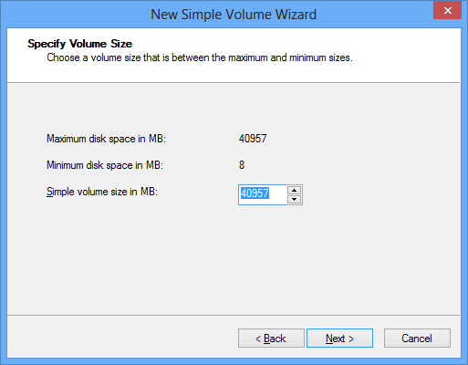
Creating a Volume

Slide 14
Extending and Shrinking Volumes
To extend or shrink a partition or volume, you simply right-click a partition or volume and select Extend Volume or Shrink Volume from the context menu, or from the Action menu
When you extend a simple volume across multiple disks, the simple volume becomes a spanned volume.
You cannot extend striped volumes.

Slide 15
Extending and Shrinking Volumes
To extend a partition on a basic disk, the system must meet the following requirements:
A basic partition must be either unformatted or formatted with the NTFS file system.
If you extend a logical drive, the console first consumes the contiguous free space remaining in the extended partition.
You can extend the partition of logical drives, boot volumes, or system volumes only into contiguous space, and only if the hard disk can be upgraded into a dynamic disk.

Slide 16
Extending and Shrinking Volumes
To extend a simple or spanned volume on a dynamic disk, the system must meet these requirements:
When extending a simple volume, you can only use the available space on the same disk, if the volume is to remain simple.
You can extend a simple volume across additional disks if it is not a system volume or a boot volume.
You can extend a simple or spanned volume if it does not have a file system (a raw volume) or if you formatted it using the NTFS file system. (You cannot extend FAT volumes.)

Slide 17
Extending and Shrinking Volumes
To shrink a basic disk partition or any kind of dynamic disk volume except for a striped volume, the system must meet the following requirements.
The existing partition or volume must not be full and must contain the specified amount of available free space for shrinking.
The partition or volume must not be a raw partition (one without a file system). Shrinking a raw partition that contains data mighty destroy the data.
You can shrink a partition or volume only if you formatted it using the NTFS file system. (You cannot shrink FAT volumes.)

Slide 18
Creating Spanned, Striped, and Mirrored Volumes
Spanned, striped, or mirrored volumes require dynamic disks.
When you create a spanned, striped, or mirrored volume, you create a single dynamic volume that extends across multiple physical disks.

Slide 19
Disk Tools
Disk Cleanup
Defragmenting Disks

Slide 20
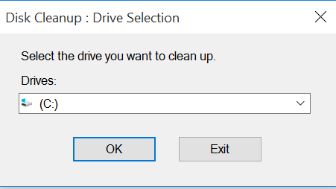
Disk Cleanup
When a disk starts to run low on storage space, it is often possible to reclaim space occupied by unnecessary files, such as temporary files, setup logs, and files in the Recycle Bin.

Slide 21
Defragmenting Disks
Hard disk drives write data in clusters, units of a standard size designated when you format the disk.
Over time, as files are written and rewritten to the disk, the contiguous spaces grow smaller, and the drive is forced to split files into clusters located at different places on the disk. This process is called fragmentation.
Windows 10 includes a tool that enables you to defragment your volumes by recopying fragmented files to contiguous space on the disk.

Slide 22
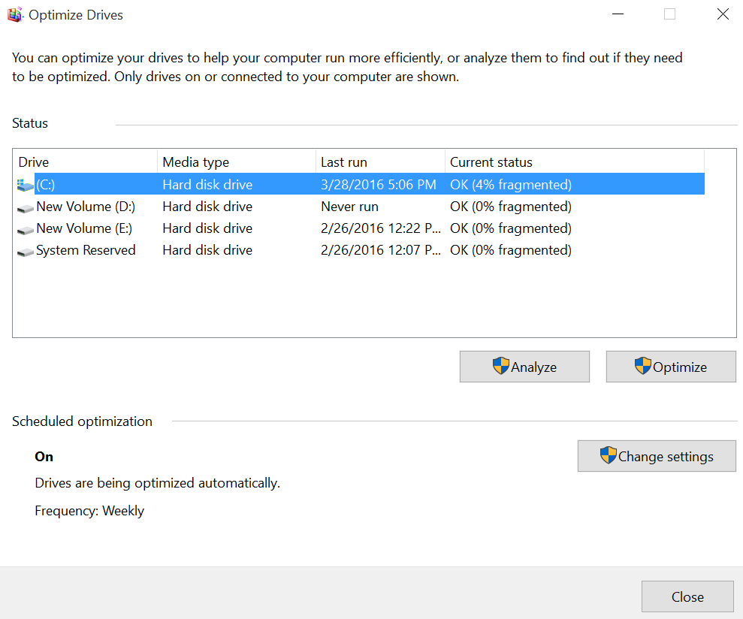

Slide 23
References
Microsoft - MOAC 70-687: Configuring Windows 8.1

